Slide 1

Sensor Fusion Based Ego Localization using Kalman Filter for Autonomous Vehicles
MINOR-1
Team Members
Nandan – 01FE21BEI058
Nishchit – 01FE21BEC198
Madhushree – 01FE21BEI040
Vijay - 01FE21BEC370
Prajwal – 01FE21BEC187

Slide 2

INTRODUCTION:
What is The Sustainable Development Goals (SDGs) and why it established?
SDGs are a set of 17 targets adopted by all United Nations countries in 2015 to guide global development through 2030.
The goals are intended to address the world's environmental, political, and economic challenges, and promote prosperity while protecting the planet
The Sustainable Development Goals (SDGs) aim to transform our world. They are a call to action to end poverty and inequality, protect the planet, and ensure that all people enjoy health, justice and prosperity.

Slide 3

17 Sustainable Development Goals are:
1. No Poverty
2. Zero Hunger
3. Good Health and Well-being
4. Quality Education
5. Gender Equality
6. Clean Water and Sanitation
7. Affordable and Clean Energy
8. Decent Work and Economic Growth
9. Industry, Innovation, and Infrastructure
10. Reduced Inequality
11. Sustainable Cities and Communities
12. Responsible Consumption and Production
13. Climate Action
14. Life Below Water
15. Life on Land
16. Peace, Justice, and Strong Institutions
17. Partnerships for the Goals

Slide 4

9.Industry, Innovation, and Infrastructure:
In the realm of Industry, Innovation, and Infrastructure, ego localization is pivotal for advancing autonomous driving technologies. By utilizing sensors like LIDAR and GPS, vehicles can accurately determine their position and navigate effectively. Research focuses on enhancing accuracy through landmark detection and cloud-based systems. These developments drive innovation in intelligent transportation systems, shaping a safer and more efficient future for mobility.
11.Sustainable Cities and Communities:
In the context of Sustainable Cities and Communities, ego localization is vital for enhancing urban sustainability by enabling precise navigation for autonomous vehicles within city environments. By leveraging technologies like LIDAR and GPS, ego localization supports efficient transportation systems, promotes inclusive urban planning, and enhances access to safe and sustainable transport options. This advancement contributes to creating resilient cities with improved mobility and reduced environmental impact.

Slide 5
The Sustainable Development Goals are the blueprint to achieve a better and more sustainable future for all.
They address the global challenges we face, including those related to poverty, inequality, climate change, environmental degradation, peace and justice.
The 17 Goals are all interconnected, and in order to leave no one behind, it is important that we achieve them all by 2030. Click on any specific Goal below to learn more about each issue and take action.
The Sustainable Development Goals (SDGs), adopted by the United Nations in 2015, represent a universal call to action to end poverty, protect the planet, and ensure prosperity for all by 2030.
SDG Target 11.2 By 2030, provide access to safe, affordable, accessible and sustainable transport systems for all, improving road safety, notably by expanding public transport, with special attention to the needs of those in vulnerable situations, women, children, persons with disabilities and older persons.
SDG Target 11.5 By 2030, significantly reduce the number of deaths and the number of people affected and substantially decrease the direct economic losses relative to global gross domestic product caused by disasters, including water-related disasters, with a focus on protecting the poor and people in vulnerable situations

Slide 6
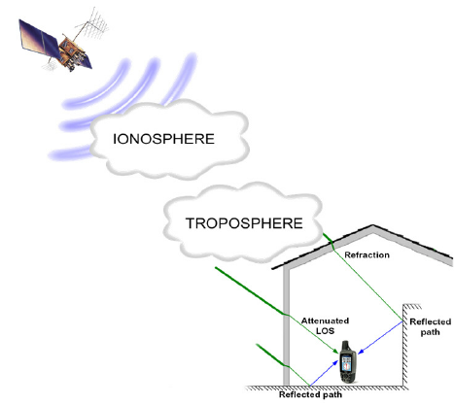
Global Positioning System (GPS) technology has revolutionized navigation and location-based services. However, challenges such as signal blockage, indoor limitations, multipath interference, and external disruptions can impact the accuracy and reliability of GPS positioning. Understanding these issues is crucial for optimizing GPS performance in various applications.

Slide 7
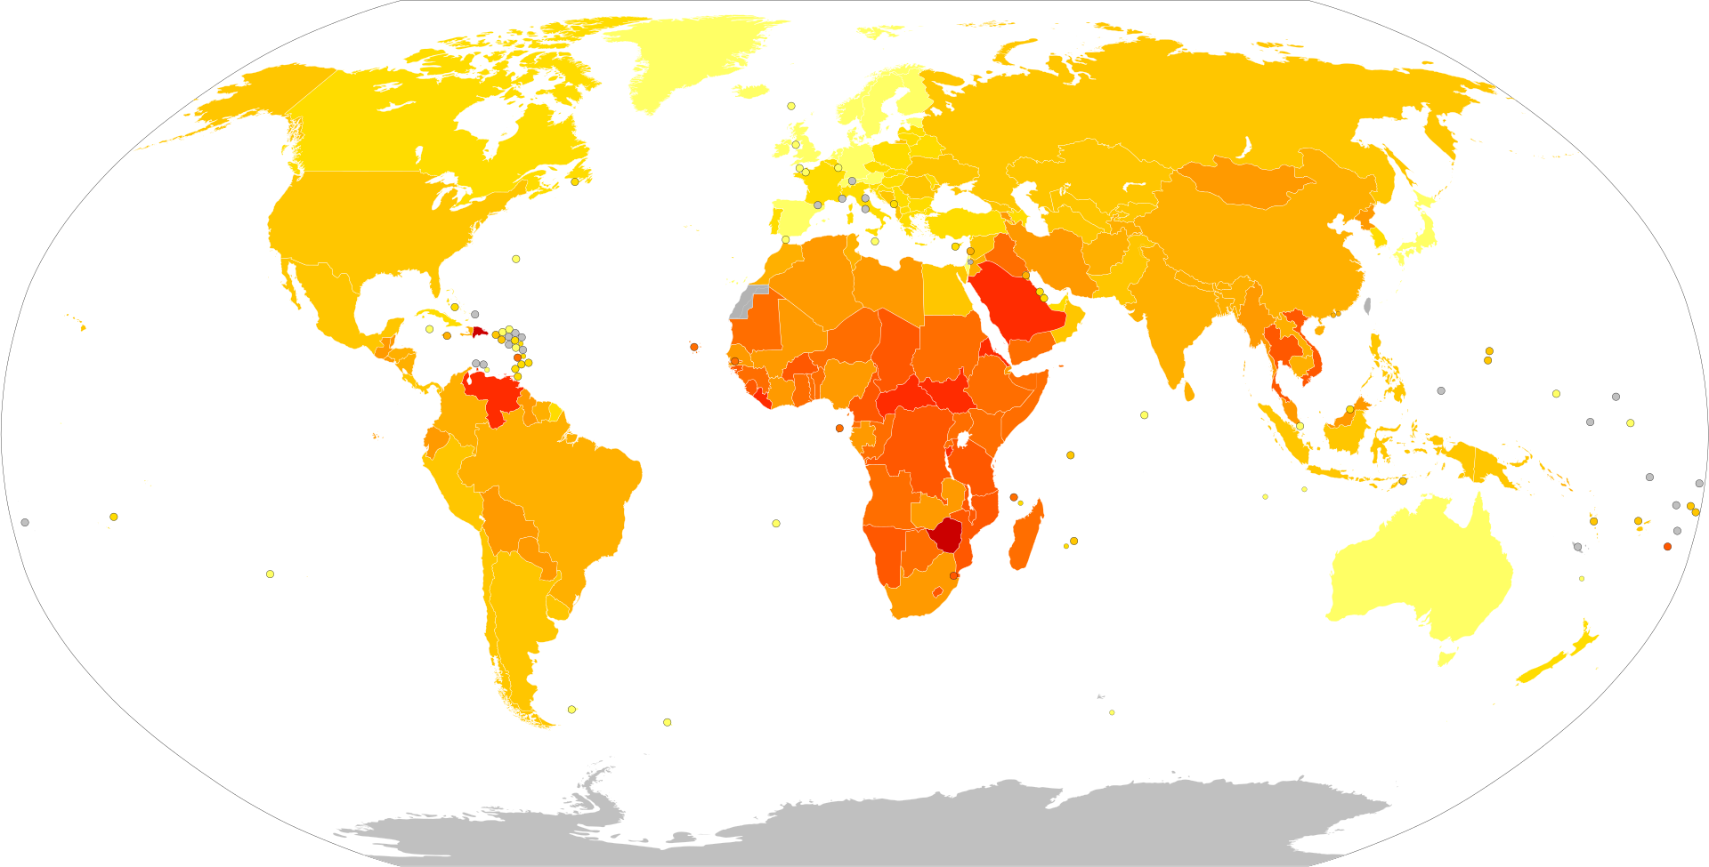
Death rates from road traffic accidents by country, per 100,000 inhabitants
unavailable

Slide 8
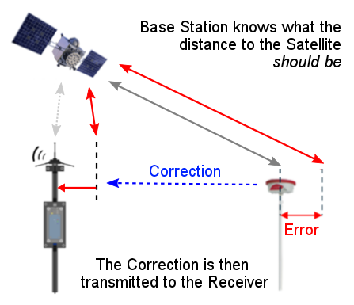
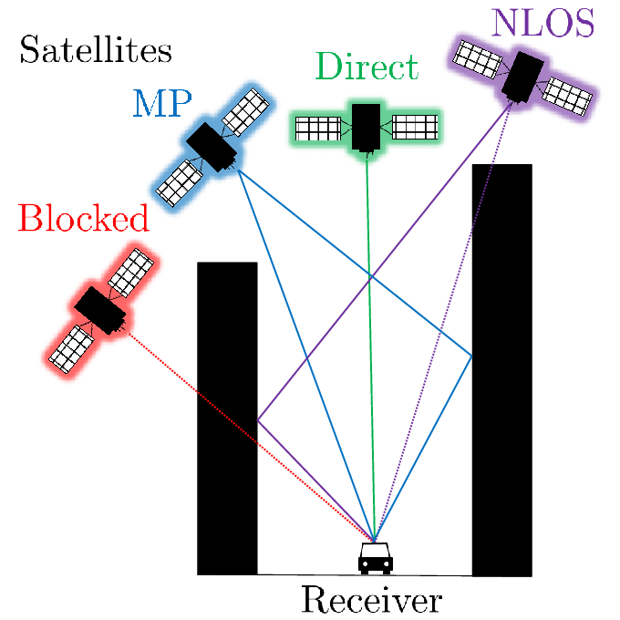
GPS localization is the ability to identify a location on Earth by measuring distance from
GPS satellites
Inaccurate positioning in self-driving cars due to sensor noise and filter limitations is a recipe for disaster.
This can cause collisions, navigation errors, and hinder crucial safety features.

Slide 9
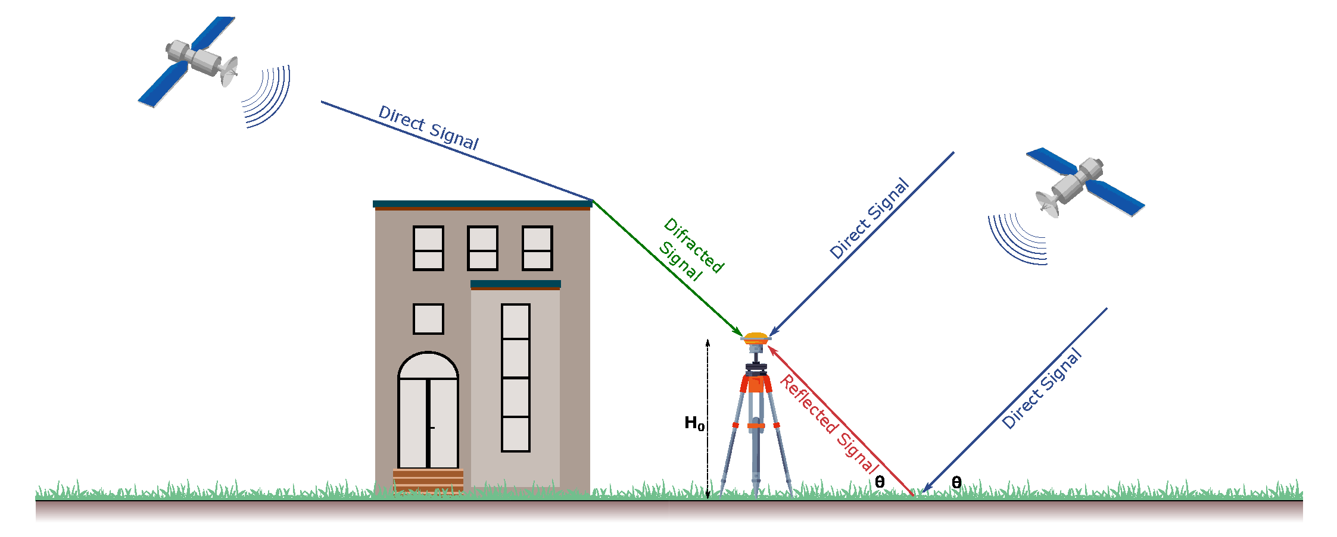
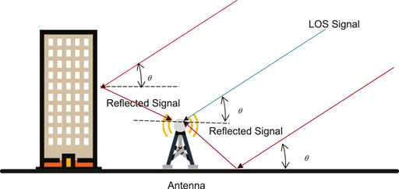
Challenges faced:
Signal blockage: Structures obstruct GPS signals, causing positioning inaccuracies.
Indoor/underground use: GPS signals struggle indoors or underground, hindering accurate positioning.
Multipath: Signal reflections create positioning errors.
Interference/jamming: External sources disrupt GPS signals, leading to inaccuracies.
Solar storms: Solar activity can disrupt GPS signals temporarily.
Satellite maintenance: Maintenance causes gaps in satellite coverage, affecting positioning accuracy.
Device design: Non-compliant devices may provide inaccurate GPS data.
Mapping errors: Incorrect maps lead to positioning inaccuracies.
Cold starts: Delay in satellite data download causes inaccurate tracking.
Satellite availability: Fewer satellites increase positioning uncertainty.
Hardware quality: Poor device hardware contributes to inaccurate GPS positioning.
Imagine the car misjudging its lane or missing a turn entirely. To ensure safe and reliable autonomous vehicles, minimizing these position estimation errors is paramount.

Slide 10
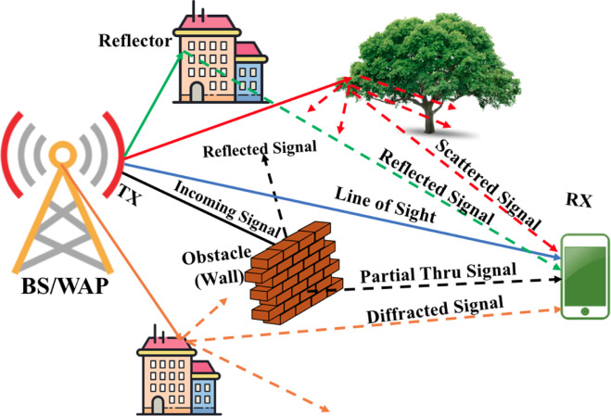
Solutions:
1. Ensure clear sky visibility for GPS receivers, use external antennas for better reception.
2. Employ GPS repeaters or alternative technologies like Wi-Fi for indoor positioning.
3. Use multi-frequency receivers to reduce signal reflections, choose locations with minimal obstructions.
4. Implement signal filters, shielding, and anti-jamming technologies in GPS receivers.
5. Use backup systems or inertial navigation during solar disturbances.
6. Utilize differential GPS correction services during satellite maintenance.
7. Comply with standards, update firmware for accurate GPS data.
8. Use updated maps, calibrate GPS systems for improved accuracy.
9. Optimize satellite data download processes to reduce delays.
10. Use multi-constellation receivers for improved accuracy in low satellite visibility areas.
11. Invest in high-quality GPS hardware, perform regular maintenance for optimal performance.

Slide 11
Objective
Fusion of GPS(NEO6m) and IMU(MPU6050) sensor
Reducing error in the GPS output

Slide 12
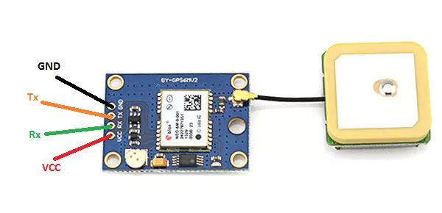
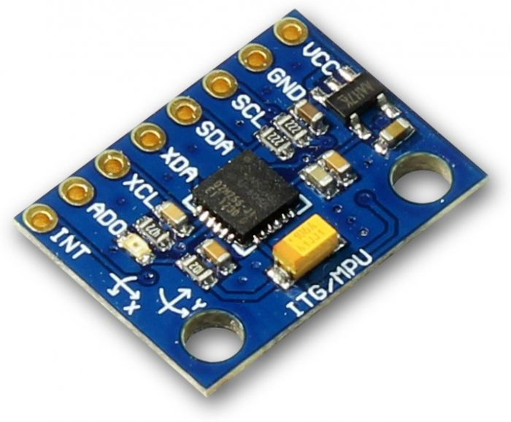
Sensor Specifications
GPS :Neo 6m Ublox
Output: Latitude, Longitude, Altitude
Vertical Accuracy (Latitude): 7.5 meters
Horizontal Accuracy (Longitude): 2.5 meters
Working Voltage : 3.3 V - 5 V
Working Frequency : 1 Hz
IMU : MPU 6000/6050
Gyroscope : Angular Velocity
Accelerometer : Rate of change of acceleration in x, y and z directions.
Working Voltage : 3.3 V - 5 V
Working Frequency : 1.2 Hz – 8KHz
Sampling Frequency : 1 KHz

Slide 13
Drawbacks of GPS
Clock errors, multiple path errors
Uncertainty of good signal strength due to weather conditions or physical barriers
Its low update rate is not suitable for Autonomous Localization

Slide 14
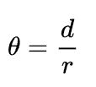
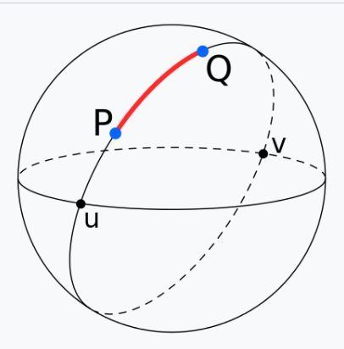
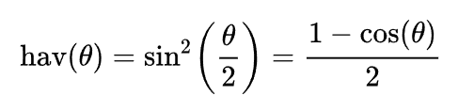
Haversine Formula
d is the distance between the two points, r is the radius of the sphere.
φ₁, φ₂ are the latitude of point 1 and latitude of point 2,
λ₁, λ₂ are the longitude of point 1 and longitude of point 2.

Slide 15
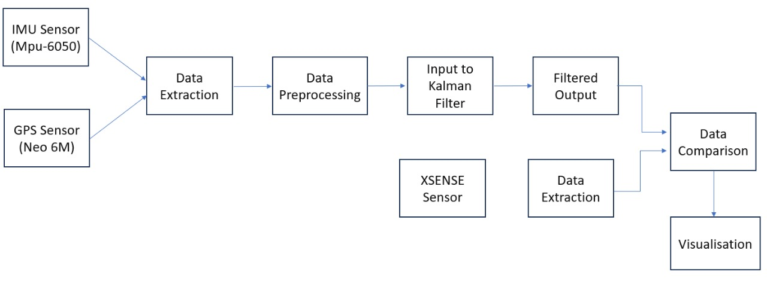
Block Diagram

Slide 16
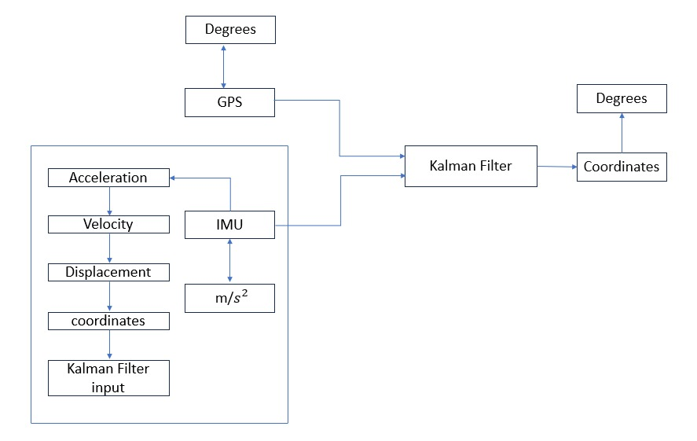
Final Design

Slide 17

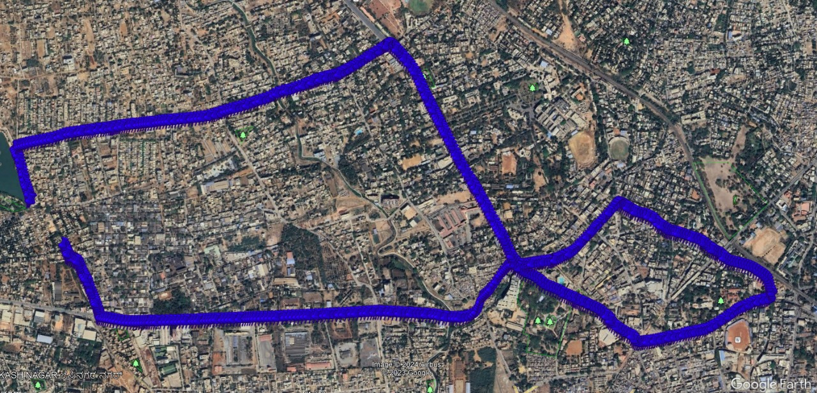
GPS data

Slide 18
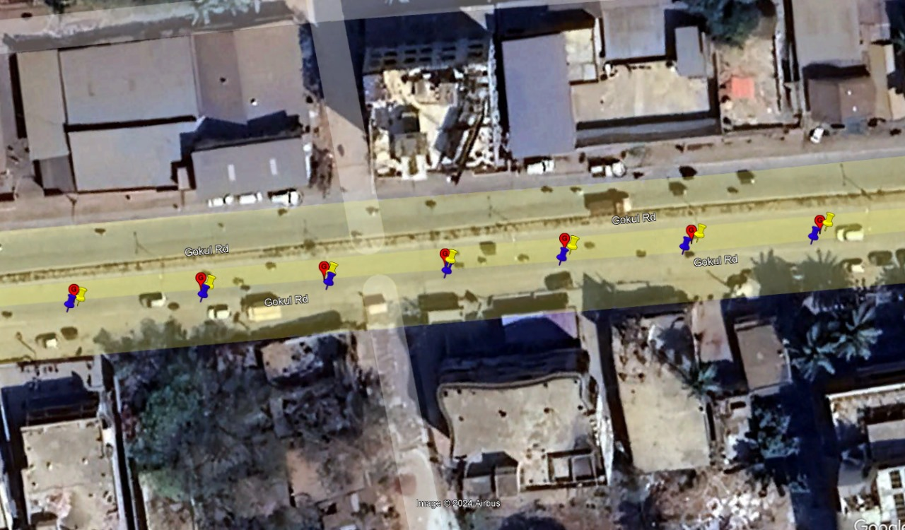
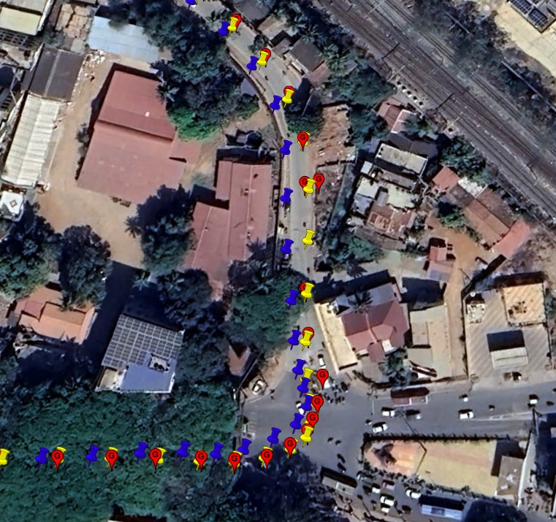
After applying Kalman

