Slide 1
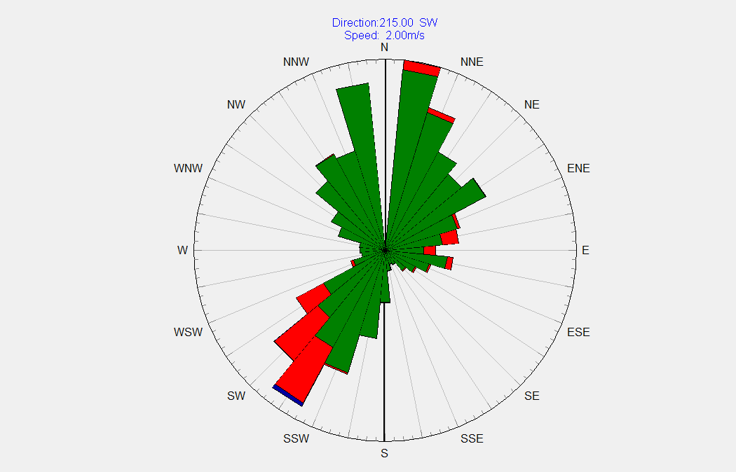
From HydroTel

Slide 2
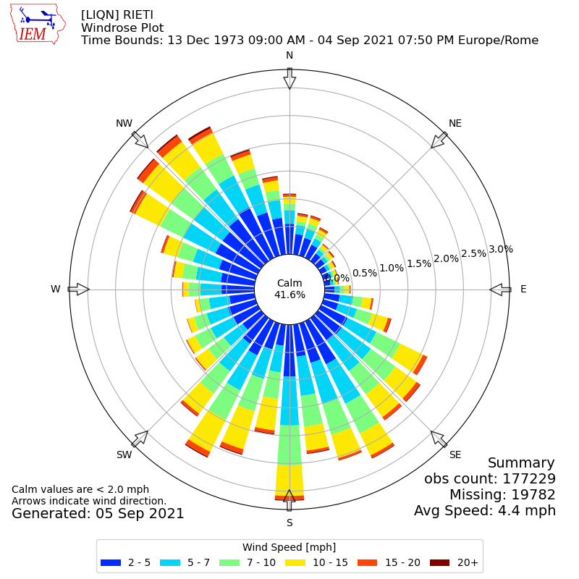
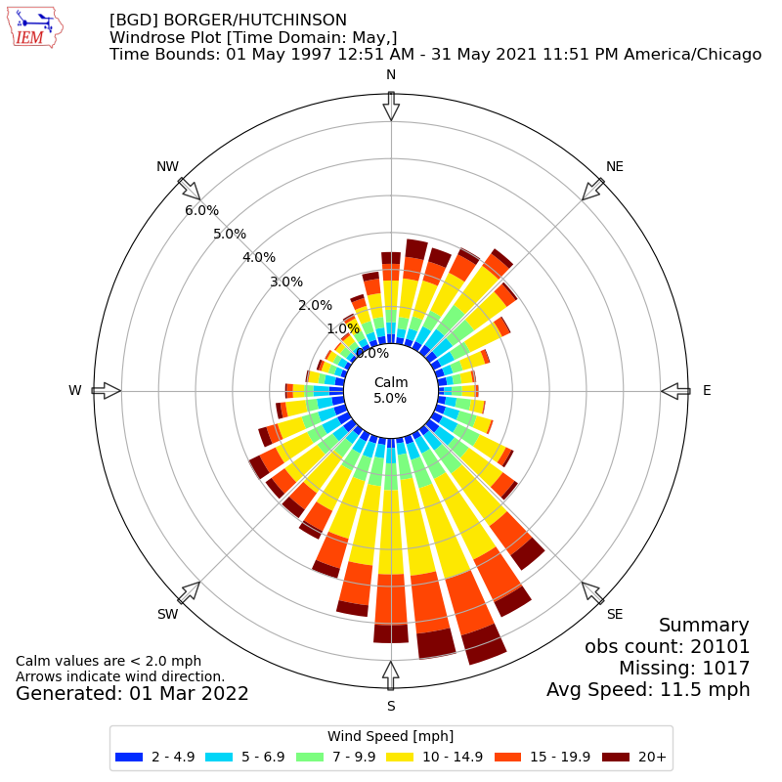
Example windrose plots (google-search)
1. #012CFF
2. #00D5F7
3. #7CFD7F
4. #FDE801
5. #FF4503
6. #7E0100

Slide 3
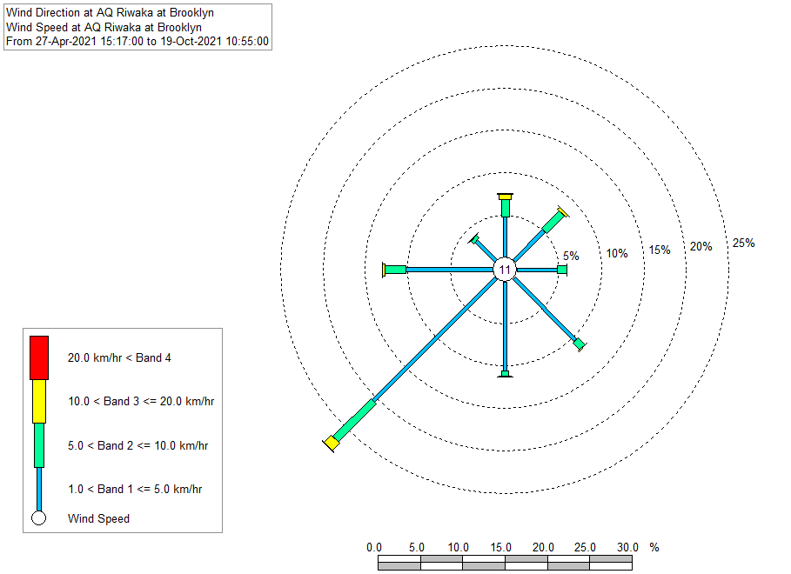
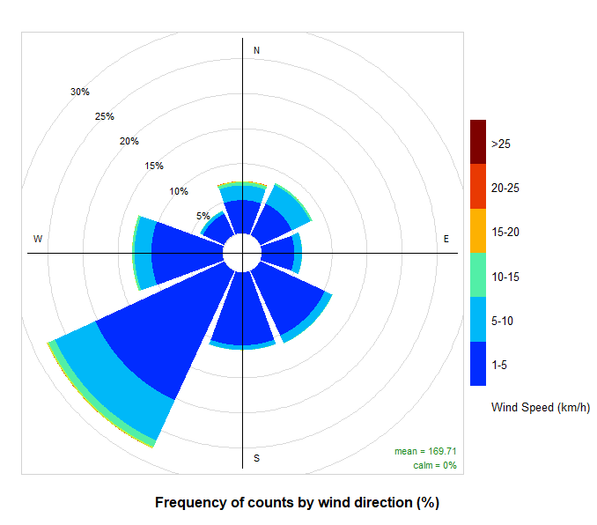
Wind data – Riwaka at Brooklyn, 27/04/2021 -> 19/10/2021
From Hilltop Hydro
From R script
Increased number of bands from 4 to 6.

