Slide 1
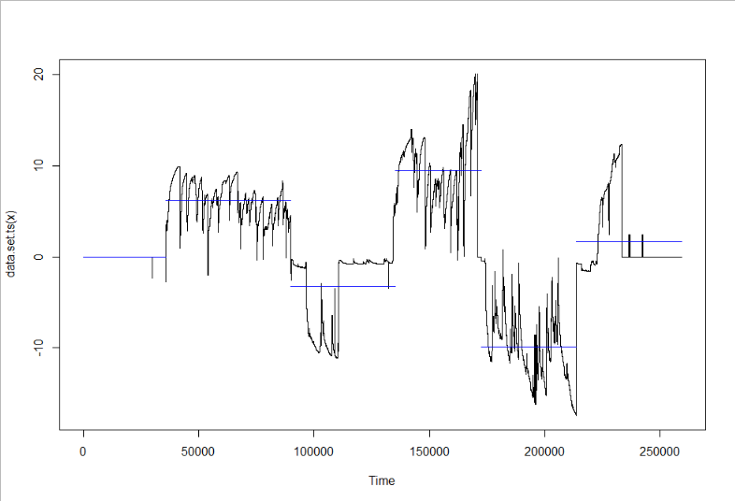
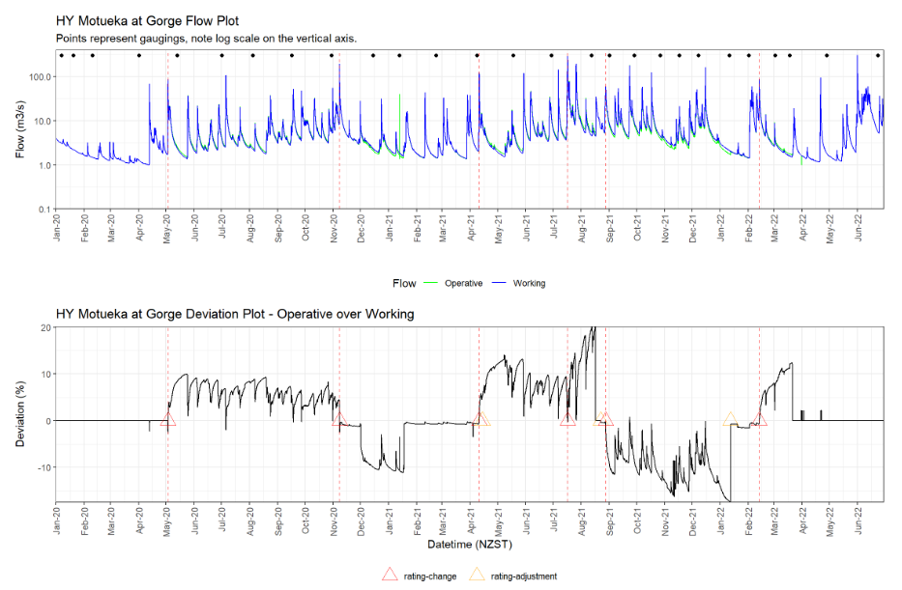
Change point detection approach
Rating adjustments determined through change point detection with default parameters (filtered if within 24 hours of a rating change).
fit_changepoint = cpt.mean(df$deviation, penalty = "Manual", method = 'BinSeg')
cp_est <- c(ints = param.est(fit_changepoint)$mean, cp = cpts(fit_changepoint))
Detect the Changes in Timeseries Data | R-bloggers
Poor job at detecting change.

Slide 2
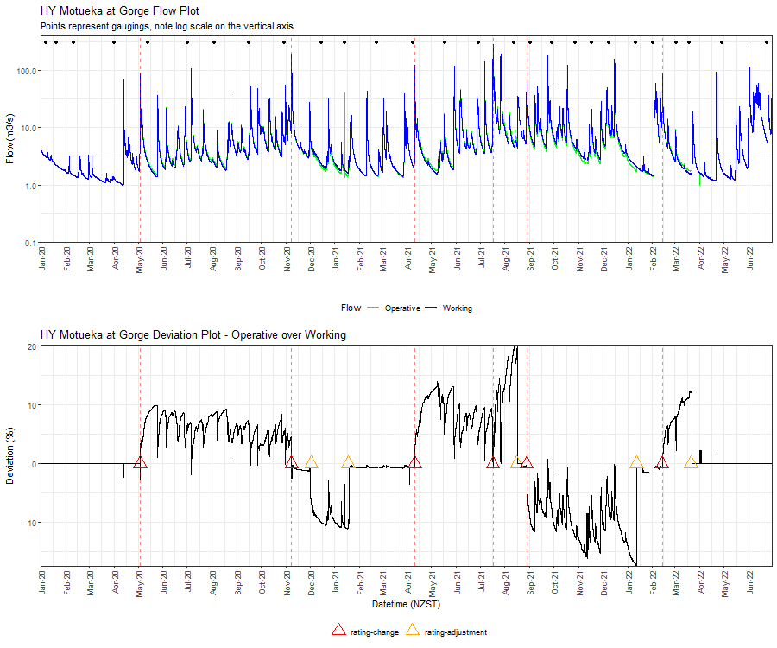
Extracting adjustment dates from rating documents:

