Slide 1
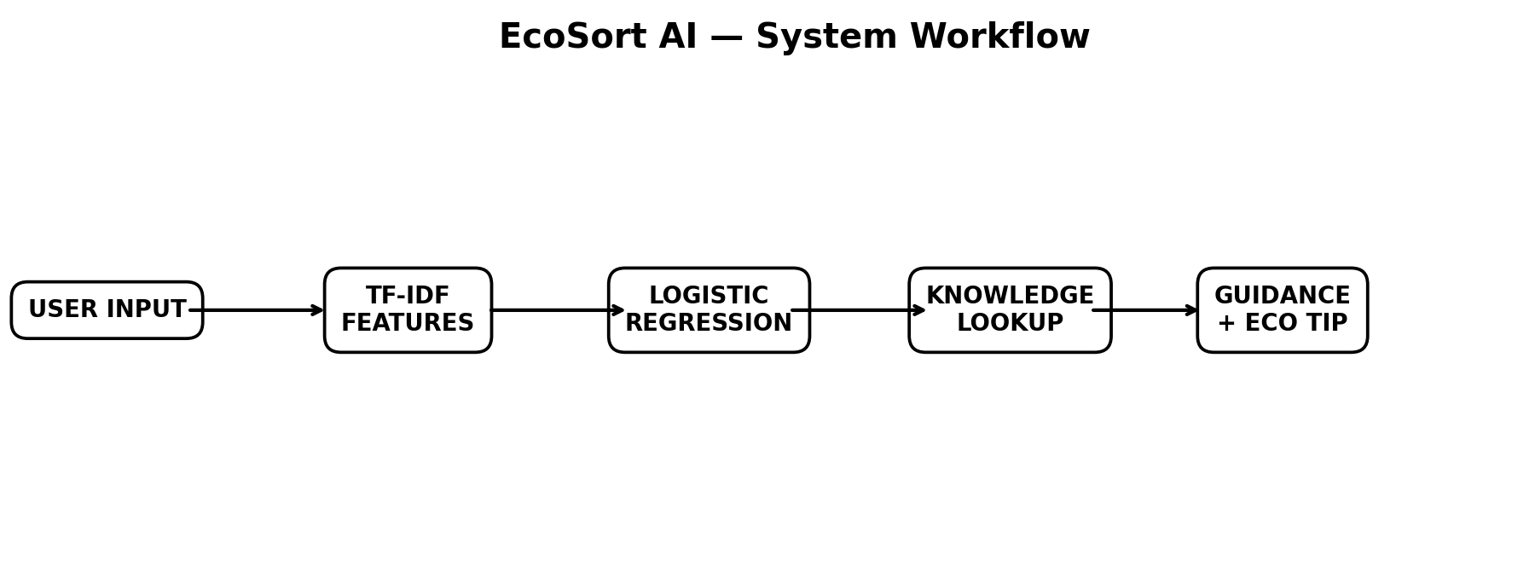
♻ Paras
AI-Powered Smart Waste Segregation
& Recycling Assistant
1M1B AI for Sustainability Virtual Internship
Parul • B.Tech CSE
Sardar Beant Singh State University, Gurdaspur
01

Slide 2
Project at a Glance
A practical AI-for-sustainability prototype aligned with SDG 12
01 Problem
Waste classification and disposal can be confusing.
02 AI Solution
Text classification + structured guidance.
03 Prototype
Python + Streamlit interactive application.
04 Impact
Better awareness and informed decisions.
02

Slide 3
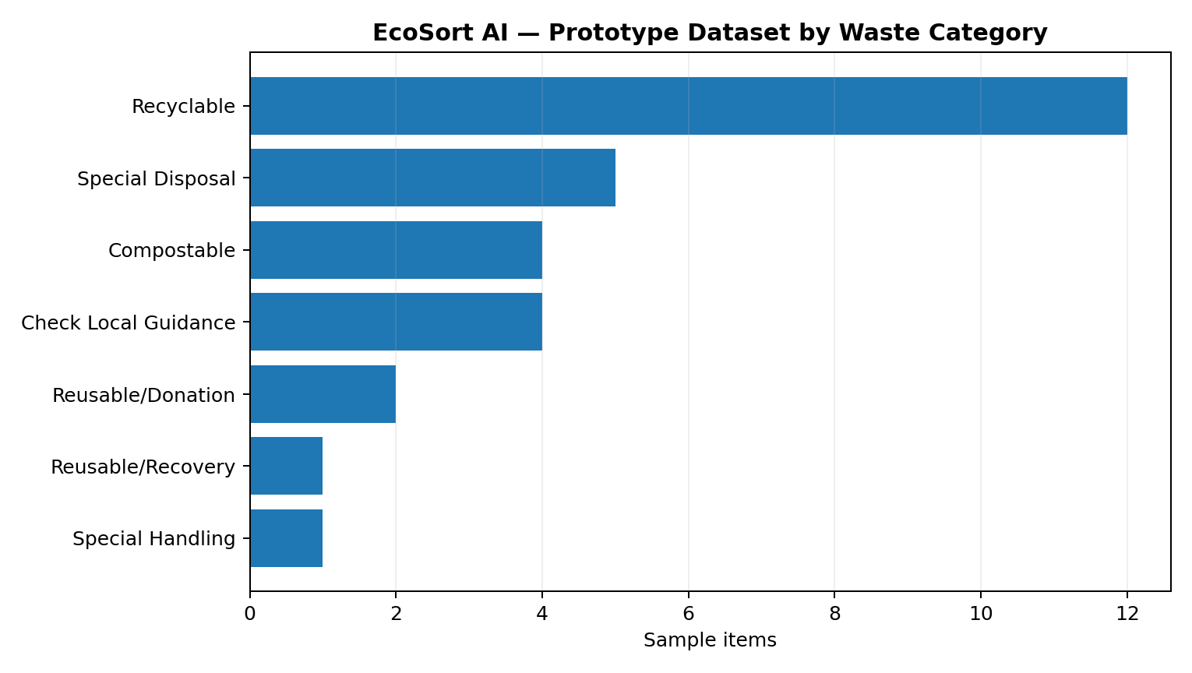
The Problem
A simple everyday sustainability challenge
• People encounter many different waste materials in daily life.
• Plastics, food scraps, batteries and electronics may need different handling.
• Users may know recycling matters but still be unsure what category an item belongs to.
• Paras provides accessible decision support while keeping official local guidance as the final reference.
03

Slide 4
Problem Statement
“How might we use AI to help people identify and properly segregate everyday waste so that waste management and responsible consumption can become more sustainable?”
04

Slide 5
SDG Alignment
Primary focus: SDG 12 — Responsible Consumption and Production
• Supports awareness around responsible consumption and waste handling.
• Encourages recycling, reuse, composting and appropriate disposal.
• Uses AI as decision support for an everyday sustainability problem.
SDG
12
05

Slide 6
Target Users
Designed for simple, everyday use
🏠 Households
🎓 Students
🏫 Institutions
🏢 Offices
🌱 Communities
06

Slide 7
Proposed Solution
From a simple waste description to actionable guidance
1 Describe
“Old mobile phone”
2 Predict
AI/ML category
3 Retrieve
Structured guidance
4 Guide
Disposal + eco tip
07

Slide 8
AI / ML Architecture
Core functionality works without an external API
Optional: Gemini generative AI can turn the structured result into a concise conversational explanation.
08

Slide 9
Technology Stack
Lightweight tools suitable for a student prototype
Python
Application logic
Streamlit
Interactive UI
Pandas
Dataset
Scikit-learn
ML
TF-IDF
Text features
Logistic Regression
Classifier
Gemini API
Optional AI
GitHub
Version control
09

Slide 10
Prototype Interface
Simple enough for beginners, structured enough for a demo
• Waste description input
• Predicted category and material
• Disposal / recycling guidance
• Sustainability tip
• Dataset Insights + Responsible AI tabs
10

Slide 11
Demo Scenario
Example: “Old mobile phone”
Predicted Category
E-waste
Material
Electronic
Guidance
Special disposal
• Recommended action: use an appropriate e-waste collection / recycling route.
• 🌱 Eco tip: repair, reuse or responsibly recycle electronics.
11

Slide 12
Dataset & Analytics
Representative prototype dataset
• 29 representative waste-item records
• Material + category + guidance + eco tip
• Designed for demonstration and learning
• Can be expanded with validated real-world data
12

Slide 13
Responsible AI
Built into the prototype, not added as an afterthought
Fairness
No personal or demographic attributes.
Transparency
Model and workflow are disclosed.
Ethics
Avoids unsupported universal claims.
Privacy
No personal data required.
Safety
Special waste is flagged.
Local context
Verify local rules.
13

Slide 14
Testing Plan
Representative inputs for prototype validation
Plastic bottle
Expected: Plastic
Banana peel
Expected: Organic
Newspaper
Expected: Paper
Old mobile phone
Expected: E-waste
Used battery
Expected: Hazardous
Old clothes
Expected: Textile
14

Slide 15
Expected Impact
What could change if the solution is adopted
• Make basic waste categories easier to understand.
• Support more informed everyday disposal decisions.
• Encourage recycling, reuse and composting where appropriate.
• Provide a scalable starting point for localized sustainability guidance.
• Demonstrate responsible AI applied to a real-world sustainability problem.
Expected/planned impact only — the prototype does not claim measured environmental reduction.
15

Slide 16
Limitations
Important boundaries of the prototype
• Small representative dataset — not a comprehensive waste database.
• Waste-management and recycling rules differ by location.
• Ambiguous descriptions may reduce classification reliability.
• Real deployment requires broader validation and authoritative local data.
• Generative-AI responses should be verified and must not override official guidance.
16

Slide 17
Future Scope
From student prototype to a richer sustainability assistant
📷 Image-based recognition
📚 RAG with verified municipal guidance
🌐 Multilingual support
📍 Local collection-point discovery
📱 Mobile application
🔄 Feedback-based improvement
17

Slide 18
Paras
AI + Python + Sustainability
A practical prototype aligned with SDG 12 and designed with responsible AI principles.
Thank You
18

