Slide 1
Part 1
Exploratory Analysis

Slide 2
1- Observe:
The total number of hospitalizations versus deaths from COVID-19 over the
entire US per month-year timestamp.

Slide 3
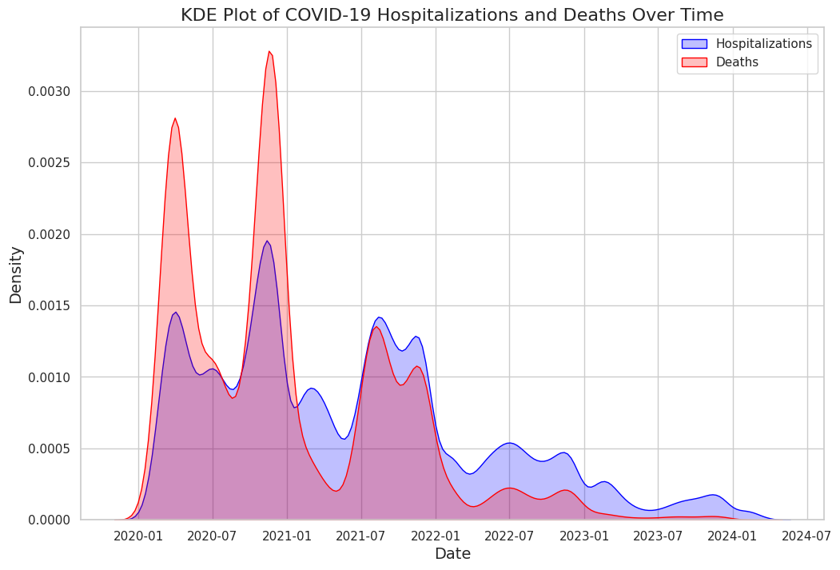
Deaths and hospitalizations with time

Slide 4
Conclusion
We can see a peek in deaths and hospitalizations at the time COVID was starting however as vaccines and ways to deal with it came out the deaths have slowed down (shrinked vertically) compared to hospitalizations.

Slide 5
2- Observe:
The average rates of COVID-related deaths relative to patient
demographics.

Slide 6
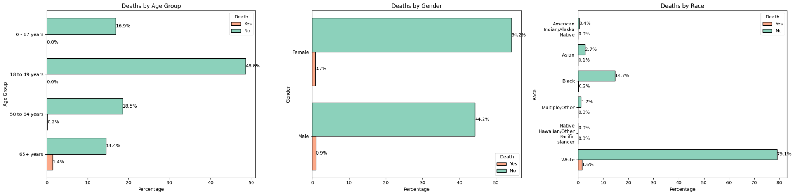
Deaths by Demographics

Slide 7
Conclusion
We an see that certain demographics are more at risk of death due to covid, for example people of ages 65 and older.

Slide 8
3- Observe:
The rates of COVID-related hospitalization and death with age (across age
groups).

Slide 9
Conclusion
We can assume that higher chance of death occurs as age increases, especially that no deaths have have taken place for the 17 and younger age group.

Slide 10
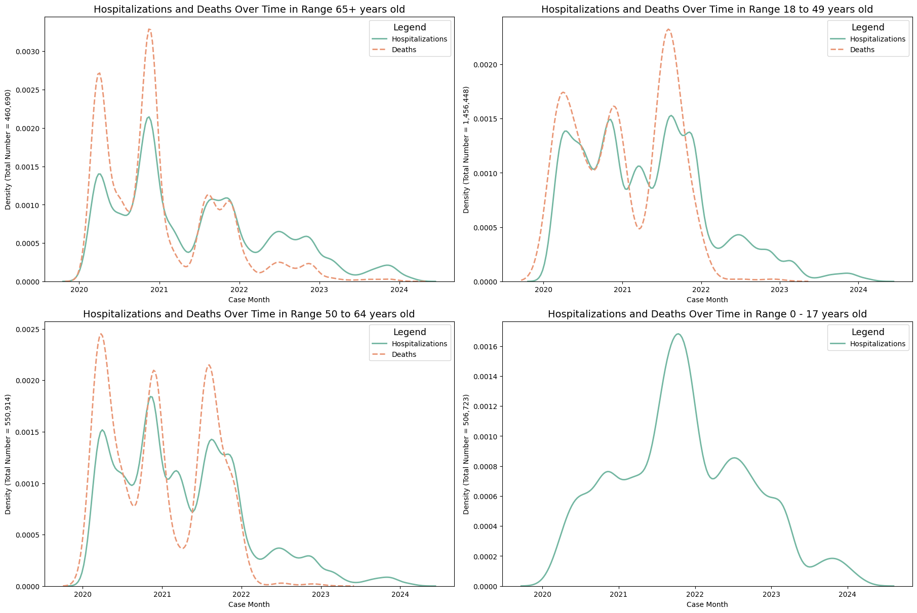
Hospitalization & Death
With age

Slide 11
4- Observe:
Average rate of COVID-related hospitalization and death per state over the
entire study period.

Slide 12
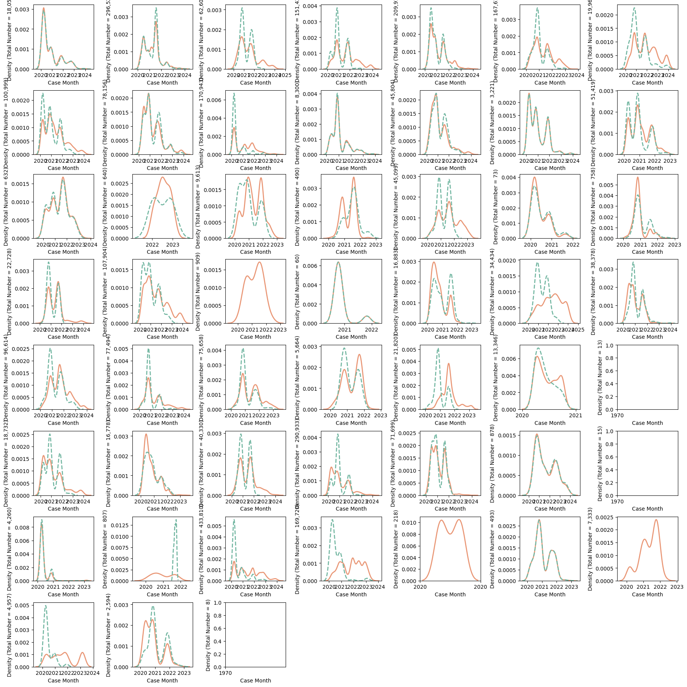
Deaths and
Hospitalizations
Per state

Slide 13
Conclusion
The deaths and hospitalizations are not consistent between states. We can see completely different looking distributions as well as different means.

Slide 14
5- Observe:
The relationship between age, pre-existing medical conditions and/or risk
behaviors, and rate of admittance to the ICU.

Slide 15
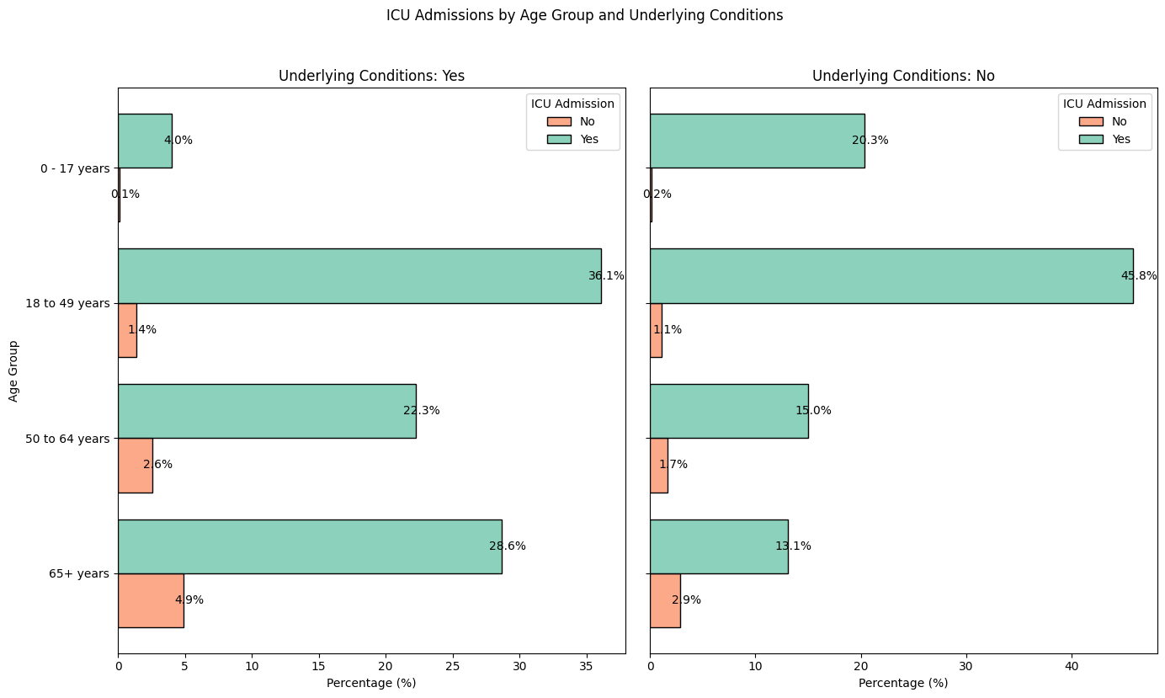
ICU admission based on age and underlying conditions

Slide 16
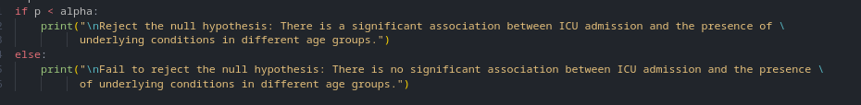
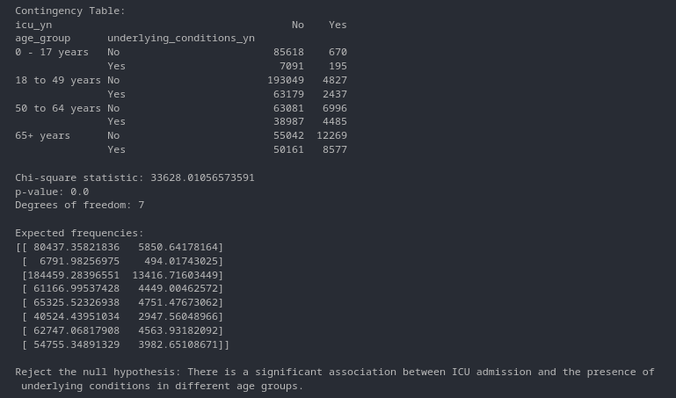
Exploring Further

Slide 17
Conclusion
Underlying conditions do have an effect on hospitalization.

Slide 18
6- Observe:
The rate of expected employment loss due to COVID-19 and sector of
employment.

Slide 19
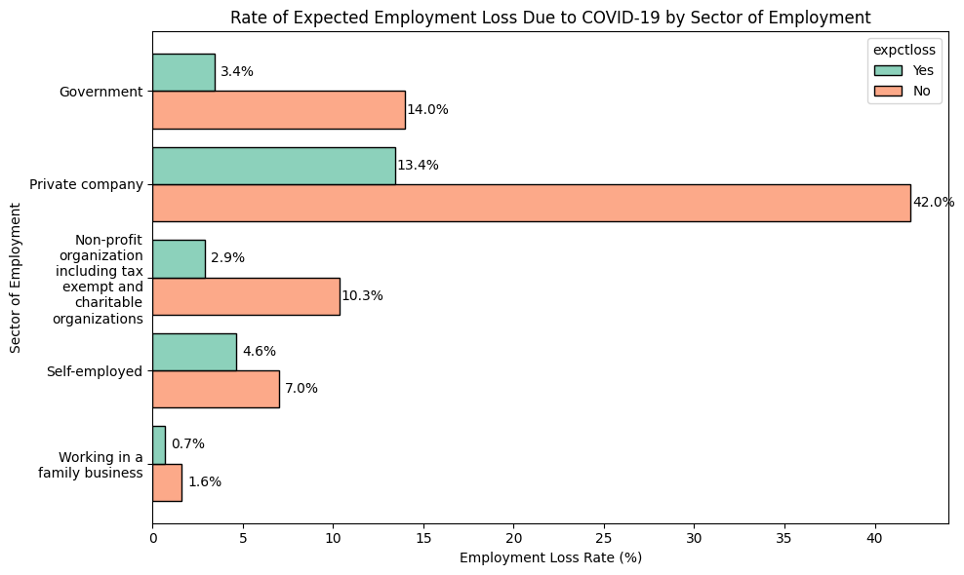
Fear of job loss and job sector

Slide 20
Conclusion
Some job sectors are more afraid of their job being at risk that others.

Slide 21
7- Observe:
The rate of expected employment loss due to COVID-19 relative to
responders demographics.

Slide 22
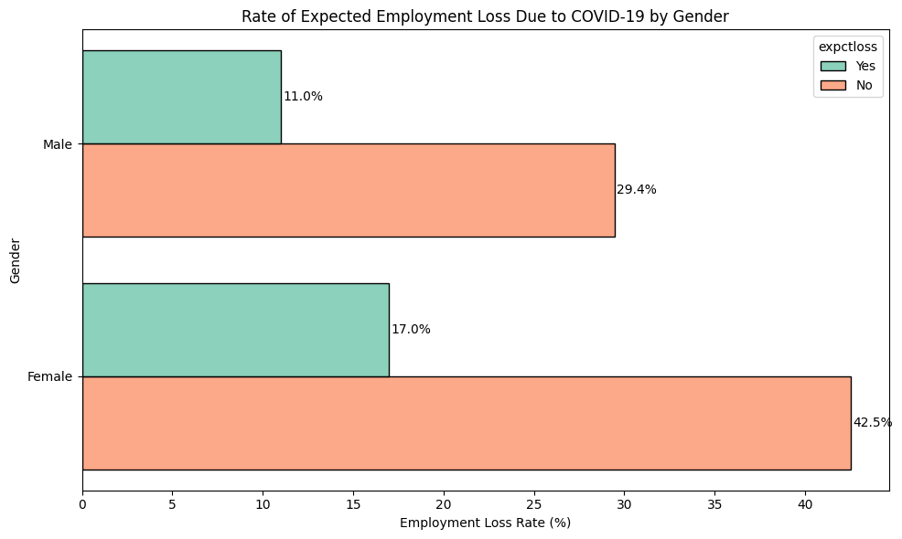
Employment loss and gender

Slide 23
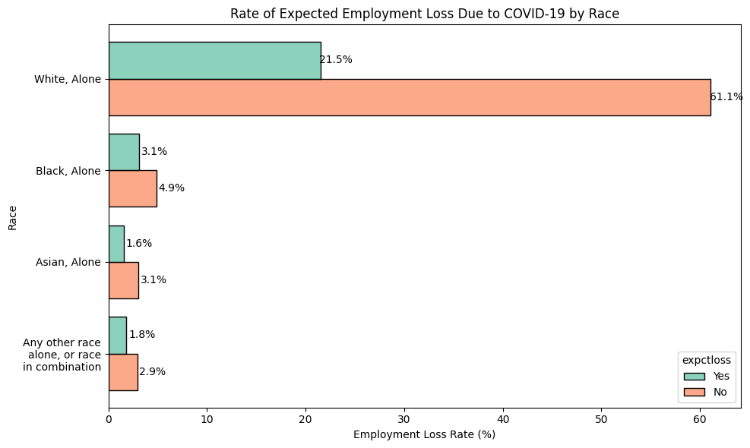
Employment loss and race

Slide 24
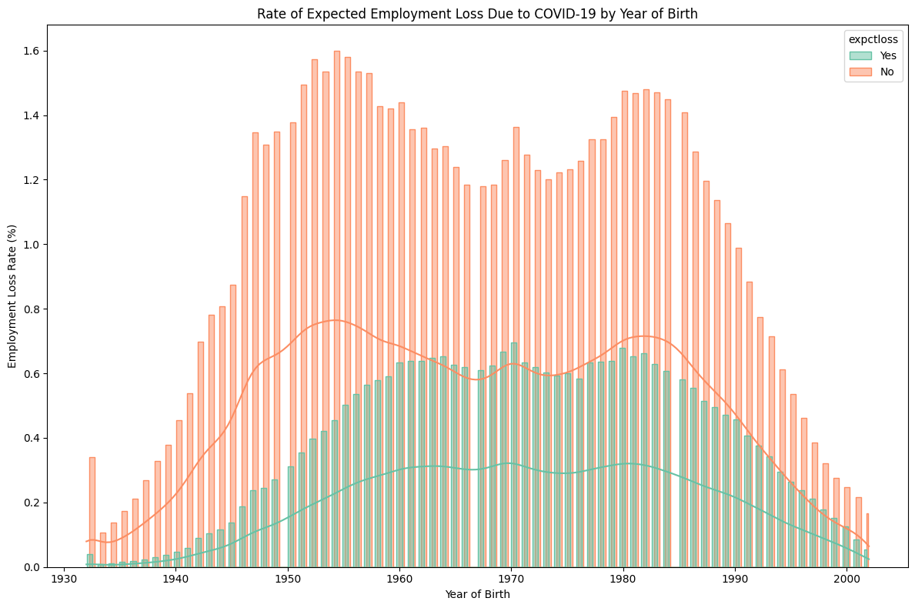
Employment loss and age

Slide 25
Conclusion
We can see that certain demographics believe they are more at risk of job loss than others

Slide 26
8- Observe:
The rate of expected employment loss due to COVID-19 for the top 10 states with the highest rate of COVID hospitalization.

Slide 27
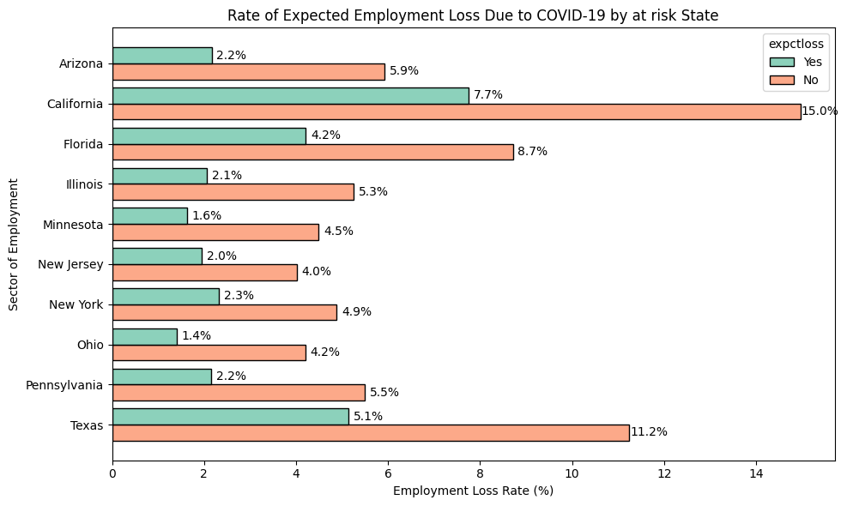
Unemployment and states

Slide 28
Conclusion
We can see that certain states at risk believe they are more at risk of job loss than others

Slide 29
9- Observe:
The relationship between household income and the rate of delayed/ OR unobtained medical treatment (Due to COVID or otherwise).

Slide 30
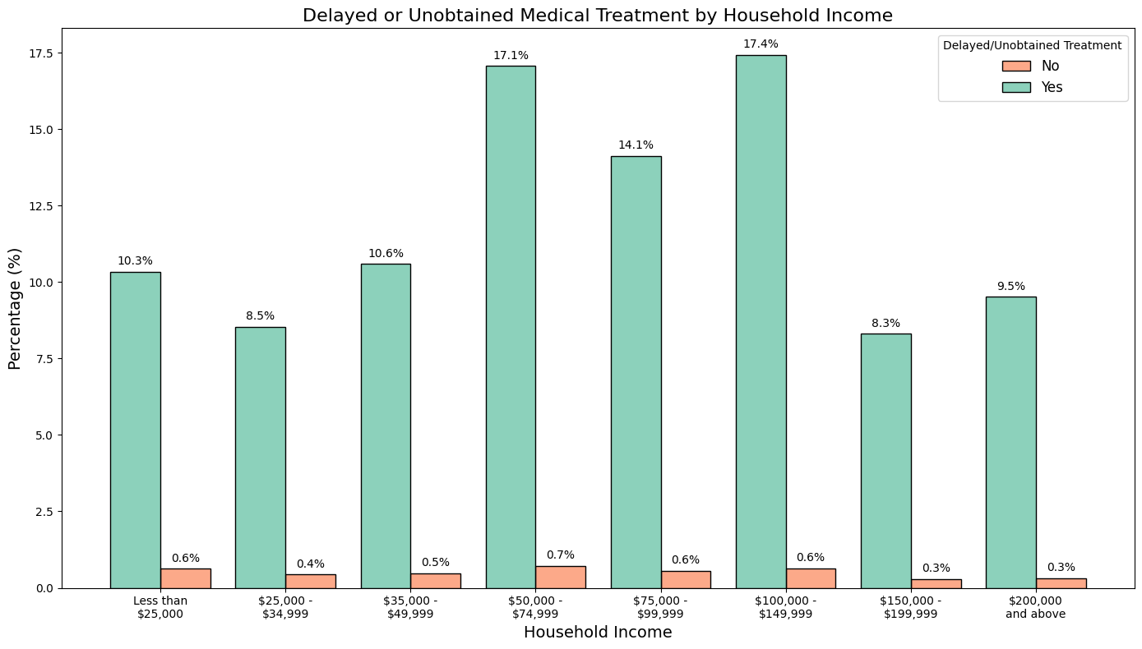
Medical treatment and income

Slide 31
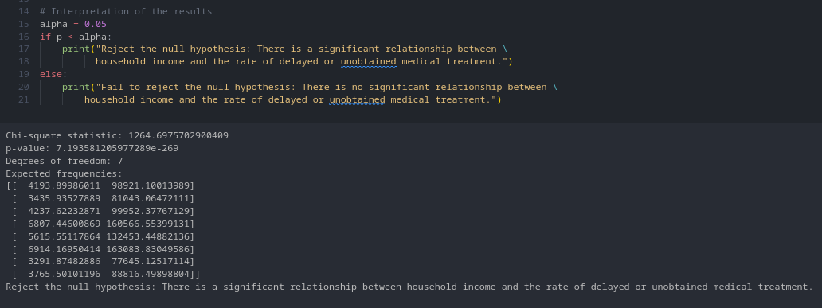
Further exploring

Slide 32
Conclusion
We can see that income effects the treatment delays.

Slide 33
10- Observe:
The relationship between COVID-19 symptom manifestation and age group.

Slide 34
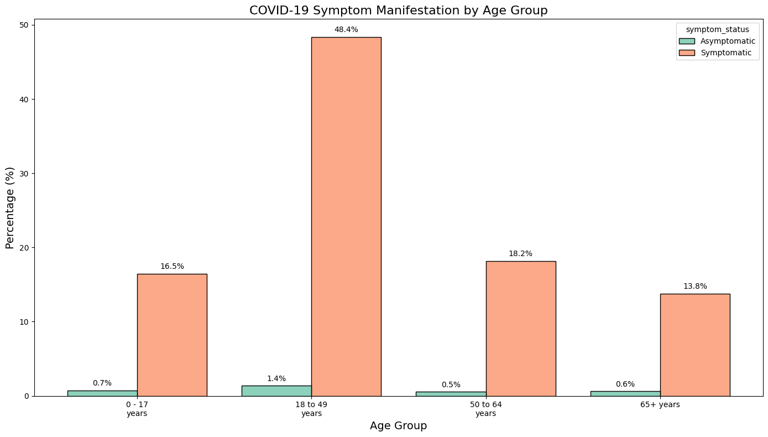
Symptoms and Age Group

Slide 35
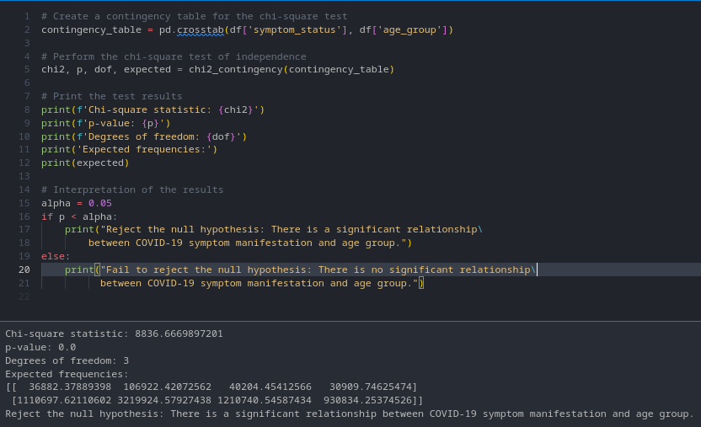
Further exploring

Slide 36
Conclusion
We can conclude that some age groups are more at risk of symptoms that others.

Slide 37
Answering Questions
Part 2

Slide 38
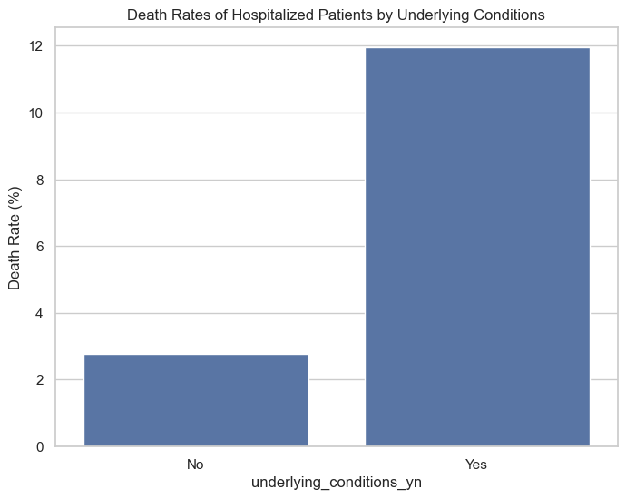
Does underlying medical conditions presence affect death rate:

Slide 39
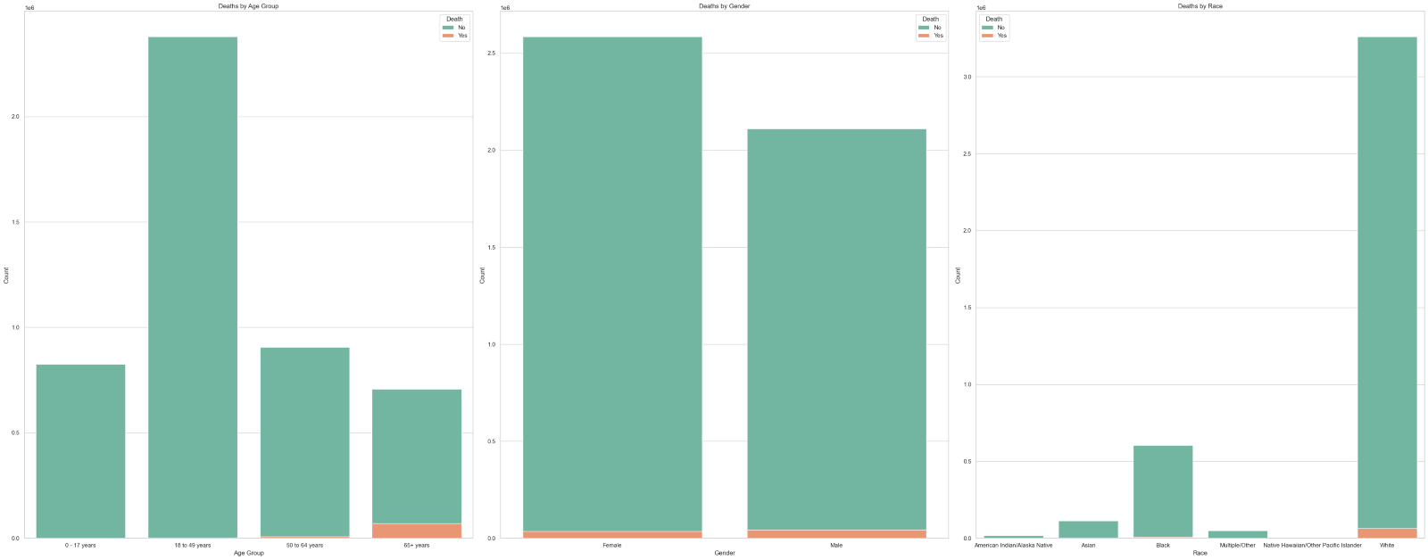
Demographic segmentation with greater risk of death due to COVID-19

Slide 40
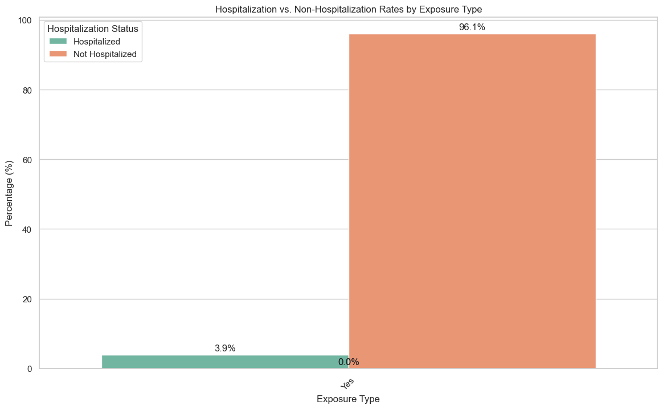
Being exposed to travel, does not necessary mean greater risk of hospitalization

Slide 41
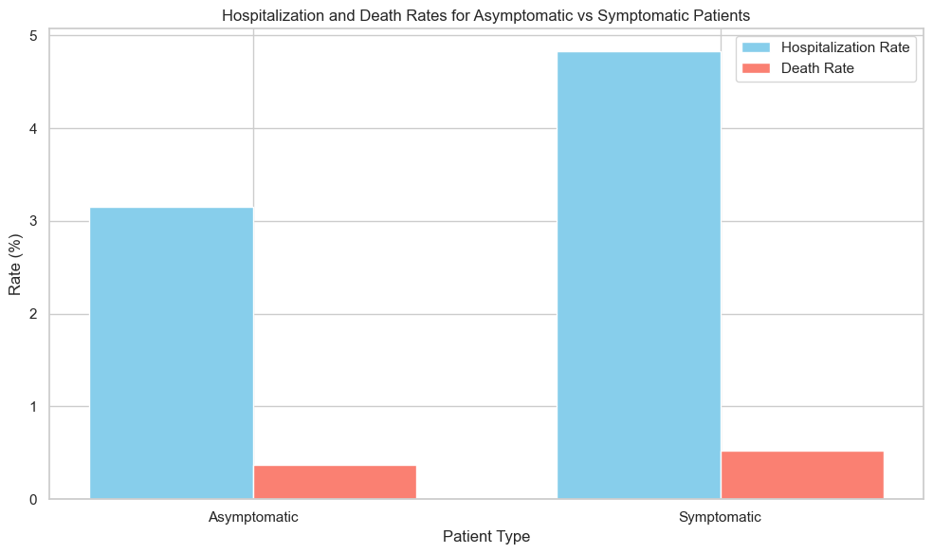
Symptomatic patients had higher death and hospitalization rates

Slide 42
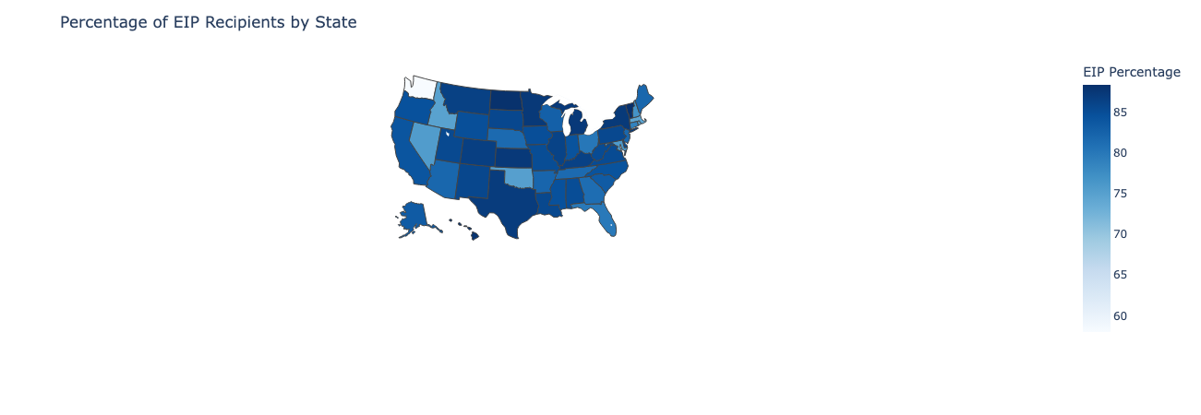
Virginia appeared to be the state with highest EIP recipients percentage
VA
88%

Slide 43
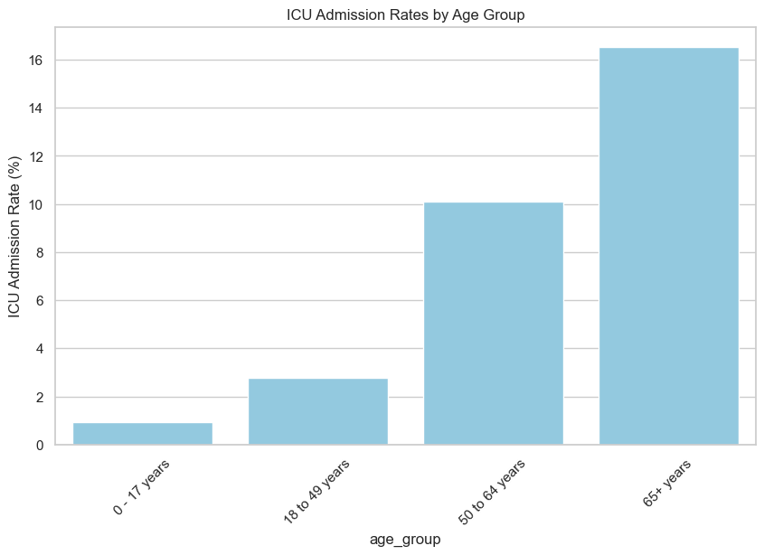
The older the patients, the more likely they are hospitalized

Slide 44
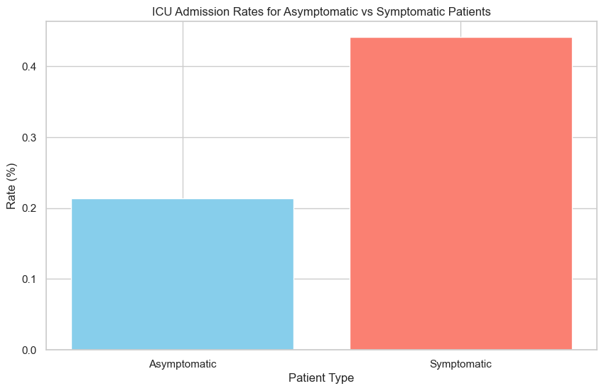
Symptomatic patients have nearly twice the possibility of deteriorating health condition

Slide 45
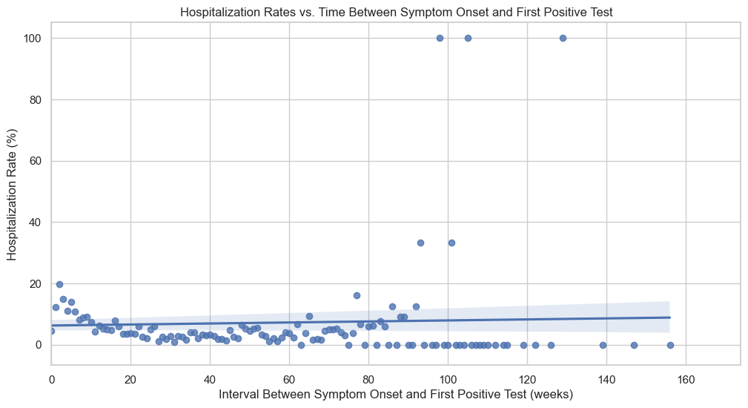
Slight correlation between time of diagnosis and hospitalization rate

Slide 46
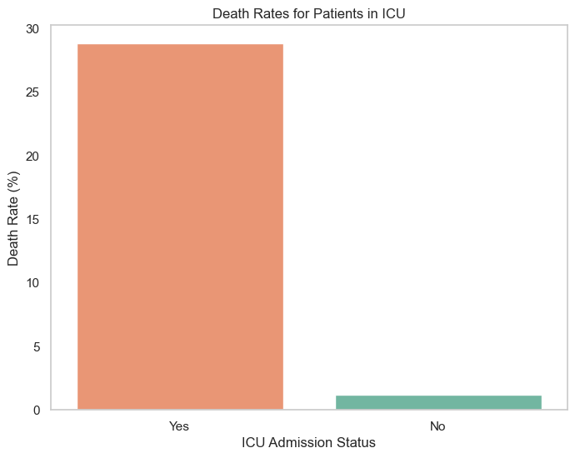
ICU Admitted patients are
nearly
20X
more likely to die

Slide 47
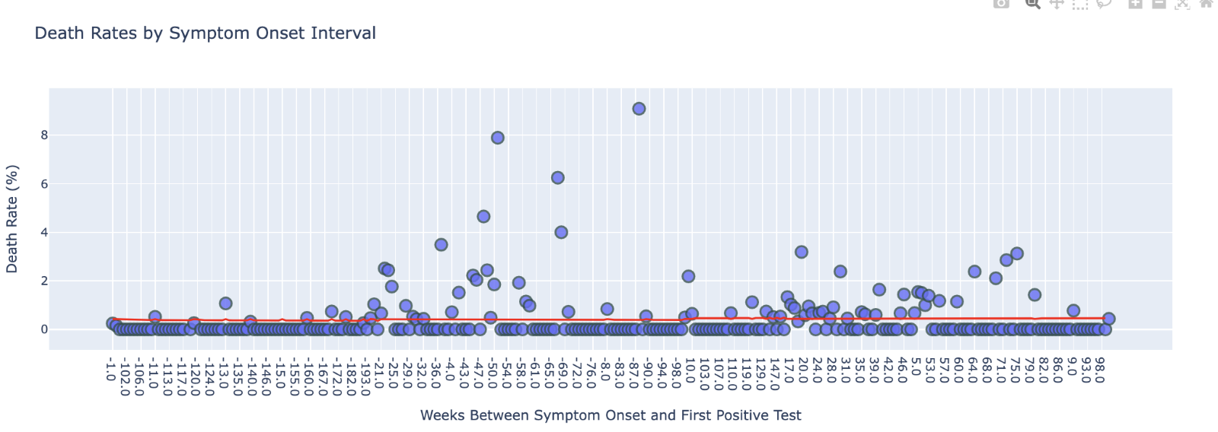
The time between symptoms onset and the first positive test does not necessarily mean that this will affect the risk of death

Slide 48
Hypothesis Testing
Part 3

Slide 49
3.1
Claim:
“There is a strong association between probability of death due to COVID-19 and patient demographics”

Slide 50
Test Type Selection
Why Use the Chi-square Test?
The Chi-square test is specifically designed for categorical data, where the variables represent categories (e.g., 'Yes'/'No', 'Male'/'Female', different age groups, etc.).
It does not assume a normal distribution of the data, making it robust for various types of categorical data.
It helps in testing the independence of two categorical variables, which is essential when you want to understand if the presence or absence of one category affects the presence or absence of another.

Slide 51
Age and Death Rate from COVID-19
Formulating the Hypothesis
Null Hypothesis Ho: there is no association between age and death rate for COVID-19 patients.
Alternative Hypothesis Ha: there is an association between age and death rate for COVID-19 patients.

Slide 52
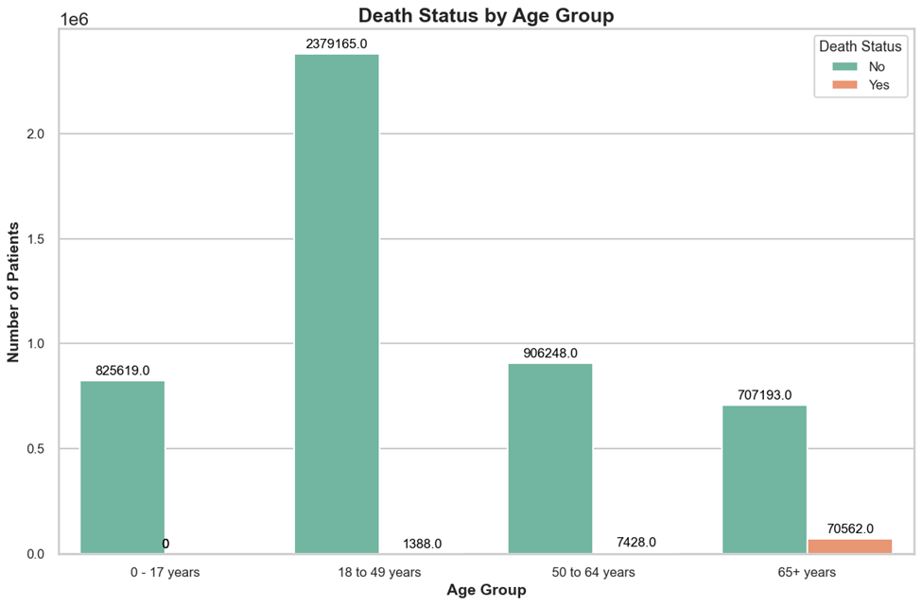
Age and Death Rate from COVID-19
Data Plotting

Slide 53
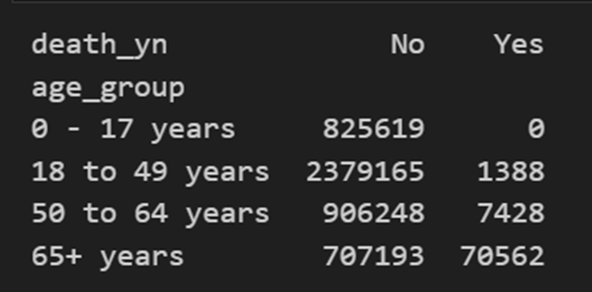
Age and Death Rate from COVID-19
Contingency Table

Slide 54
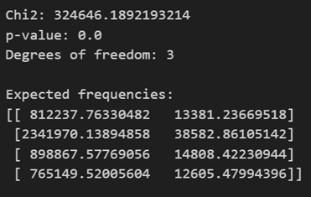
Age and Death Rate from COVID-19
Test Results Interpretation
From the test result, it can be said there is enough evidence to say reject the null hypothesis, meaning that there is a significant association between age and death probability from COVID-19.

Slide 55
2. Sex and Death Rate from COVID-19
Formulating the Hypothesis
Null Hypothesis Ho: there is no association between sex and death rate for COVID-19 patients.
Alternative Hypothesis Ha: there is an association between sex and death rate for COVID-19 patients.

Slide 56
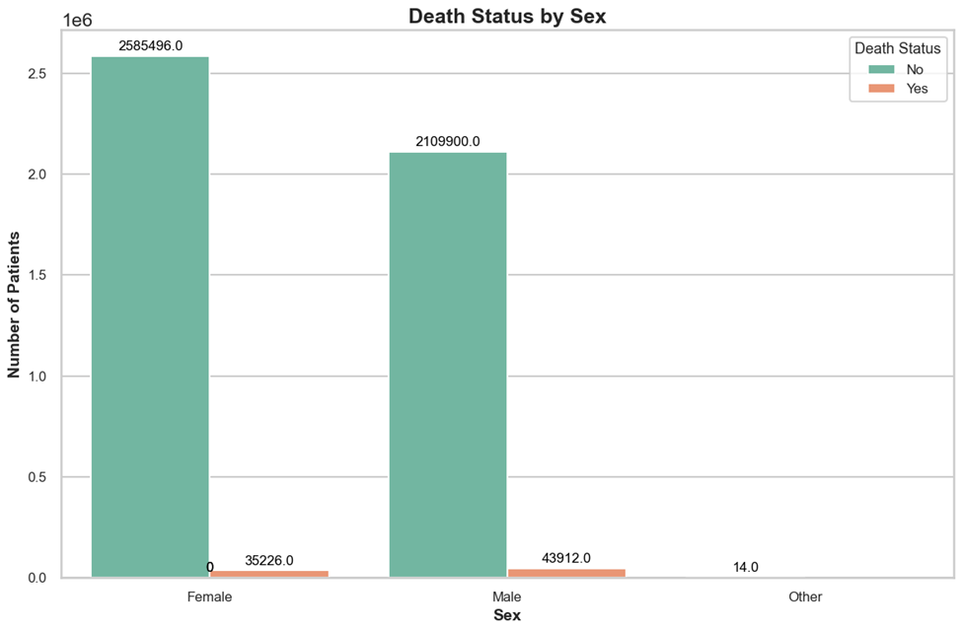
2. Sex and Death Rate from COVID-19
Data Plotting

Slide 57
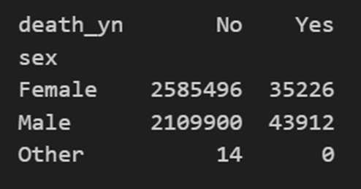
2. Sex and Death Rate from COVID-19
Contingency Table

Slide 58
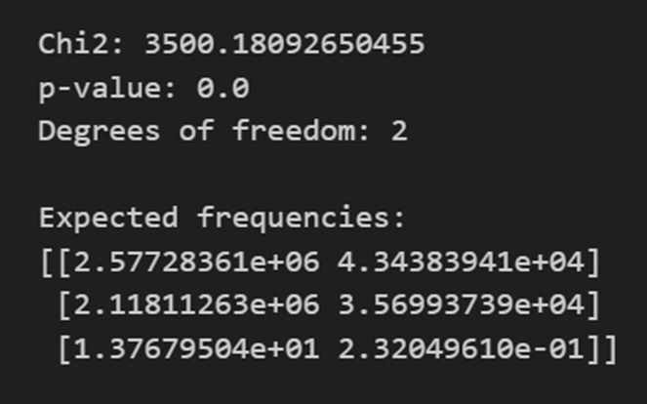
2. Sex and Death Rate from COVID-19
Test Results Interpretation
From the test result, it can be said there is enough evidence to say reject the null hypothesis, meaning that there is a significant association between sex and death probability from COVID-19.

Slide 59
3. Race and Death Rate from COVID-19
Formulating the Hypothesis
Null Hypothesis Ho: there is no association between race and death rate for COVID-19 patients.
Alternative Hypothesis Ha: there is an association between race and death rate for COVID-19 patients.

Slide 60
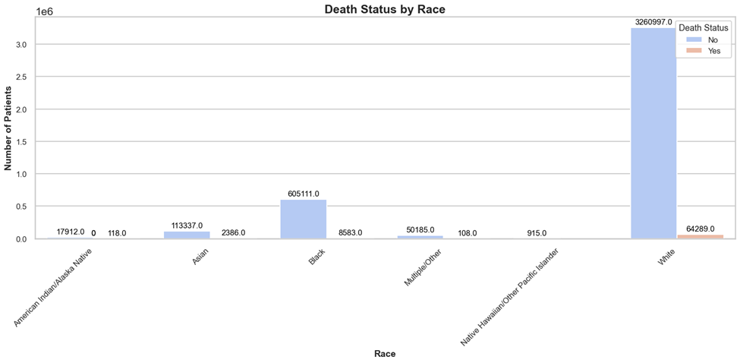
3. Race and Death Rate from COVID-19
Data Plotting

Slide 61
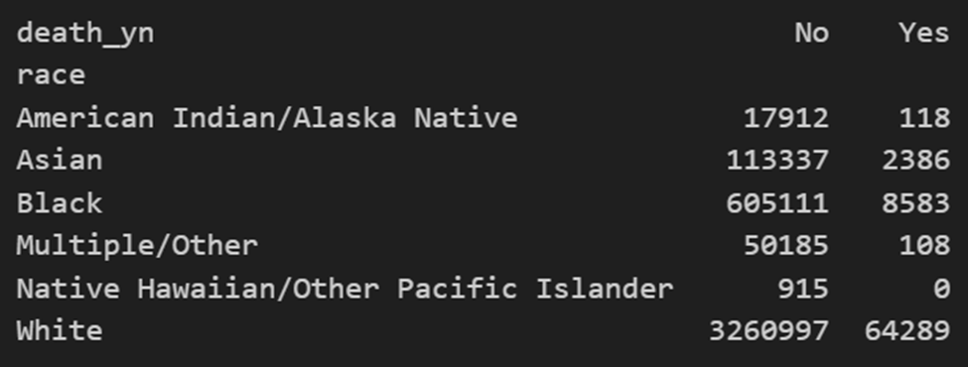
3. Race and Death Rate from COVID-19
Contingency Table

Slide 62
3. Race and Death Rate from COVID-19
Test Results Interpretation
From the test result, it can be said there is enough evidence to say reject the null hypothesis, meaning that there is a significant association between race and death probability from COVID-19.

Slide 63
3.2
My Claim:
“There is an association between patients having asymptomatic or symptomatic symptoms and the probability of death from COVID-19.”

Slide 64
Test Type Selection
For comparing a proportion between only two populations, it is best to use Z-test statistic.

Slide 65
Symptom and Death Rate from COVID-19
Formulating the Hypothesis
Null Hypothesis Ho: the death probability from COVID-19 patients is equal for patients with asymptotic and asymptotic symptom status.
Alternative Hypothesis Ha: the death probability from COVID-19 patients is not the same for patients with asymptotic and asymptotic symptom status.

Slide 66
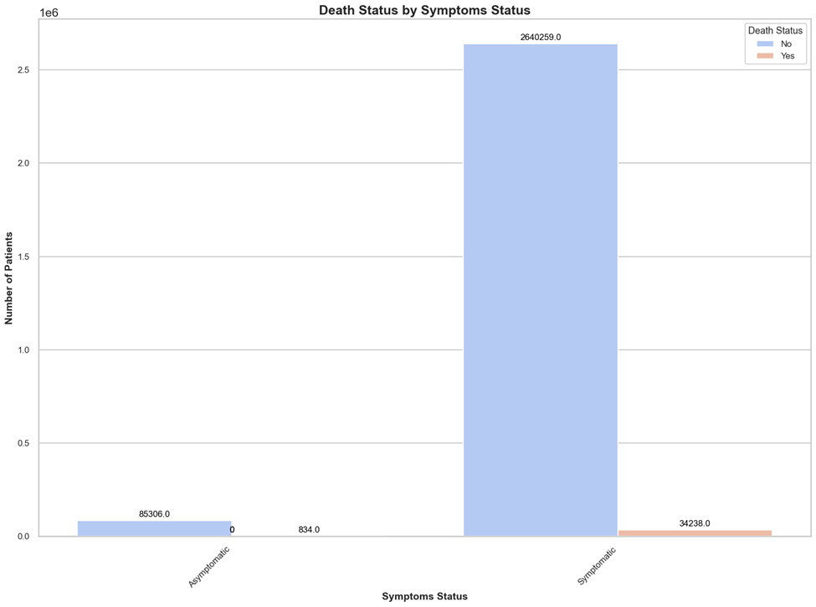
Symptom and Death Rate from COVID-19
Data Plotting

Slide 67
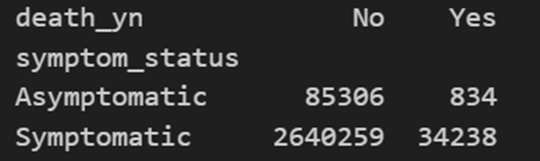
Symptom and Death Rate from COVID-19
Contingency Table

Slide 68

Symptom and Death Rate from COVID-19
Z-Test Result Interpretation
Based on the resulting p-value, it can be said that there is enough evidence to reject the null hypothesis in favor of the alternative hypothesis, that is, the death probability from COVID-19 is not the same for patients with symptomatic and asymptomatic symptom status.

Slide 69
Part 4: Regression Analysis

Slide 70
Introduction
Objective: To predict the total percent of deaths out of all COVID-19 cases in a given month using regression analysis.
Reason: Understand the impact of gender distribution, age distribution, ICU admissions, and hospitalizations on COVID-19 death rates.

Slide 71
Importance of regression analysis
Predictive Power: Helps in predicting outcomes based on input variables.
Understanding Relationships: Reveals the strength and nature of relationships between dependent and independent variables.
Data-Driven Decisions: Aids in making informed decisions by identifying key factors that influence the target variable.
Resource Allocation: Guides efficient resource allocation by highlighting significant predictors.
Policy Making: Supports evidence-based policy making, especially in public health scenarios like COVID-19.

Slide 72
Data Preprocessing
Missing Data Handling:
Imputed missing values using appropriate statistical methods or removed rows with missing data to maintain data integrity.
Feature Engineering:
Calculated the proportion of females and males, different age groups, ICU admissions, and hospitalizations for each month.

Slide 73
Analysis Procedure
We trained a regression model with input parameters proportion of females and males, different age groups, ICU admissions, and hospitalizations for each month and the output parameter is the proportion of death for that month.
We used Statmodels Regression to do our analysis on

Slide 74
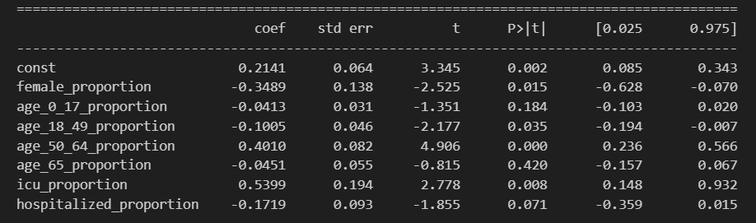
Analysis Results
Model Coefficients and P-values:

Slide 75
Analysis Results
15.74
Model R squared Value: 0.692, This means that the models approximately explain 69.2% of the variance in the target variable.
Model F statistic: 15.74, This indicates that the model is statistically significant.

Slide 76
Predictors Significance
Significant Predictors
Based on the p-values, the following predictors are considered significant (p-value < 0.05):
female_proportion
age_18_49_proportion
age_50_64_proportion
icu_proportion
Predictors with higher p-values, such as age_0_17_proportion, age_65_proportion, and hospitalized_proportion, are not considered significant.

Slide 77
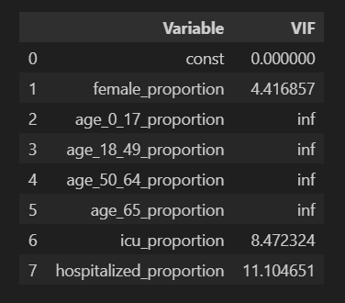
Correlation Detection
Multicollinearity Check: Checked for correlations between predictor variables using variance inflation factors (VIFs).
Observations: Identified strong correlations between some predictors, indicating potential multicollinearity issues.

Slide 78
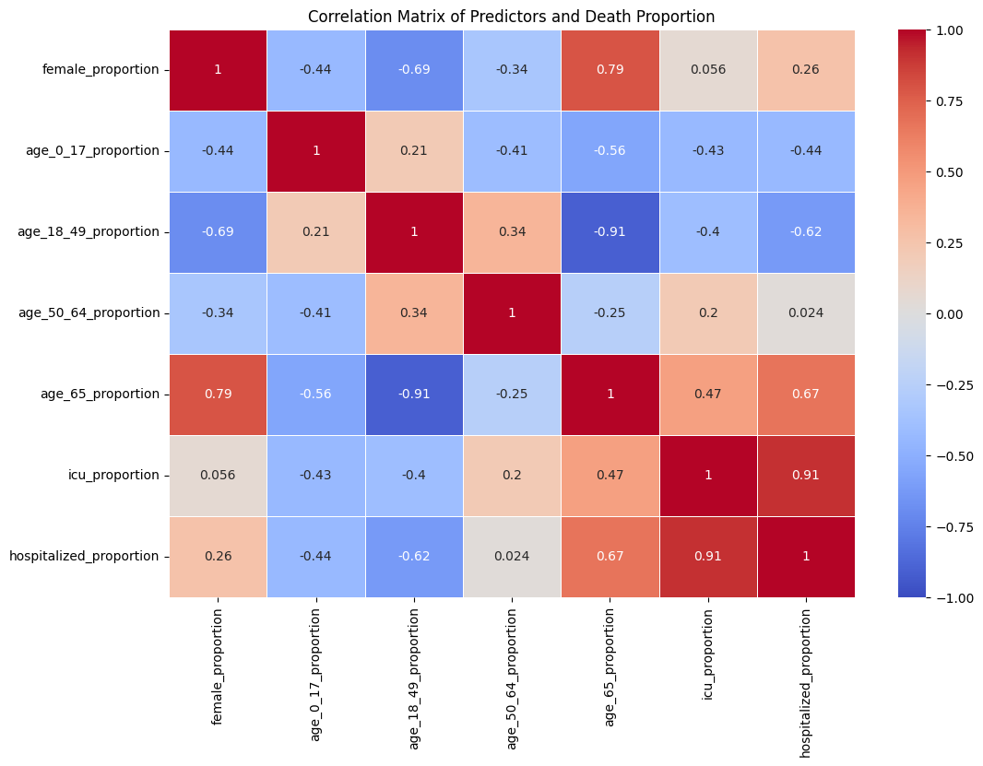
Heatmap

Slide 79
Model Improvement
Higher-Order Terms:
Introduced quadratic terms for each predictor to capture non-linear relationships and improve model fit.
Intercept Management:
Experimented with adding and removing intercepts to observe their impact on model performance, ultimately aiming for the best model fit.

Slide 80
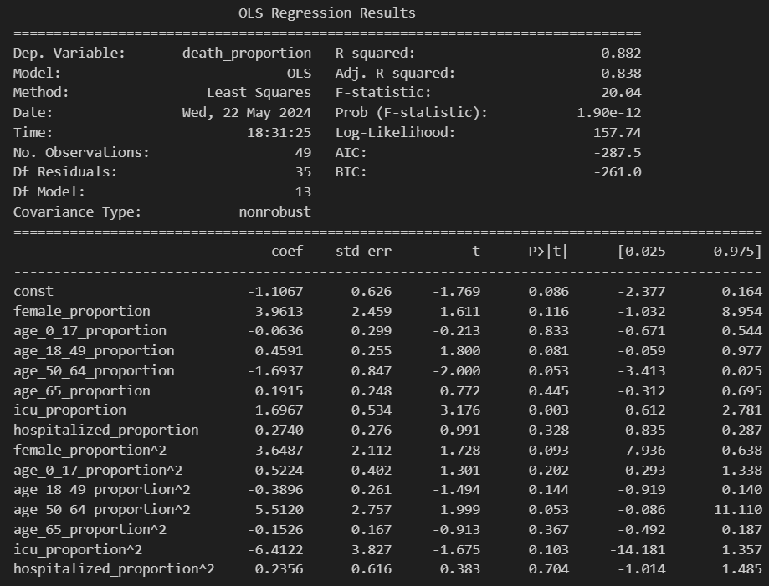
Model after Adding quadratic terms

