Slide 1

Department of Artificial Intelligence and Data Science
JP MORGAN CHASE DATA BREACH –Case Study
Dr. S. SURESH KUMAR, M.E., Ph.D.,
Professor
Sangamithra V 231801147
Moghanapriya R 231801102

Slide 2
Problem Statement and Motivation
Problem Statement:
Large financial institutions face increasing cyber threats targeting sensitive customer data.
Even a single security misconfiguration can expose millions of records.
Traditional security systems often fail due to inconsistent enforcement.
Motivation:
To understand how real-world cyberattacks happen.
To analyze weaknesses in authentication and network security.
To learn how to design secure, scalable, and resilient systems.

Slide 3
Existing System
Relied on traditional perimeter-based security.
Incomplete implementation of Multi-Factor Authentication (MFA).
Lack of uniform security policies across all servers.
Limited real-time monitoring and threat detection.
Weak network segmentation, allowing attackers to move laterally.
Limitation:
One vulnerable server compromised the entire network.

Slide 4
Objectives
Analyze the root cause of the breach.
Understand the role of authentication failures.
Study modern security concepts like:
Zero Trust Security
Network Segmentation
SIEM (Security Monitoring)
Propose improved cybersecurity strategies.
Build awareness of secure system design principles.

Slide 5
Abstract
The JPMorgan Chase breach (2014) exposed data of over 76 million households.
Attackers exploited a server without MFA.
Gained unauthorized access and moved across systems.
No financial data stolen, but personal information was exposed.
This case highlights:
Importance of consistent security implementation
Need for advanced monitoring systems
Critical role of authentication mechanisms

Slide 6
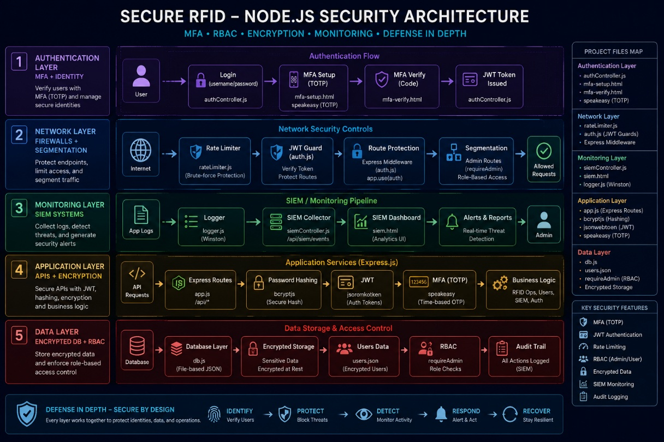
Architecture(framework)
Authentication Layer
Multi-Factor Authentication (MFA)
Identity Verification
Network Layer
Firewalls
Network Segmentation
Monitoring Layer
SIEM Systems
Real-time Alert

Slide 7
Architecture(framework)
Application Layer
Secure APIs
Encrypted Communication
Data Layer
Encrypted Databases
Access Control Policies

Slide 8
Module
Authentication: MFA, Tokens
Access Control: Roles,Least Privilege
Network Security: Firewall,Segmentation
Monitoring: Logs,SIEM
Incident Response: Alerts,Recovery.

Slide 9
Conclusion
Lessons Learned:
Small security gaps can cause massive breaches.
Authentication is the first and most critical defense.
Security must be consistent, continuous, and comprehensive.
Final Conclusion:
The JPMorgan Chase breach is a landmark cybersecurity case.
It transformed security practices: MFA, Zero Trust, and continuous monitoring.
Security is not optional—it is essential.

Slide 10
Thank You

