Slide 1

Making recommendations more accurate
Game Recommendation System
Predict Your Next Game

Slide 2
Motivation
Using SQL queries, build a recommendation system that only works on the user's history.
This project allows understanding the internal working and all the steps required to build a system from scratch and various techniques.

Slide 3
Presentation Outline
Background
Problem Statement
Project Workflow
EDA
Data insights
Model Comparison
Recommendation
Future Scope

Slide 4

Background
In earlier generations, We bought games in the form of media disks like compact disks and player game history stored on the same machine.
Nowadays, more customers are connected digitally to play online games because of the affordable prices of games, the internet, and gaming devices like mobiles, gaming computers, and consoles.
Due to this increasing trend, companies sell games through e-commerce websites or steam platforms which helps customers and gaming companies.
Now player game history and what type of games they played stored on cloud services which gathered by companies.

Slide 5
Problem Statement
The amount of player data generated daily over the cloud, complex for companies to identify current treading games.
Companies cannot provide a user-oriented experience.
Game sales were falling, and less buyer participation.
Solution
Increase Advertising Revenue
Boost sales
Improve user experience
Build an “item to item” similar games recommendation system.

Slide 6
Project Workflow
Data Understanding
EDA
Recommendation
Raw Data (json)
Missing Data
Data Visualisation
Convert json to csv
Data Imputation
Content Based
Data Pre-Processing
Encoding
Collaborative Model
Merge Data
Model Training
Results

Slide 7
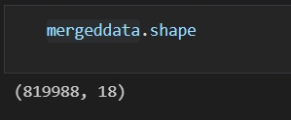
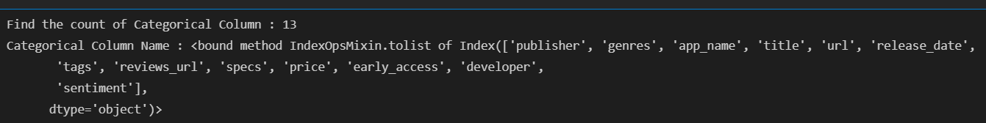
Data Summary
Raw Data : Total Player Data – 88310 (10000) , Game Data (32135)
Merge Data : 819988 rows , 18 columns
Numeric Columns : 5
Categorical Columns : 13

Slide 8
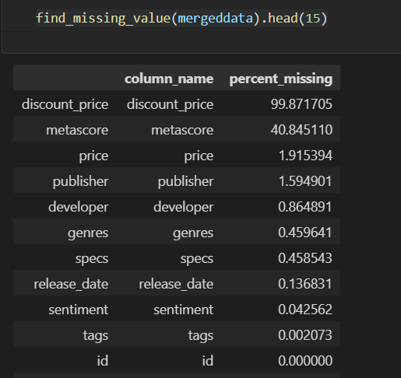
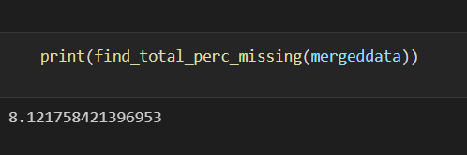
Missing Values :
Total percentage of missing values in merge data : 8.12
Column discount_price have over 50 % missing values in dataset.
Remove the column with more than 50% null values and the rows .

Slide 9
Feature Engineering
Item’s column: This column contains the list of games played with details like game id, game name. So, we extract the game id from items column and create new column as id.
Steam id: These columns have the unique steam platform id for every player. The size of ids is large integer, so we rename the column and recreate the id with counter start from 0 to increment by 1 for better understand to join data.
Owned: Add new column to signify that player owned game or not for better recommendation. If Player owned the value is 1 otherwise 0.
Release_date: This column holds the date on which game was released and its data type is panda series. So, we change its datatype into date. After conversion we extract the year and month into different column for visualization release_date_year and release_date_month respectively.
Title column: This column contains the name of the various game and is presented in the game meta data. As per data exploration we found out that some of the titles are missing and we remove it.
Sentiment: We have 18 different type of reviews, so we transform it into major review as Positive, Negative and mixed review for the games. This is our target variable for the further model training and prediction.

Slide 10
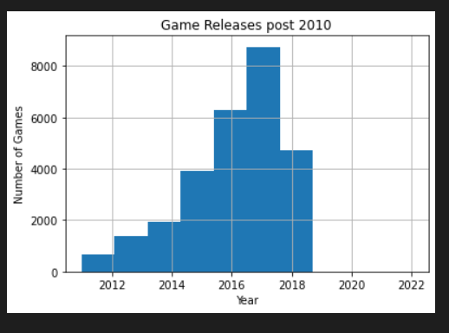
Data Insight
Game Released Period
Most of the games released in last decades, after 2010. We can verify this by graph
Most of the game release in between 2014 to 2018

Slide 11
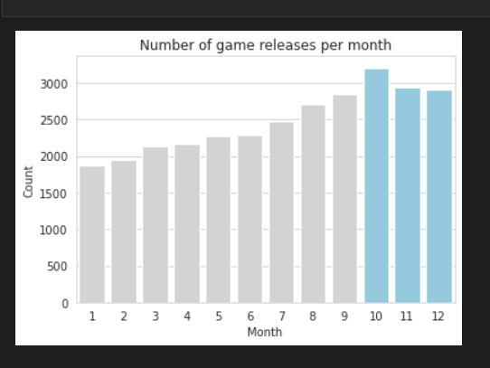
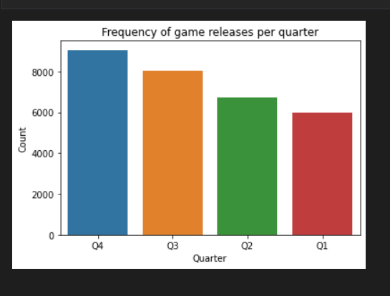
Most game released from September to December month
Most game released in Q4 and Q3

Slide 12
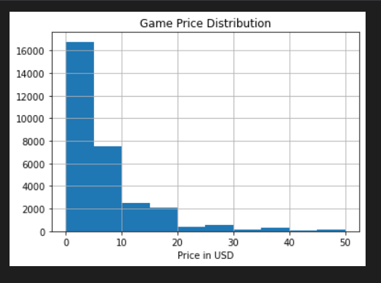
Games Price in USD
Most number of games purchased are in free to 20-dollar range.
From this graph we found out that player prefer more cheaper games to buy.

Slide 13
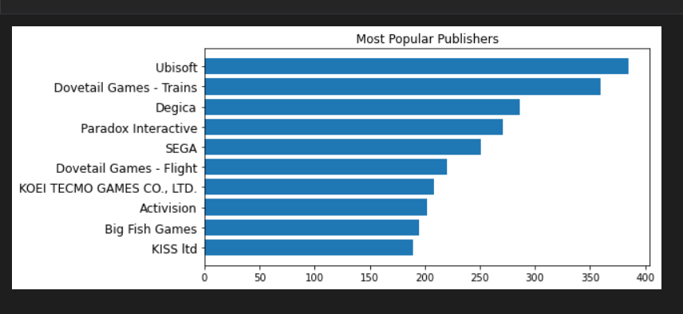
Top 10 Game Publisher Company
Ubisoft publish the greatest number of online games & purchase by players.

Slide 14
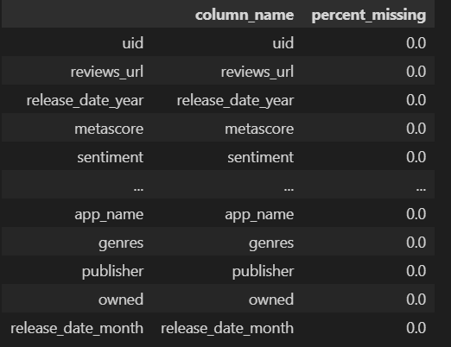
Data Value Imputation
To improve the data set quality and to achieve better accuracy score, I need to remove the remaining null and NAN values from the dataset.
For removing, I am using data value imputer, which fills the numeric values with mean value and categorical values with mode value.
After applying this, now in my dataset I don’t have any null values.

Slide 15
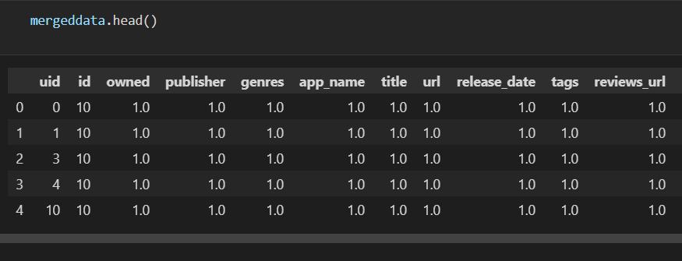
Data Encoding
In our dataset , We have 13 categorical columns and I train model on same but got below 70% accuracy.
When I convert all value to numerical , I achieve better score above 70%.

Slide 16
Type of Recommendation Methods
Collaborative Filtering (CF): In CF method works on the assumptions and gathers the user inputs like search keyword, some survey, user opinion, rating of the items and then a user profile is generated and mapped with the other user profile to recommend the same things.
Content-based Filtering (CB): In the CB approach, the recommendation learns the user patterns in the history of choices and predicts the product dynamically.
Hybrid Filtering (HF): The HB process combines the collaborative and content-based filtering and combines both the result and use once output into another filtering for a better recommendation.

Slide 17
Best Method
Hybrid suits best for my recommendation engine because it address both the content as well as collaborative recommendation technique.
As per the research, Light FM library which works best with hybrid model and generate good quality recommendation.
In player data set, we have player history, what game player purchased.

Slide 18
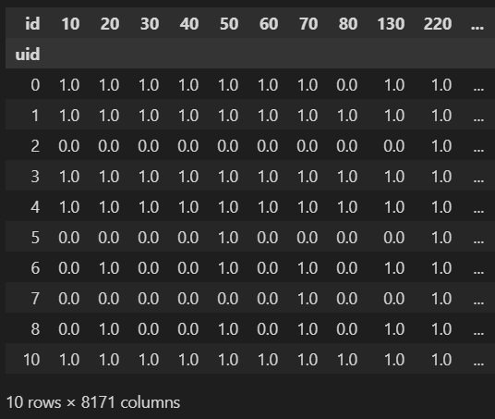
Recommendation Working
Interaction matrix will be generated between player and game. This matrix identifies whether a player-owned the game or not.
This matrix tends to have blank values where player and game interaction was null; therefore, solving this problem of sparsity data was imputed for further arithmetic operations.
This matrix is used as model input in the Hybrid system to generate recommendations.

Slide 19
Model Hyper Tuning
N_components | Precision | AUC score
10 | 0.67 | 0.97
30 | 0.80 | 0.96
50 | 0.76 | 0.99
We break down the data into Train and test as 80 and 20 percent, respectively. To achieve better accuracy and choose the best model components, we apply hyper tuning.
Let us compare the tuning effect on the model results based on the various number of n_components.
As per tuning, the model performs better with values of 30 n_components with balanced Precision and AUC scores.

Slide 20
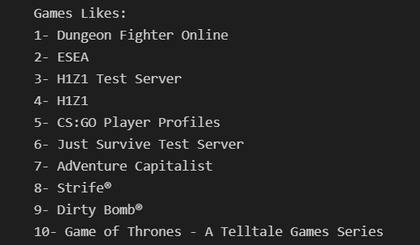
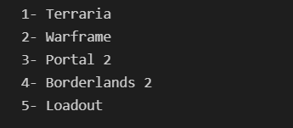
Recommendation to Existing User
Games Owned by Player
Recommended Game

Slide 21
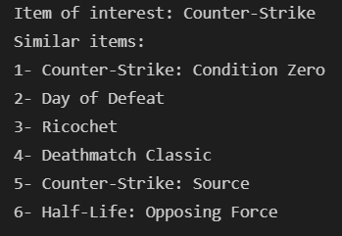
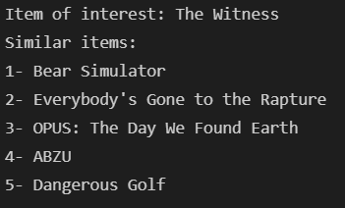
Item To Item Recommendation
Based on the game id , recommendation generated

Slide 22
Model Comparison
Model | Scaler | PCA | Normalization | SMOTE
Decision Tree | Less Error | Low Accuracy | No Effect | Improve Accuracy
Random Forest | Less Error | Worst Accuracy | No Effect | Improve Accuracy
SVM | Less Error | Worst Accuracy | No Effect | Improve Accuracy
Class Imbalance Problem: There is a problem of class imbalance in the target variable because this model is always biased to the majority class. To fix this, We have applied various parameters as below.
Using this chart, we compare the results of each parameter and check the improved accuracy of the model and less biased results.
Smote worked better with all the models and did not impact the model quality, increasing accuracy to over 70%.

Slide 23
Model Based Result Comparison
Model | Accuracy | Precision(1|2|3) | Recall (1|2|3) | F1-Score (1|2|3)
Decision Tree | 0.87 | 0.97|0.04|0.44 | 0.90|0.14|0.80 | 0.93|0.07|0.57
Random Forest | 0.91 | 0.99|1.00|1.00 | 1.00|0.59|0.80 | 0.99|0.74|0.89
SVM | 0.93 | 0.98|1.00|1.00 | 1.00|0.47|0.80 | 0.99|0.64|0.89
Random Forest and SVM perform better because of the better Precision and F1-Score
Precision: The model correctly predicted the positive case.
Recall: Percentage of prediction of the positive case correctly.
F1-Score: Combination of the Precision and Recall metric

