Slide 1
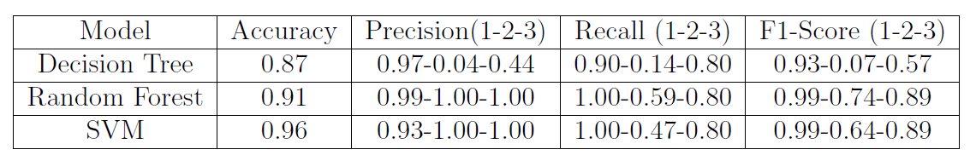
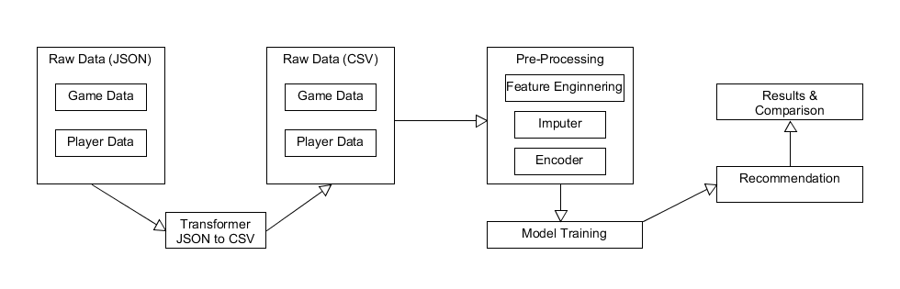
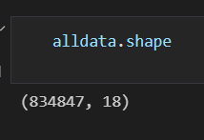
Making recommendations more accurate
Student: 100344954, Supervisor: Dr. Jeannette Chin
School of Computing Sciences, December 2021
Aim and Objectives
We create a dynamic RT system that works for both players, new and old, which favor the items based on the player performance and user rating. Objectives are :
We need to research and find out the best model to apply and generate recommendations
Develop the recommendation model based on the Hybrid model.
Methods
Hybrid Filtering: combination of both content and collaborative filtering methods.
Model Based : Using the SVM , random forest , decision tree classification model and trained on merged dataset.
Experiment Results
Likelihood Classification and Recommendation
Model Based : Random Forest and SVM performs better than the SVM
Recommendation : Using the LightFm , generated the results for New and old players.
Data
Two data sets were collected for this study from the steam game platform with player data and game meta. Once all the EDA steps performed we merged the both dataset.
Figure 2. The comparisons of the classification performance
Conclusions
In model based , accuracy of the decision tree and the random forest is 0.87 and 0.92, respectively.
We can be able to generate recommendation using player old history and for new player. We are showing it user to user and item to item .
We can create the website that use the same model.
Figure 1. The Flow Diagram of the Project
System Design/Experiment Design
A hybrid filtering was build using the LightFm library.
Using the benchmark parameter to compare the results like Precision, Recall , F1-Score and Accuracy.
MSc Dissertation 2012-13
MSc Course: Computing Science, or ACS, IS, GD, KDD or CmpBio

