Slide 1
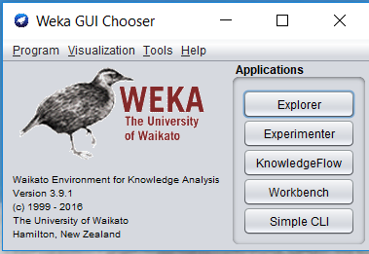
Weka Workflow
Open WEKA. This menu should pop up. Press the Explorer button

Slide 2
Weka Input file
Weka takes an input file in a special format -- .arff
Open up the .arff file (found on Canvas) with Excel or a plain text editor (such as Wordpad).
Important features of the .arff file:
Right below the @data line, each instance is listed with its feature values separated by commas.
The header (top of the file) lists the name of the features and what type they are (numeric, string, etc.). The features are listed in the order they appear in each instance.

Slide 3
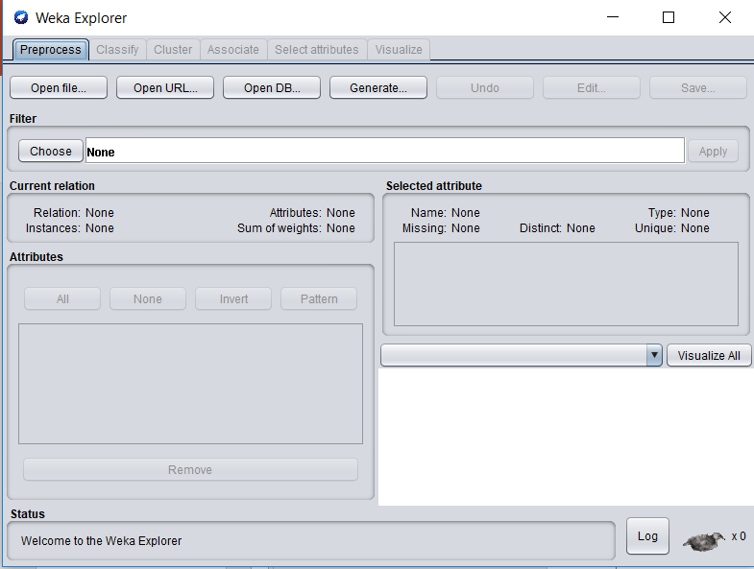
First we must load the .arff file
(Navigate to where your .arff file is an load it in)

Slide 4
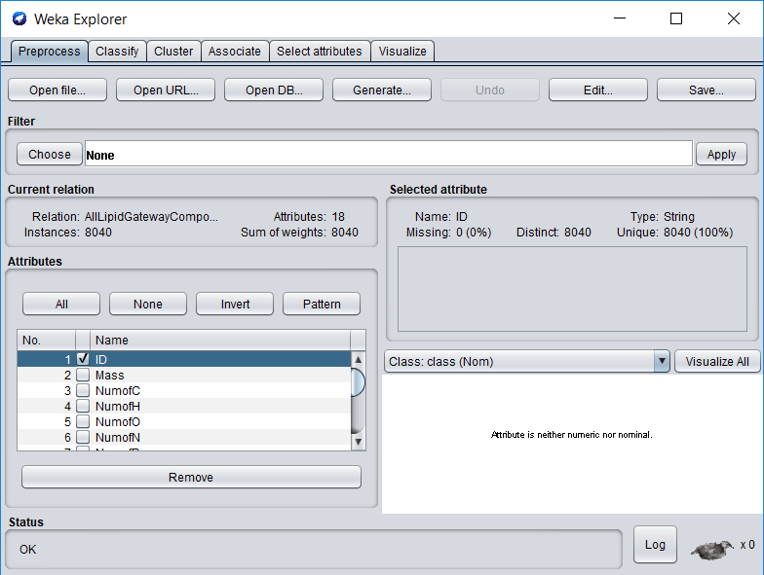
Remove ID (we’ll add it back in later)
Check the box and hit Remove

Slide 5
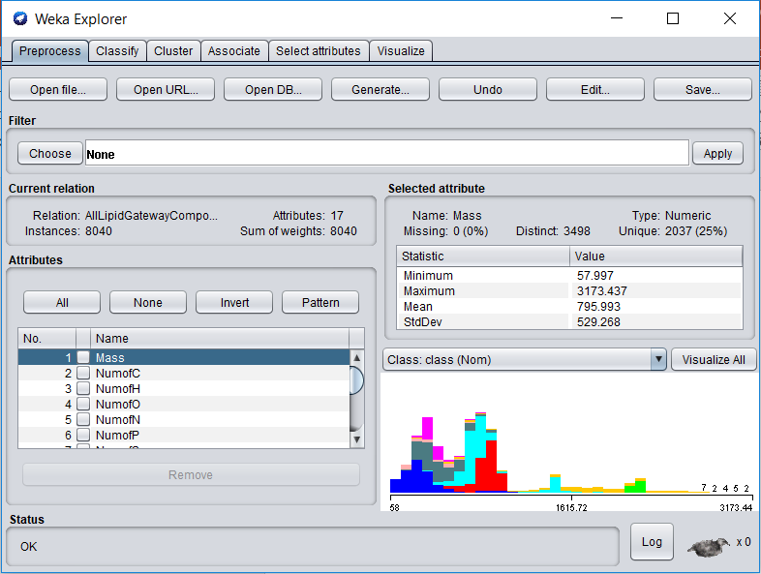
Look at Feature Distributions
Click this

Slide 6
Analyze!
It’s very important to have features that distinguish among your classes. Which features differentiate one class (or multiple classes) from the others?

Slide 7
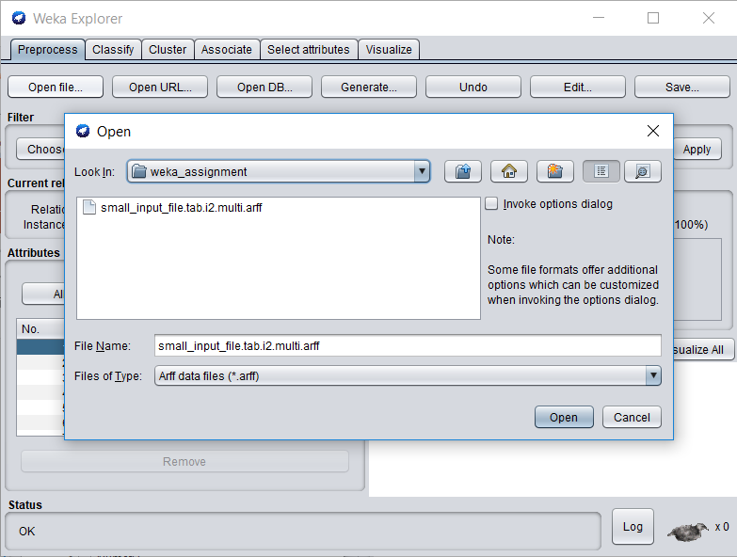
Reload .arff to add back ID
1) Click this
2) This box should appear
3) Click this

Slide 8
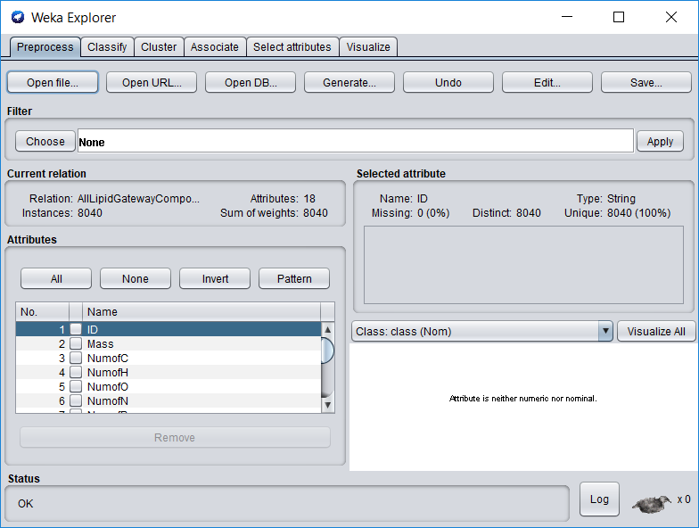
Add some filters
Once the window is open, click on the arrows to see various available options

Slide 9
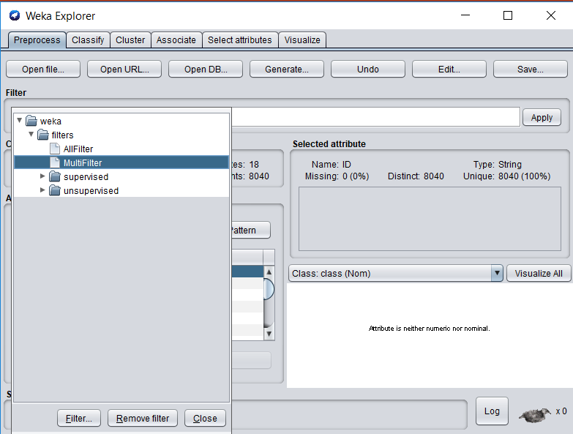
Select Multifilter
To find Multifilter: Open the filters folder. This allows us to select multiple subsequent filters.

Slide 10
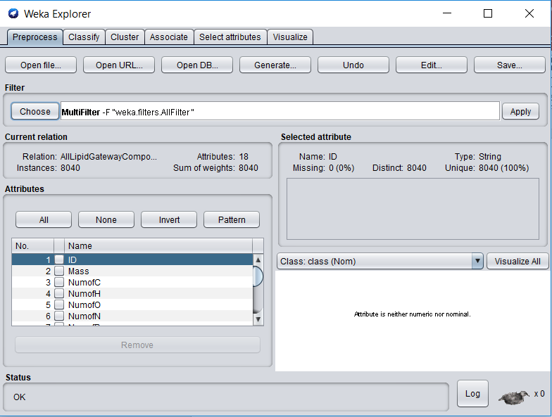
You must Click Apply to Add Filters
Click Apply

Slide 11
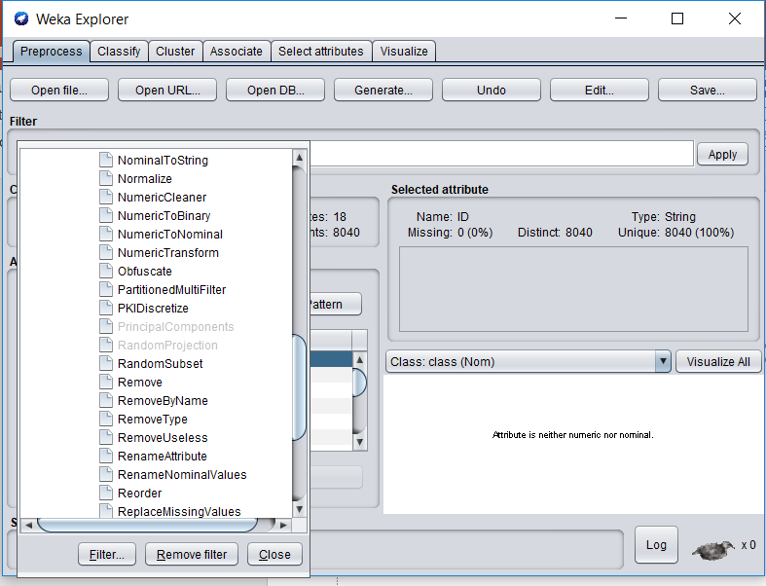
Select RemoveType
To find RemoveType: Open filters, then Unsupervised, then Attribute. Scroll down.
This filter will make sure Weka doesn’t think the instance ID is a feature for classification.
Remember to Click Apply after you’ve selected it!!!!!!!

Slide 12
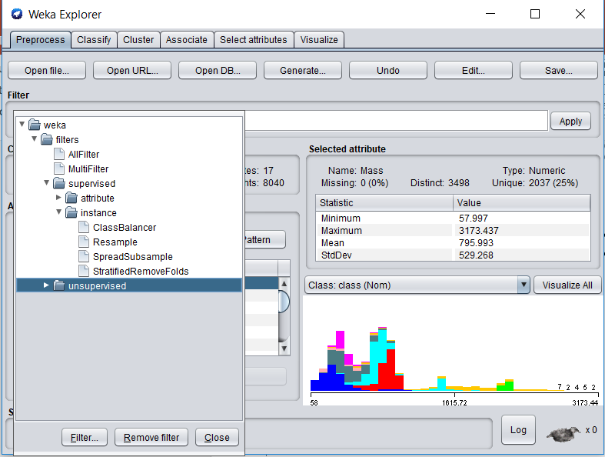
Select SpreadSubsample
To find SpreadSubsample: Click on filters, then Supervised, then instance. This will make sure that there is a maximum ratio between the largest and the smallest class represented in any given cv fold.
DON’T click Apply yet!!!!!!

Slide 13
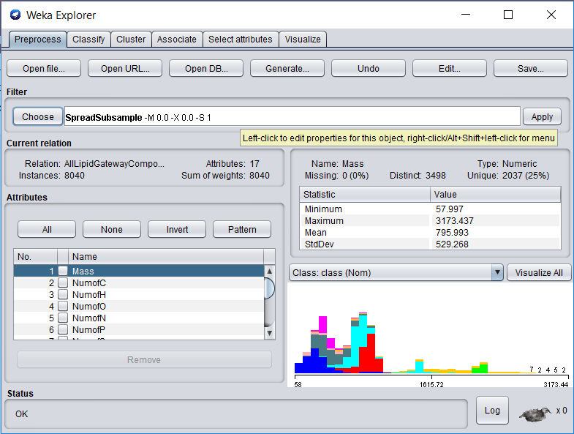
Right Click to edit the parameters of your filters
Right click here

Slide 14
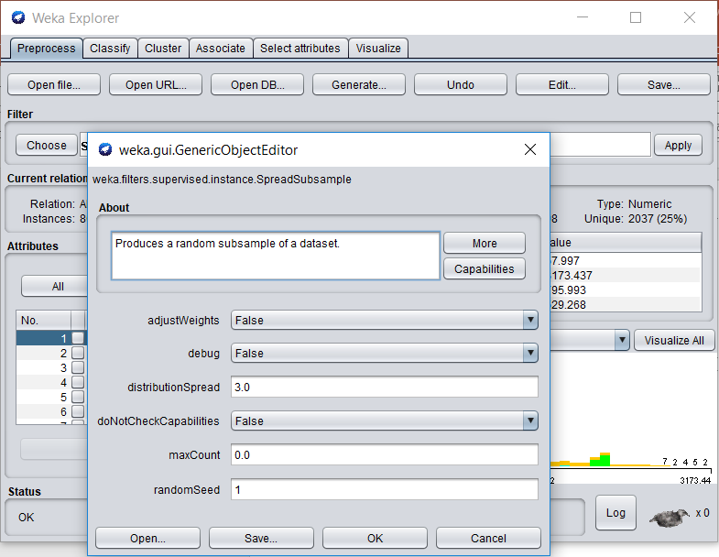
This box should pop up
3) Click Apply
1) Change this to 3. The largest class will be a max of 3x larger than the smallest class
2) Click OK

Slide 15
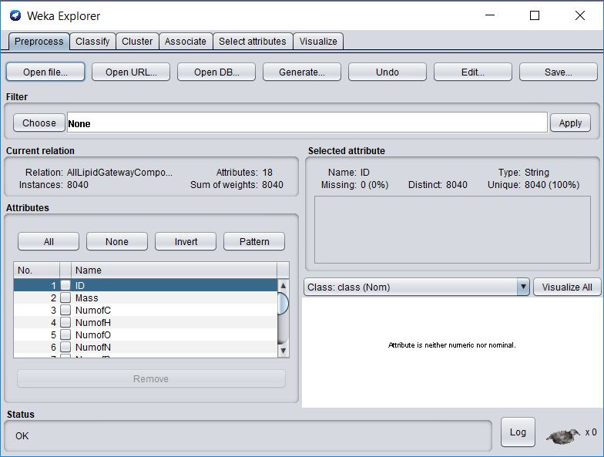
Head to the Classify Tab

Slide 16
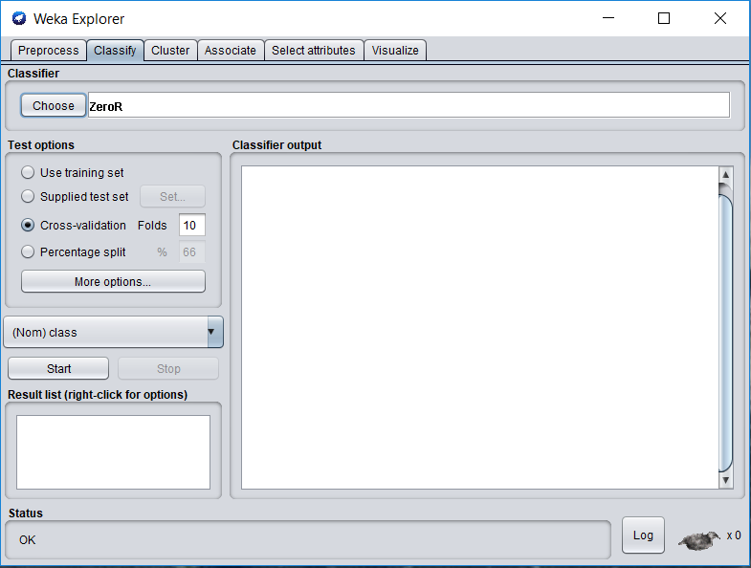
Now we’re going to choose a classifier!
Click this button to choose your classifier

Slide 17
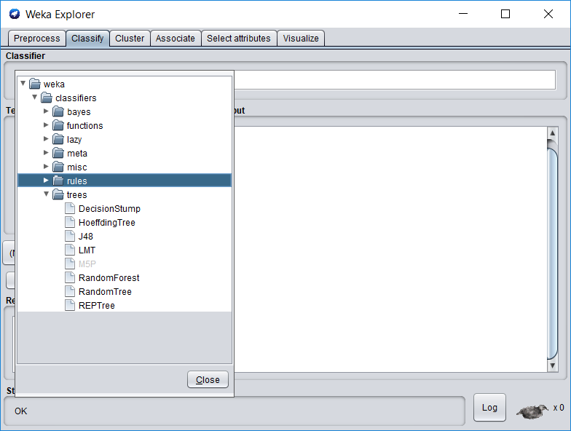
We’ll use Random Forest
To find Random Forest, open trees.

Slide 18
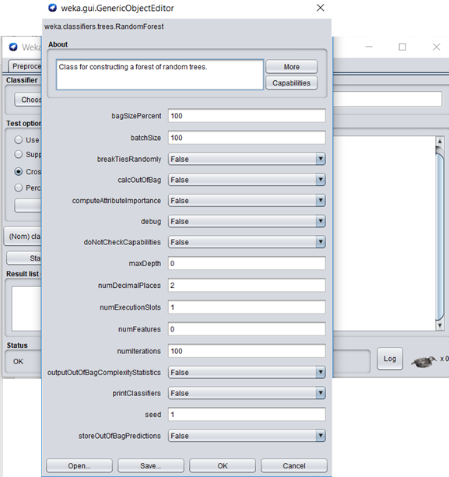
Right click on the panel to bring up this menu
Right click on this

Slide 19
Change parameters of Random Forest
Change this to ‘True’. We want to see how important each feature is for classifying.
Change this to 5.
Random Forest will randomly choose 5 features to look at for each split.
After changing those 2, click OK

Slide 20
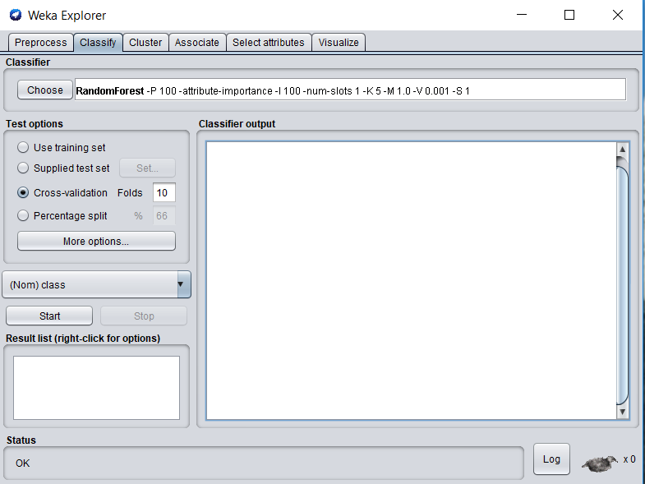
Next click ‘More Options’

Slide 21
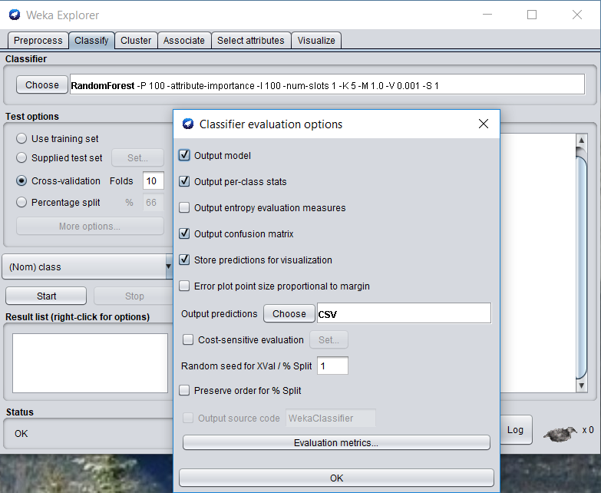
We want to output the prediction of each instance as a .csv file
Click ‘Choose’ and select CSV
Then click OK

Slide 22
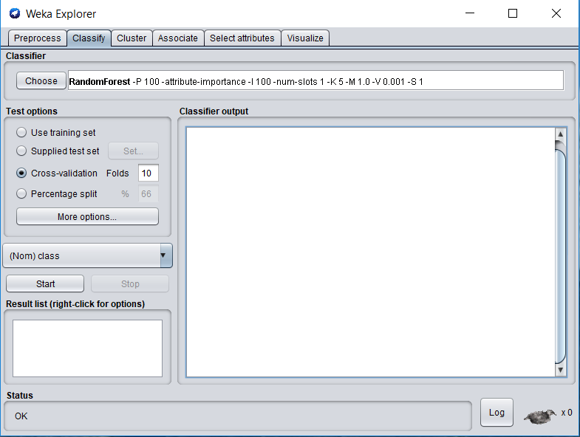
Now We’re ready to classify!
Your screen should look like this, by the way.
Click Start

Slide 23
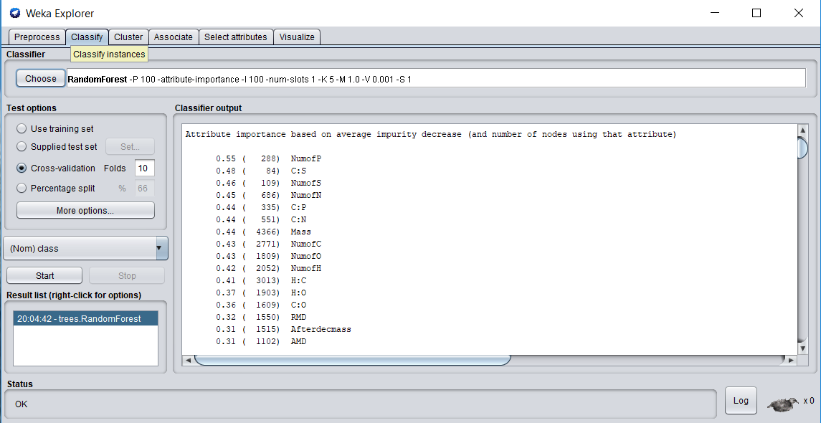
Let’s look at the output!
Here’s attribute importance, calculated via Gini index

Slide 24
Gini index
All ML classifiers operate by minimizing some classification error. For example, linear regression makes a “line of best fit” by minimizing the Sum of Squared Error between the line and all the points it is fitting.
Classification tree algorithms (like Random Forests) try to minimize the Gini Index (or perhaps the Cross Entropy / Information Gain). For a detailed explanation of the Gini Index, see here.

Slide 25
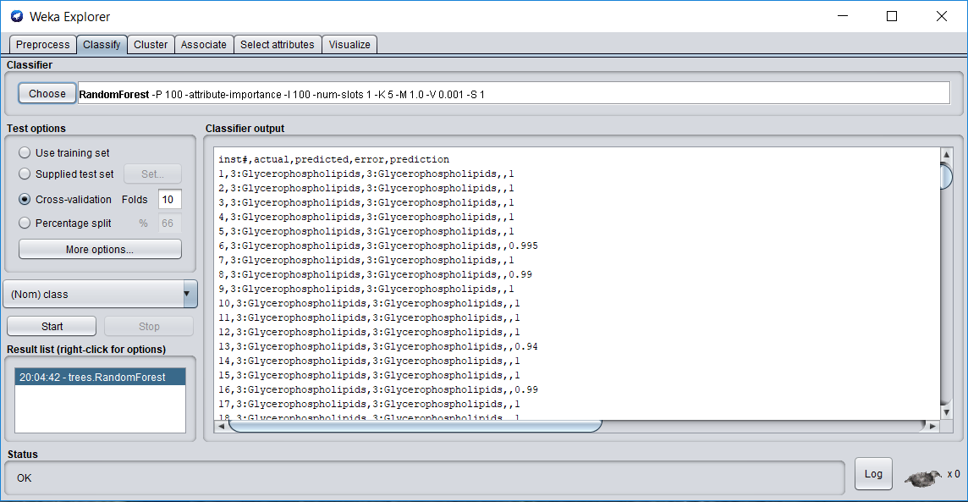
Here’s the prediction and prediction probability of each instance

Slide 26
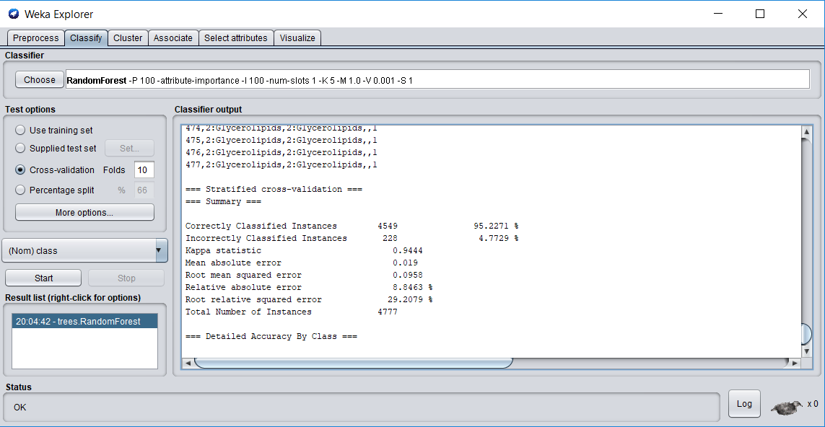
Here are some stats on overall performance

Slide 27
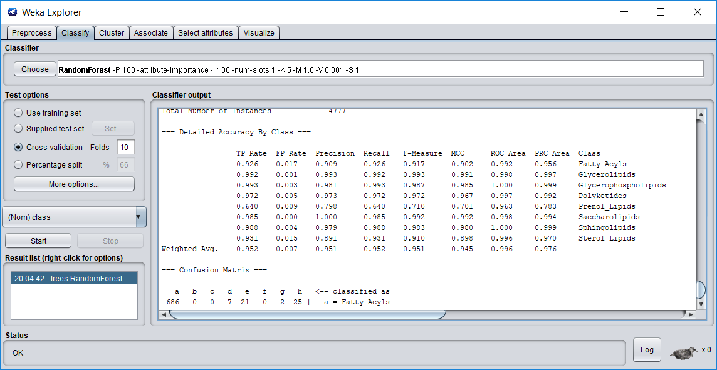
Important stats for each class

Slide 28
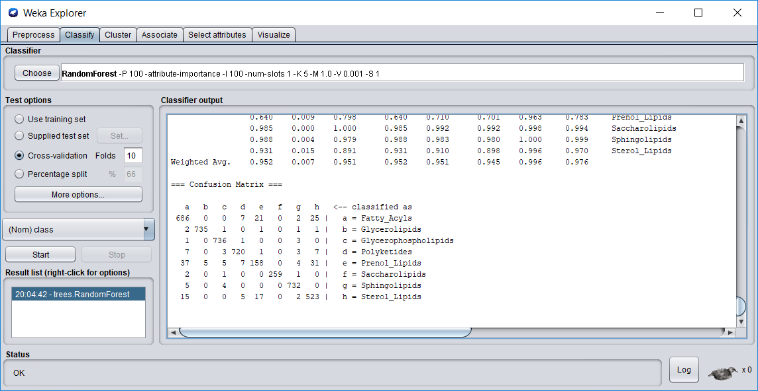
And finally the confusion matrix

Slide 29
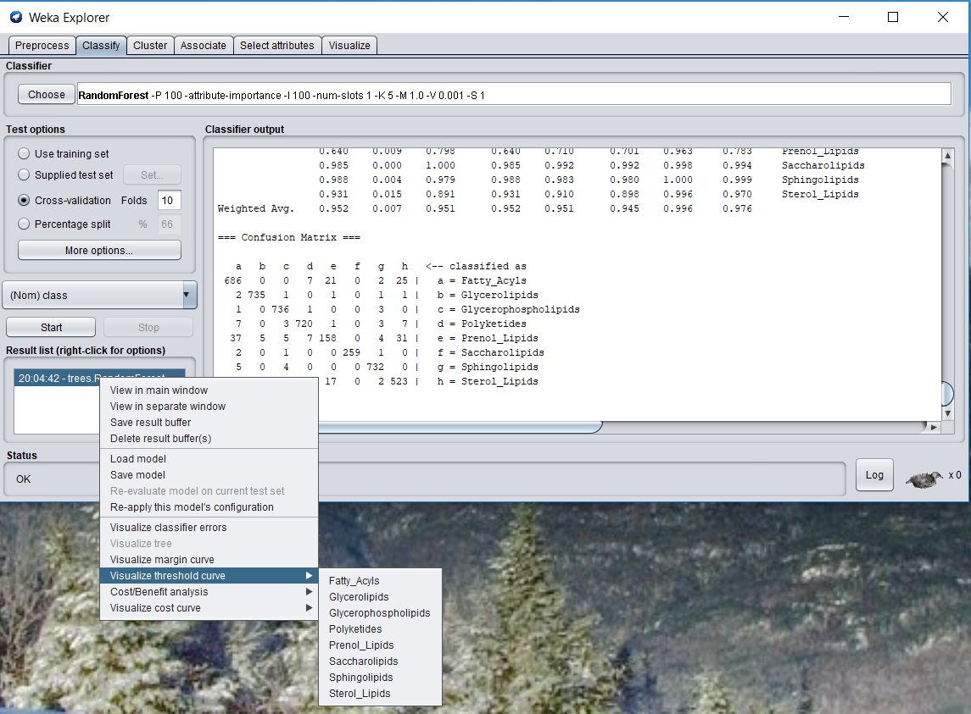
Some more things to look at: AUROC plots
Right click on the highlighted text in this box
Here you can view AUROC plots and other curves
Select a class to view its curves

Slide 30
AUROC plots – what are they showing?
There’s a lot that goes into these plots. A good explanation of all it shows is here.

Slide 31
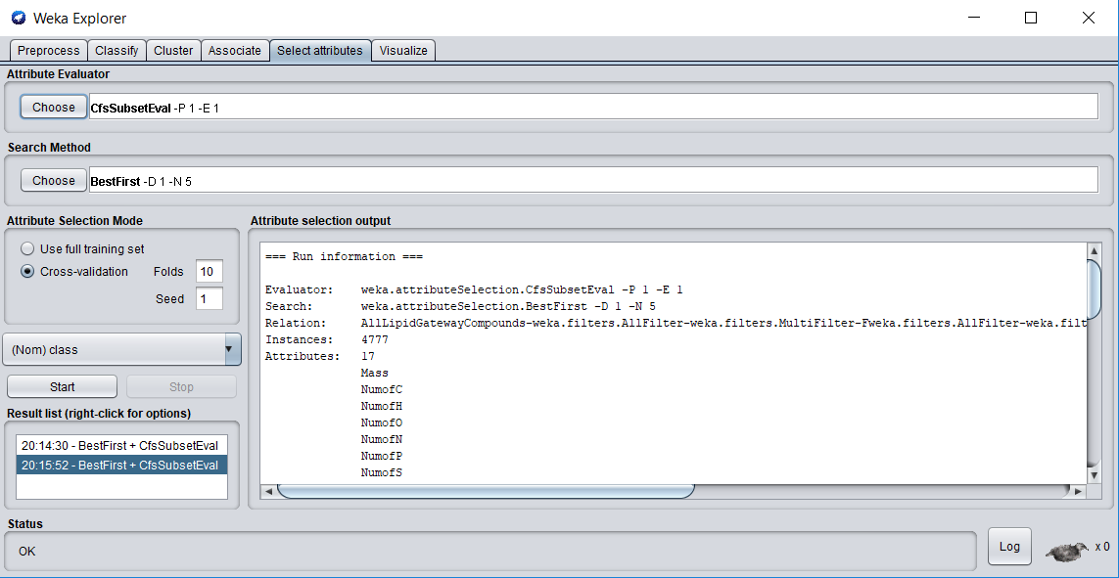
Some more things to look at: Attribute Importance
1) Head to this tab
2) Select your choices for both of these
3) Start!
Your results here may differ from the results we saw earlier….

Slide 32
WEKA can also be used on the command line!
XSEDE does not have Weka, so we will have to download it. On XSEDE, navigate to your folder on pylon5 (or wherever it is you want weka to be downloaded to).
Type: wget https://sourceforge.net/projects/weka/files/weka-3-8/3.8.4/weka-3-8-4-azul-zulu-linux.zip
It should take several minutes to download.
It will make a zipped folder when done. Unzip it.
Upload the arff file we used previously onto XSEDE.

Slide 33
How to train a model on the Command Line?
First you will need your training arff (which you just uploaded onto XSEDE on the last slide), and an idea of what ML model you want to use for training. We’ll use the same model we used above, on the GUI.
Let’s bring up the manual explaining weka’s command line arguments. Go into the weka-3-8-4 folder, and type:
java -classpath './weka.jar' weka.classifiers.meta.FilteredClassifier

Slide 34
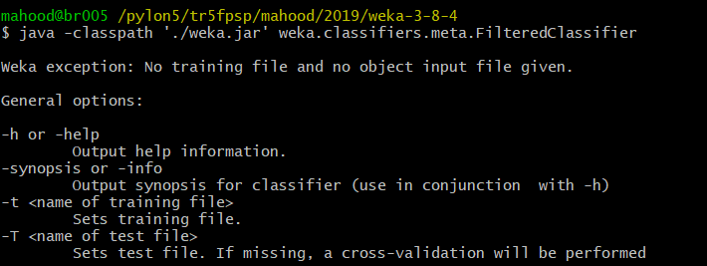
You should see this:
Go through this output. Make sure you know what –t , -W, -c, and –F do.

Slide 35
Now let’s make our model in the Command line
We want to add the same filters (MultiFilter, RemoveType, and SpreadSubsample) and the same model (Random Forest)
For convenience, the command is on the next slide. Make sure you replace <path-to-training-file> with the path to your arff, and <path-to-output> with the path to where you want the output to go.
Make sure it is all ONE line (not multiple) before you run it.
If you still get strange activity, you might have to write it all out on XSEDE (so no copy-paste). This is probably because Powerpoint substitutes strange characters into text.

Slide 36
Full Command
java -classpath “./weka.jar" weka.classifiers.meta.FilteredClassifier -t <path-to-training-file> -c last -p 1 -distribution -F "weka.filters.MultiFilter -F \"weka.filters.supervised.instance.SpreadSubsample -M 4\" -F \"weka.filters.unsupervised.attribute.RemoveType -T string\"" -W weka.classifiers.trees.RandomForest -- -I 100 -K 5 -S 1 > <path-to-output>

Slide 37
At home/future exercise
Now that we have a trained model, how can we use it to classify new data (perhaps use it to classify instances whose class we don’t already know)?
Follow this link!
https://machinelearningmastery.com/save-machine-learning-model-make-predictions-weka/
(We already did Step 1 in this article, so you would start at Step 2).

