Slide 1


Algorithms for Predictive Plant Monitoring
Umut Çakır
Muhammed Orhun Gale
A. Ozan Biçen
Nihal Öztolan Erol
Stuart J. Lucas
04.08.2020

Slide 2

Smart Agriculture
Industry 4.0 in Agriculture = Agri-Food 4.0
Big Data – IoT – Machine Learning – Automation – Blockchain
Algorithms -> Analyze/process/predict (Sarkaç, August 2020)

Slide 3
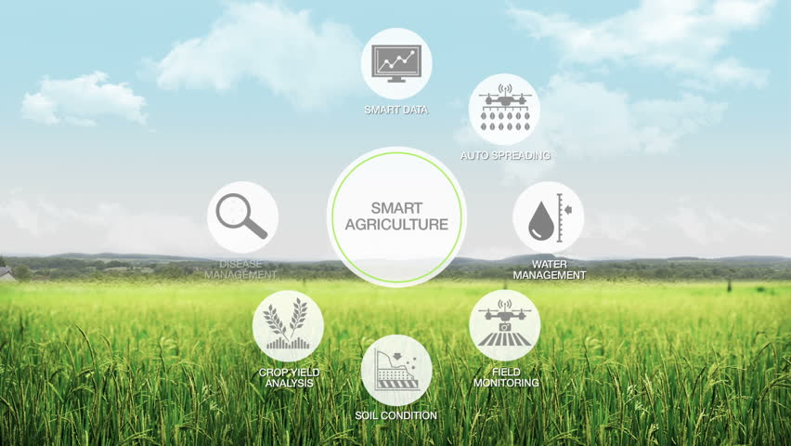
Shutterstock

Slide 4
Crop Yield
Basically, numbers of seed harvested, and seed sown
Resistance to alterations = High yield in any case
Water limitation – a factor affects the yield (Fao, & Dwfi)
Osmotic stress tolerance – plant’s genotype (Oktem et al.,2006, pp. 194-203)

Slide 5
Theoretical Framework
Since, better osmotic tolerance = high yield → Detecting T. durum wheat which have better osmotic stress tolerance
Analyzing the data by ML algorithms → Detect the candidate plants which have appropriate fenotype

Slide 6
Methodology/Case
Analyzed T. Durum and its relatives from Tarla Bitkileri Merkez Araştırma Enstitüsü Ankara, Turkey
19 different genotypes, multiple samples which multiple lines were produced by back-crossed and self-fertilization
For each they are growed under osmotic stress and well-watering conditions for 5 days. 3rd and 5th day data collected
Root Length – Root Volume – Surface Area – Average Diameter – No. of Tips → GMM used

Slide 7
Background/Literature Review
High-throughput SNP genotyping of modern and wild emmer wheat for yield and root morphology using a combined association and linkage analysis (Budak et al.,2017 ,pp. 667-685 )
Osmotic Stress Tolerance in Plants: Transgenic Strategies (Oktem et al.,2006, pp. 194-208)
Yield gap analysis of field crops (Fao, & Dwfi)

Slide 8

Our Data
DATA
TREATMENT
WELL-WATERED (WW)
OSMOTIC STRESS (OS)
X day after sowing
3rd Day
5th Day
3rd Day
5th Day
FOR EACH:
LENGTH – CM (L)
SURFACE AREA-CM2 (SA)
AVERAGE DIAMETER – MM (AVD)
ROOT VOLUME - CM3 (RV)
NUMBER OF ROOTS (TIPS)

Slide 9
Briefly:
 |  | Well-Watered, 3 DAS
Sample ID | Rep ID | L (cm) | SA (cm2) | AvD (mm) | RV (cm3) | Tips
AS3 | a | 7,057 | 1,6756 | 0,7558 | 0,032 | 12
AS3 | b | 15,3137 | 2,903 | 0,6034 | 0,044 | 9
AS3 | c | 18,9329 | 3,6129 | 0,6074 | 0,055 | 33
AS3 | d | 15,518 | 3,2231 | 0,6611 | 0,053 | 8
AS3 | e | 12,2101 | 2,0658 | 0,5385 | 0,028 | 5
 |  | Osmotic Stress, 3 DAS
Sample ID | Rep ID | L (cm) | SA (cm2) | AvD (mm) | RV (cm3) | Tips
AS3 | a | 12,5811 | 2,3156 | 0,5859 | 0,034 | 5
AS3 | b | 2,84 | 1,1538 | 1,2932 | 0,037 | 6
AS3 | c | 9,4126 | 1,9157 | 0,6478 | 0,031 | 6
AS3 | d | 12,2128 | 3,8438 | 1,0018 | 0,096 | 26
 |  | Well-Watered, 5 DAS
Sample ID | Rep ID | 26,5449 | 4,0625 | 0,4871 | 0,049 | 12
AS3 | a | 22,5236 | 3,49 | 0,4932 | 0,043 | 9
AS3 | b | 25,1873 | 3,965 | 0,5011 | 0,05 | 124
AS3 | c | 33,491 | 7,883 | 0,7492 | 0,148 | 12
AS3 | d | 16,0203 | 2,9222 | 0,5806 | 0,042 | 5
 |  | Osmotic Stress, 5 DAS
Sample ID | Rep ID | 18,825 | 2,8485 | 0,4816 | 0,034 | 24
AS3 | a | 16,6493 | 2,662 | 0,5089 | 0,034 | 23
AS3 | b | 9,1081 | 1,8988 | 0,6636 | 0,032 | 13
AS3 | c | 16,3603 | 3,3105 | 0,6441 | 0,053 | 12

Slide 10

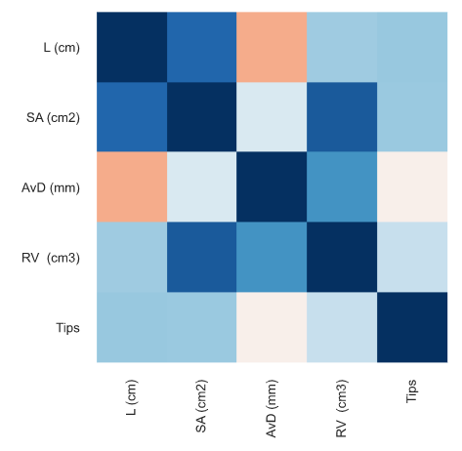
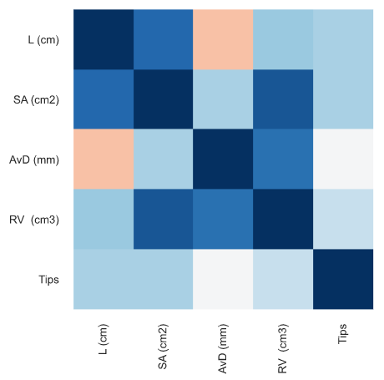
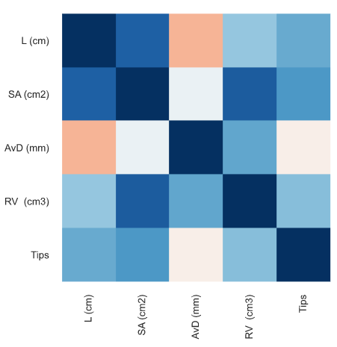
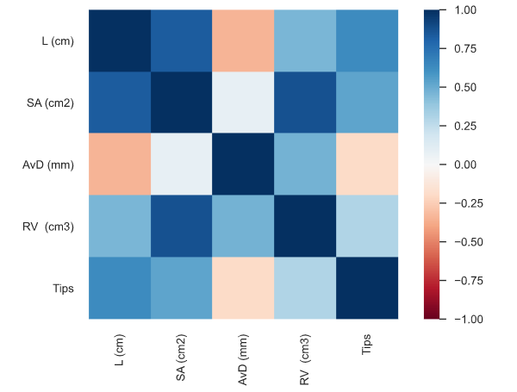
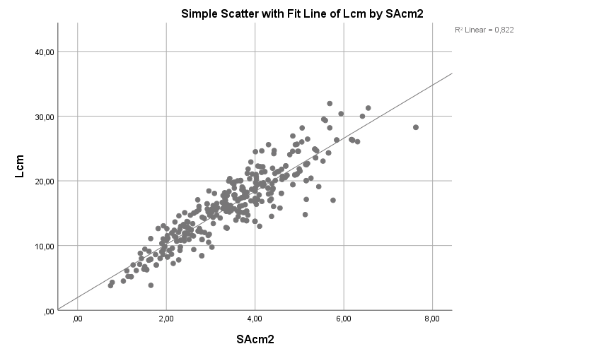
Surface Area Increases, Length Increases.
WW3
WW5
OS3
OS5

Slide 11
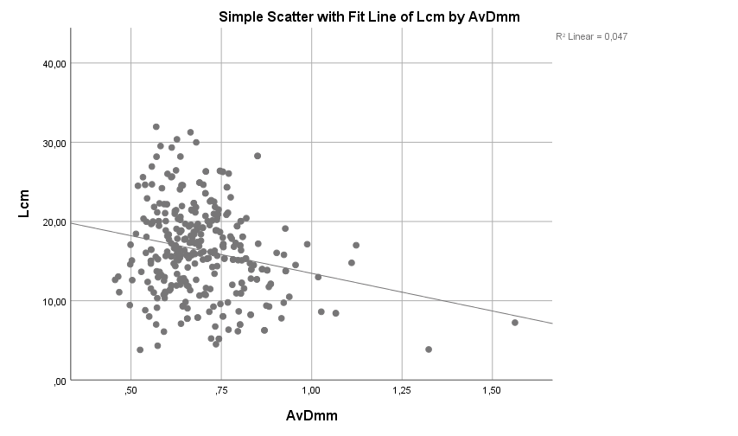
Average Diameter Increases, Length Decreases
OS3
OS5
WW3
WW5

Slide 12
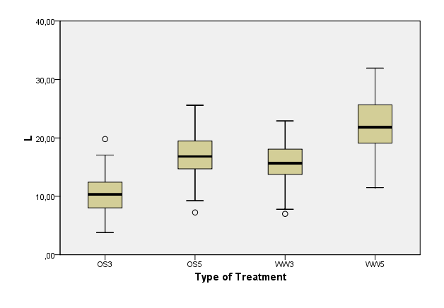
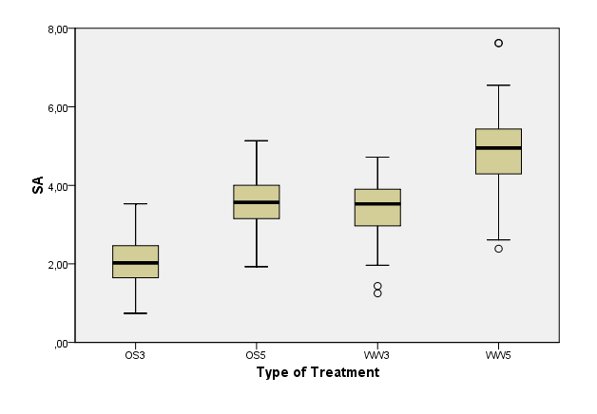
Compare Treatments On Different Days
***
***
***
***
10,34 16,82 15,67 21,84
2,02 3,57 3,53 4,95
*** : p < 0.001
L & SA is statistically significant on different days for both OS and WW.

Slide 13
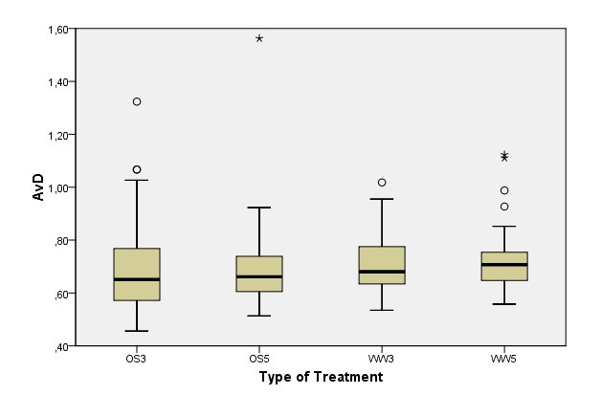
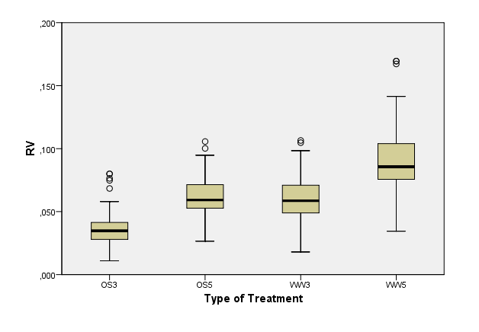
AvD is NOT Significant, but RV is Significant
***
Not Significant
Not Significant
***
p = 0.75
p = 0.37
0,65 0,66 0,68 0,71
0,03 0,06 0,06 0,09
AvD is not statistically significant, but
RV is statistically significant on different days for both OS and WW.

Slide 14
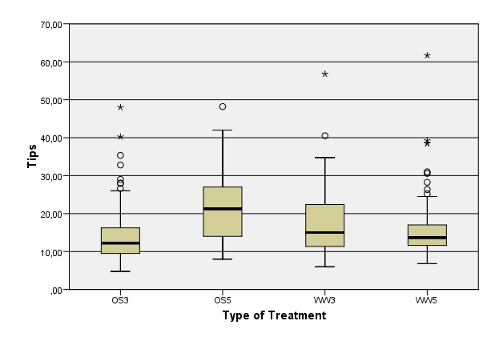
Tips is significant for OS, but not for WW.
 | OS | WW
L | ✅ | ✅
SA | ✅ | ✅
AvD | ✖ | ✖
RV | ✅ | ✅
Tips | ✅ | ✖
Not Significant
p = 0.38
***
12,20 21,25 15,00 13,67

Slide 15
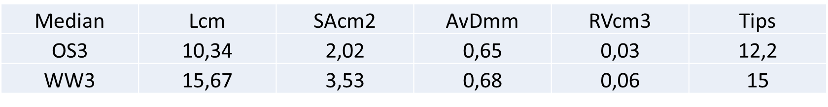
Compare Treatments On the Same Days
p = 0.10
p = 0.06
***
***
***
***
***
***
***
***
***
***
***
***
***
***
 | 3 DAS | 5 DAS
L | ✅ | ✅
SA | ✅ | ✅
AvD | ✖ | ✖
RV | ✅ | ✅
Tips | ✖ | ✅
Notes:
P = 0.06 Random sampling error ?

Slide 16

What is next ?
In OS3, but look like WW3

Slide 17
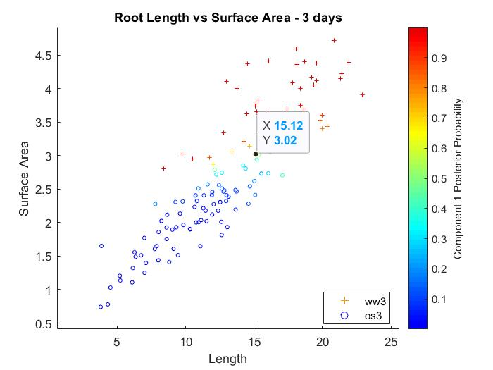
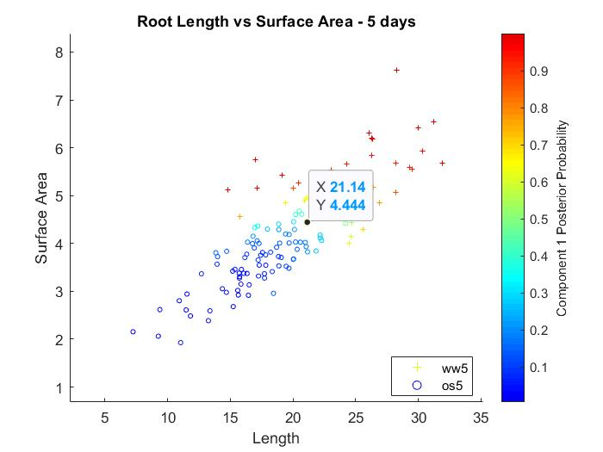
AS205

Slide 18


Slide 19
References
Budak, H. (2017). High-throughput SNP genotyping of modern and wild emmer wheat for yield and root morphology using a combined association and linkage analysis. Functional & Integrative Genomics, 17.(pp. 667-685) http://doi.org/10.1007/s10142-017-0563-y
Fao, & Dwfi. (n.d.). Yield gap analysis of field crops: Methods and case studies. Retrieved from www.fao.org/publications
Oktem, H., Eyidoøan, F., Selçuk, F., da Silva, J., & Yücel, M. (2006). Osmotic Stress Tolerance in Plants: Transgenic Strategies (pp. 194–208).
https://ak.picdn.net/shutterstock/videos/31228321/thumb/4.jpg
Tarımda dijital (yani sayısal) dönüşüm - Sarkaç. (n.d.). Retrieved 3 August 2020, from https://sarkac.org/2020/07/tarimda-dijital-yani-sayisal-donusum/

