Slide 1
Data Structures and Algorithms (CS210/ESO207/ESO211)
Lecture 1:
An overview and motivation for the course through some concrete examples.

Slide 2
Prerequisite of this course
A good command on Programming in C
Programs involving arrays
Recursion
Linked lists (preferred)
Fascination for solving Puzzles
Hard work

Slide 3
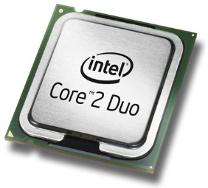
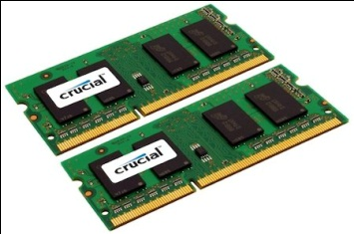
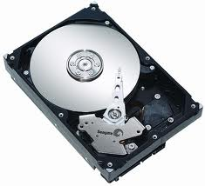
Let us open your desktop
A processor (CPU)
speed = few GHz
(a few nanoseconds to execute an instruction)
Internal memory (RAM)
size = a few GB (Stores few million bytes/words)
speed = a few GHz(a few nanoseconds to read a byte/word)
External Memory (Hard Disk Drive)
size = a few tera bytes
speed : seek time = miliseconds
transfer rate= a billion bytes per second

Slide 4
A simplifying assumption for the rest of the lecture
It takes around a few nanoseconds to execute an instruction.
(This assumption is well supported by the modern day computers)

Slide 5
Efficient Algorithms

Slide 6
What is an algorithm ?
A finite list/sequence of well defined instructions required to solve a given computational problem.
(We shall see more precise definition in Lecture 2)

Slide 7
Why do we care for Efficient Algorithms when we have Processors running at gigahertz?

Slide 8
Problem 1: Bit-sum-prime numbers
Definition: A positive integer is said to be bit-sum-prime if the sum of its bits is a prime number.
Examples: 6 (110) is bit-sum prime.
7 (111) is bit-sum prime.
29 (11101) is not bit-sum prime.
Algorithmic problem:
Input: positive integer n,
Output: the count of all bit-sum-prime numbers less than n.
Homework 1: Write a C program for bit-sum prime problem with n as long long int (64 bit integer), and execute it for some large value of n. For example, execute the program for n=123456789123456789.

Slide 9
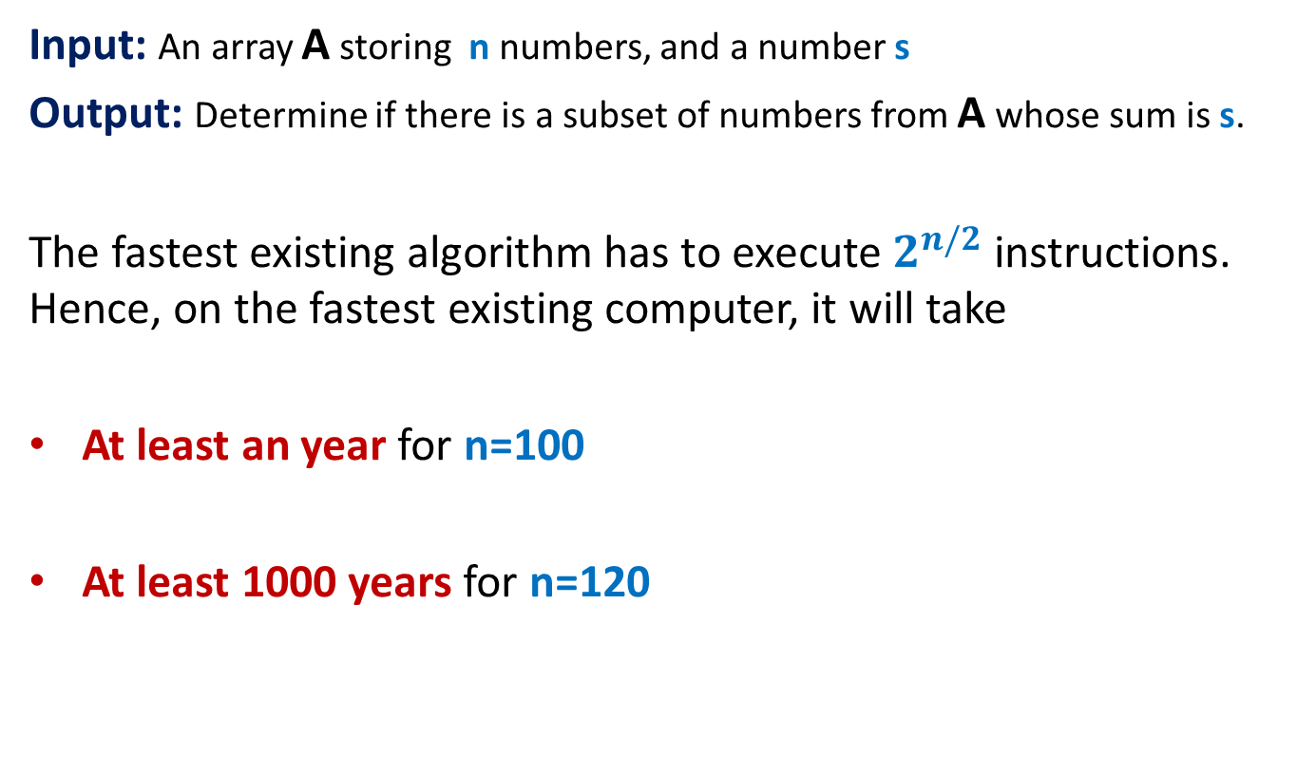
Problem 2: Subset-sum problem
Input: An array A storing n numbers, and a number s
Output: Determine if there is a subset of numbers from A whose sum is s.
The fastest existing algorithm has to execute $2^{n/2}$ instructions. Hence, on the fastest existing computer, it will take
At least an year for n=100
At least 1000 years for n=120

Slide 10
Problem 3: Sorting
Input: An array A storing n numbers.
Output: Sorted A
A fact:
A significant fraction of the code of all the software is for sorting or searching only.
To sort 10 million numbers on the modern computers
Selection sort will take at least a few hours.
Merge sort will take only a few seconds.

Slide 11
Summary of Algorithms
There are many practically relevant problems for which there does not exist any efficient algorithm till date.
Efficient algorithms are important for theoretical as well as practical purposes.
Algorithm design is an art which demands a lot of creativity, intuition, and perseverance.
More and more applications in real life require efficient algorithms
Search engines like Google exploits many clever algorithms.

Slide 12
The Data Structures

Slide 13
An Example
There is a telephone directory storing telephone numbers of hundred million persons.
Aim: to answer a sequence of queries of the form
“what is the phone number of a given person ?”.
Solution 1 (around 1/10th of a second per query) :
Keep the directory in an array and do sequential search for each query.
Solution 2: (less than 100 nanoseconds per query) :
Keep the directory in an array, and sort it according to names, and do binary search for each query.

Slide 14
Aim of data structure ?
To store/organize a given data in the memory of computer so that each subsequent operation (query/update) can be performed efficiently ?

Slide 15
RANGE-MINIMA Problem
An interesting example to realize the importance of data structures

Slide 16
Range-Minima Problem
Given an array A storing numbers, design a data structure to answer a sequence of queries of the following type
Range-minima(i,j) : report the smallest element from A[i],…,A[j]
Let A store one million numbers
Let the number of queries be 10 millions
Range-Minima(i,j) = -6
A
3 5 1 8 19 0 -1 30 99 -6 10 2 40 27 44 67
i=4
j=11

Slide 17
Range-Minima Problem
Solution 1: Answer each query in a brute force manner using A itself.
Range-minima-trivial(i,j)
{ temp ← i+1;
min ← A[i];
While(temp <= j)
{ if (min > A[temp])
min ← A[temp];
temp← temp+1;
}
return min
}
Worst case time for answering a query: a few milliseconds
Time for answering all queries: a few hours

Slide 18
Range-Minima Problem
Solution 2: Compute and store answer for each possible query in a matrix B and keep it in RAM.
B[i][j] stores the smallest element from A[i],…,A[j]
1 million
Time for answering all queries: few milliseconds
Time for answering all queries: still a few hours
B
WAIT !
Size of B is too large to be kept in RAM. So we shall have to keep most of it in the Hard disk drive. Hence it will take a few milliseconds per query.
1 million

Slide 19
Range-Minima Problem
Question: Does there exist a data structure which is
Compact
(nearly the same size as the input array A)
Can answer each query efficiently ?
(a few nanoseconds per query)
Homework 2: Ponder over the above question.
(we shall solve it in the next week)

Slide 20
Data structures to be covered
Elementary Data Structures
Array
List
Stack
Queue
Hierarchical Data Structures
Binary Heap
Binary Search Trees
Augmented Data Structures
Most fascinating and powerful data structures

Slide 21
Summary of Data Structures
The world of data structures is full of elegant and novel data structures which are extremely efficient.
Designing data structure is an extremely creative task.
Data structures add new dimensions to our ability to design efficient algorithms

