Slide 1
Data Structures and Algorithms (CS210/ESO207/ESO211)
Lecture 10
An interesting application of Stack: An elegant algorithm to evaluate arithmetic expression

Slide 2
Evaluation of an arithmetic expression
How does a computer/calculator evaluate an arithmetic expression given in the form of a string of symbols?
8 + 3 * 5 ^ 2 – 9
First it splits the string into tokens which are operators or operands (numbers). This is not difficult. But how does it evaluate it finally ???
operators
operands

Slide 3
Precedence of operators
Precedence: “priority” among different operators
Operator + has same precedence as –.
Operator * (as well as /) has higher precedence than +.
Operator * has same precedence as /.
Operator ^ has higher precedence than * and /.

Slide 4
Associativity of operators
What is 2^3^2 ?
What is 3-4-2 ?
What is 4/2/2 ?
Associativity: “How to group operators of same type ?”
A ● B ● C = ??
(A ● B) ● C or A ● (B ● C)
Left associative
Right associative

Slide 5
A trivial way to evaluate an arithmetic expression
First perform all ^ operations.
Then perform all * and / operations.
Then perform all + and - operations.
Disadvantages:
An ugly and case analysis based algorithm (just imagine how will the code look like and how long will it be ?).
Multiple scans of the expression (one for each operator).
What about expressions involving parentheses: 3+4*(5-6/(8+9^2)+33)
What about associativity of the operators:
2^3^2 = 512 and not 64
16/4/2 = 2 and not 8.
8
+
3
5
2
-
*
^
9

Slide 6
Overview of our solution
Focusing on a simpler version of the problem:
Expressions without parentheses
Every operator is left associative
Solving the simpler version
Transforming the solution of simpler version to generic

Slide 7
Step 1
Focusing on a simpler version of the problem

Slide 8
Incorporating precedence of operators through priority number
Operator | Priority
+ , - | 1
* , / | 2
^ | 3

Slide 9
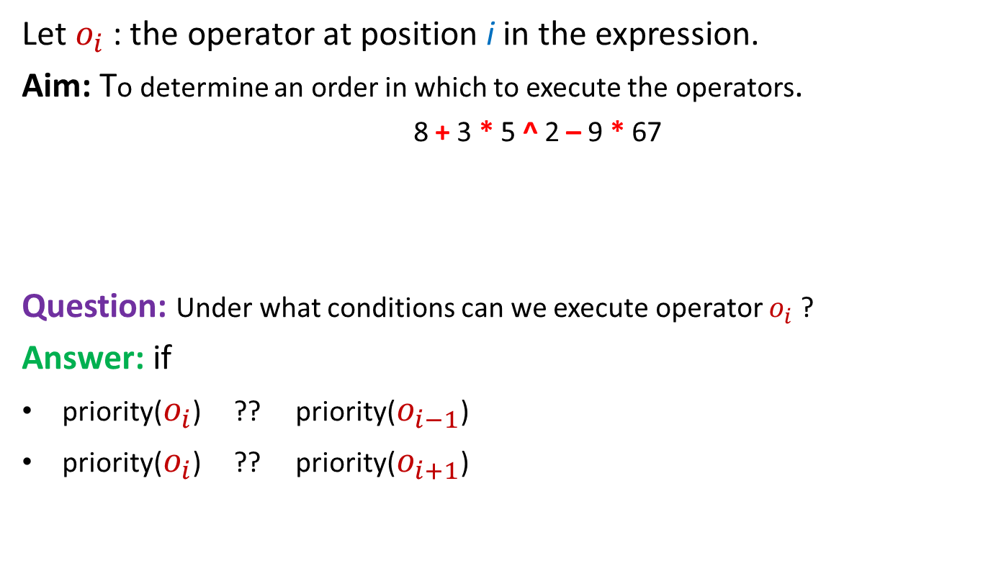
Insight into the problem
Let $o_{i}$ : the operator at position i in the expression.
Aim: To determine an order in which to execute the operators.
8 + 3 * 5 ^ 2 – 9 * 67
Question: Under what conditions can we execute operator $o_{i}$ ?
Answer: if
priority($o_{i}$) ?? priority($o_{i−1}$)
priority($o_{i}$) ?? priority($o_{i+1}$)
Position of an operator does matter
>
≥
Give reasons for ≥ instead of >

Slide 10
















Question: How to evaluate expression in a single scan ?
Expression: $n_{1}{o_{1} n}_{2}o_{2}{ n}_{3}$ $o_{3} n_{4} o_{4}{ n}_{5 }o_{5} …$
We can execute $o_{5}$
We can execute $o_{4}$
$$o_{1}$$
$$o_{2}$$
$$o_{3}$$
$$o_{4}$$
$$o_{5}$$
$$o_{6}$$
$$o_{7}$$
$n_{1}{ n}_{2}$ $n_{3}$
$$n_{4}$$
$$n^{′′}$$
$$n_{5}$$
$$n^{′}$$
$${ n}_{6}$$

Slide 11
Take a pause for a few minutes to design an algorithm for evaluation of arithmetic expression based on the insight we developed in the last slides.
(hint: use 2 stack.)

Slide 12
Step 2
Solving the simpler version of the problem

Slide 13

To Evaluate an expression in a single scan using stacks
Expression: $n_{1}{o_{1} n}_{2}o_{2}{ n}_{3}$ $o_{3} n_{4} o_{4}{ n}_{5 }o_{5} …$
We keep two stacks:
N-stack
for operands
O-stack
for operators

Slide 14
A simple algorithm
While (true) do
{ x ← next_token();
Two cases:
x is number : push(x,N-stack);
x is operator :
while(PRIORITY(TOP(O-stack) >= PRIORITY(x))
{ o ← POP(O-stack);
Execute(o);
}
push(x,O-stack);
}
POP two numbers from N-stack and apply operator x on them
place the result back into N-stack

Slide 15
Step 3
Transforming the solution to Solve the most general case

Slide 16
How to handle parentheses ?
3+4*(5-6/2)
Observations about parentheses :
Question: What needs to be done whenever we encounter ( in the expression ?
Answer: We need to evaluate the expression enclosed by this parenthesis before any other operator currently present in the O-stack. So we must push ( into the O-stack.
Question: What needs to be done when ( is at the top of the O-stack ?
Answer: The ( at the top of the stack should act as an artificial bottom of the O-stack so that we may evaluate its expression before any other operator lying below (. Hence every other operator that follows ( should be allowed to sit on the top of ( in the stack .
Question: What needs to be done whenever we encounter ) in the expression ?
Answer: Keep popping O-stack and evaluating the operators until we get its matching (.
Treating ( and ) as operators, how should our simple algorithm handle them ?
Hence, while ( is the current operator encountered in the expression,
it must have higher priority than every other operator
Contradiction!!
Hence, while ( is inside the stack, it must have less priority than every other operator.

Slide 17
Take a pause for a few minutes to realize surprisingly that
the contradicting requirements for the priority of (
in fact hints at a suitable solution for handling (.

Slide 18
How to handle parentheses ? Using two types of priorities of each operator ●.
InsideStack priority
OutsideStack priority
The priority of an operator ● when it is inside the stack.
The priority of an operator ● when it is encountered in the expression.
top
O-stack
O-stack

Slide 19
How to handle parentheses ? Using two types of priorities of each operator.
Operator | InsideStackPriority | OutsideStackPriority
+ , - | 1 | 1
* , / | 2 | 2
^ | 3 | 3
( | ?? | ??
0
4

Slide 20
The algorithm generalized to handle parentheses
While (true) do
x ← next_token();
Cases:
x is number : push(x,N-stack);
x is ) : while( TOP(O-stack) <> ( )
{ o ← Pop(O-stack);
Execute(o);
}
Pop(O-stack); //popping the matching (
otherwise : while(InsideStackPriority(TOP(O-stack)) >= OutsideStackPriority(x))
{ o ← Pop(O-stack);
Execute(o);
}
Push(x,O-stack);

Slide 21
Practice exercise:
Execute the algorithm on 3+4*(5+6*3)^2 and convince yourself through proper reasoning that the algorithm handles parentheses suitably.

Slide 22
How to handle associativity of operators ?

Slide 23
Associativity of arithmetic operators
Left associative operators : +, - , * , /
a+b+c = (a+b)+c
a-b-c = (a-b)-c
a*b*c = (a*b)*c
a/b/c = (a/b)/c
Right associative operators: ^
2^3^2 = 2^(3^2) = 512.

Slide 24
How to handle associativity of operators ? Using two types of priorities of each operator.
Operator | InsideStackPriority | Outside-stack priority
+ , - | 1 | 1
* , / | 2 | 2
^ | 3 | 3
( | 0 | 4
4
5

Slide 25
The general Algorithm It is the same as the algorithm to handle parentheses :-)
While (true) do
x ← next_token();
Cases:
x is number : push(x,N-stack);
x is ) : while( TOP(O-stack) <> ( )
{ o ← Pop(O-stack);
Execute(o);
}
Pop(O-stack); //popping the matching (
otherwise : while(InsideStackPriority(TOP(O-stack)) >= OutsideStackPriority(x))
{ o ← Pop(O-stack);
Execute(o);
}
Push(x,O-stack);

Slide 26
Homeworks
Execute the general algorithm on 3+4*((4+6)^2)/2 and convince yourself through proper reasoning that the algorithm handles nested parentheses suitably.
Execute the general algorithm on 3+4^2^2*3 and convince yourself through proper reasoning that the algorithm takes into account the right associativity of operator ^.
Our simple (as well as general) algorithm does not consider the case when the O-stack is empty. How can you take care of this small technical thing without changing the while loop of the algorithm ?
Hint: Introduce a new operator $ with both its priorities -1 and push it into O-stack before the while loop.
How to take care of the end of the expression ?
Hint: Introduce a new operator symbol # so that upon seeing #, we do very much like what we do on seeing ).

