Slide 1
Data Structures and Algorithms (CS210/ESO207/ESO211)
Lecture 2
3 algorithms for Fibonacci number,
Algorithm and its essential characteristics
word RAM model of computation
time complexity

Slide 2
Revisiting an Example from ESC101
Fibonacci numbers

Slide 3
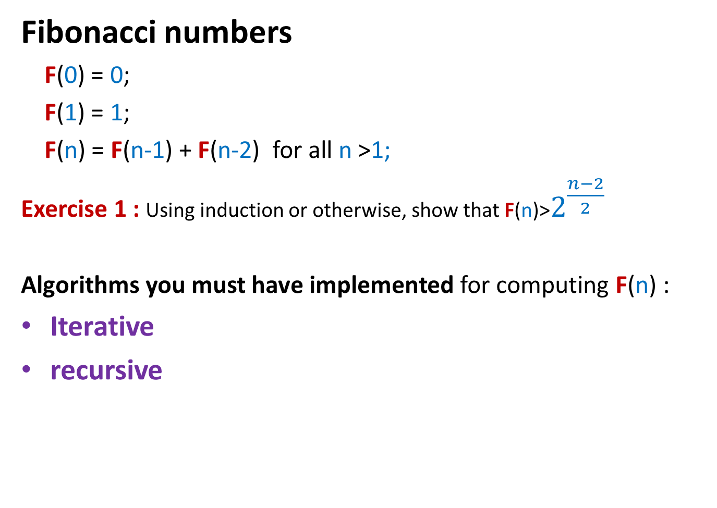
Algorithms for Fibonacci numbers
Fibonacci numbers
F(0) = 0;
F(1) = 1;
F(n) = F(n-1) + F(n-2) for all n >1;
Exercise 1 : Using induction or otherwise, show that F(n)>$2^{\frac{n−2}{2}}$
Algorithms you must have implemented for computing F(n) :
Iterative
recursive

Slide 4
Iterative Algorithm for F(n)
Total number of instructions= 4+3(n-2)+1 < 3n
IFib(n)
if n=0 return 0;
else if n=1 return 1;
else { a ← 0; b← 1;
For(i=2 to n) do
{ temp ← b;
b← a+b;
a← temp;
}
}
return b;
Let us calculate the number of instruction executed by IFib(n)
4 instructions
n-2 iterations
3 instructions per iteration
the final instruction

Slide 5
Recursive algorithm for F(n)
Rfib(n)
{ if n=0 return 0;
else if n=1 return 1;
else return(Rfib(n-1) + Rfib(n-2))
}
Let G(n) denote the number of instruction executed by RFib(n)
G(0) = 1; G(1) = 2;
For n>1 G(n) = G(n-1)+G(n-2) + 4
Observation 1: G(n)>F(n) for all n;
It follows from Observation 1 and Exercise 1 that G(n) is exponential in n !!!

Slide 6
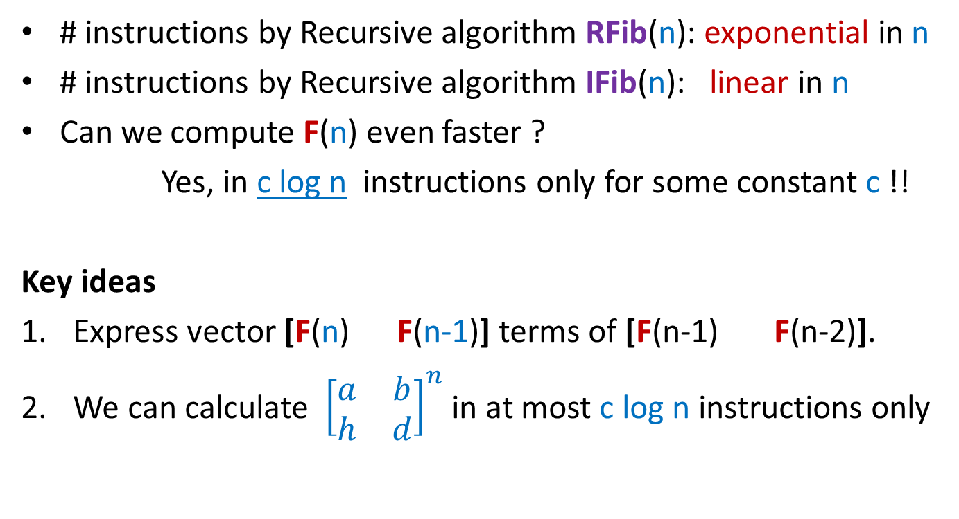
Algorithms for F(n)
# instructions by Recursive algorithm RFib(n): exponential in n
# instructions by Recursive algorithm IFib(n): linear in n
Can we compute F(n) even faster ?
Yes, in c log n instructions only for some constant c !!
Key ideas
Express vector [F(n) F(n-1)] terms of [F(n-1) F(n-2)].
We can calculate ${\left[\begin{matrix}a & b \\ h & d\end{matrix}\right]}^{n}$ in at most c log n instructions only
Ponder over these two ideas before proceeding further.

Slide 7
Key idea 1
F(n)
F(n-1)
F(n-1)
F(n-2)
1
1 0
?
Unfolding the RHS of this equation, we get …
F(n)
F(n-1)
n-1
1
0
1
1 0

Slide 8
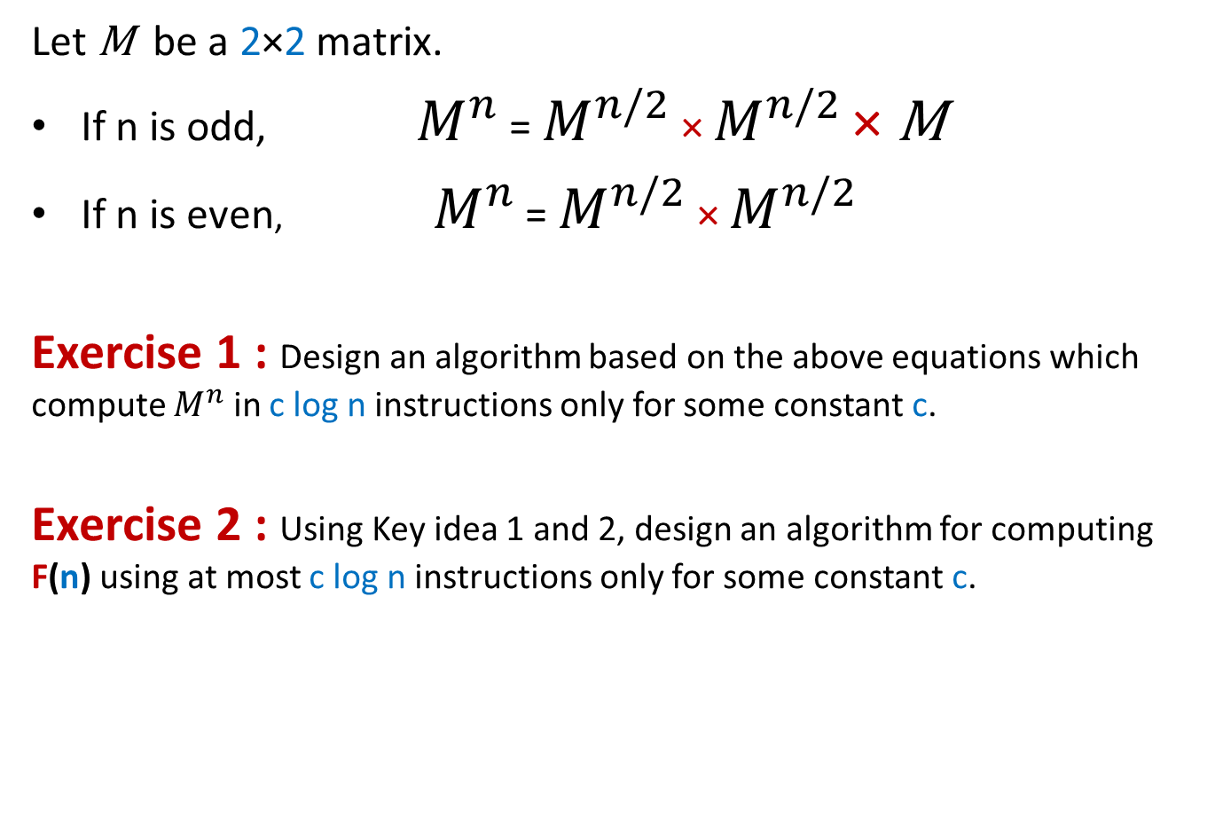
Key idea 2
Let $\text{M}$ be a 2×2 matrix.
If n is odd, $M^{n}$ = $M^{n/2}$ × $M^{n/2}$ × $\text{M}$
If n is even, $M^{n}$ = $M^{n/2}$ × $M^{n/2}$
Exercise 1 : Design an algorithm based on the above equations which compute $M^{n}$ in c log n instructions only for some constant c.
Exercise 2 : Using Key idea 1 and 2, design an algorithm for computing F(n) using at most c log n instructions only for some constant c.

Slide 9
Efficient Algorithms
Definition, model of computation, measure of efficiency

Slide 10
Characteristics of an algorithm
The algorithm must have a finite description.
For each possible input instance of the problem,
The algorithm must output correct answer.
The algorithm must stop in a finite number of steps (the number of steps may be a function of the input).
The characteristic 2.b is usually called effectiveness of the algorithm.

Slide 11
A toy example to illustrate the effectiveness of an algorithm
Example :
How to search for your friend when you know neither the direction nor the distance ?
Procedure “travel eastward” is not effective.
Procedure “travel k units in each direction” is also not effective.
An algorithm: travel 1 km in each direction, and then travel 2 km in each direction, travel 3 km in each direction, …
An efficient algorithm: travel 1 km in each direction, and then travel 2km in each direction, travel 4 km in each direction, travel 8 km in each direction,….
Your friend
you

Slide 12
An important Lesson from Lecture 1
Design of efficient algorithm is very important.

Slide 13
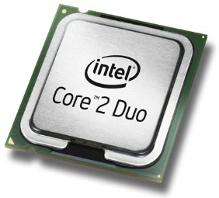
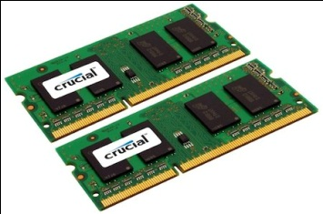

Recall from Lecture 1: Current-state-of-the-art Desktop
A processor (CPU)
speed = few GHz
(a few nanoseconds to execute an instruction)
Internal memory (RAM)
size = a few GB (Stores few million bytes/words)
speed = a few GHz(a few nanoseconds to read a byte/word)
External Memory (Hard Disk Drive)
size = a few tera bytes
speed : seek time = miliseconds
transfer rate= a billion bytes per second

Slide 14
Models of computation
Why do we need such models?
In order to analyze the efficiency of an algorithm, we need a model of computation which is simpler and still captures the essence of the real world computer.
Models :
Word RAM model
Bit complexity model
Universal RAM model
Cell probe model
….
We shall deal mainly with word-RAM model due to its simplicty and higher degree of closeness to the real world computer.

Slide 15
word RAM : a model of computation
Data
Processor
Program
RAM

Slide 16
Execution of a instruction (fetching the operands, arithmetic/logical operation, storing the result back into RAM)
Processor
RAM

Slide 17
word RAM model of computation: Characteristics
Word is the basic storage unit of RAM. Word is a collection of few bytes.
Each input item (number, name) is stored in binary format.
RAM can be viewed as a huge array of words. Any arbitrary location of RAM can be accessed in the same time irrespective of the location.
Data as well as Program reside fully in RAM.
Each arithmetic or logical operation (+,-,*,/,or, xor,…) involving a constant number of words takes a constant number of steps by the CPU.

Slide 18
Efficiency of an algorithm
Question:
which of the two is an absolute measure for the efficiency of an algorithm ?
Choices are
Time
Number of instructions executed
Answer: Number of instructions

Slide 19
Efficiency of an algorithm: number of instructions executed
Question: What are the factors on which the number of instructions executed by an algorithm depend ?
Answer:
The size of the input
Sorting 1 billion numbers will take more time than one hundred
Multiplying two matrices of size 1000*1000 will take more time than two matrices of size 10*10.
The input instance
Sequential search for a ‘0’ in a matrix M[n,n] may executed different number of instructions depending upon the location of ‘0’ in the matrix.

Slide 20
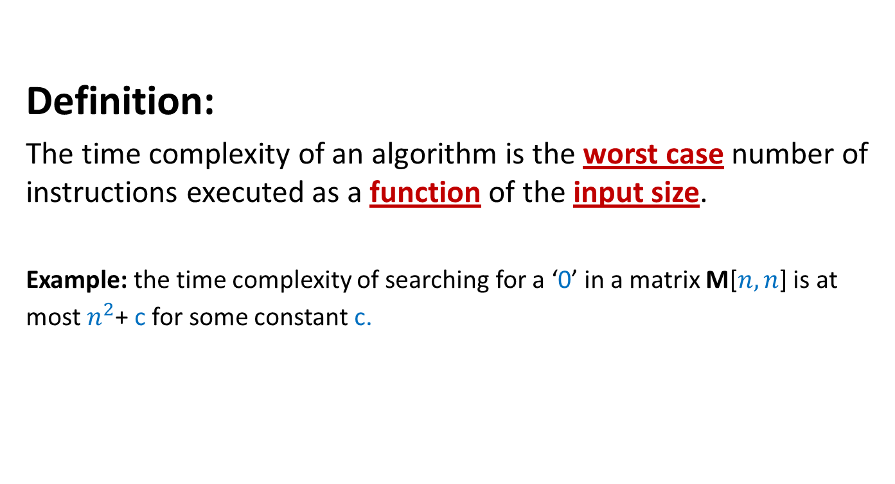
Time complexity of an algorithm
Definition:
The time complexity of an algorithm is the worst case number of instructions executed as a function of the input size.
Example: the time complexity of searching for a ‘0’ in a matrix M[$n,n$] is at most $n^{2}$+ c for some constant c.

Slide 21

Example: Time complexity of matrix multiplication
Matrix-mult(C[n,n],D[n,n])
{ for i = 0 to n-1
{ for j=0 to n-1
{ M[i,j] ← 0;
for k=0 to n-1
{ M[i,j]← M[i,j] + C[i,k]*D[k,j];
}
}
}
Return M
}
Time complexity = $n^{3}+n^{2}+1$

Slide 22
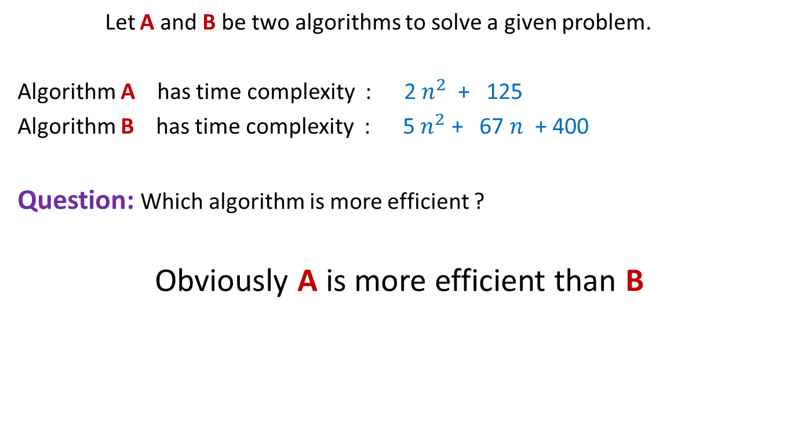
Comparing efficiency of two algorithms
Let A and B be two algorithms to solve a given problem.
Algorithm A has time complexity : 2 $n^{2}$ + 125
Algorithm B has time complexity : 5 $n^{2}$ + 67 $n$ + 400
Question: Which algorithm is more efficient ?
Obviously A is more efficient than B

Slide 23
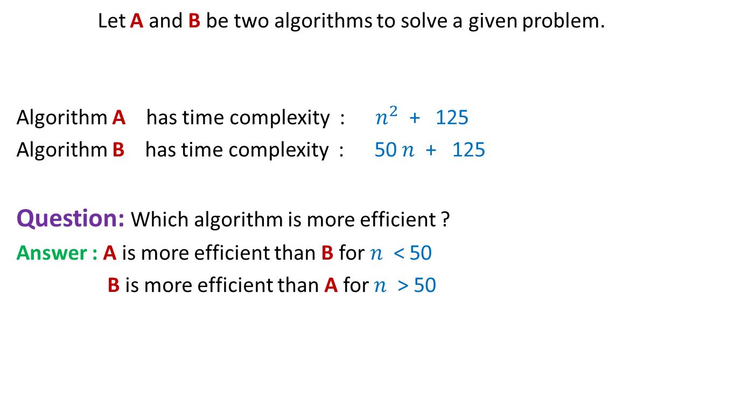
Comparing efficiency of two algorithms
Let A and B be two algorithms to solve a given problem.
Algorithm A has time complexity : $n^{2}$ + 125
Algorithm B has time complexity : 50 $n$ + 125
Question: Which algorithm is more efficient ?
Answer : A is more efficient than B for $n$ < 50
B is more efficient than A for $n$ > 50
Time complexity is really an issue when the input is of large size

Slide 24

Comparing efficiency of two algorithms
Algorithm A with time complexity 50 $n$+ 125
is certainly more efficient than
Algorithm B has time complexity : $n^{2}$ + 125
Do not accept the theories or claims mentioned in the lectures without seeing their justification.
Questions are welcome by the instructor.

