Slide 1
Data Structures and Algorithms (CS210/ESO207/ESO211)
Lecture 3
Time complexity
Big O notation
Solving a problem: Maximum sum subarray

Slide 2
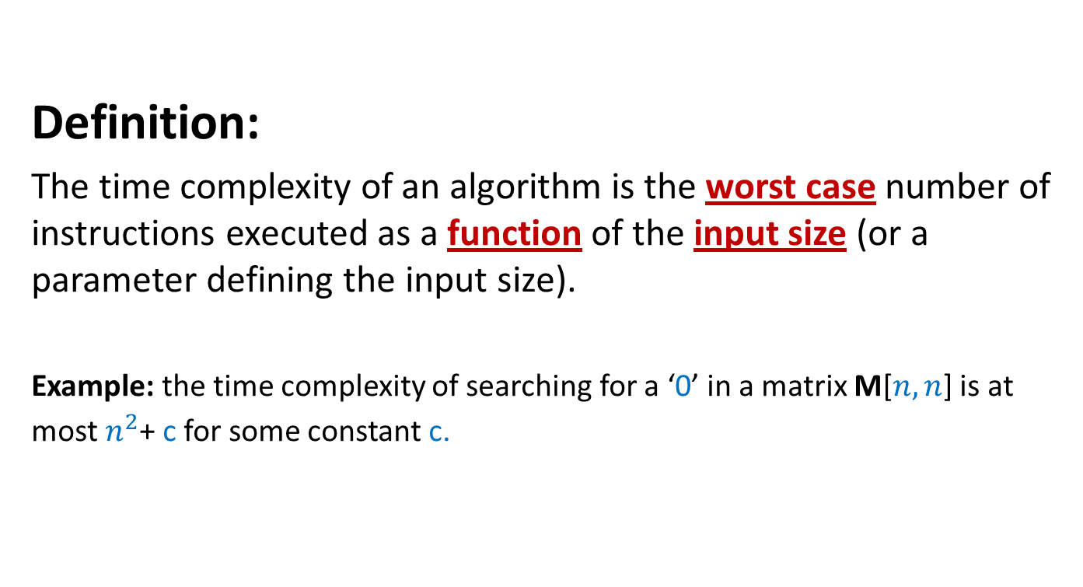
Time complexity of an algorithm
Definition:
The time complexity of an algorithm is the worst case number of instructions executed as a function of the input size (or a parameter defining the input size).
Example: the time complexity of searching for a ‘0’ in a matrix M[$n,n$] is at most $n^{2}$+ c for some constant c.

Slide 3

Example: Time complexity of matrix multiplication
Matrix-mult(C[n,n],D[n,n])
{ for i = 0 to n-1
{ for j=0 to n-1
{ M[i,j] ← 0;
for k=0 to n-1
{ M[i,j]← M[i,j] + C[i,k]*D[k,j];
}
}
}
Return M
}
Time complexity = $n^{3}+n^{2}+1$

Slide 4
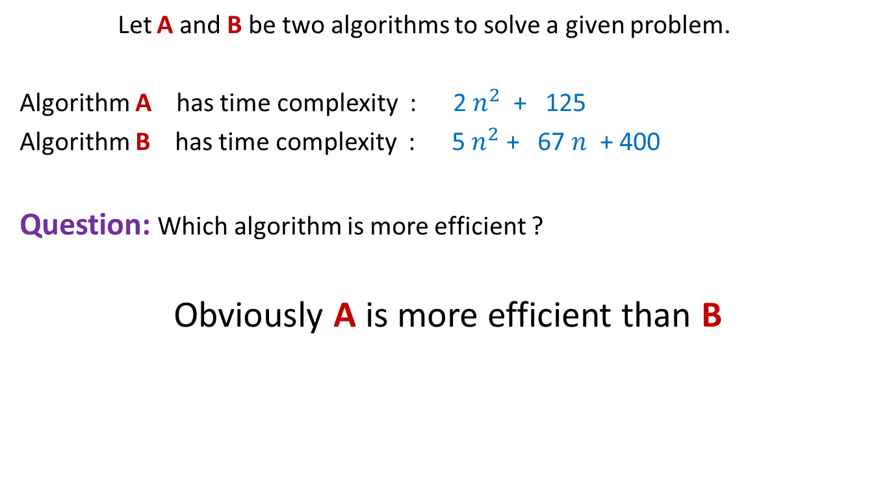
Comparing efficiency of two algorithms
Let A and B be two algorithms to solve a given problem.
Algorithm A has time complexity : 2 $n^{2}$ + 125
Algorithm B has time complexity : 5 $n^{2}$ + 67 $n$ + 400
Question: Which algorithm is more efficient ?
Obviously A is more efficient than B

Slide 5
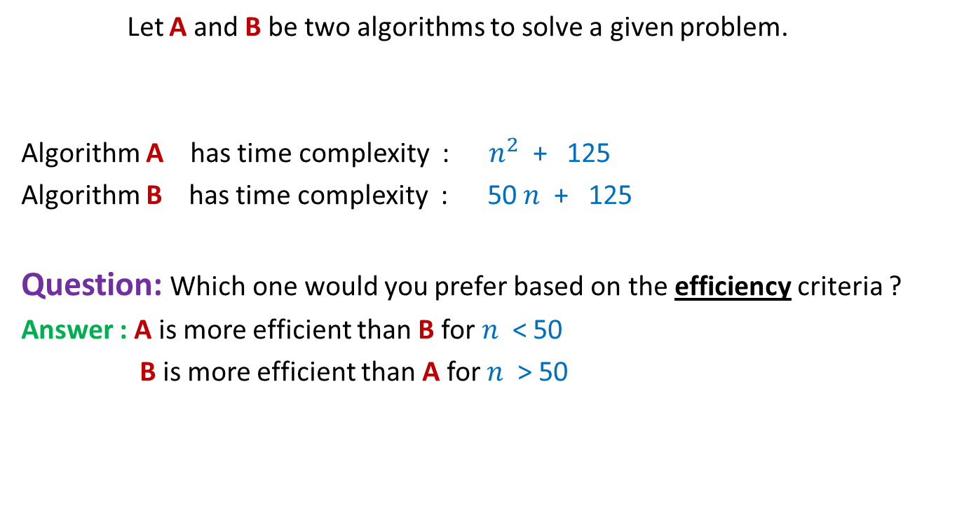
Comparing efficiency of two algorithms
Let A and B be two algorithms to solve a given problem.
Algorithm A has time complexity : $n^{2}$ + 125
Algorithm B has time complexity : 50 $n$ + 125
Question: Which one would you prefer based on the efficiency criteria ?
Answer : A is more efficient than B for $n$ < 50
B is more efficient than A for $n$ > 50
Time complexity is really an issue only when the input is of large size

Slide 6
Rule1
We must compare the time complexities of two algorithms for asymptotically large value of input size only

Slide 7

Comparing efficiency of two algorithms
Algorithm A with time complexity 50 $n$+ 125
is certainly more efficient than
Algorithm B has time complexity : $n^{2}$ + 125

Slide 8
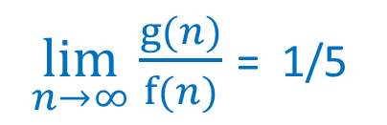

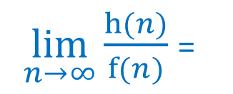
Exercise 1: A judgment question for you !
Algorithm A for a given problem has time complexity f($n$)= ${5 n}^{2}$ + $n$+ 1250
Researchers have designed two new algorithms B and C
Algorithm B has time complexity g($n$) = $n^{2}$ + 10
Algorithm C has time complexity h($n$) = ${10 n}^{1.5}$ + 20 $n$ + 2000
Which of B and C is an improvement over A in the true sense ?
$\lim_{n→∞}{\frac{g(n)}{f(n)}}$ = 1/5
$\lim_{n→∞}{\frac{h(n)}{f(n)}}$ =
?
0
C is an improvement over A in the true sense.

Slide 9
Another Rule
An algorithm X is superior to another algorithm Y if
the ratio of time complexity of X and time complexity of Y approaches 0 for asymptotically large input size.

Slide 10
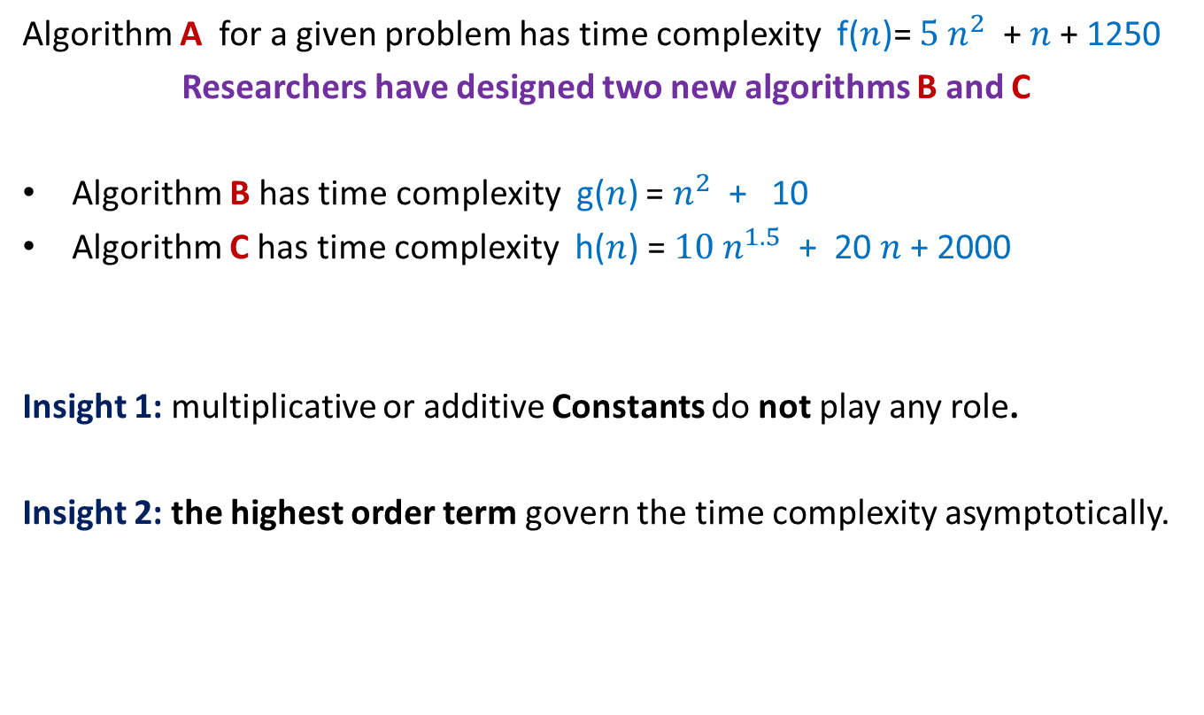
Some insights from the Exercise 1
Algorithm A for a given problem has time complexity f($n$)= ${5 n}^{2}$ + $n$+ 1250
Researchers have designed two new algorithms B and C
Algorithm B has time complexity g($n$) = $n^{2}$ + 10
Algorithm C has time complexity h($n$) = ${10 n}^{1.5}$ + 20 $n$ + 2000
Insight 1: multiplicative or additive Constants do not play any role.
Insight 2: the highest order term govern the time complexity asymptotically.

Slide 11
Order Notations : a neat and Precise description of Time Complexity

Slide 12


Order notation
Definition: Let f(n) and g(n) be any two increasing functions of n. f(n) is said to be of the order of g(n) if there exist constants c and $n_{0}$such that
f(n) ≤ c g(n) for all n > $n_{0}$
c g(n)
f(n)
$$n_{0}$$
If f(n) is of the order of g(n), we write f(n) = O(g(n))

Slide 13
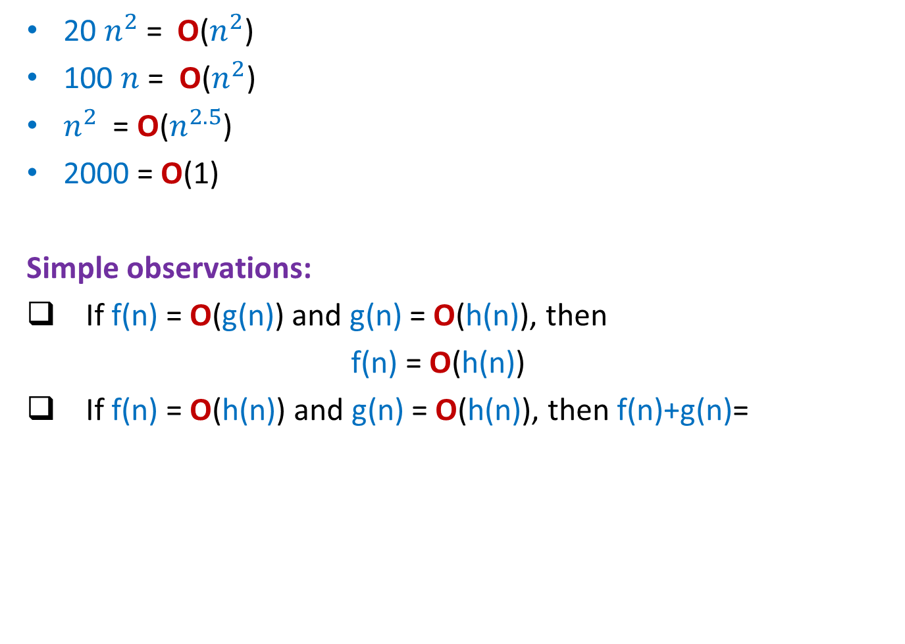
Order notation : Examples
20 $n^{2}$ = O($n^{2}$)
100 $n$ = O($n^{2}$)
$n^{2}$ = O($n^{2.5}$)
2000 = O(1)
Simple observations:
If f(n) = O(g(n)) and g(n) = O(h(n)), then
f(n) = O(h(n))
If f(n) = O(h(n)) and g(n) = O(h(n)), then f(n)+g(n)=
O(h(n))
?

Slide 14
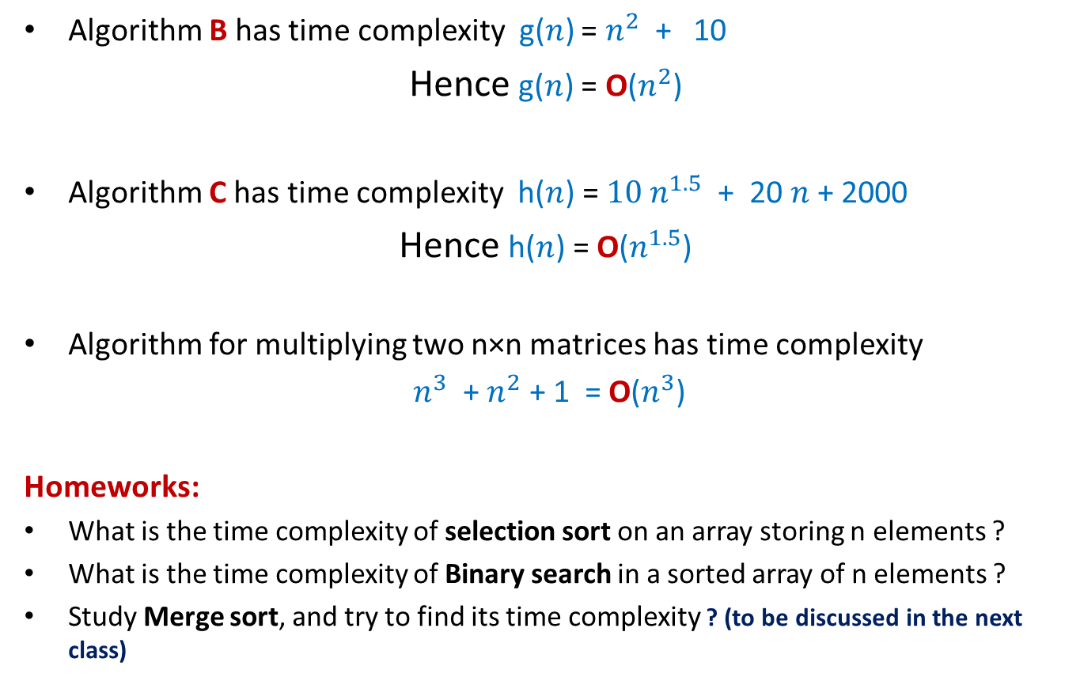
A neat description of time complexity
Algorithm B has time complexity g($n$) = $n^{2}$ + 10
Hence g($n$) = O($n^{2}$)
Algorithm C has time complexity h($n$) = ${10 n}^{1.5}$ + 20 $n$ + 2000
Hence h($n$) = O($n^{1.5}$)
Algorithm for multiplying two n×n matrices has time complexity
$n^{3}$ + $n^{2}$ + 1 = O($n^{3}$)
Homeworks:
What is the time complexity of selection sort on an array storing n elements ?
What is the time complexity of Binary search in a sorted array of n elements ?
Study Merge sort, and try to find its time complexity ? (to be discussed in the next class)

Slide 15
Max-sum subarray problem: Designing efficient algorithm
Given an array A storing n numbers, find its subarray the sum of whose elements is maximum?
4
7
A
3 -5 3 8 2 -4 9 -6 3 -2 8 3 -5 1 7 -9
18
14

Slide 16
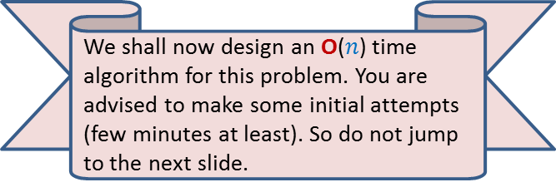

Max-sum subarray problem: A trivial algorithm
A_trivial_algo(A)
{ max← A[0];
For i=0 to n-1
For j=i to n-1
{ temp ← compute_sum(A,i,j);
if max< temp then max← temp;
}
return max;
}
compute_sum(A, i,j)
{ sum←A[i];
For k=i+1 to j sum← sum+A[k];
return sum;
}
Homework: Prove that its time complexity is O($n^{3}$)
We shall now design an O($n$) time algorithm for this problem. You are advised to make some initial attempts (few minutes at least). So do not jump to the next slide.

Slide 17
Max-sum subarray problem: Designing an efficient algorithm
Facts from the world of algorithms:
There is no formula for designing efficient algorithms. Almost every second problem demands a fresh approach.
Designing an efficient algorithm or data structure requires
A deep insight into the existing efficient algorithms for various problems and the ability to use that insight at right place.
Ability to make key observation about the problem and its solution.
Ability to ask right kind of questions when some promising idea fails.
A positive attitude and a lot of perseverance.
We shall demonstrate the above facts during this course many times.

Slide 18
Max-sum subarray problem: Towards designing an O(n) time algorithm
Let S(i): the sum of the largest-sum subarray ending at A[i].
Note that A[i] surely contributes to S(i) (empty subarrays are not considered).
i=5
A
3 -5 3 8 2 -4 8 -6 3 -2 8 3 -5 1 7 -9
-4
-2
6
9
S(i)=9 for i = 5
4
7

Slide 19
Max-sum subarray problem: Towards designing an O(n) time algorithm
Observations:
In order to solve our problem, it suffices to compute S(i) for all possible 0 ≤ i ≤ n-1.
Since our objective is to achieve O(n) time complexity bound, we need a way to compute S(i) in O(1) time only. How can we achieve this (ambitious) goal ?
Lesson you should have learnt from the iterative algo for Fibonacci number
Solve a problem incrementally.
How to use the above insight from Fibonacci number ?
Question: what is the relation between S(i) and S(i-1) ?

Slide 20
Max-sum subarray problem: Towards designing an O(n) time algorithm
If S(i-1) ≤ 0 then
S(i)=A[i]
If S(i-1) > 0 then
S(i) = S(i-1) + A[i]
Homework:
Prove the above mentioned relation between S(i) and S(i-1).
Design an O(n) time algorithm for Max-sum subarray using the above formulation.

