Slide 1
Data Structures and Algorithms (CS210/ESO207/ESO211)
Lecture 6
Data Structures
A gentle introduction
Range Minima Problem: an inspirational example

Slide 2
Data Structures
Aim : To store/organize a given data in the memory of computer so that each subsequent operation (query/update) can be performed efficiently ?
A simple example: A Telephone directory

Slide 3
Data Structures
The world of data structures is full of elegant and novel data structures which are extremely efficient.
Designing data structure is an extremely creative task.
Data structures add new dimensions to our ability to design efficient algorithms
We shall formally start the topic of Data structure in the next class.

Slide 4
RANGE-MINIMA Problem
An interesting example to realize the importance of data structures

Slide 5
Range-Minima Problem
Given an array A storing numbers, design a data structure to answer a sequence of queries of the following type
Range-minima(i,j) : report the smallest element from A[i],…,A[j]
Let A store one million numbers
Let the number of queries be 10 millions
Range-Minima(i,j) = -6
A
3 5 1 8 19 0 -1 30 99 -6 10 2 40 27 44 67
i=4
j=11

Slide 6
Range-Minima Problem
Applications:
Computational geometry
String matching
As an efficient subroutine in a variety of algorithms
( I myself used it in a research problem of shortest paths in graphs)

Slide 7
Range-Minima Problem
Solution 1: Answer each query in a brute force manner using A itself.
Range-minima-trivial(i,j)
{ temp ← i+1;
min ← A[i];
While(temp <= j)
{ if (min > A[temp])
min ← A[temp];
temp← temp+1;
}
return min
}
Time complexity for answering a query: O(n) (equivalent to few milliseconds)
Real Time for answering all queries: a few hours

Slide 8
Range-Minima Problem
Solution 2: Compute and store answer for each possible query in a n×n matrix B.
B[i][j] stores the smallest element from A[i],…,A[j]
Space : O(n²)
j
Solution 2 is
Theoretically inefficient and practically impossible
i
3
Size of B is too large to be kept in RAM. So we shall have to keep most of it in the Hard disk drive. Hence it will take a few milliseconds per query.
B

Slide 9
Range-minima problem
Query:
Report_min(A,i,j) : report smallest element from {A[i],…,A[j]}
Aim :
To build a compact data structure which can answer Report_min(A,i,j)
in O(1) time for any 1 ≤ i < j ≤ n.
1
i
j
n
A
29
3.1
99
781
41.5
67.4

Slide 10
Why does O(n²) bound on space appear so hard to break if we want O(1) query time?
… Because of artificial hurdles we have created in our mind about this problem.

Slide 11
Artificial hurdle 1
If we want to answer each query in O(1) time, we must store its answer explicitly. Since there are around O(n²) queries, so O(n²) space is needed.
Spend some time to convince yourself that it is not true at all.…

Slide 12
Artificial hurdle 2
… If we fix the first parameter i for all queries, we need O(n) space.
So
for all i, we need O(n²) space.
i
A
29
3.1
99
781
41.5
67.4
0
n-1
True Fact
A wrong inference because it assumes that data structure for an index i will work in total isolation of others (NO collaboration)

Slide 13

Collaboration (team effort) works in real life
Why not try collaboration for the given problem ?

Slide 14
Range-minima problem: Breaking the O(n²) barrier using collaboration
An Overview:
Keep n tiny data structures:
Each index i stores minimum only for a few j>i.
For a query Range-minima(i,j), if the answer is not stored in the tiny data structure of i,
look up tiny data structure of some index q (chosen carefully).

Slide 15
Range-minima problem: Breaking the O(n²) barrier using collaboration
Details of Collaboration
We may use the tiny data structure of index q to answer Range-Minima(i,j)
i
j
A
1
i
q
n
i stores answers for this range
q stores answers for this range

Slide 16
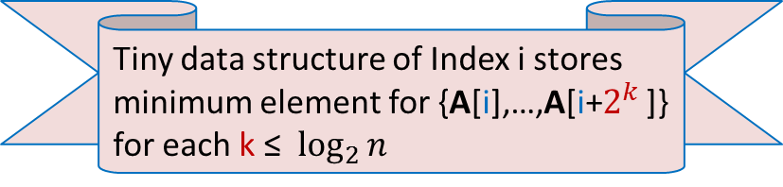

Range-minima problem : Details of tiny data structure stored at each i
$$2^{t}$$
8
4
2
1
A
1
i
n
Tiny data structure of Index i stores minimum element for {A[i],…,A[i+$2^{k}$ ]} for each k ≤ $\log_{2}{n}$

Slide 17



Answering Range-minima query for index i : Collaboration works
$$2^{k+1}$$
$$2^{k}$$
A
1
i
j
n
j ${−2}^{k}$
Look at this picture carefully to design the query algorithm. At least make an attempt

Slide 18
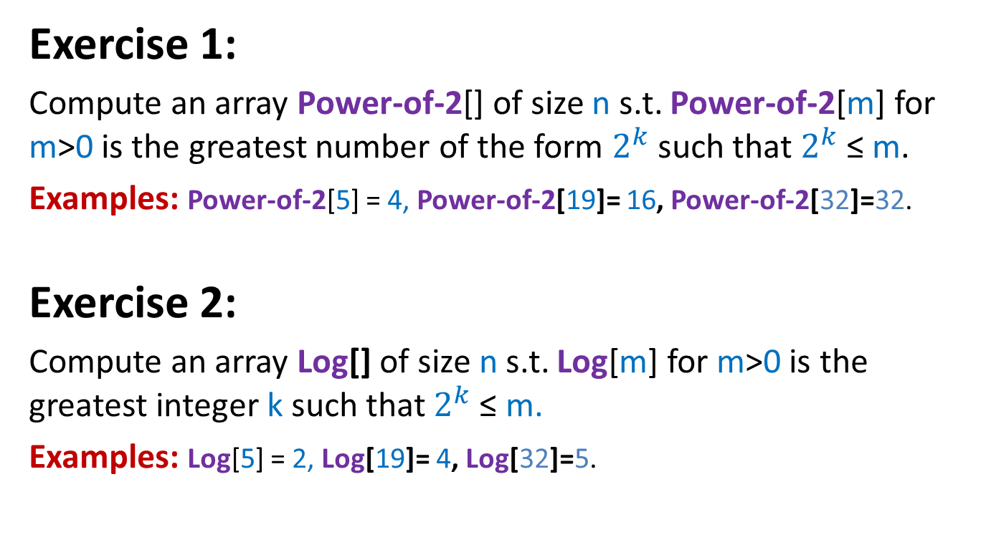
We shall use two additional arrays
Exercise 1:
Compute an array Power-of-2[] of size n s.t. Power-of-2[m] for m>0 is the greatest number of the form $2^{k}$such that $2^{k}$≤ m.
Examples: Power-of-2[5] = 4, Power-of-2[19]= 16, Power-of-2[32]=32.
Exercise 2:
Compute an array Log[] of size n s.t. Log[m] for m>0 is the greatest integer k such that $2^{k}$≤ m.
Examples: Log[5] = 2, Log[19]= 4, Log[32]=5.

Slide 19
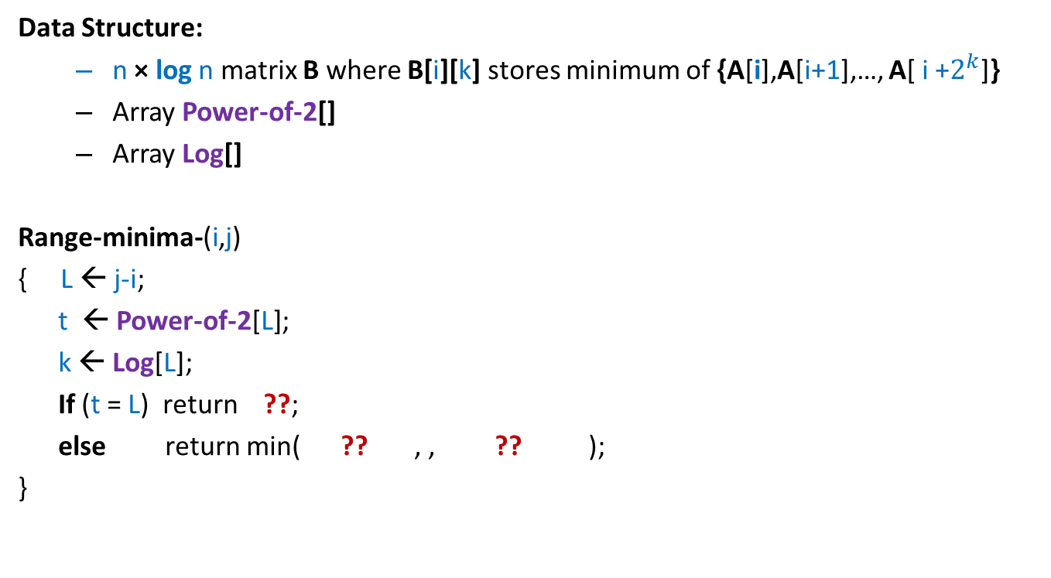
Range-Minima Problem: Data structure with O(n log n) space and O(1) query time
Data Structure:
n × log n matrix B where B[i][k] stores minimum of {A[i],A[i+1],…, A[ i +$2^{k}$]}
Array Power-of-2[]
Array Log[]
Range-minima-(i,j)
{ L ← j-i;
t ← Power-of-2[L];
k ← Log[L];
If (t = L) return ??;
else return min( ?? , , ?? );
}
B[i][k];
B[i][k]
B[j-t][k];

Slide 20
Range-Minima Problem: Data structure with O(n log n) space and O(1) query time
Homework: Design an O(n log n) time algorithm to build the n × log n matrix B used in data structure of Range-Minima problem.
Hint: (Inspiration from iterative algorithm for Fibonacci numbers).
Spend some time before looking at the more explicit hint below. (it is just a click away)…You can do it…
To compute B[i][k], you need to know only two entries from column **.

Slide 21
Range Minima Problem: further extensions
How to achieve O(n) space and O(1) query time ?
Yes it is possible. wait for 1.5 years ☺….
(A part of the course CS345)
Extension to 2-dimensions ?
Dynamic RMQ: What if the values stored in array change ?
wait for a month only ☺ ... But keep pondering over it …

