Slide 1
Data Structures and Algorithms (CS210/ESO207/ESO211)
Lecture 7
Data Structures
Modeling versus Implementation
Example: Abstract Data Type “List” and its implementations
Two interesting data structure problems

Slide 2
Data Structure
Definition: A collection of data elements arranged and connected in a way which can facilitate efficient executions of a (possibly long) sequence of operations.
For example, it makes sense to sort the telephone directory only if there is going to be a large number of queries.

Slide 3
Two steps process of designing a Data Structure
Step 1: Mathematical Modeling
A Formal description of the possible operations of a data structure. Operations can be classified into two categories:
Query Operations: Retrieving some information from the data structure
Update operations: Making a change in the data structure
Step 2: Implementation
Explore the ways of organizing the data that facilitates performing each operation efficiently using the existing tools available.
Outcome of Mathematical Modeling: an Abstract Data Type
Since we don’t specify here the way how each operation of the data structure will be implemented

Slide 4
Modeling of LIST
Outcome will be:
Abstract Data Type “List”

Slide 5
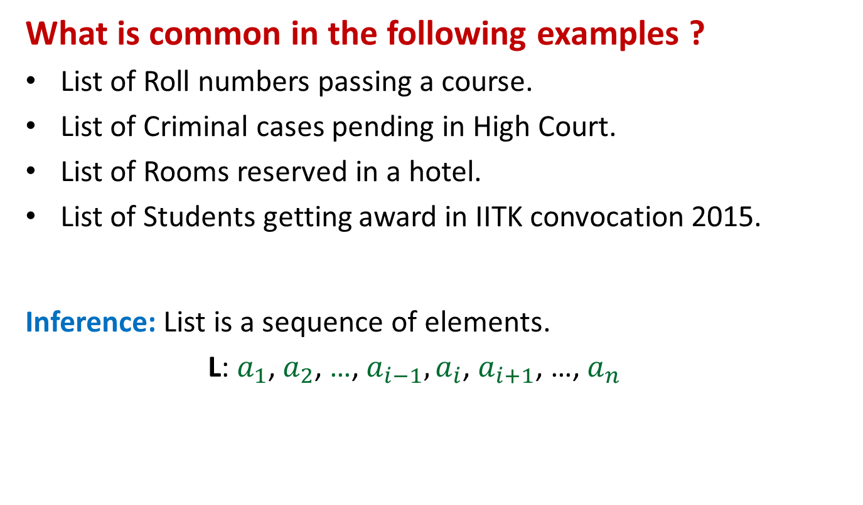
Mathematical Modeling of a List
What is common in the following examples ?
List of Roll numbers passing a course.
List of Criminal cases pending in High Court.
List of Rooms reserved in a hotel.
List of Students getting award in IITK convocation 2015.
Inference: List is a sequence of elements.
L: $a_{1}$, $a_{2}$, …, $a_{i−1}, a_{i}$, $a_{i+1}$, …, $a_{n}$
ith element of list L

Slide 6
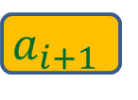
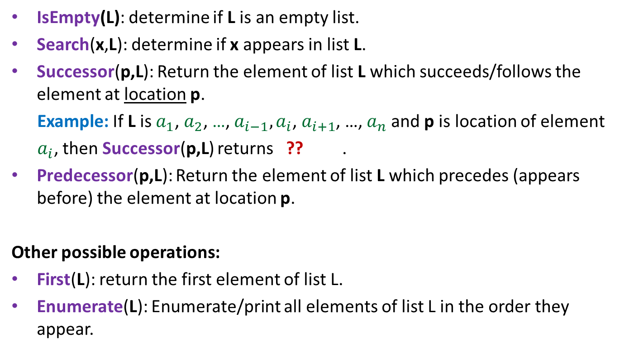
Query Operations on a List
IsEmpty(L): determine if L is an empty list.
Search(x,L): determine if x appears in list L.
Successor(p,L): Return the element of list L which succeeds/follows the element at location p.
Example: If L is $a_{1}$, $a_{2}$, …, $a_{i−1}, a_{i}$, $a_{i+1}$, …, $a_{n}$and p is location of element
$a_{i}$, then Successor(p,L) returns ?? .
Predecessor(p,L): Return the element of list L which precedes (appears before) the element at location p.
Other possible operations:
First(L): return the first element of list L.
Enumerate(L): Enumerate/print all elements of list L in the order they appear.
The type of this parameter will depend on the implementation
$$a_{i+1}$$

Slide 7

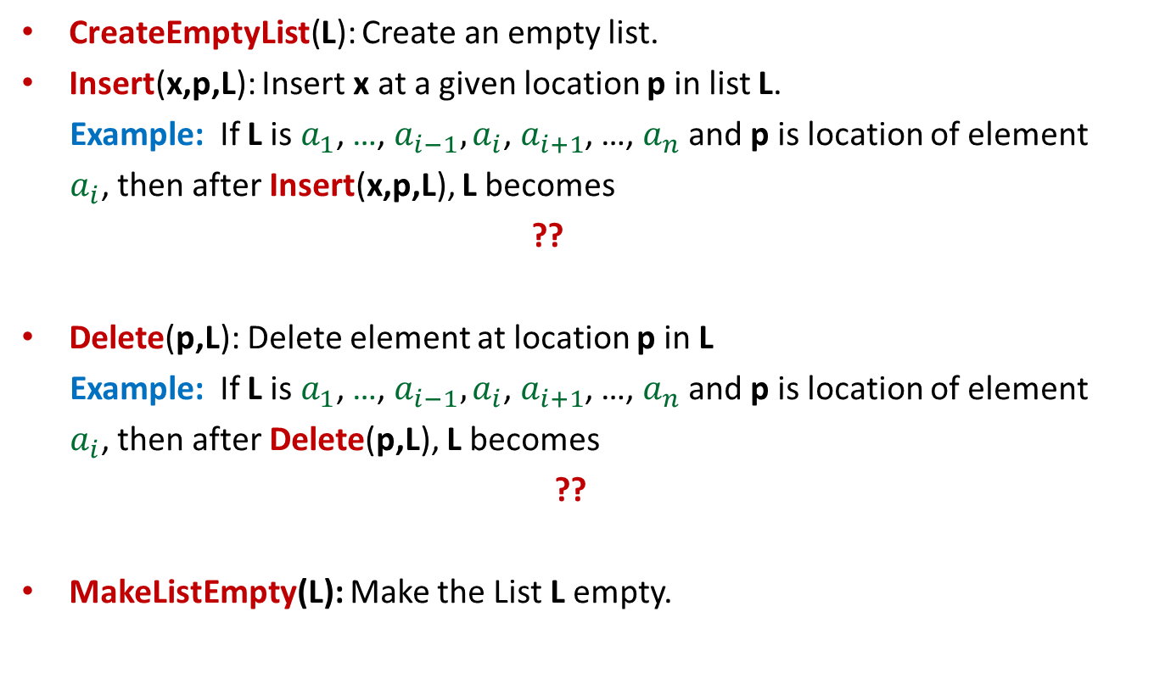

Update Operations on a List
CreateEmptyList(L): Create an empty list.
Insert(x,p,L): Insert x at a given location p in list L.
Example: If L is $a_{1}$, …, $a_{i−1}, a_{i}$, $a_{i+1}$, …, $a_{n}$and p is location of element
$a_{i}$, then after Insert(x,p,L), L becomes
??
Delete(p,L): Delete element at location p in L
Example: If L is $a_{1}$, …, $a_{i−1}, a_{i}$, $a_{i+1}$, …, $a_{n}$and p is location of element
$a_{i}$, then after Delete(p,L), L becomes
??
MakeListEmpty(L): Make the List L empty.
$a_{1}$, …, $a_{i−1}, {x,a}_{i}$, $a_{i+1}$ ,…, $a_{n}$
$a_{1}$, …, $a_{i−1}, a_{i+1}$ ,…, $a_{n}$

Slide 8
Implementation of
Abstract Data Type “List”

Slide 9
Array based Implementation
Before we proceed, let us know a little bit more about arrays.
RAM allows O(1) time to access any memory location.
Array is a contiguous chunk of memory kept in RAM.
For an array A[] storing n words,
the address of element A[i] =
“start address of array A” + i
Array A
This feature supports O(1) time to access A[i] for any i
RAM

Slide 10
Array based Implementation
Store the elements of List in array A such that A[i] denotes (i+1)th element of the list at each stage (since index starts from 0).
(Assumption: The maximum size of list is known in advance.)
Keep a integer variable Length to denote the number of elements in the list at each stage.
Example: If at any moment of time List is 3,5,1,8,0,2,40,27,44,67, then the array A looks like:
Question: How to describe location of an element of the list ?
Answer: by the corresponding array index. Location of 5th element of List is 4.
A
3 5 1 8 0 2 40 27 44 67
Length = 10

Slide 11
Time Complexity of each List operation using Array based implementation
Operation | Time Complexity per operation
IsEmpty(L)
Search(x,L)
Successor(i,L)
Predecessor(i,L)
CreateEmptyList(L)
Insert(x,i,L)
Delete(i,L)
MakeListEmpty(L)
O(1)
n: number of elements in list at present
O(n)
O(1)
O(1)
O(1)
Arrays are very rigid
O(n)
O(n)
O(1)
All elements from A[i] to A[n-1] have to be shifted to the right by one place.
Homework: Write C Function for each operation with matching complexity.
All elements from A[i+1] to A[n-1] have to be shifted to the left by one place.

Slide 12
Link based Implementation:
Address of previous (left) node
Head
node
Value
Address of next (or right) node
Doubly Linked List
Singly Linked List

Slide 13
Doubly Linked List based Implementation
Keep a doubly linked list where elements appear in the order we follow while traversing the list.
The location of an element is the address of the node containing it.
Example: List 3,9,1 appears as
Head
3
9
1

Slide 14
How to perform Insert(x,p,L) ?
Insert(x,p,L){
q← new(node); q.value← x;
q.right ← p;
temp← p.left;
q.left ← temp;
temp.right← q;
q.right← p;
p.left← q;
}
Head
p
3
9
1
x
O(1) time
Arrays are very flexible

Slide 15
How to perform successor(p,L) ?
Successor(p,L){
q← p.right;
return q.value;
}
Head
p
p.right
3
9
1

Slide 16
Time Complexity of each List operation using Doubly Linked List based implementation
Operation | Time Complexity per operation
IsEmpty(L)
Search(x,L)
Successor(p,L)
Predecessor(p,L)
CreateEmptyList(L)
Insert(x,p,L)
Delete(p,L)
MakeListEmpty(L)
O(1)
O(n)
O(1)
O(1)
O(1)
O(1)
O(1)
O(1)
Homework: Write C Function for each operation with matching complexity.

Slide 17
Doubly Linked List based implementation versus array based implementation of “List”
Operation | Time Complexity per operation for array based implementation | Time Complexity per operation for doubly linked list based implementation
IsEmpty(L) | O(1) | O(1)
Search(x,L) | O(n) | O(n)
Successor(p,L) | O(1) | O(1)
Predecessor(p,L) | O(1) | O(1)
CreateEmptyList(L) | O(1) | O(1)
Insert(x,p,L) | O(n) | O(1)
Delete(p,L) | O(n) | O(1)
MakeListEmpty(L) | O(1) | O(1)

Slide 18
Two concrete Problems
(If you underestimate the power of lists and arrays, ponder over these problems)

Slide 19
Problem 1
Maintain a telephone directory
Operations:
Search the phone # of a person with name x
Insert a new record (name, phone #,…)
Delete an existing record (name, phone #,…)
Array based | Linked list based
O(n) | O(n)
O(n) | O(1)
O(n) | O(1)
Log n
Yes. Keep the array sorted according to the names and do Binary search for x.
Can we improve it ? Think over it …
Can we achieve the best of the two data structure simultaneously ?

Slide 20
Problem 2
There are n students with roll number from 1 to n appearing for interview. Each student has finite information (name, roll #, section, …) associated with him/her. The interview board calls students in any arbitrary order. The information(record) of each student is destroyed just after the interview. Due to reason best known to the board, while interviewing a student, with roll number, say i, they want to know the information about the student with maximum roll number less than i who has not been interviewed yet. We call such student as pred(i) (a shorthand for predecessor). Likewise we define succ(i) (a shorthand for successor). So design a data structure storing information of n students so that each of the following operations can be performed in O(1) time. (No assumption on the sequence of operations allowed).
Access(i): return information about a student with roll number i.
Delete(i): delete the record of a student with roll number i.
Pred(i): return the roll no. of the predecessor of a student with roll number i.
Succ(i): return the successor of an existing student with a roll number i.

Slide 21
Important Advice
In this lecture, it was assumed that the student has basic knowledge of records and singly linked lists from ESC101. In case, you lack this basic knowledge, you are advised to revise the basic concepts of pointers, records in C from ESC101. This will also be helpful for some programming assignment in future as well.

