Slide 1
Data Structures and Algorithms (CS210/ESO207/ESO211)
Lecture 9
Stack: A new data structure

Slide 2
Stack: a new data structure

Slide 3
Motivation
Maze problem: How to design an algorithm for finding a path in a maze ?
8 queens problem: How to efficiently find a way to place 8 queens on a chess board so that no two of them attack each other ?
Did you even wonder how recursion is actually implemented during execution of a program ?
How does a computer program evaluate arithmetic expression ?
x = 3+4*(5-6*(8+9^2)+3)

Slide 4
Stack: a new data structure
Data Structure Stack:
Mathematical Modeling of Stack
Implementation of Stack (will be left as an exercise)

Slide 5

Revisiting List
List is modeled as a sequence of elements.
L: $a_{1}$, $a_{2}$, …, $a_{i−1}, a_{i}$, $a_{i+1}$, …, $a_{n}$
Top
ith element of list L
In a list, we can insert/delete/query element at any arbitrary position in the list. What if we restrict all these operations to take place only at one end of the list ?

Slide 6



Stack: a new data structure
A special kind of list where all operations (insertion, deletion, query) take place at one end only, called the top.
top
$$a_{1}$$
$$a_{2}$$
$$a_{n}$$

Slide 7

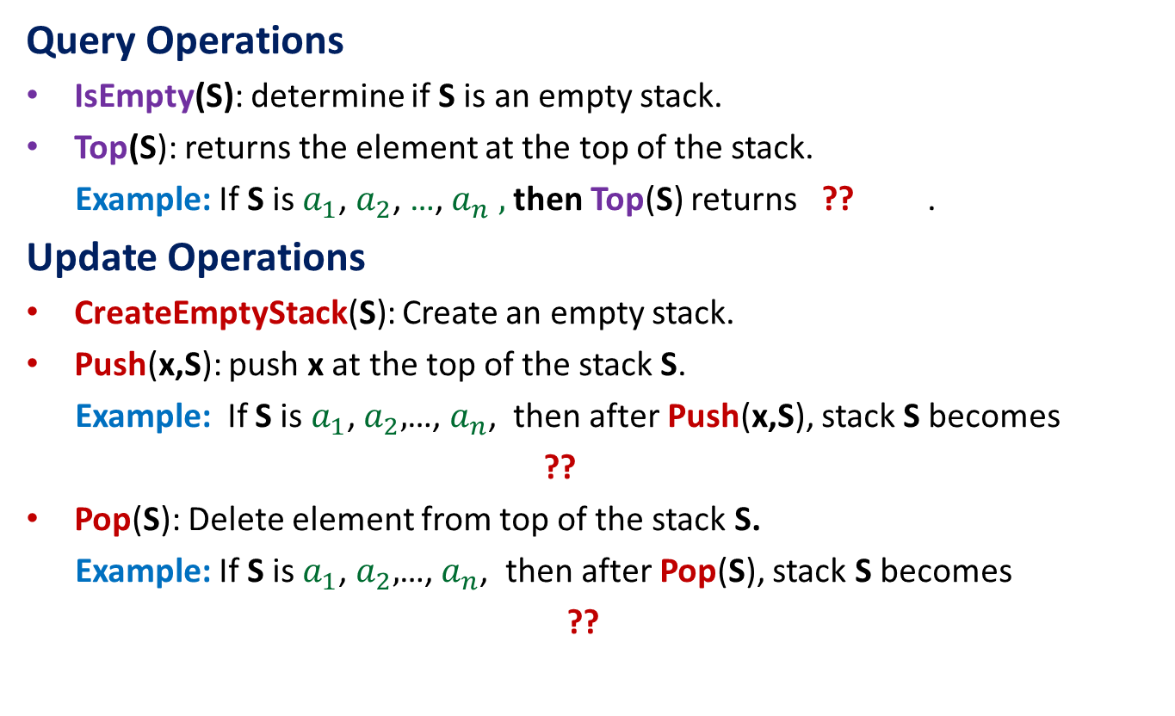
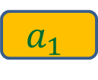

Operations on a Stack
Query Operations
IsEmpty(S): determine if S is an empty stack.
Top(S): returns the element at the top of the stack.
Example: If S is $a_{1}$, $a_{2}$, …,${ a}_{n} ,$ then Top(S) returns ?? .
Update Operations
CreateEmptyStack(S): Create an empty stack.
Push(x,S): push x at the top of the stack S.
Example: If S is $a_{1}$, $a_{2},$…, $a_{n}$, then after Push(x,S), stack S becomes
??
Pop(S): Delete element from top of the stack S.
Example: If S is $a_{1}$, $a_{2},$…, $a_{n}$, then after Pop(S), stack S becomes
??
$$a_{1}$$
${x, a}_{1}$, $a_{2}$ ,…, $a_{n}$
$a_{2}$ ,…, $a_{n}$

Slide 8




An Important point about stack: How to access ith element from the top ?
To access ith element, we must pop (hence delete) one by one the top i-1 elements from the stack.
$$a_{1}$$
$$a_{i−1}$$
$$a_{i}$$
$$a_{n}$$

Slide 9
Evaluation of an arithmetic expression
How does a computer/calculator evaluate an arithmetic expression given in the form of a string of symbols?
8 + 3 * 5 ^ 2 – 9
First it splits the string into tokens which are operators or operands (numbers). This is not difficult. But how does it evaluates it finally ???
operators
operands

Slide 10
Precedence of operators
Precedence: “priority” among different operators
Operator + has same precedence as –.
Operator * (as well as /) has higher precedence than +.
Operator * has same precedence as /.
Operator ^ has higher precedence than * and /.

Slide 11
A trivial way to evaluate an arithmetic expression
First perform all ^ operations.
Then perform all * and / operations.
Then perform all + and - operations.
Disadvantages:
An ugly and case analysis based algorithm.
Multiple scans of the expression.
What about expressions involving parentheses : 3+4*(5-6*(8+9^2)+3)
What about associativity of the operators:
2^3^2 = 512 and not 64
16/4/2 = 2 and not 8.
8
+
3
5
2
-
*
^
9

Slide 12
In the next class (27 August), we shall devise a very simple, elegant, efficient and compact way to evaluate an arithmetic expression based on stacks.
(Though it was briefly outlined in today’s class, we shall do it all over again.)
See you on 27 August at 9 AM.

