Slide 1
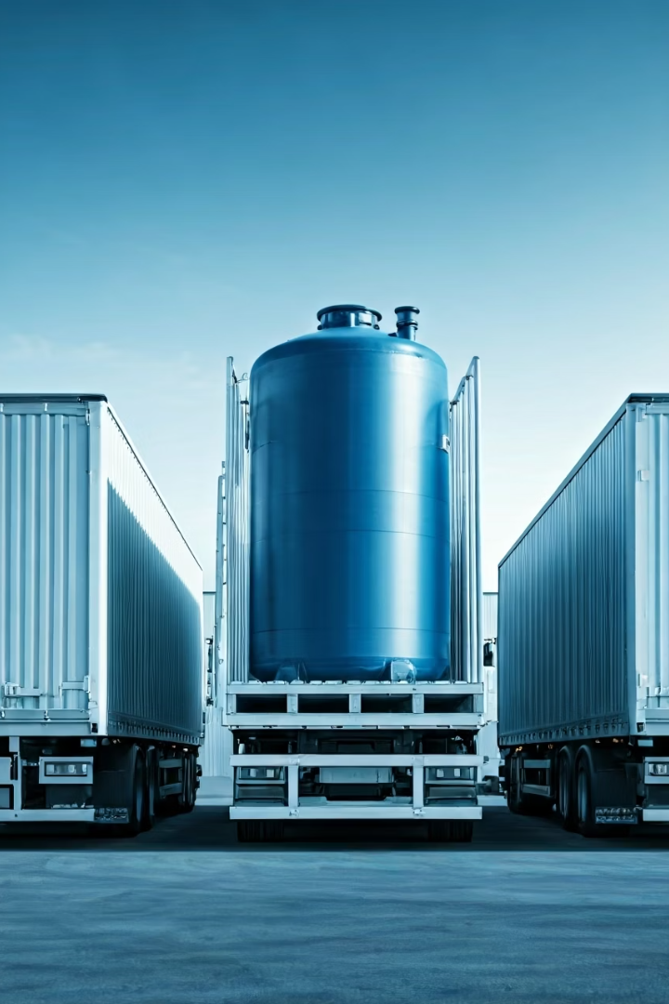

Optimizing Distribution Scheduling for Ice Bath Tanks Using AI-Based Analytics
Presenter: Abishai Srinivasan

Slide 2
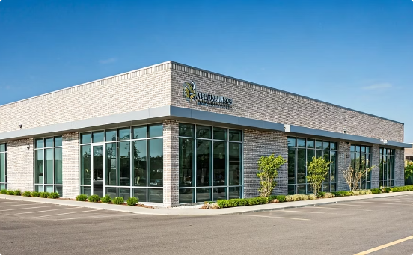
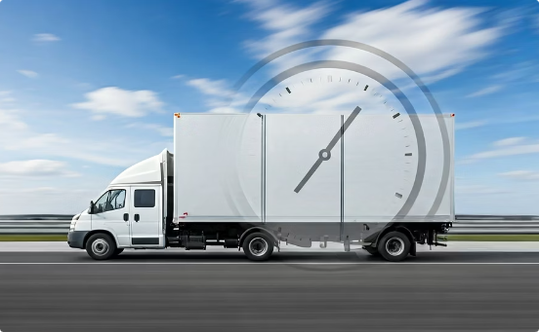
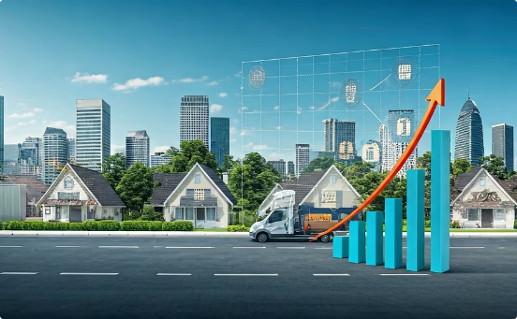
Challenges in Distribution Scheduling at Ice Bath Tanks GmbH
Company Profile
Delivery Challenges
Consequences
Wellness company with €15M sales in 2024.
Strict customer delivery time windows
Increased distribution costs and complex scheduling issues.
Legal working hour limits for drivers
Multi-driver deliveries for some orders

Slide 3

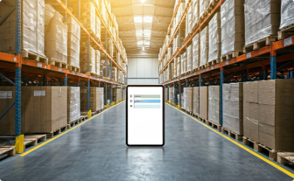

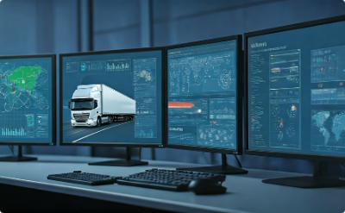
Proposed AI-Driven Optimization Model
Data Collection
Mathematical Modeling
Algorithms
System Integration
Gathering customer orders, delivery time windows, and driver availability.
Representing constraints and objectives with Mixed-Integer Programming.
Applying metaheuristics such as Genetic Algorithm and Simulated Annealing for scalable solutions.
Real-time scheduling dynamically adapts to new orders and driver absences.

Slide 4



Impact and Next Steps
Expected benefits:
Future research:
Cost savings
By minimizing travel and labor.
Extend model
Incorporate real-time data
With vehicle capacity and maintenance scheduling.
Improved adherence
Traffic and weather information.
To customer time windows.
Increased efficiency
In operational processes.

