Slide 1
Effect of analytical skills on interns recruitments yvj349 DA 6223-Data Analytics Tools and Technique Dr. Matthew Martinez
Martin Oguntunde

Slide 2
Abstract
Data analytics skills are quite universal. They are used nearly in every industry ranging from manufacturing, government parastatals and technology companies. As these needs are abound, it is paramount for every data analytical student to familiarize themselves with all these skills and tools while they are in school in order to have significant edge over their contemporary.
This study investigate the role analytical skills play in job advertisement for analytical interns across in the United States.

Slide 3
INTRODUCTION
Analytical tools are abound these days and normally used in virtually every thriving industry. Consequently, in order to be competitive in this dynamic business world, it behooves every aspiring professional to acquire these set skills. Although, most organizations might not state the need to have knowledge of certain skills like advance excel skills, SQL, Phyton, R programming and SAS programming but it is important for interns to have an ideas of these tools so that they can excel during the interview and then get employed.
For this study, the job recruiting site indeed.com was used determine the importance of skills to prospective employers while considering placement for their intends by scrapping relevant information using beautiful soup on python. After scrapping these information, the researcher used tools like panda and tableau to visualize the data to be able to arrive at valuable decisions.

Slide 4
Expected Outcome
Ascertain if knowledge of analytical skills are important in intern job placements of under graduate and graduate students.
Ascertain whether data analytical intern roles are predominately available in certain region of the country.
Ascertain how high the monetary compensation for data analyst interns

Slide 5
Method
In order to perform this test ,data were scrapped from indeed.com with searching for all data analytics interns by pulling the job locations, descriptions, job title and salary. The data were retrieved by using phyton programming.
To able to complete the this task, various packages such as beautiful soup, csvs , time, requests and os were imported to be able scrape data from indeed.com
Search words such as Python, SAS, SSRS, Big Data and SQL were the key words used to filter for the skills in the job description section.
Thereafter, the data were visualized using phyton panda and tableau.

Slide 6
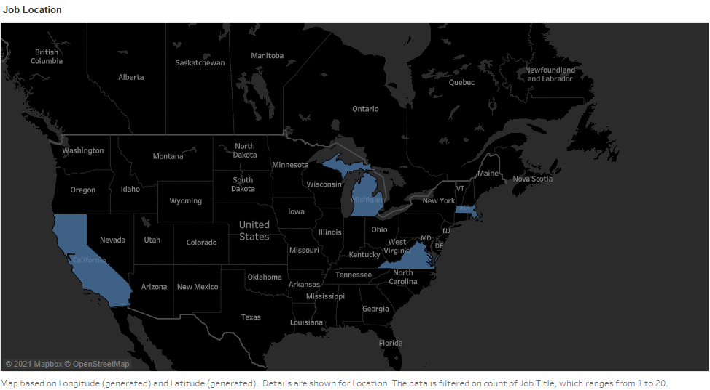
GEOGRAPHICAL LOCATION OF AVAILABLE POSITIONS
Based on this figure,80% of this job vacancies are remote position while the rest are spread across the states with the blue highlights. California, Massachusetts, Michigan and Virginia seem to take the lead on where these positions are largely located.
This is not surprising because with the current pandemic going on, many organizations have been virtually onboarding new employees remotely.

Slide 7
Need for analytical skills
Figure 1.2
Figure 1.2 shows that only 8% of the job postings categorically states analytical skills required of their candidates.
Knowledge of python, R programming, SAS and SQL are categorically stated in the job description and summary.
However, the rest of the positions that did not specify need for knowledge of certain analytical skills emphasize on the type of course of study they prefer applicant to be currently studying.
This study reveals computer science as number one choice of course of study.

Slide 8
JOB TITLE
From this illustration, it is obvious that data analyst role continue to be in a very high demand compare to other roles followed by business analyst and business Intelligence.
In the others category comprise of roles like analyst development analyst, HR analyst and market research analyst.
This chart clearly depicts and asserts the fact data analyst roles have come to stay and it relevance can not be ignored and they are integral to every organization.

Slide 9
Compensation rates
Although majority of organizations did not divulge their pay rates for various job postings. However, few companies divulged the intended pay for the new hires. But surprisingly, compensation rates are as high as $75K.
Also worthy of note is that all these companies pay above federal minimum pay rate of $7.50.

Slide 10
Conclusion
While acquisition and knowledge of certain analytical and programming skills are very important in succeeding in today’s fast pace job market, the result of this study proves that most employers do not place too much of emphasis on the skills of their intending interns. They assume with degrees like computer science students should be able to cope and exceed expectations at their respective companies when given internship opportunities.

