Slide 1
Bootstrap for dummies
Mo’s guide to using Bootstrap.

Slide 2
Before we start…
Please make sure you have git and at least node v4 installed on your machine.

Slide 3
Grab the session tutorials
Clone this repo: https://github.com/mogusbi/bootstrap-for-dummies.git
And then cd into the bootstrap-for-dummies directory checkout the “part-one” branch.
Once you’re in there, run “npm install” to install project dependencies and then “npm start” and load up http://localhost:3000 on your chosen browser

Slide 4
What this session will talk about
What is Bootstrap?
The pros and cons of Bootstrap
Mo’s step-by-step guide to using Bootstrap
Looking at visuals and identifying which existing Bootstrap components to use so that you can build a skeleton site without writing a single line of (S)CSS
Looking at something like a brand guideline and using the info from that update the Bootstrap configuration file to make your skeleton site look closer to the end product
How to use existing helpers that come with Bootstrap to add more components (i.e. how to avoid reinventing the wheel)
Using built in utilities
Putting the finishing touches to your Bootstrap site by adding in your own styles

Slide 5
What is Bootstrap?
According to their website, it is a “HTML, CSS, and JS framework for developing responsive, mobile first projects on the web”

Slide 6
Bootstrap pros
It does all the heavy lifting for you so that you can knock together a fully responsive website in next to no time.
You don’t have to worry about how it works on different browsers, provided you haven’t done anything too wacky, your site should work just fine on all the supported browsers (IE8+). After all, it is the most popular framework in the world so you’d assume they’ve done some rigorous testing….

Slide 7
Bootstrap cons
It makes you write crap HTML. Bootstrap is notorious for making your write spaghetti code
It’s pretty easy to spot a site built on Bootstrap if you’re being lazy and don’t customise it. You end up making rubbish sites that don’t stand out.
People misuse Bootstrap. It makes no sense including the entire compiled library and then creating another stylesheet to overwrite colours, fonts, buttons, etc. (This is why we’ll be using Bootstrap-Sass to pick and choose which bits of Bootstrap we want and the config file to that we’re not forced to overwrite properties).

Slide 8
Before we start…
This is all opinionated, if you don’t agree with something I say then speak up

Slide 9
Part 1
Looking at visuals and identifying which existing Bootstrap components to use so that you can build a skeleton site without writing a single line of (S)CSS

Slide 10

Look at this design: which existing Bootstrap components can we use?

Slide 11
Navbar
Jumbotron
Input group
Media object
Panel
Lists
Buttons
Forms

Slide 12
There isn’t an existing component we can use to build the news and events section, but that’s fine, we can knock something together pretty quickly using just the grid.

Slide 13
Load up http://localhost:3000 to see what the skeleton of our site looks like

Slide 14
Part 2
Using brand guidelines or anything else to update the Bootstrap config file
Before we start, please checkout the branch “part-two”

Slide 15
Bootstrap config
To avoid falling into the trap of overwriting large chunks of Bootstrap like a noob, you can use the config file to modify large swathes of the framework on build.
I’d recommend familiarising yourself with the config file here: https://github.com/twbs/bootstrap-sass/blob/0a64ad76107e0363e0d504287c0f9b88c6679399/templates/project/_bootstrap-variables.sass

Slide 16
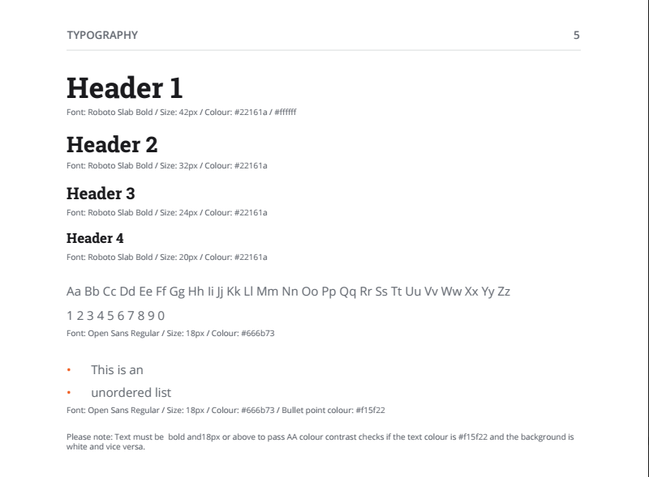
Using brand guidelines

Slide 17
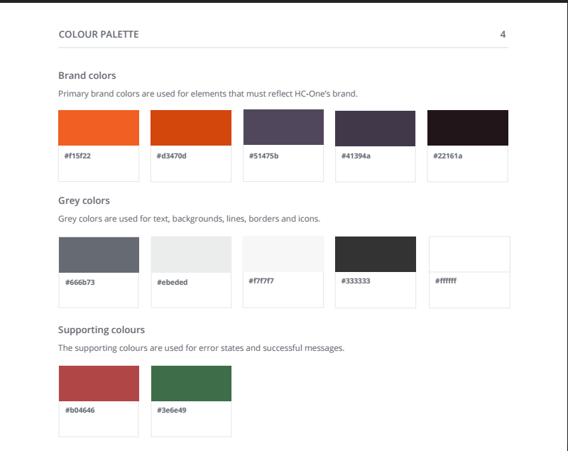
Using brand guidelines

Slide 18
Reload http://localhost:3000 to see what the skeleton of our site looks like now we’ve updated the config file

Slide 19
Part 3
Use existing helpers that come with Bootstrap to add more components
Before we start, please checkout the branch “part-three”

Slide 20
Why do we need to bother with this?
We might need yet another button variation because default, primary, success, error and danger might not be enough
Rather than creating a new class and manually recreating all the properties, chances are there’s a helper within Bootstrap that’ll let you quickly build another component variation

Slide 21
How can I find out if a helper utility exists?
Go to the Bootstrap-sass Github repo and search the source code. https://github.com/twbs/bootstrap-sass
If source maps are enabled, use that to see how a component is built in the SCSS source code using your web inspector

Slide 22
Fire up Sublime Text!
If you open up _buttons.scss in the source folder of the project you can see how you can quickly generate new button variations.

Slide 23
Part 4
Using utility classes
Before we start, please checkout the branch “part-four”

Slide 24
Utilities
Bootstrap comes with a load of utility classes to make your life easier. I could go through all of them but you have a web browser and can read, so RTFM.
http://getbootstrap.com/css/
http://getbootstrap.com/components/

Slide 25
Part 5
Putting the finishing touches on your site by creating your own styles
Before we start, please checkout the branch “part-four”

Slide 26
Best practices
If you need to add your own styles, then try to make use of all the variables made available in the Bootstrap config, it comes with standardised padding, font sizes, colours, etc. There’s no point not using them
Use the Bootstrap breakpoints for your media queries. There’s no point in adding more than the 4 breakpoints that ship with the framework (xs for mobile, sm for portrait tablet, md for landscape tablet and lg for desktop) otherwise your site just becomes a mess and hard to maintain

