Slide 1

Pruning
Neural Networks are just awe-some, let’s make them awe-more!

Slide 2
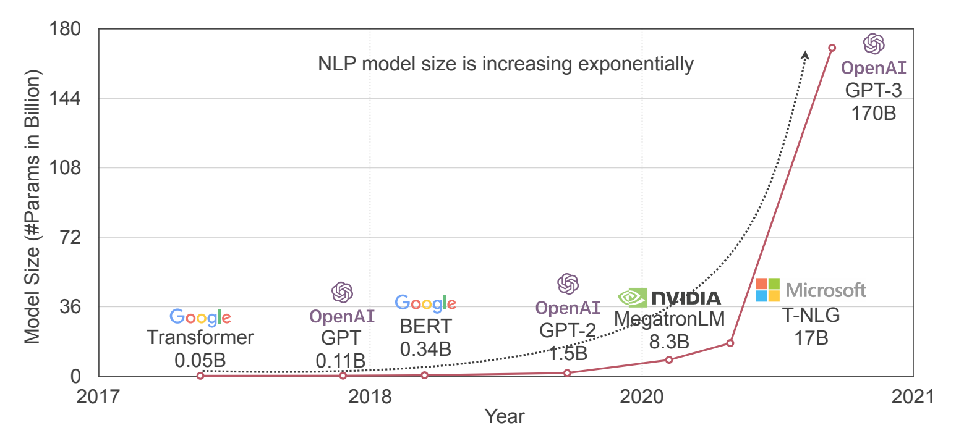
Models are just TOO big

Slide 3
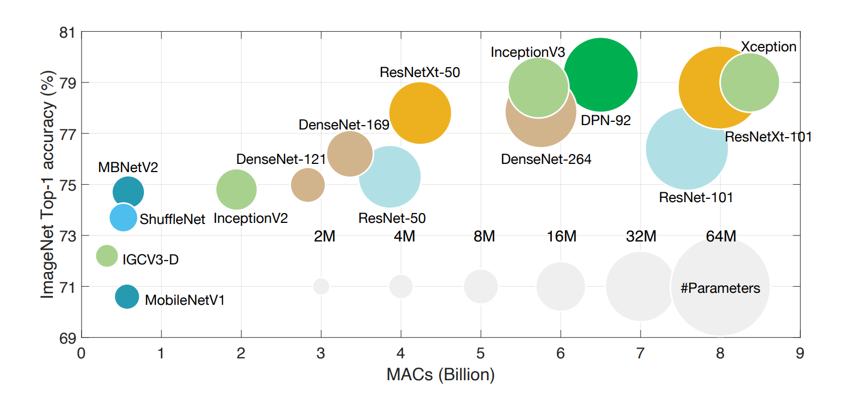
Models are just TOO big

Slide 4
Neural Network Pruning
Introduction to Pruning
What is pruning?
Pruning granularity
Pattern by which we are pruning
Pruning Criterion
What synapses are we pruning?
Pruning Ratio
Target sparsity (for each layer?)
Finetuning the pruned model
How should we improve performance of pruned models?

Slide 5
Neural Network Pruning
Introduction to Pruning
What is pruning?
Pruning granularity
Pattern by which we are pruning
Pruning Criterion
What synapses are we pruning?
Pruning Ratio
Target sparsity (for each layer?)
Finetuning the pruned model
How should we improve performance of pruned models?

Slide 6
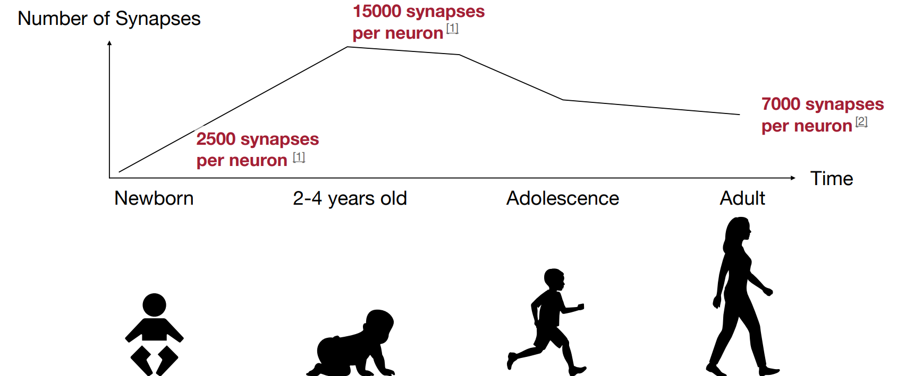
What is pruning?
Do we have brain to spare?

Slide 7
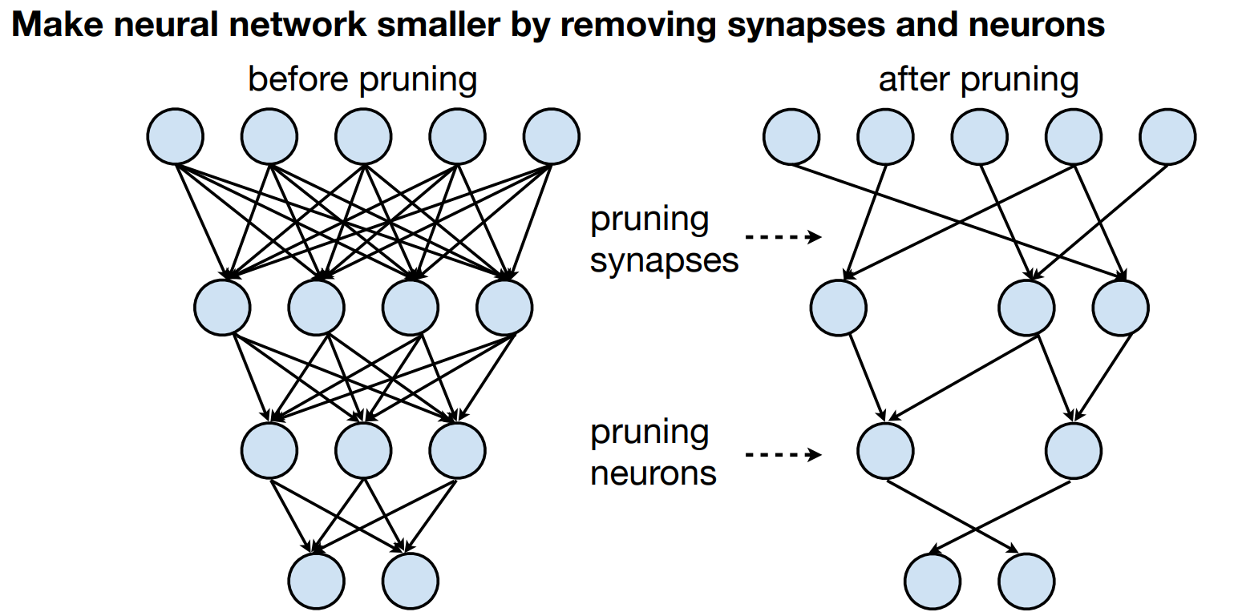
What is pruning?

Slide 8
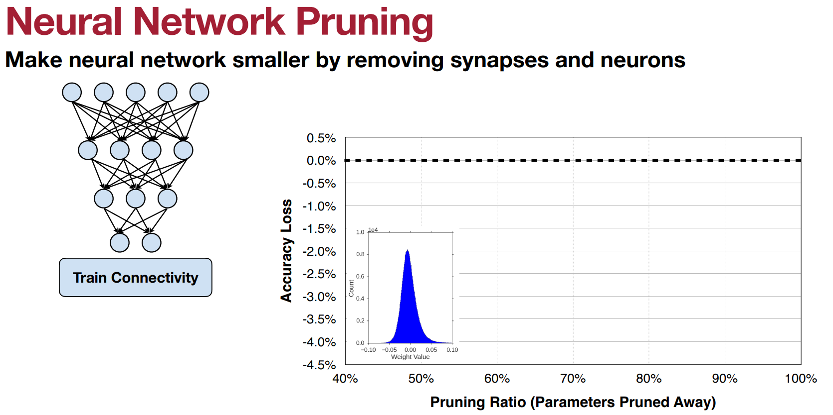
What is pruning?

Slide 9
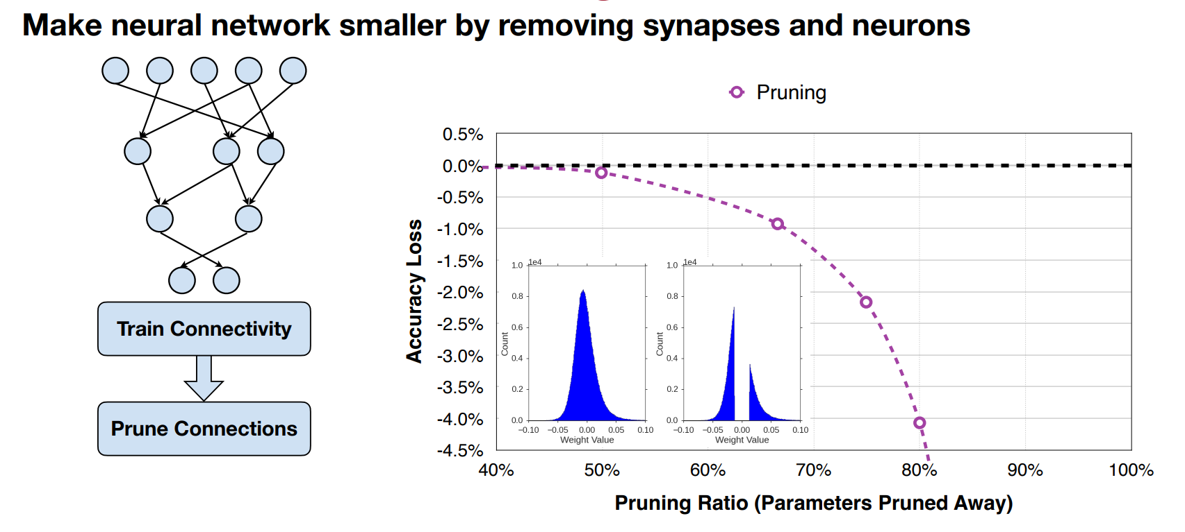
What is pruning?

Slide 10
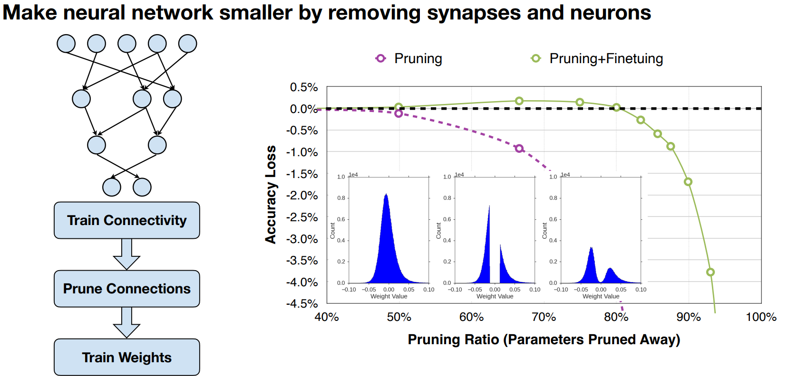
What is pruning?

Slide 11
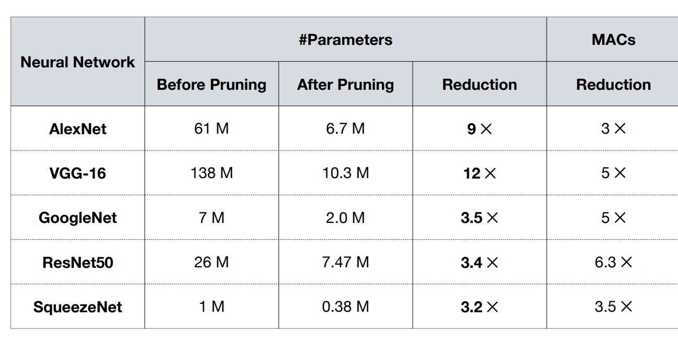
What is pruning?

Slide 12
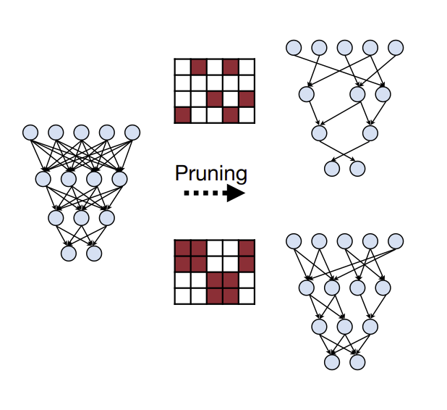
Pruning Granularity
Introduction to Pruning
What is pruning?
Pruning granularity
Pattern by which we are pruning
Pruning Criterion
What synapses are we pruning?
Pruning Ratio
Target sparsity (for each layer?)
Finetuning the pruned model
How should we improve performance of pruned models?

Slide 13
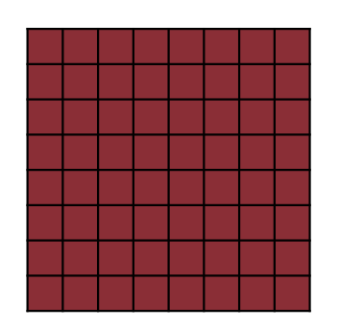
Pruning Granularity
A simple weight matrix of a Dense network

Slide 14
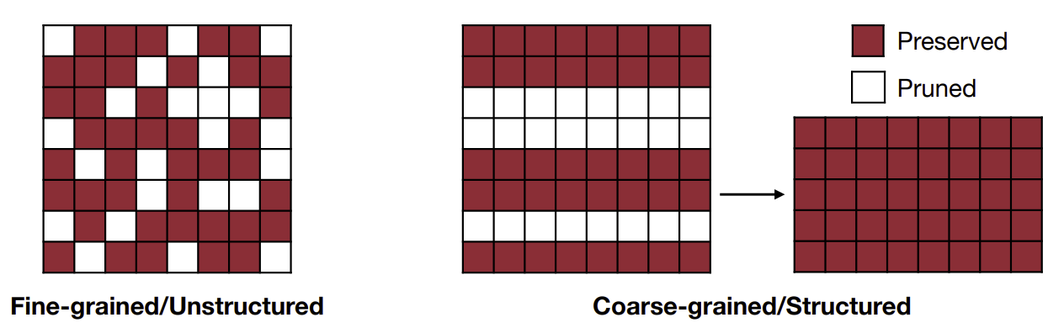
Pruning Granularity
Different types of pruning

Slide 15
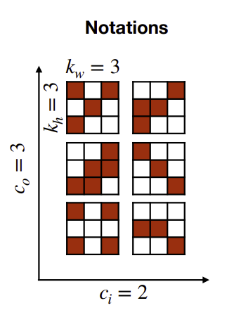
Pruning Granularity
Convolution?
4 degree of freedom:
c_{i}, c_{o}, k_{w}, k_{h}
Input Channels
Output Channels
Kernel Size Height
Kernel size Width

Slide 16
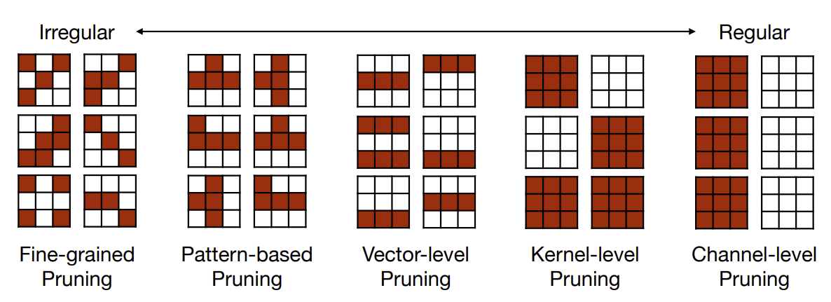
Pruning Granularity

Slide 17
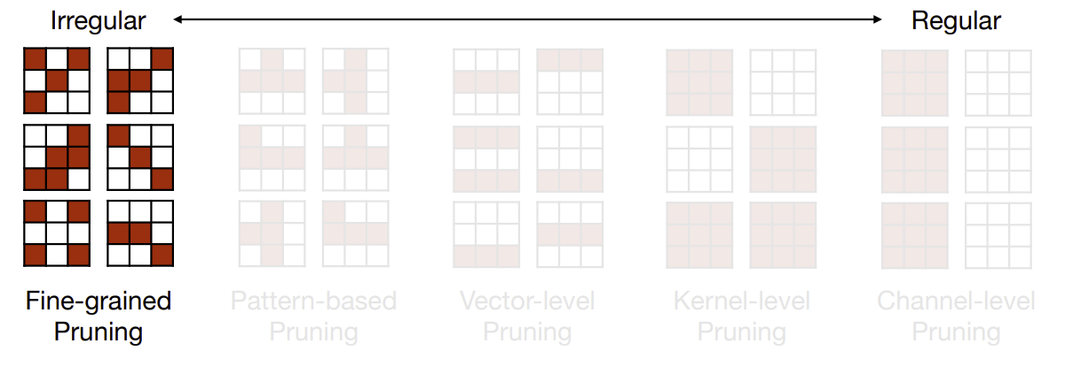
Fine-grained pruning

Slide 18
Fine-grained pruning
Flexible pruning
Better compression ratio
Speed up on some custom hardware?

Slide 19
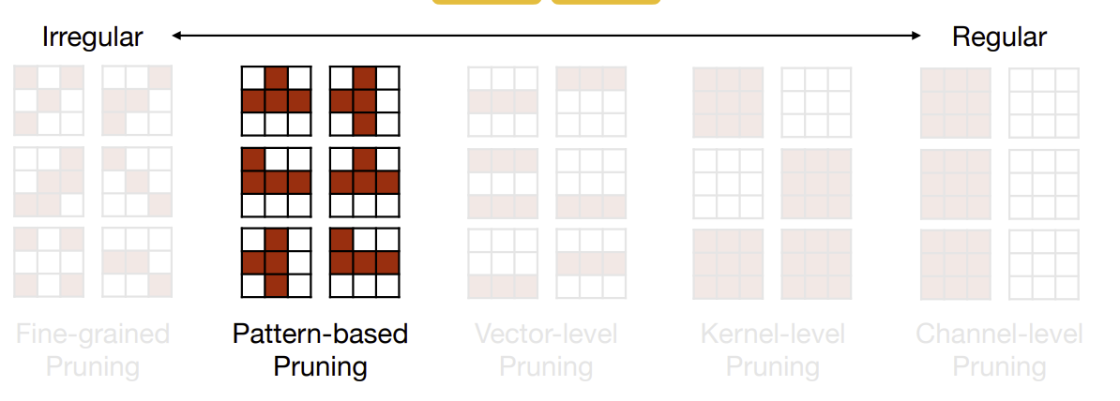
Pattern-based Pruning

Slide 20
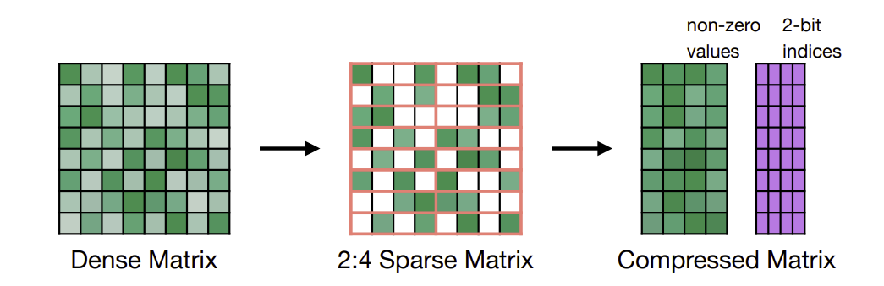
Pattern-based Pruning
N:M sparsity
Supported by NVIDIA’s Ampere GPU Arch.

Slide 21
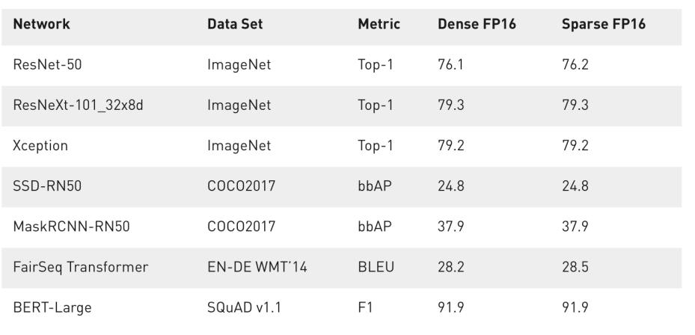
Pattern-based pruning

Slide 22
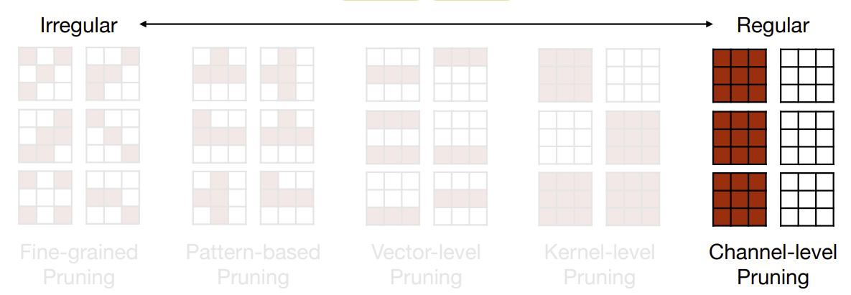
Channel-wise Pruning

Slide 23
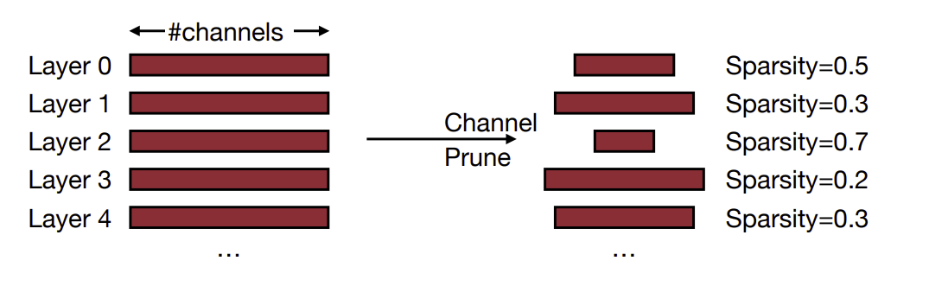
Channel-wise Pruning

Slide 24
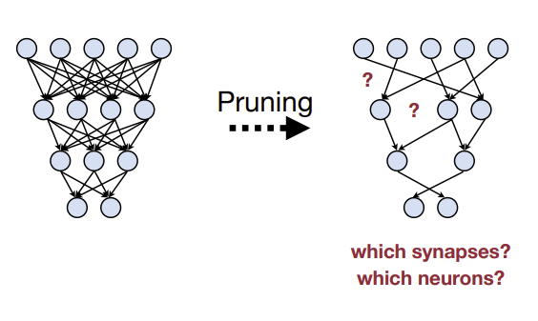
Pruning Criterion
Introduction to Pruning
What is pruning?
Pruning granularity
Pattern by which we are pruning
Pruning Criterion
What synapses are we pruning?
Pruning Ratio
Target sparsity (for each layer?)
Finetuning the pruned model
How should we improve performance of pruned models?

Slide 25
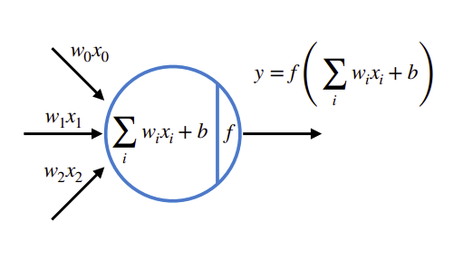
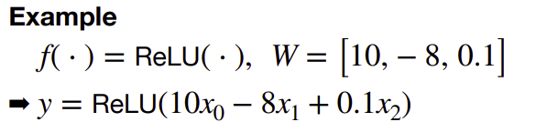
Pruning Criterion
The less “important” parameters are removed

Slide 26
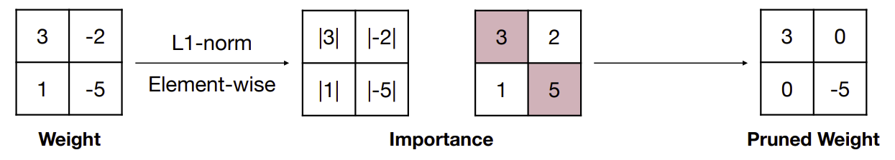
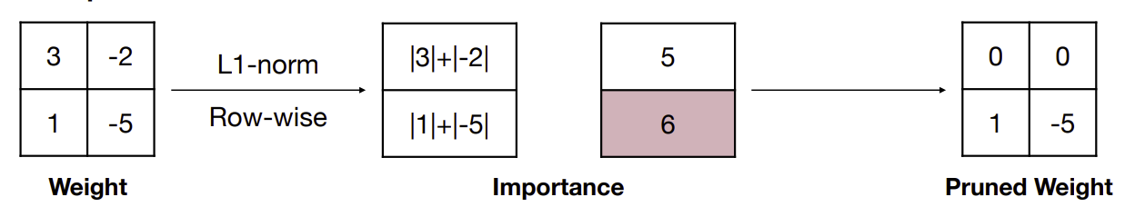
Pruning Criterion

Slide 27
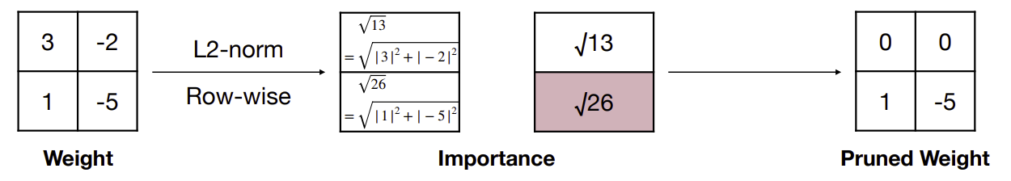
Pruning Criterion

Slide 28
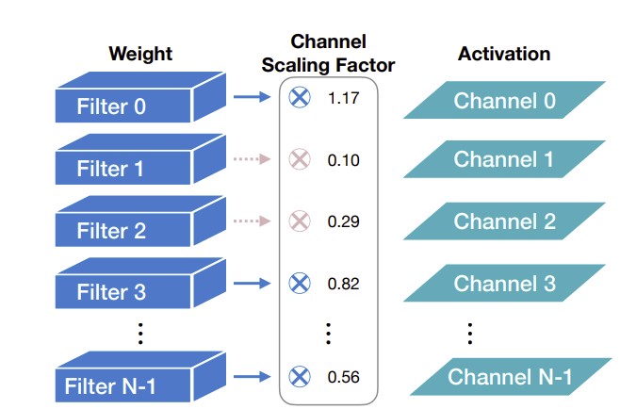
Pruning Criterion

Slide 29
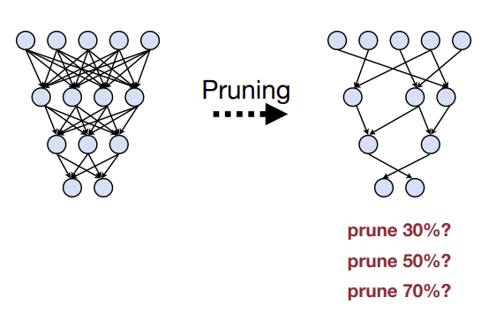
Pruning Ratio
Introduction to Pruning
What is pruning?
Pruning granularity
Pattern by which we are pruning
Pruning Criterion
What synapses are we pruning?
Pruning Ratio
Target sparsity (for each layer?)
Finetuning the pruned model
How should we improve performance of pruned models?

Slide 30
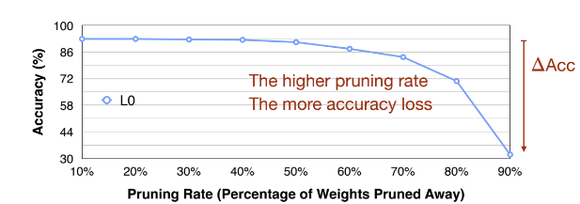
Pruning Ratio
Sensitivity analysis

Slide 31
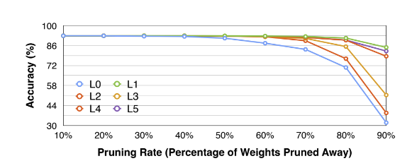
Sensitivity Analysis

Slide 32
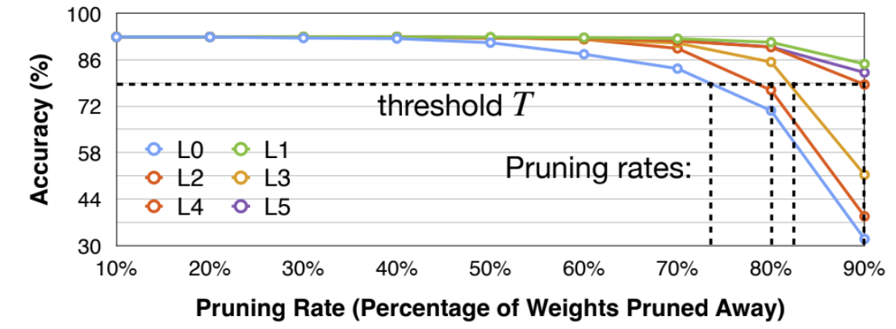
Sensitivity Analysis

Slide 33
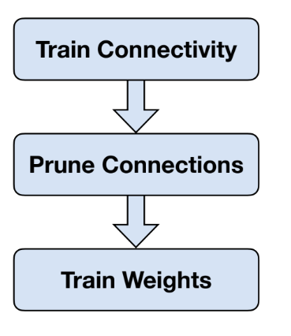
Finetuning the pruned network
Introduction to Pruning
What is pruning?
Pruning granularity
Pattern by which we are pruning
Pruning Criterion
What synapses are we pruning?
Pruning Ratio
Target sparsity (for each layer?)
Finetuning the pruned model
How should we improve performance of pruned models?

Slide 34
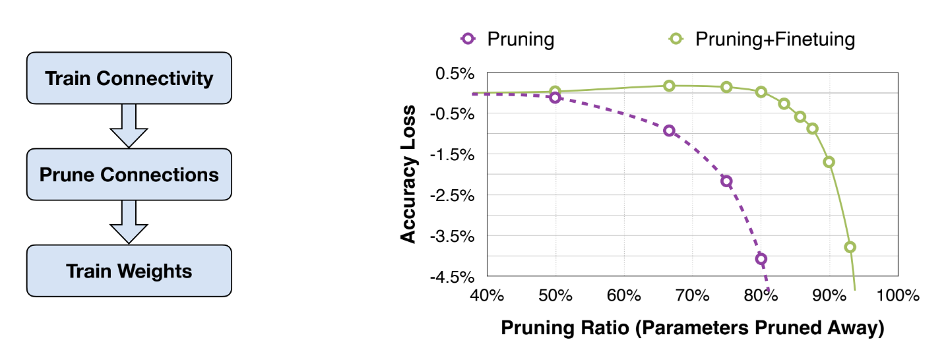
Finetuning the pruned network

Slide 35
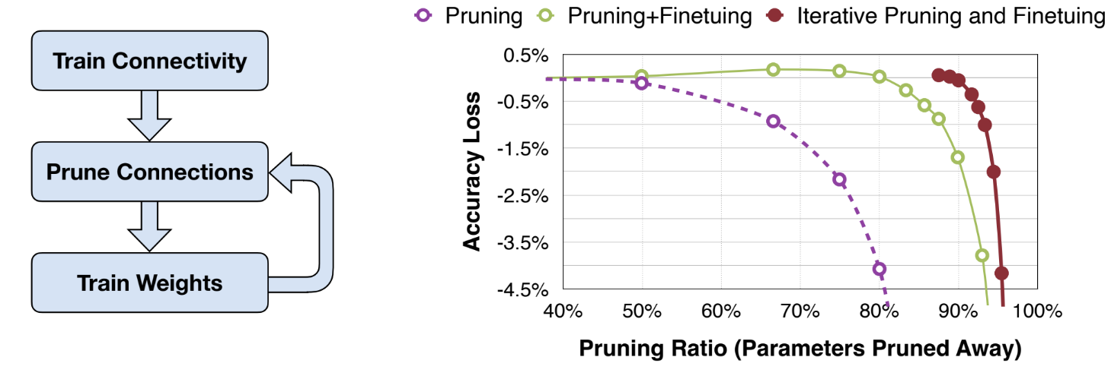
Finetuning the pruned network

Slide 36

Lab
Let’s get our hands dirty

