Slide 1
AI Adoption
0.72
Amplifying the Digital Divide
the country-level correlation between AI adoption and GDP per capita
A cross-country and within-country exploration of generative AI use,
compiling 11 primary data sources across 38 countries.
Mohamed Abdel-Hamid · Data Preparation and Analysis · Spring 2026 · University of St. Thomas

Slide 2
02
The question
Inside a country, and across countries
“Is generative AI adoption following — and amplifying — the existing digital divide?”
QUESTION
WITHIN COUNTRIES
ACROSS COUNTRIES
Does AI use vary by
age, income, and education?
Does AI use track GDP
and internet penetration?
Tested with US (Pew, Brookings) and EU (Eurostat) data on adoption by demographic group.
Tested with Microsoft AI Diffusion (34 countries) and World Bank/IMF macro indicators.
Mohamed Abdel-Hamid · AI Adoption Research · May 2026

Slide 3
03
Hypothesis
What I expected to see in the data
Generative AI adoption follows existing digital-divide patterns. AI is amplifying — not closing — the digital divide.
HYPOTHESIS
Specifically:
1.
Within countries: Younger, higher-income, more-educated individuals adopt at substantially higher rates.
2.
Across countries: Adoption correlates strongly with GDP per capita and internet penetration.
Mohamed Abdel-Hamid · AI Adoption Research · May 2026

Slide 4
04
Eleven primary data sources
Compiled into a 10-sheet master workbook (38 countries)
WITHIN-COUNTRY
CROSS-COUNTRY
CONTROL VARIABLES
Pew Research
Microsoft
IMF / World Bank
ChatGPT use by US adults (n=5,123, 2025); by age + education
AI Diffusion Report 2025 H2 — % of working-age pop using GenAI (top 30)
GDP per capita (PPP), 2024
DATA
Pew Research
Stanford HAI
ITU / World Bank
Teens AI use by household income (Dec 2025)
AI Index 2025 — country-level optimism
Internet users (% of population), 2024
Pew Research
Ipsos
World Bank
21% of US workers use AI on the job (Oct 2025)
AI Monitor 2024 — 32-country attitudes
Tertiary education completion rate
Brookings / RPS
Anthropic
US generative AI use by demographics (2024)
Economic Index Sept 2025 — per-capita Claude usage
Eurostat
Visual Capitalist
EU GenAI use by country and age group (2025)
GPO-AI 2024 — daily/weekly use, 21 countries
Mohamed Abdel-Hamid · AI Adoption Research · May 2026

Slide 5
05
How I tested it
Compile, compare, correlate — then check the numbers two different ways
1
Compile
2
Compare
11 sources → 10-sheet workbook with merged Master_Country sheet (38 countries)
US/EU adoption rates by age, income, education vs. national average
METHODS
3
Correlate
4
Verify
Pearson r between country-level adoption and GDP, internet, education
Cross-check Python correlations against Excel CORREL() formulas in workbook
Sources use different adoption definitions (have-ever-used vs. used-in-last-3-months vs. daily). Cross-source comparisons are indicative; the Microsoft and Eurostat measures are most directly comparable.
Mohamed Abdel-Hamid · AI Adoption Research · May 2026

Slide 6
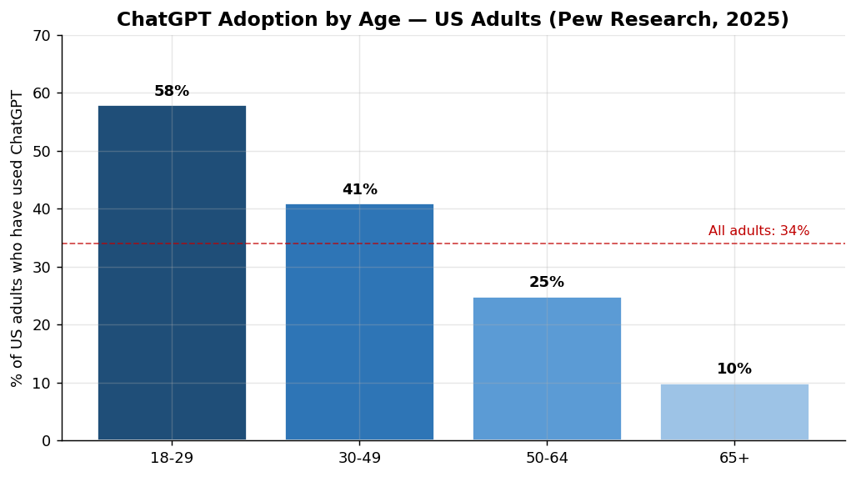
06
Result A — The within-country divide
Younger and more-educated adults use ChatGPT far more than everyone else
5.8x
more likely · US adults under 30 use ChatGPT than 65+ (58% vs. 10% — Pew, 2025)
RESULT A
2.9x
Figure: ChatGPT use by US adults, by age. Source: Pew Research Center, June 2025 (n=5,123).
more likely · Postgrads use ChatGPT than HS-or-less (52% vs. 18% — Pew, 2025)
Same pattern shows up in Europe — Eurostat reports 64% of 16-24 year-olds use generative AI vs. 7% of 65-74 year-olds.
Mohamed Abdel-Hamid · AI Adoption Research · May 2026

Slide 7
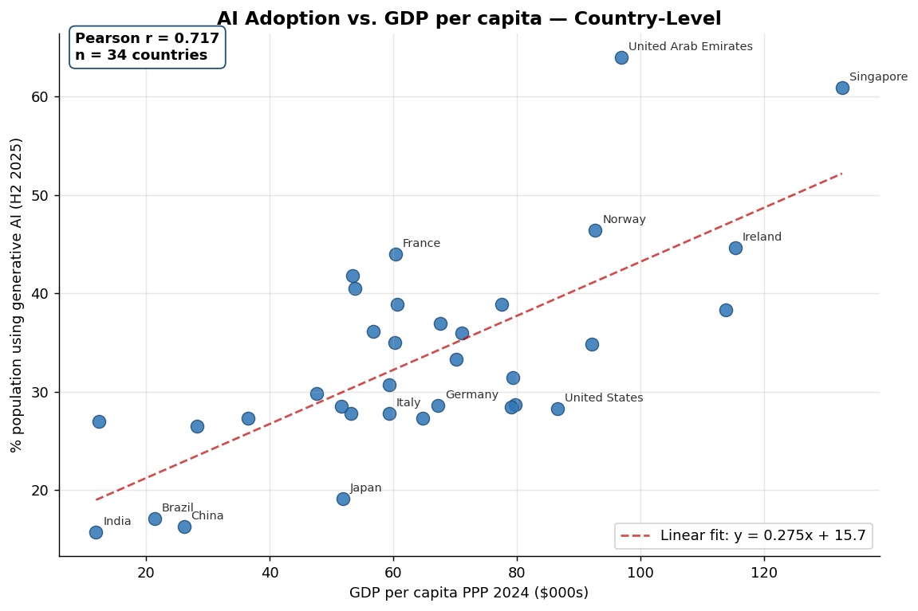
07
Result B — The across-country divide
Richer countries use AI more — and the link is strong, not subtle
KEY CORRELATIONS
+0.72
RESULT B
Adoption × GDP/cap
+0.61
Adoption × Internet
+0.51
Adoption × Tertiary ed.
n = 34 countries
Wealth, internet access, and education all predict how much a country uses AI. Of the three, wealth is the strongest predictor.
Mohamed Abdel-Hamid · AI Adoption Research · May 2026

Slide 8
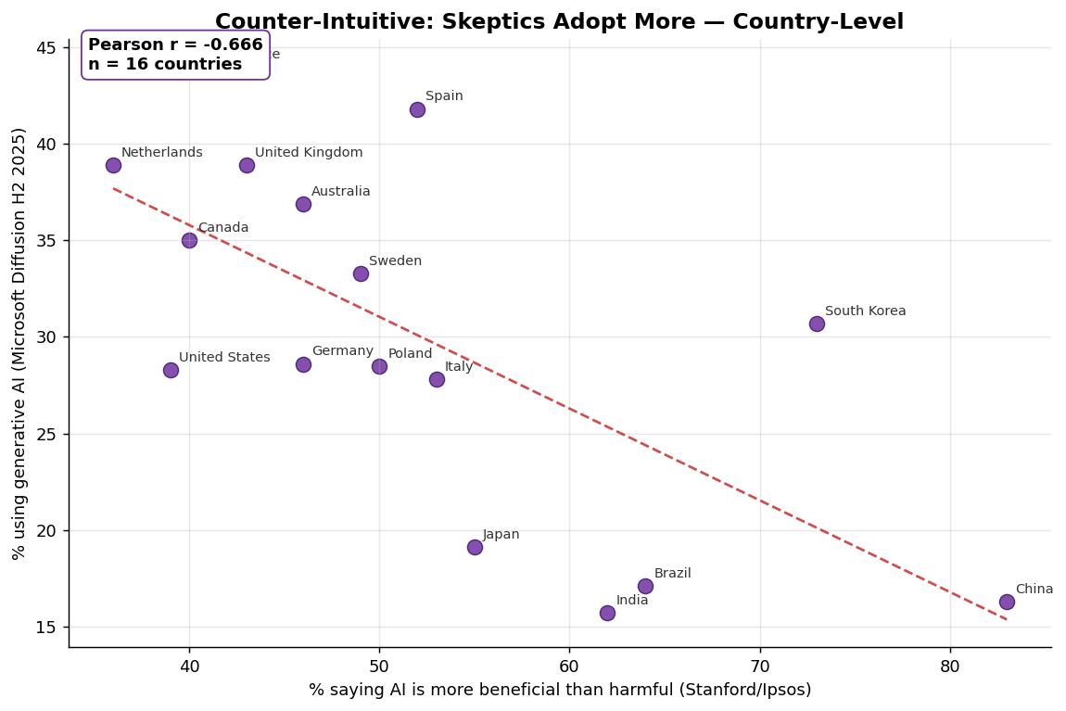
08
Skeptics adopt more, enthusiasts adopt less
Where AI use is highest, public opinion of AI is actually lowest
−0.67
SURPRISE
AI adoption × AI optimism across 16 countries with both measures
Most optimistic, lower adoption:
China 83% · Indonesia 80% · Thailand 77%
Most skeptical, higher adoption:
Netherlands 36% · US 39% · France 42%
Figure: Country-level AI adoption (Microsoft) vs. AI optimism (Stanford/Ipsos), n=16.
Liking AI and using AI turn out to be different things. One reading: people who actually use the tools see the failures up close.
Mohamed Abdel-Hamid · AI Adoption Research · May 2026

Slide 9
09
Uncertainty & scope of inference
Where these findings should and should not be applied
01
Source comparability · Different surveys define "adoption" differently — ever-used vs. last-3-months vs. daily. Direct comparisons are indicative.
02
Online sampling bias · Country-level surveys are mostly online — likely overstating adoption in lower-internet countries.
LIMITS
03
Correlational, not causal · Cross-sectional Pearson r only. Reverse causation (AI → productivity → GDP) cannot be ruled out.
04
Small n for the twist · Optimism×adoption analysis rests on only 16 countries. Larger sampling needed to firmly establish the paradox.
05
Coverage skews OECD · 34-country adoption sample under-represents Sub-Saharan Africa and parts of Central Asia.
Scope of inference: Findings generalize to OECD and middle-income economies. Not generalizable to low-income contexts — those need separate data.
Mohamed Abdel-Hamid · AI Adoption Research · May 2026

Slide 10
WRAPPING UP
What I learned
Original (supported)
Generative AI adoption follows existing digital-divide patterns. Within countries, age and education gradients are steep. Across countries, adoption tracks GDP (r=+0.72) and internet penetration (r=+0.61). AI is amplifying the digital divide.
Added refinement (new)
Public sentiment about AI is decoupled from — and inversely related to — actual usage (r=−0.67). Adoption and optimism are distinct outcomes with potentially different drivers. Future work should treat them separately.
Repository github.com/moh-a-abde/ai-adoption-research
Mohamed Abdel-Hamid · May 2026

