Slide 2
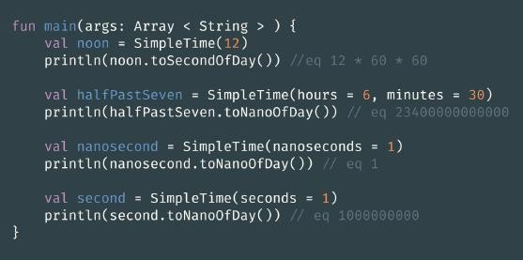
Lab1
Define a class SimpleTimethat stores the time passed from the beginning of the day. It should take four arguments: hours, minutes, seconds and nanoseconds, where each argument has the default value of zero.
Implement two member functions: toSecondOfDayand toNanoOfDayreturning the number of seconds and nanoseconds accordingly passed from the beginning of the day.

Slide 3
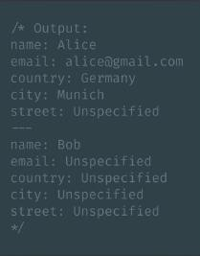
Lab2
Implement the extension function getFullInfo() returning a string value. It should list the properties of the class as in the example below and add "Unspecified" if the corresponding value is null:
name: Alice
email: alice@gmail.com
country: Germany
city: Munich
street: Unspecified
void main() {
var alice = Client('ALice', Personal Info( email = 'alice@gmail.com', address =
Address('Germeny', 'Munich'))); print(alice.getFullInfo()); print('---');
print(Client('Bob’).getFullInfo());
}

Slide 4
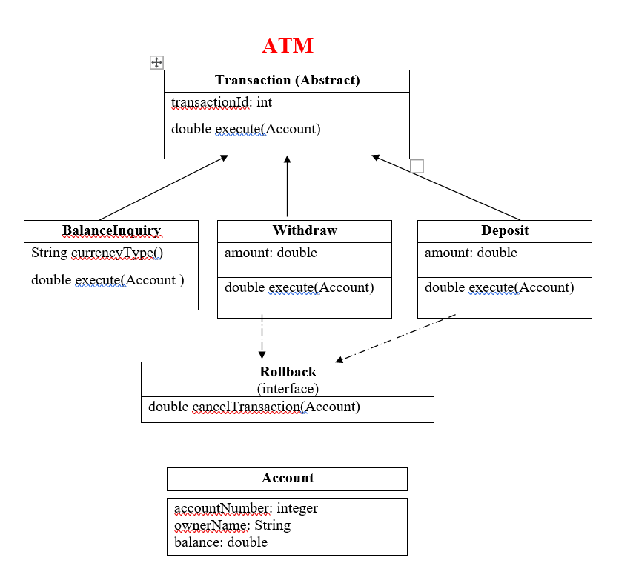
lab3

Slide 5
Design the previous classes and note that
"execute" method of each class will return the new account balance.
"execute" method in balance inquiry will return the account balance in the specified currencyType, currencyType could be "U" for USD or "E" for euro
"cancelTransaction" of each class will be opposite to the execute method, i.e. "execute" method in case of "Deposit" class will increase the balance of the account by the specified amount while "cancelTrasnaction" will decrease the balance by the specified amount.
Create main function and test your classes using the following
Display the following menu to the user:
Press 1 to enter account details
Press 2 to deposit
Press 3 to withdraw
Press 4 to show current balance
Press 5 to cancel last transaction
Press 6 to exit
- If '1' is entered, you will ask the user to enter all account details (balance, owner name …etc) then save these values in an Account object
- If '2' is entered, ask the user to enter the required amount then increase the account balance by the specified amount using an object of "Deposit" class then print the new balance.
- If '3' is entered, ask the user to enter the required amount then decrease the account balance by the specified amount using an object of "Withdraw" class then print the new balance
- If '4' is entered, ask the user to enter the required currency type 'U for USD, E for euro' then print the current balance according to the specified currencyType
- If '5' is entered cancel the last transaction and display the new balance.

