Slide 1


LifeFlow
Emergency Blood Matching System
SDG 3 · GOOD HEALTH AND WELL-BEING
Githup Repo: github.com/moha-r/LifeFlow
BIT1123 / BISE2093 / DIT1113 · Object Oriented Programming — Final Project (Group, 40%)
City University Malaysia — Faculty of Information Technology, Cyberjaya Campus
Prepared by: [ALI MOHAMMED RIYADH YASEEN FAREA] · [Omar Algaafari] · [KISRANE AMINE ] · [GHAITH ALDAIN GAMIL HAMID MELHI QASEM ] · [Jiha Omar]

Slide 2

THE CONTEXT
Why LifeFlow Matters
Blood expires.
A donated unit doesn't stay usable forever — untracked stock is stock that gets wasted.
Emergencies can't wait.
SDG 3
A hospital in crisis needs a match now, not after someone checks a spreadsheet.
GOOD HEALTH
AND WELL-BEING
One broken workflow, many risks.
Donor sign-up, stock, requests, and matching are usually managed separately — LifeFlow connects them into a single, consistent system.
Educational health simulation — not a real hospital system, but modelled on how real blood banks operate.
LIFEFLOW
02

Slide 3

THE PROBLEM
Problem Statement
Manual, spreadsheet-based blood tracking can't answer the question that matters most in a crisis: what's available, right now, and for whom? Without a connected system, hospitals lose time they don't have — and blood banks lose stock they can't get back.
No real-time visibility
No systematic priority
No safeguard on records
Staff can't see current stock by blood type, or which units are close to expiry, without checking manually.
Emergency and routine requests compete for the same attention, with no consistent rule for which comes first.
A single corrupted file or crashed spreadsheet can mean losing donor and stock history with no way to recover it.
LIFEFLOW
03

Slide 4
THE GOAL
System Objectives
1
Centralize donor, blood stock, and hospital request management in one connected system.
2
Automate emergency-first matching using priority rules and FEFO (first-expiry, first-out).
3
Screen every donor against eligibility rules before a donation is ever accepted.
4
Guarantee reliable, tamper-evident local data storage that survives a crash.
5
Demonstrate the four core OOP principles as working, load-bearing parts of the system — not decoration.
LIFEFLOW
04

Slide 5



THE USERS
Three People. One System.
01
02
03
ADMIN
DONOR
HOSPITAL
Manages donors, stock, matching, appointments, centers, and reports.
Checks eligibility, books appointments, and reviews donation impact.
Creates blood requests, tracks volunteers, and records donations.
LIFEFLOW
05

Slide 6
THE PIPELINE
One Connected Workflow
Hospital creates a request
A valid unit enters inventory
1
2
3
4
Donor books and gives blood
Admin matches and fulfils the request
LIFEFLOW
06

Slide 7
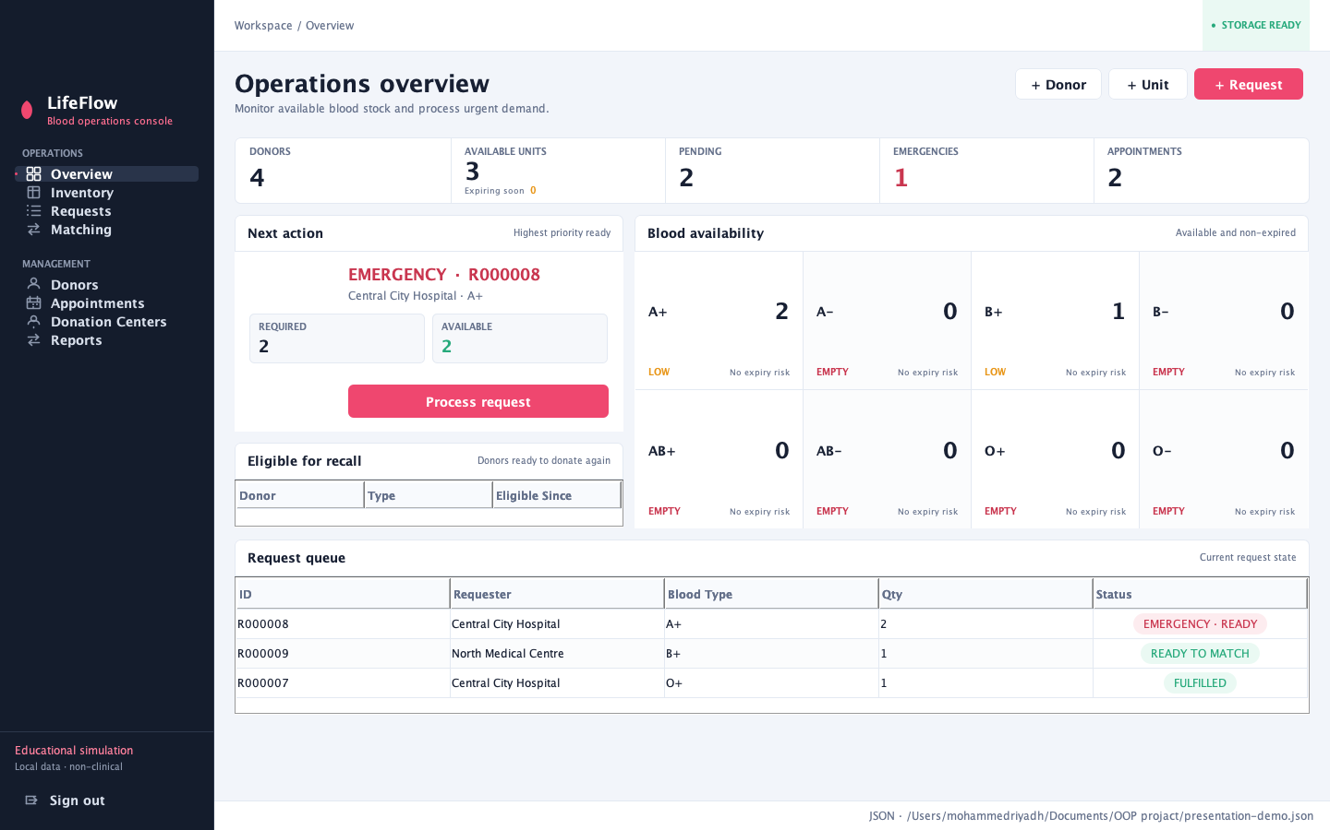
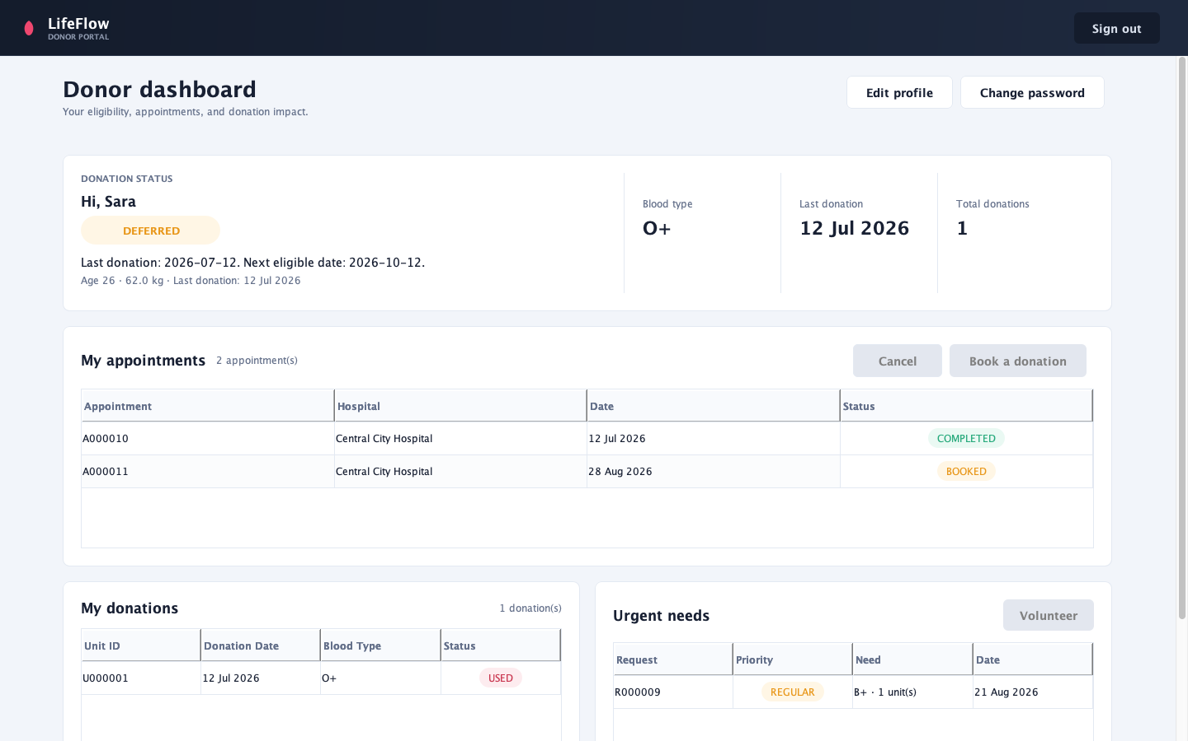
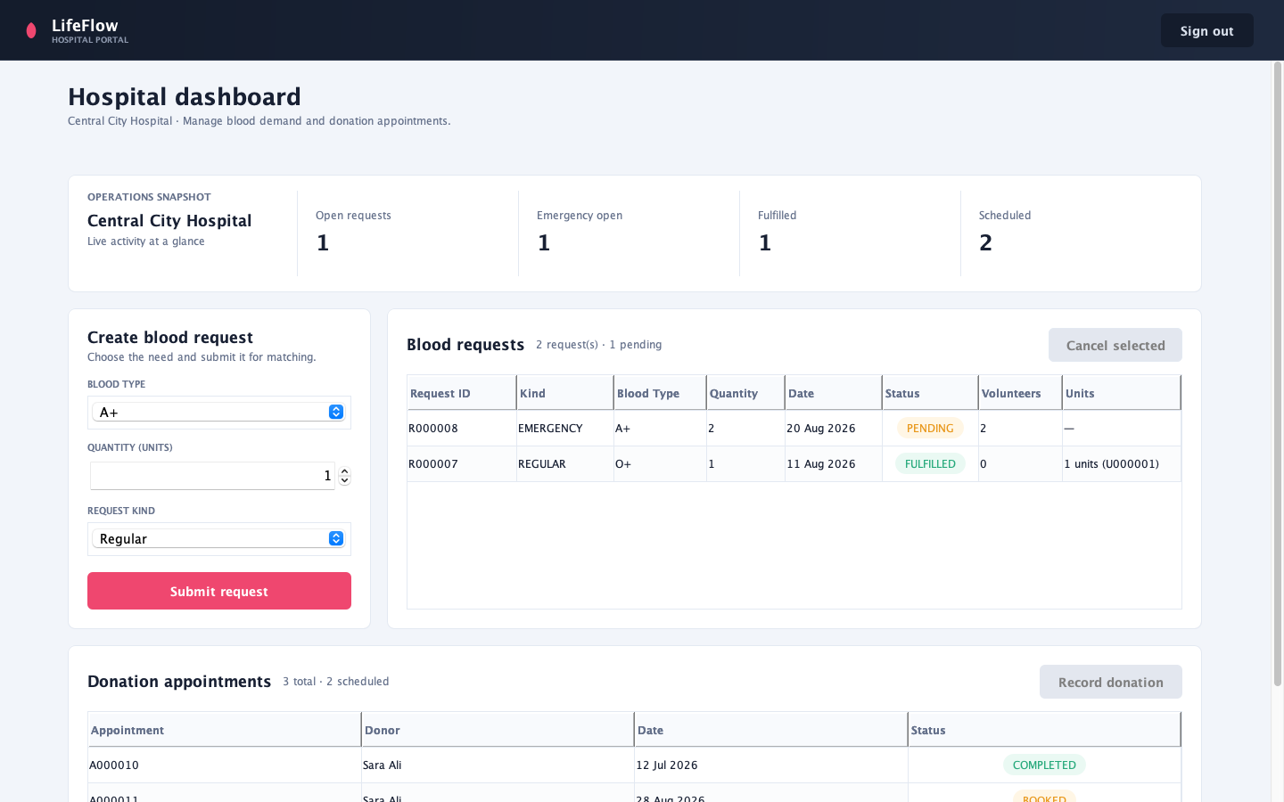
THE INTERFACE
One System. Three Views.
ADMIN
DONOR
HOSPITAL
Stock and priority
Eligibility and appointments
Requests and donations
Same underlying data. Each portal only shows what that role needs to act on.
LIFEFLOW
07

Slide 8
UNDER THE HOOD
Simple Architecture
SWING USER INTERFACE
Admin, Donor, and Hospital screens
The interface never touches data directly.
LIFEFLOW CONTROLLER
Every screen calls one controller. The controller checks whether the action is allowed, applies the business rules, and saves one complete, consistent snapshot to the verified JSON store — never a partial update.
Single entry point — a Facade
SERVICES & RULES
Matching, eligibility, validation
DOMAIN SNAPSHOT
One consistent in-memory state
VERIFIED JSON STORE
Checksummed, atomic, backed up
LIFEFLOW
08

Slide 9

OOP PRINCIPLE 01
Encapsulation — Protecting the Data
An object's internal data stays private. The only way in or out is through methods the object controls itself.
Donor.java
public class Donor implements Identifiable { private String name; private int age; private BloodType bloodType; public String getName() { return name; } public void updateDetails( String name, int age, BloodType bloodType) { // validation happens here first this.name = name;
this.age = age;
this.bloodType = bloodType;
}
}
In Donor: all fields are private. Nothing outside the class can set a donor's age directly — every change goes through updateDetails(), which validates first.
Defensive copying: LifeFlowState.getDonors() never returns the real list — it returns a fresh copy every time, so no outside code can add or remove donors without going through the controller.
LIFEFLOW
09

Slide 10



OOP PRINCIPLES 02–04
OOP That Changes Real Behaviour
01
02
03
ABSTRACTION
INHERITANCE
POLYMORPHISM
BloodRequest is abstract and defines shared data plus required behaviour — getPriority() and getKind() — without saying how. LifeFlowStore does the same for storage: load(), save(), nothing about JSON.
RegularRequest and EmergencyRequest both extend BloodRequest. They reuse its fields and shared methods like markFulfilled(), adding only what's actually different.
Both override getPriority() with different values — 1 or 2. MatchingService calls it through a BloodRequest reference, and the correct version runs at runtime, with no if-statement checking the type.
LIFEFLOW
10

Slide 11
POLYMORPHISM IN ACTION
How the Matching Engine Decides
Emergency requests
come first
Ignore used or
expired units
1
2
3
4
Use EXACT or
COMPATIBLE mode
Use FEFO and require
the full quantity
MatchingService.ORDER compares requests by getPriority() first, then by date, then by ID — one comparator, no branching by request type.
LIFEFLOW
11

Slide 12
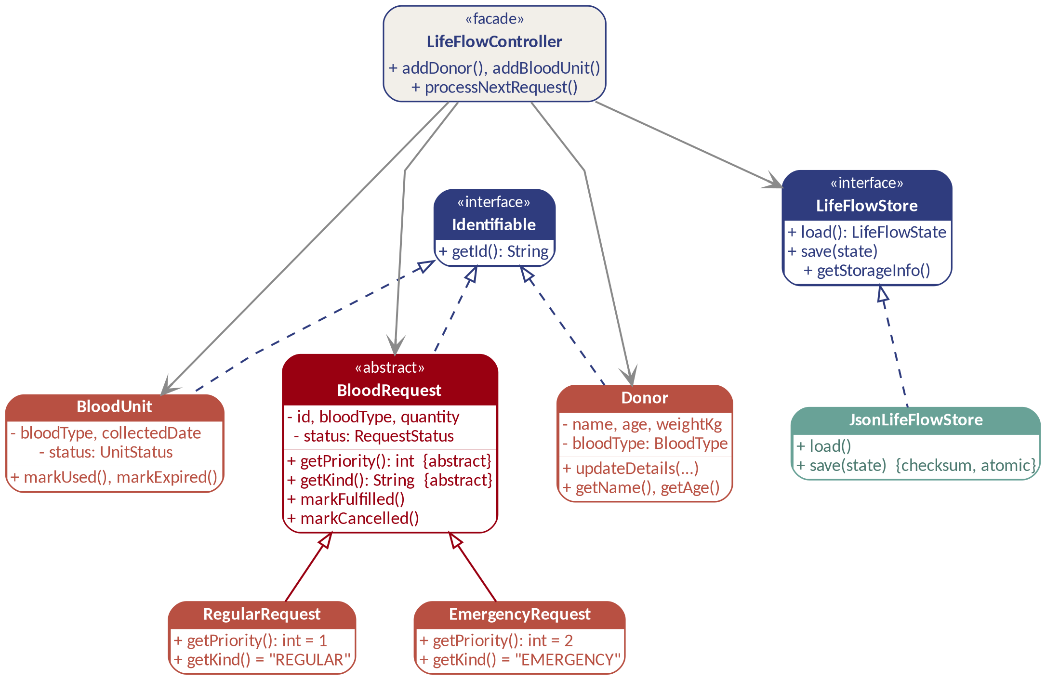
SYSTEM DESIGN
OOP Design — UML Class Diagram
Hollow triangle = extends (inheritance) · Dashed hollow triangle = implements (interface) · Solid arrow = uses / association
LIFEFLOW
12

Slide 13



PERSISTENCE
Reliable Local Storage
1
2
CHECKSUM
ATOMIC SAVE
SHA-256 detects changed or incomplete JSON data before it is accepted.
A validated temporary file replaces the primary file in one safe step.
3
4
BACKUP & MIGRATION
SINGLE WRITER
Verified backups recover data. Older formats migrate automatically on load.
A file lock prevents two app instances from writing to the same store.
LIFEFLOW
13

Slide 14
QUALITY ASSURANCE
Testing & Sample Outputs
33
73
0 / 0
JUnit 5 test files
Java source files
failures · errors on last run
What we test
mvn test — sample output
Model validation — donor and request data rejected when invalid
Running lifeflow.service.MatchingServiceTest Tests run: 12, Failures: 0, Errors: 0 Running lifeflow.persistence.JsonLifeFlowStoreTest Tests run: 9, Failures: 0, Errors: 0 Running lifeflow.service.DonationPolicyTest Tests run: 7, Failures: 0, Errors: 0 BUILD SUCCESS
Matching and priority logic — emergency-first, FEFO ordering
Eligibility rules — age, weight, and donation-interval checks
Persistence round-trip — save, reload, and checksum verification
LIFEFLOW
14

Slide 15

HONEST ASSESSMENT
Discussion & Limitations
What Works Well
Current Limitations
✓
Emergency-first matching with FEFO, no manual triage
!
Single local JSON file — no multi-device or multi-user sync
✓
Tamper-evident storage — checksum, atomic writes, backups
!
Not connected to real hospital or blood bank record systems
✓
Three role-based portals sharing one consistent data model
!
No medical or regulatory certification — a learning simulation
✓
OOP principles genuinely drive behaviour, not just structure
!
Eligibility relies on entered data, not lab or biometric checks
LIFEFLOW
15

Slide 16

DEMONSTRATION
One Repeatable Demo.
0 FAILURES · 0 ERRORS
1
Create an emergency request
2
Record a donation
3
Match the full stock
4
Restart and confirm saved data
LIVE DEMO
16

Slide 17
LifeFlow: Clear. Reliable.
Ready to Explain.
Thank you — questions welcome.
github.com/moha-r/LifeFlow
17

