Slide 1
JAVA OOP PROJECT • SDG 3
LifeFlow Blood Matching Simulation
Java Swing • OOP • File I/O • Emergency-first matching
Notes:
Introduce LifeFlow as an educational desktop simulation. State clearly that it demonstrates software design and is not a clinical blood-matching system.

Slide 2
The problem LifeFlow addresses
A small but meaningful simulation
Blood donation scenarios involve several connected decisions: donor eligibility, unit validity, request priority, and stock availability.
Treating each part as an isolated record misses the real workflow and gives weak evidence of OOP.
LifeFlow joins the steps into one repeatable simulation that can be demonstrated live.
The intended outcome
Register donors and blood units, queue regular and emergency requests, then process the highest-priority request safely.
Persist every successful operation so the next session continues from the same state.
2
Notes:
Explain that the value comes from connecting decisions rather than building four unrelated CRUD screens. Link the project context to SDG 3 without presenting the software as a real medical product.

Slide 3
Four pillars define the system
01 Eligibility
Check age, weight, donation interval, and future dates before accepting a new unit.
02 Inventory
Track every unit by type, expiry, and AVAILABLE or USED status.
03 Priority
Process emergency requests first, then the oldest request at equal priority.
04 Dashboard + UX
Expose live stock, urgent demand, quick actions, and safe editing in one clear interface.
3
Notes:
Walk through the four objectives. Emphasize that the eligibility thresholds are simplified educational rules derived from Malaysian public-health guidance.
[Sources]
- https://jknjohor.moh.gov.my/hsi/syarat-syarat-penderma-darah-yang-layak-2/
- https://jknsabah.moh.gov.my/hwkks/en/?id=178&option=com_sppagebuilder&view=page
[/Sources]

Slide 4
One dashboard guides the complete workflow
SEE STATUS
ACT
MATCH & SAVE
Live operational view
Review donors, available stock, pending requests, and the emergency queue at startup.
Focused quick actions
Open a clean add dialog for donors, units, or requests without leaving the dashboard.
Atomic result
Use matching units only when the full quantity is available, then persist.
4
Notes:
Use this slide as the demo map. Start from the dashboard, use a quick action, and then open Matching to process the emergency request.

Slide 5
The architecture stays intentionally simple
Presentation
Sidebar + CardLayout Five focused panels Reusable UI theme
Controller + domain
LifeFlowController Request hierarchy Inventory + matching
Persistence
FileManager Three text files Clear line-level errors
5
Notes:
Explain that no external UI framework or database is added. LifeFlowController keeps validation and persistence out of the Swing pages while the UI remains standard Java.

Slide 6
OOP concepts are visible in real behavior
The request hierarchy is the main OOP example
BloodRequest holds shared state and declares getPriority() as an abstract operation.
RegularRequest and EmergencyRequest override that operation with different priorities.
Abstraction + Inheritance
Runtime Polymorphism
Private fields preserve encapsulation.
Shared request data lives once in the parent.
Subclasses supply only distinct behavior.
Requests share one ArrayList<BloodRequest>.
Matching calls getPriority() through the parent.
The actual subclass decides the result at runtime.
6
Notes:
Show the BloodRequest reference in the code and point out that the matching service does not need instanceof checks to calculate priority.

Slide 7
Matching is priority-aware and atomic
Selection policy
1. Ignore fulfilled requests.
2. Choose the highest getPriority() value.
3. At equal priority, choose the oldest request date.
Fulfillment policy
Use only AVAILABLE, unexpired units with exactly the same ABO and Rh type.
If the full quantity is unavailable, change nothing. No partial fulfillment is allowed.
7
Notes:
Demonstrate the emergency request being selected before the regular request. Clarify that exact-type matching is deliberately conservative and simplified; a real transfusion requires clinical compatibility testing and crossmatching.
[Sources]
- https://portal.appshtaa.moh.gov.my/images/ProfilJabatan/Transfusi/handbook.pdf
[/Sources]

Slide 8
Persistence is readable and recoverable
donors.txt
Identity, eligibility data, blood type, and optional last donation date.
blood_units.txt
Donor link, donation and expiry dates, type, and unit status.
requests.txt
Kind field restores the correct RegularRequest or EmergencyRequest subclass.
Safe loading
Missing files mean empty data; malformed rows report the exact line and stop startup.
8
Notes:
Show one saved row during the demo. Explain why pipe-delimited text was selected: it satisfies File I/O while remaining easy to inspect and explain.

Slide 9
Tests verify boundaries and state changes
Automated with plain Java assertions
The suite covers eligibility, priority, atomic matching, persistence, safe editing, dashboard counts, and headless refresh of all five Swing panels.
ALL
17 → 61
0 PARTIAL
Controller + UI assertions
Age boundaries tested
Failed matches mutate nothing
9
Notes:
Run java -ea -cp out lifeflow.AllTests and show the single clean result: All tests passed. Then mention one boundary and one atomicity test as examples.

Slide 10
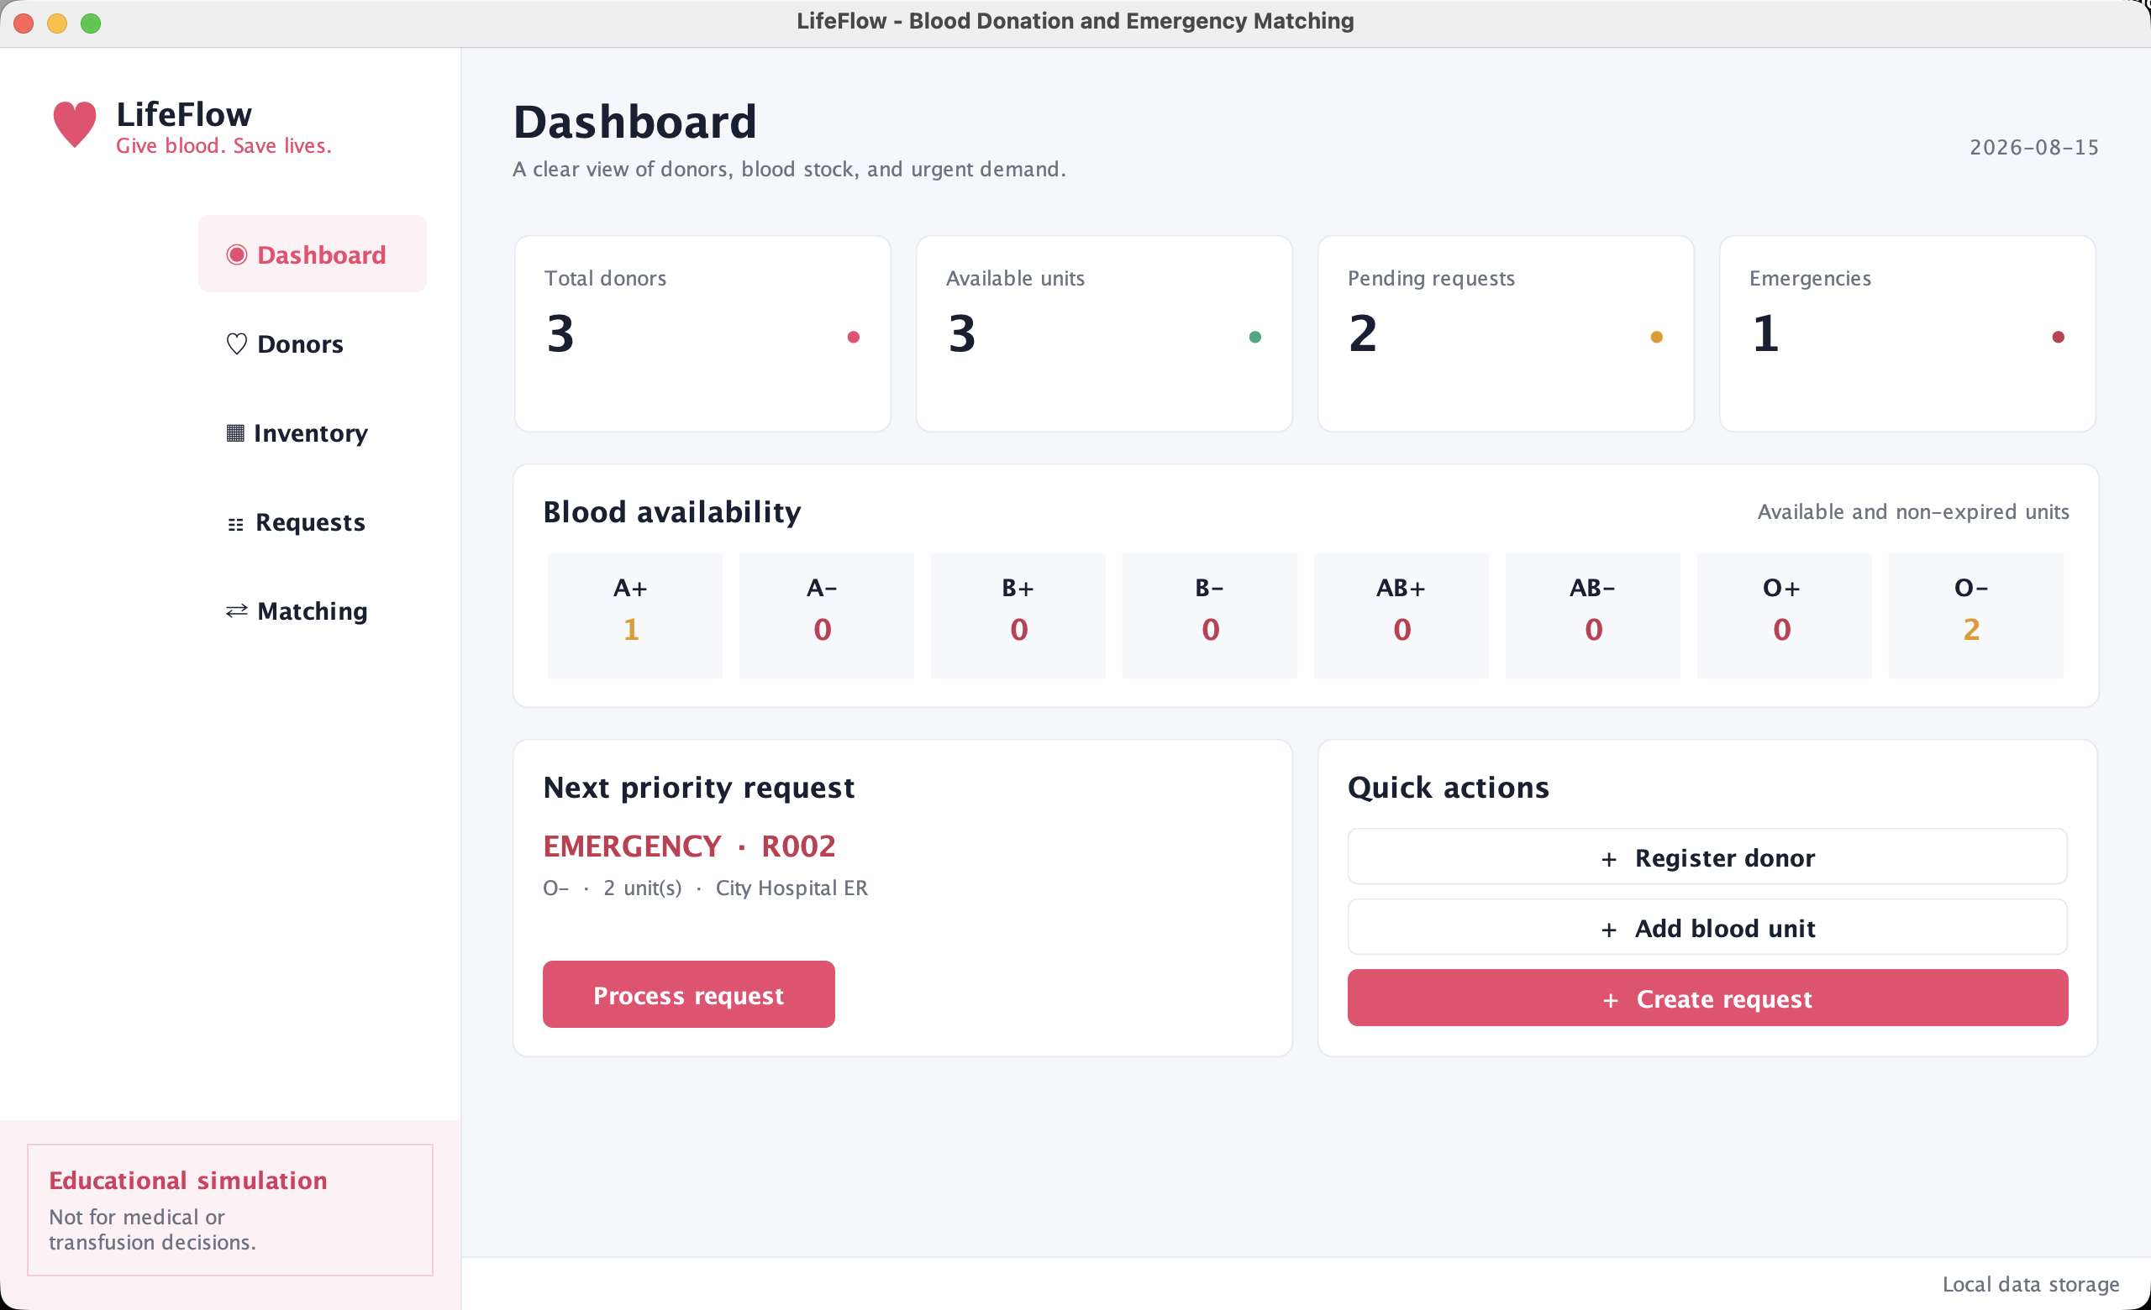
LIFEFLOW • JAVA SWING
Live demo
Review the dashboard
Process the emergency
Confirm save + restart
Notes:
Transition directly into the live demonstration. End by restating the three learning outcomes: clear OOP, meaningful simulation logic, and persistent data.

