Slide 1
Meet and Assist Service At Muscat international Airport
Premium Services

Slide 2
Objective
To enhance the passenger journey by providing personalized "Meet and Assist" services at both Departure and Arrival, designed to elevate the travel experience with optional luxury, convenience, and surprise elements.

Slide 3
Departure Meet and Assist
Dedicated staff to greet the passenger at drop-off or parking
Porter service for baggage handling
Fast-track through:
Check-in counters
Security screening
Passport control
Escort to lounge (if included)
Final assistance until boarding gate

Slide 4
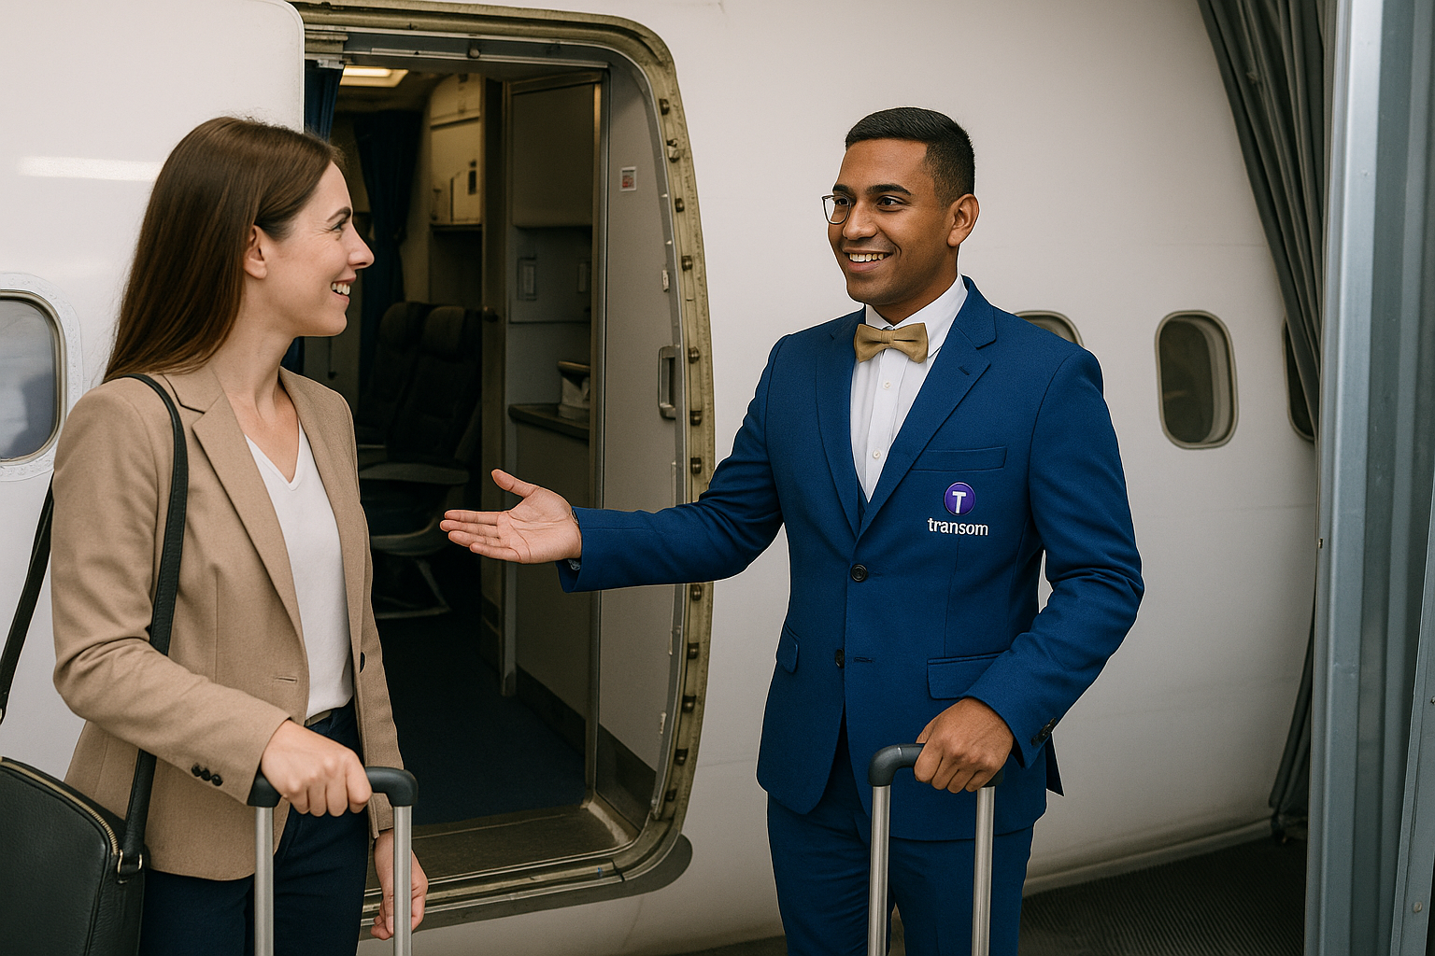
Arrival Meet and Assist
Personalized meet at the aircraft gate or aerobridge
Fast-track through immigration
Baggage claim assistance
Porter service
Escort to transport (taxi, limo, family)

Slide 5
Optional Add-On Packages
1. Lounge Access
Access to Majan Lounge
2. Surprise Gift Package
Optional personalized gift based on:
Occasion (birthday, honeymoon, first trip, etc.)
Client preference (selected during booking)
Delivered during arrival or departure meet
3. Honeymoon & Special Occasion Package
Flower bouquet
Personalized message card
Lounge access + mocktail
Romantic gift or themed souvenir
4. Fast Track Only Package
Priority check-in
Immigration fast track
Escort to gate or transport

Slide 6



Additional Creative Service Ideas
Kids & Family Assist
Priority stroller or child seat support
Gift toy or snack for child
Coloring kit or small welcome pack
Corporate & Group Travel Support
Group handling with name boards
Coordination with transport
Welcome kits branded for companies
Senior & VIP Assist
Wheelchair coordination (if needed)
Dedicated concierge
VIP lane fast-tracking
Bottled water/snack

Slide 7
Booking Process
Service booking through:
Website portal
Travel agency partners
Airline codeshare (optional)
Walk In
Passenger fills out preference form (for surprise, gifts, language, etc.)a

Slide 8
Package Examples
Package Name | Included Services | Price (Example)
Standard | Meet + Escort + Baggage Help | $$
Premium | Standard + Lounge Access + Fast Track | $$$
Luxury | Premium + Surprise Gift + Fragrance Towel + Photo | $$$$
Occasion Special | Luxury + Flower + Personalized Card | $$$$+

Slide 9
Manpower required
Area Covered | Role | Staff per Shift | Notes
Departure Area | Meet & Assist Agent | 1 | Passenger greeting, check-in escort, fast-track
Arrival Area | Meet & Assist Agent | 1 | Arrival gate meet, immigration fast-track, transport escort
Porter Support | Porter | 2 | 1 at departure, 1 at arrival for baggage and special handling
Booking Coordination | Reservation Agent | 1 | Remote or on-site, handles booking, reminders, special requests
Day Shift: 5
Night Shift: 5
Total Daily Staff: 10
With 4-on / 4-off rotation,
10 x 2 = 20 staff

Slide 10

Waiting Area in Departure
Location: South PRM Office
Purpose: Temporary holding area for Meet & Assist departure passengers arriving early

Slide 11
Tools, Equipment & Infrastructure
Item | Quantity / Details | Purpose
Reception/Check-in Podium | 2 | For staff at entry points
Fast Track Podium | 2 | Positioned before immigration counters
Tablet/Handheld Device | 4 | Pax coordination, tracking, and form signing
Laptop/Desktop | 2 | Admin and guest management
Fast Track Signage | 3–5 | Clear directions near immigration

Slide 12



Baggage Trolley
Fast Track Podium
Name Display

Slide 13
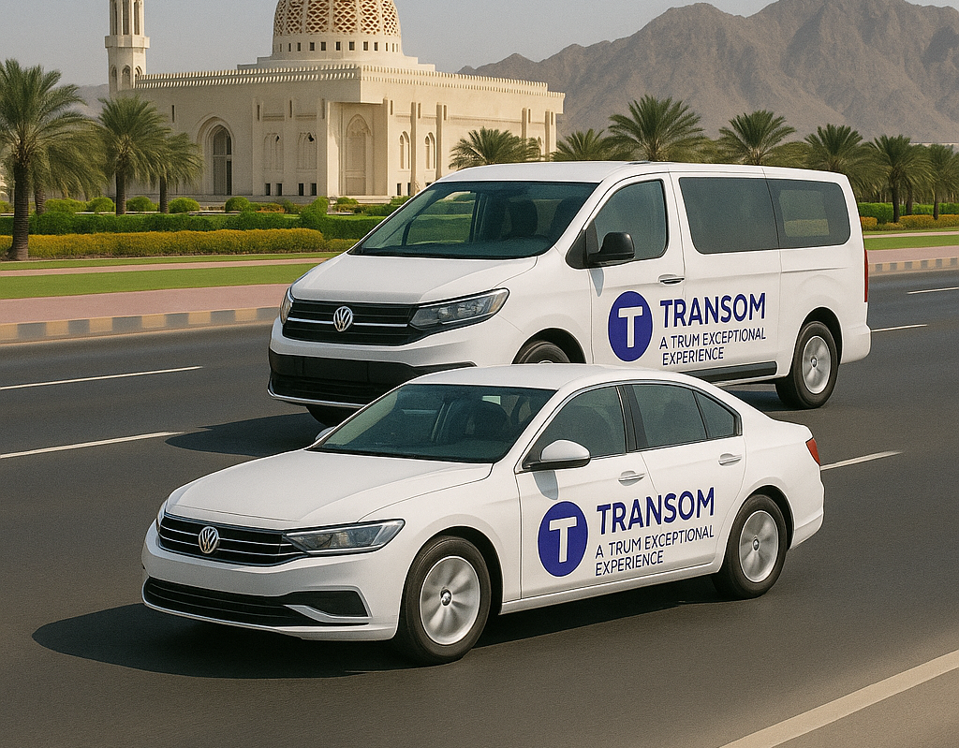
Package top up
Limousine Service – Arrival Add-On
Enhance the arrival experience with our premium limousine transfer — seamless, stylish, and personalized from gate to destination.

Slide 14
A Truly Exceptional Experience with Transom Handling

