Slide 1
Majan Valet Parking service
Premium services

Slide 2

Overview
Objective: Introduce valet service for arriving/departing passengers
Drop-off at: Departure Entrance A
Pick-up at: Arrival Entrance C
Target Users: VIPs, families, elderly, business travelers

Slide 3
Detailed Drop-Off Process
Greet customer at Entrance A
Register:
(Name, phone, ID, flight, car info)
Spot check with photo/video
Generate digital valet ticket (QR code)
Secure car in valet parking lot

Slide 4
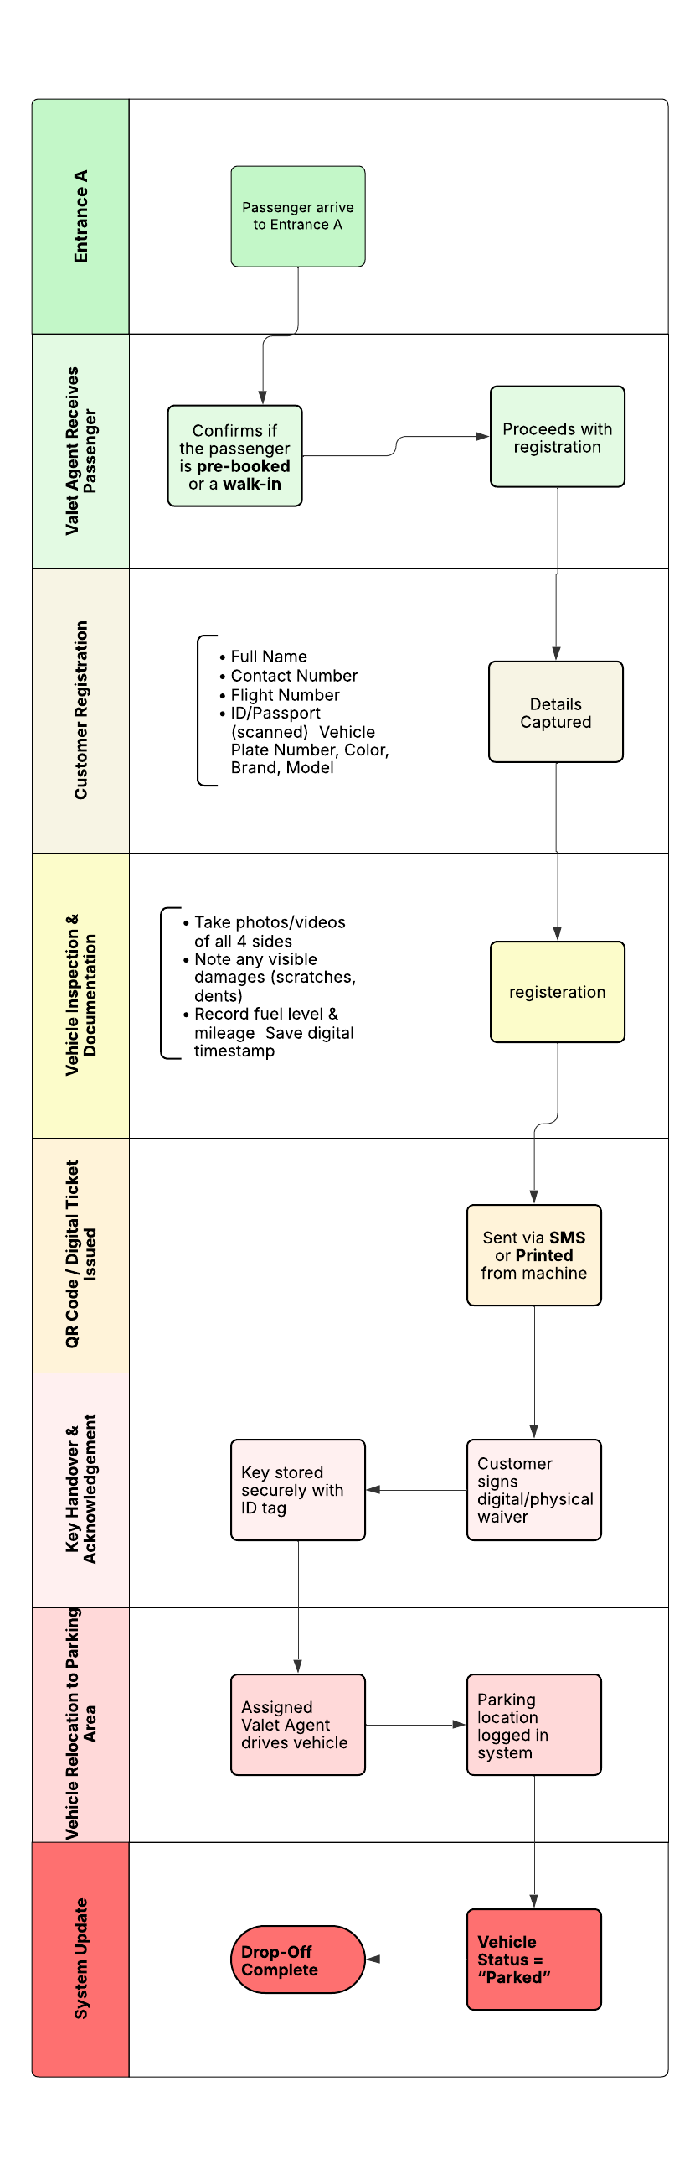

Operational Flow – Overview
(Drop Off)

Slide 5
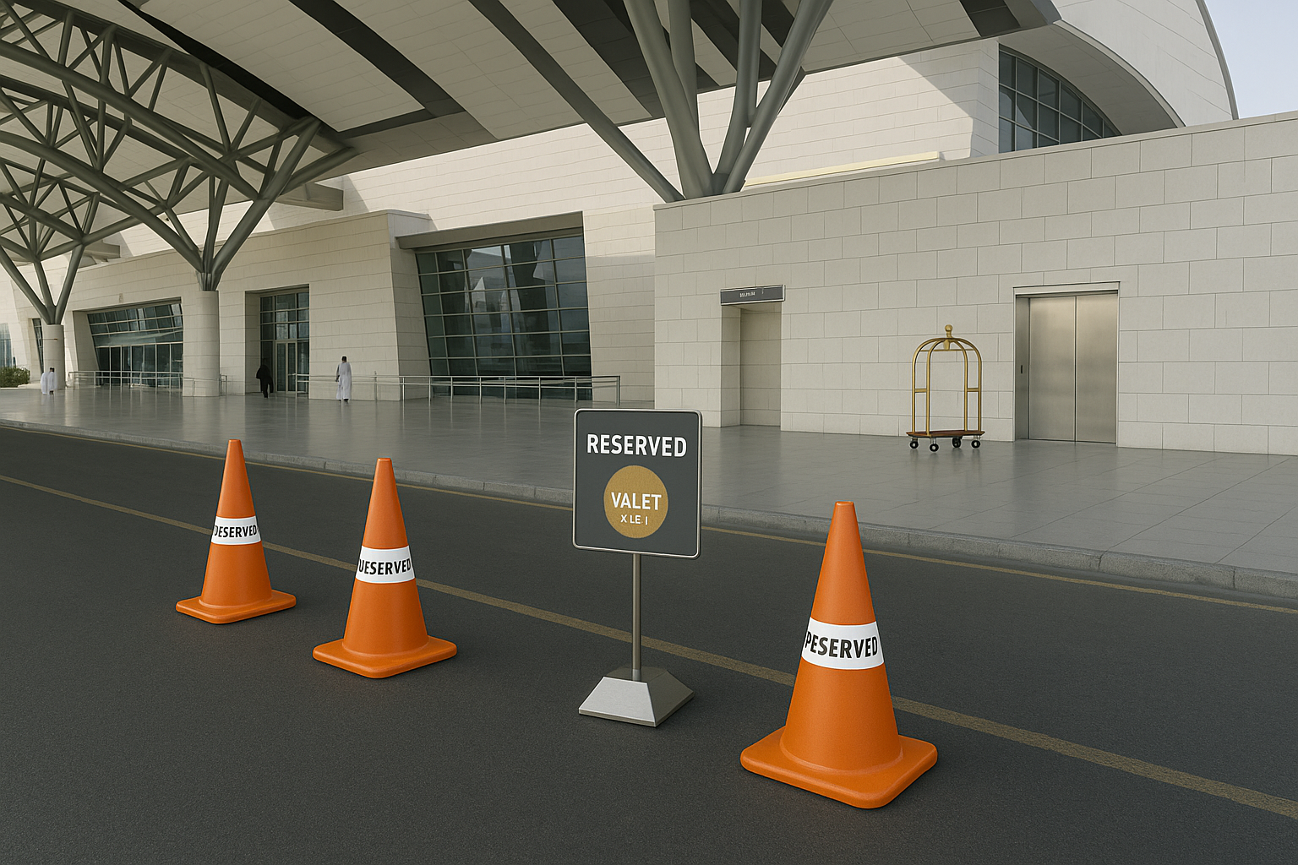
Detailed Pick-Up Process
Flight tracking system notifies dispatch
Car retrieved before PAX reaches Arrival B
Verify identity/ticket
Handover car and confirm condition

Slide 6
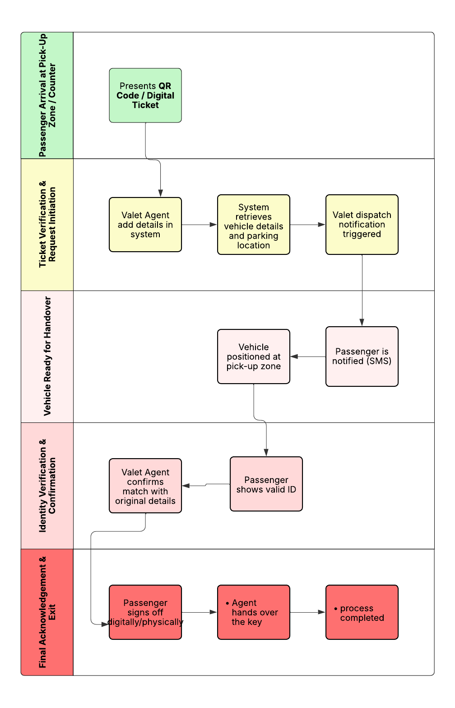
Operational Flow – Overview
(Pick up )

Slide 7
Required Equipment & Tools
Hardware:
Valet kiosks with tablet & printers
Cameras (drop/pick/parking area)
Smartphones for inspections
Secure key cabinet
Walkie-talkies or Push-to-Talk apps
Infrastructure:
Dedicated valet zone at both entrances
Signage, cones, Cabin
Secured parking lot

Slide 8
Software & System Needs
Valet Management System (VMS)
Digital check-in/check-out
Flight integration
QR code tickets
Damage logs
Notifications to staff
Real-time vehicle tracking
Optional: Integrate with airport app or loyalty system

Slide 9
Staffing Requirements
Drivers: 8
Valet Agents: 4
Total Staff Required: 12
Daily Shift Structure
Number of Shifts: 2 shifts per day
Shift Duration: 12 hours per shift
Shift Pattern: 4 days on / 4 days off
Per Shift Staff Requirement
Drivers: 2
Valet Agents: 1
Total per shift = 3 staff members

Slide 10
SOPs & Safety Protocols
Vehicle inspection with photo proof
Emergency handling (damage/lost ticket)
Secure key handling
Reconciliation at end of day
Staff check-in/out via system

Slide 11

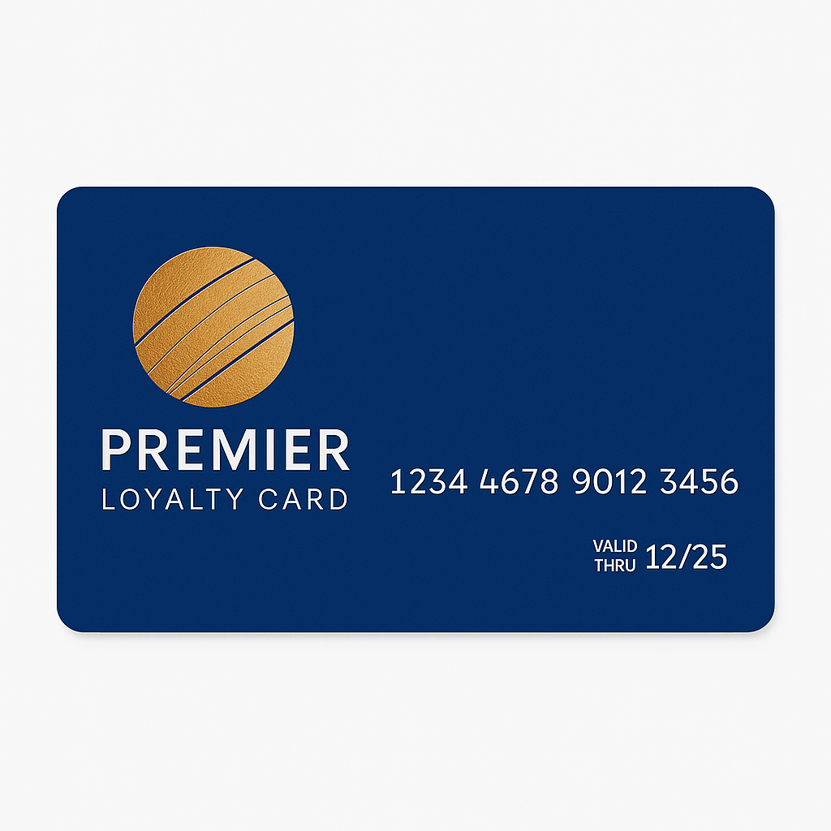
Optional Add-ons
Car wash/detailing upsell
Pre-booking through app or website
Loyalty points integration
Premium/VIP valet tier

