Slide 1

Exploring Toronto Neighborhoods To Decide Where To Live
IBM Coursera Capstone Project

Slide 2
Background and Description of the Problem
Toronto is the most populous city in Canada and the fourth most populous city in North America with a population of about 3 million. It is one of the most multicultural cities in the world and the center of many of Canada’s industries. It also has 140 neighborhoods.
Living in Toronto can be expensive, and rents are among the highest in Canada. Hence determining where to live in Toronto is one of the most important decision a newcomer must make. There are lot of factors to consider and few resources on the internet to assist in decision making. The purpose of the project is to analyze available datasets for the neighborhoods to extract insights that will be useful in decision-making.
In this project we will go through step by step process to decide which neighborhoods are ideal to live in. We will analyze the neighborhoods in Toronto to identify the most safe, affordable and closest to the venues we want.

Slide 3
Target Audience
Who will be more interested in this project? What type of clients or a group of people would be benefitted?
1. Immigrants or Toronto residents who want to relocate to better neighborhoods in Toronto.
2. Businesspeople who want to invest in or open businesses in Toronto.
3. Real estate agents who will use the research to advise their clients.

Slide 4
Data Sources
Datasets that will be used for the analysis:
1. Toronto geojson and csv files from Toronto’s City Government Open Data Portal. They contain the latitudes and longitudes for the neighborhood boundaries and will be used for creating choropleth maps.
2. Toronto Wellbeing data from Toronto’s City Government Open Data Portal for 2014. It contains the number and types of crimes committed and average rents in each neighborhood. It will be used for analyzing the average rent and crime rates in different neighborhoods.
3. Foursquare API will be for fetching details about the venues in Toronto and collecting their names, categories and locations (latitude and longitude). It will be used to get the most common venues in Toronto neighborhoods.

Slide 5
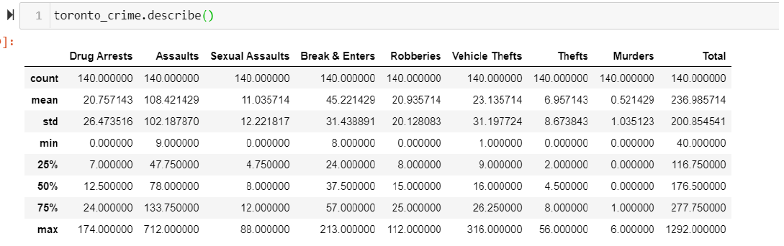
Crime Rates Descriptive Statistics

Slide 6
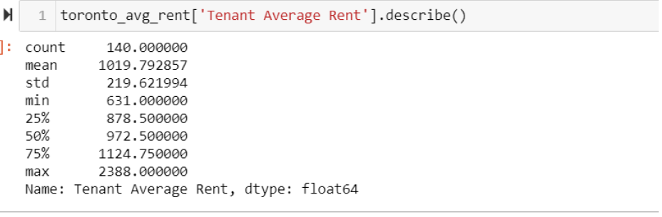
Average Rent Descriptive Statistics

Slide 7
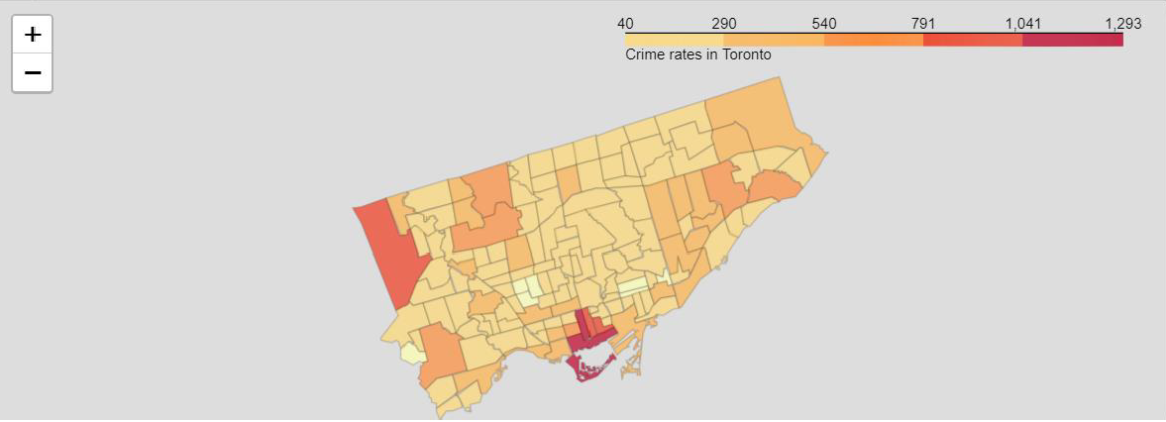
Crime Rates Choropleth Map

Slide 8
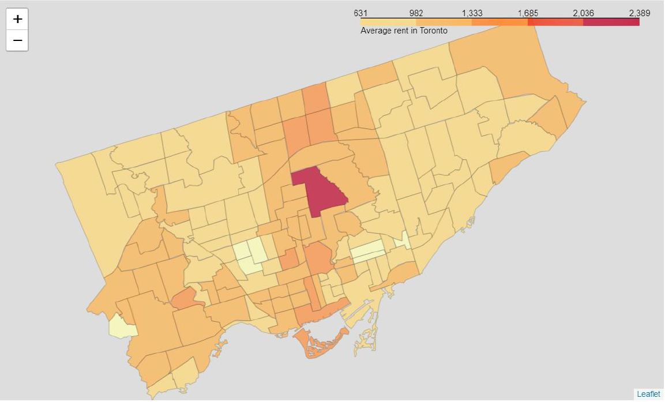
Average Rents Choropleth Map

Slide 9
Fetching Venues Data From Foursquare

Slide 10
Clustering Neighborhoods of Toronto

Slide 11
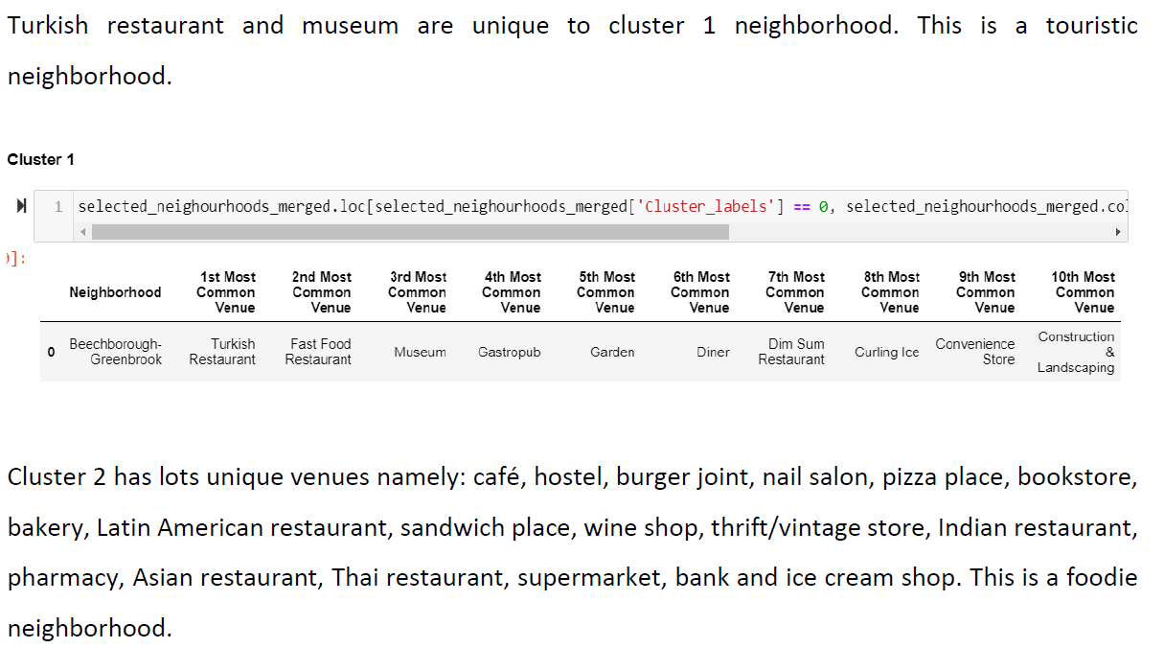
Results

Slide 12
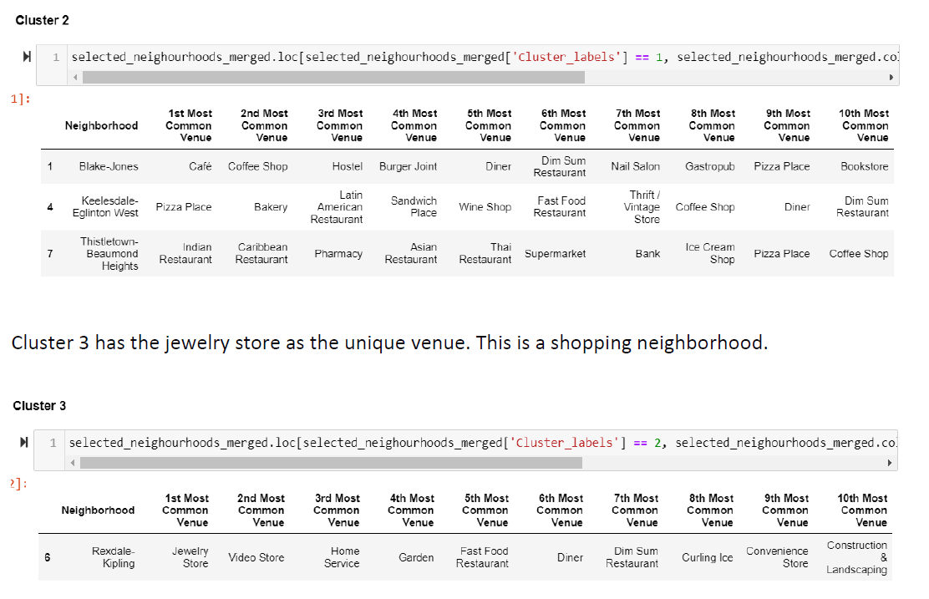

Slide 13
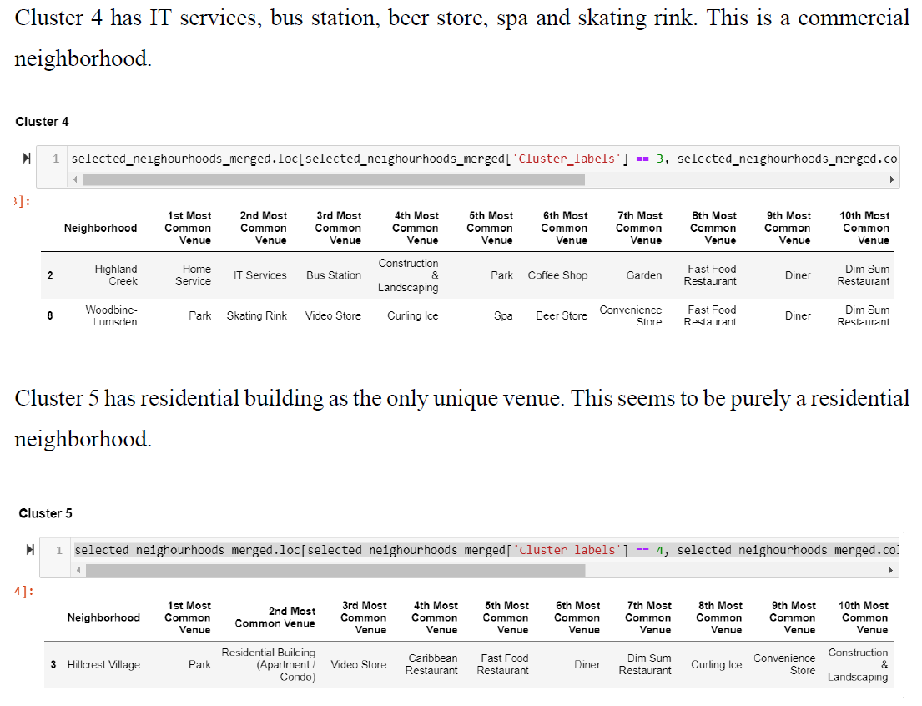

Slide 14
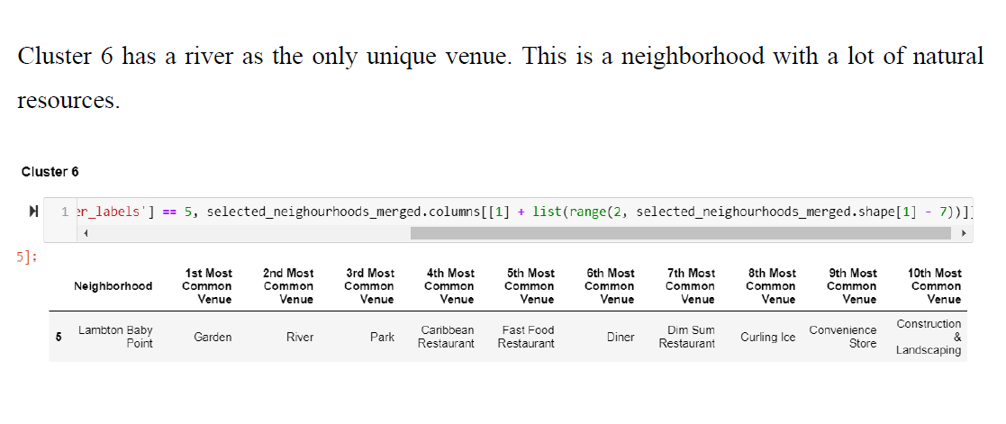

Slide 15
Discussion
Deciding where to live in Toronto is not an easy task. Mainly, due to the factors to take into consideration and the number of neighborhoods to consider.
In our study, we decided to use only three factors to make the decision. These factors are crime rates in the neighborhoods, the average rent and venues close to the neighborhoods.
We selected 45 neighborhoods with the least crime rates and from that we selected 10 that were more affordable. Then we searched for venues that were close the selected neighborhoods.
The neighborhoods were split into 6 clusters and analyzed based on their unique venues. Now one has only to choose one of the six clusters and choose a neighborhood if the cluster has more than one neighborhood.

Slide 16
Conclusion
Data science and machine learning techniques are very useful for analyzing data and extracting insights that can be used to make informed decisions. In our case, to choose the neighborhood to reside.
The analysis can be improved by using other factors such proximity to schools, hospitals, average income, population density, etc.

