Slide 1

^{SAT} SELF-SERVE ACADEMIC transcript

Slide 2
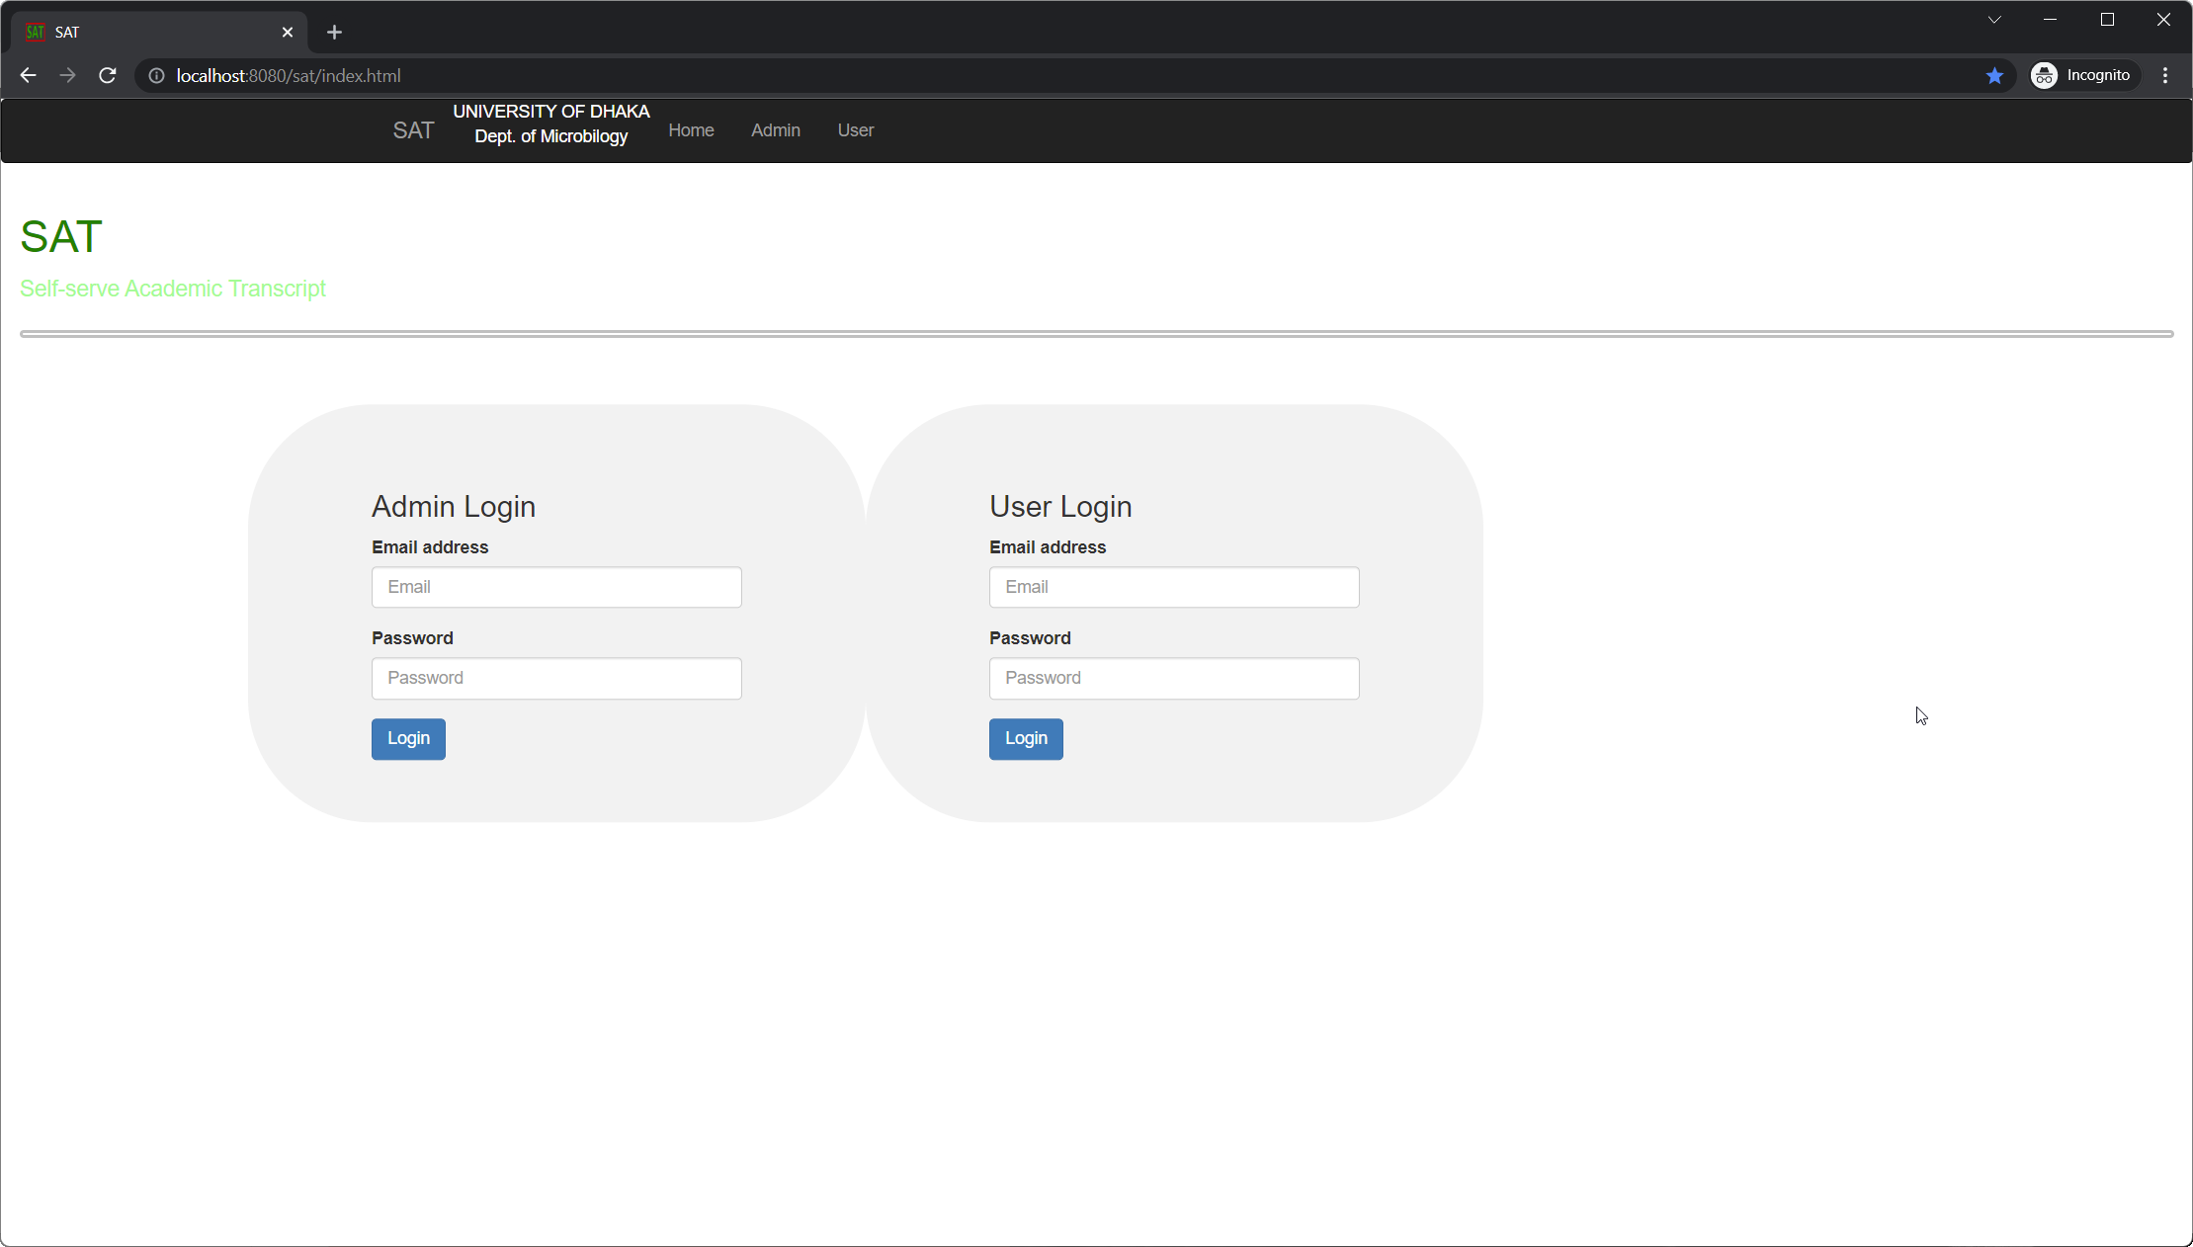
SAT
Students could send their academic transcript to desired institutions via email.
Students have the privilege to view and send academic record and change login information.
Student records can be added, updated or deleted by logging in the application as Administrator.
There are REST API interfaces to access, edit or add student records and send transcript via email

Slide 3
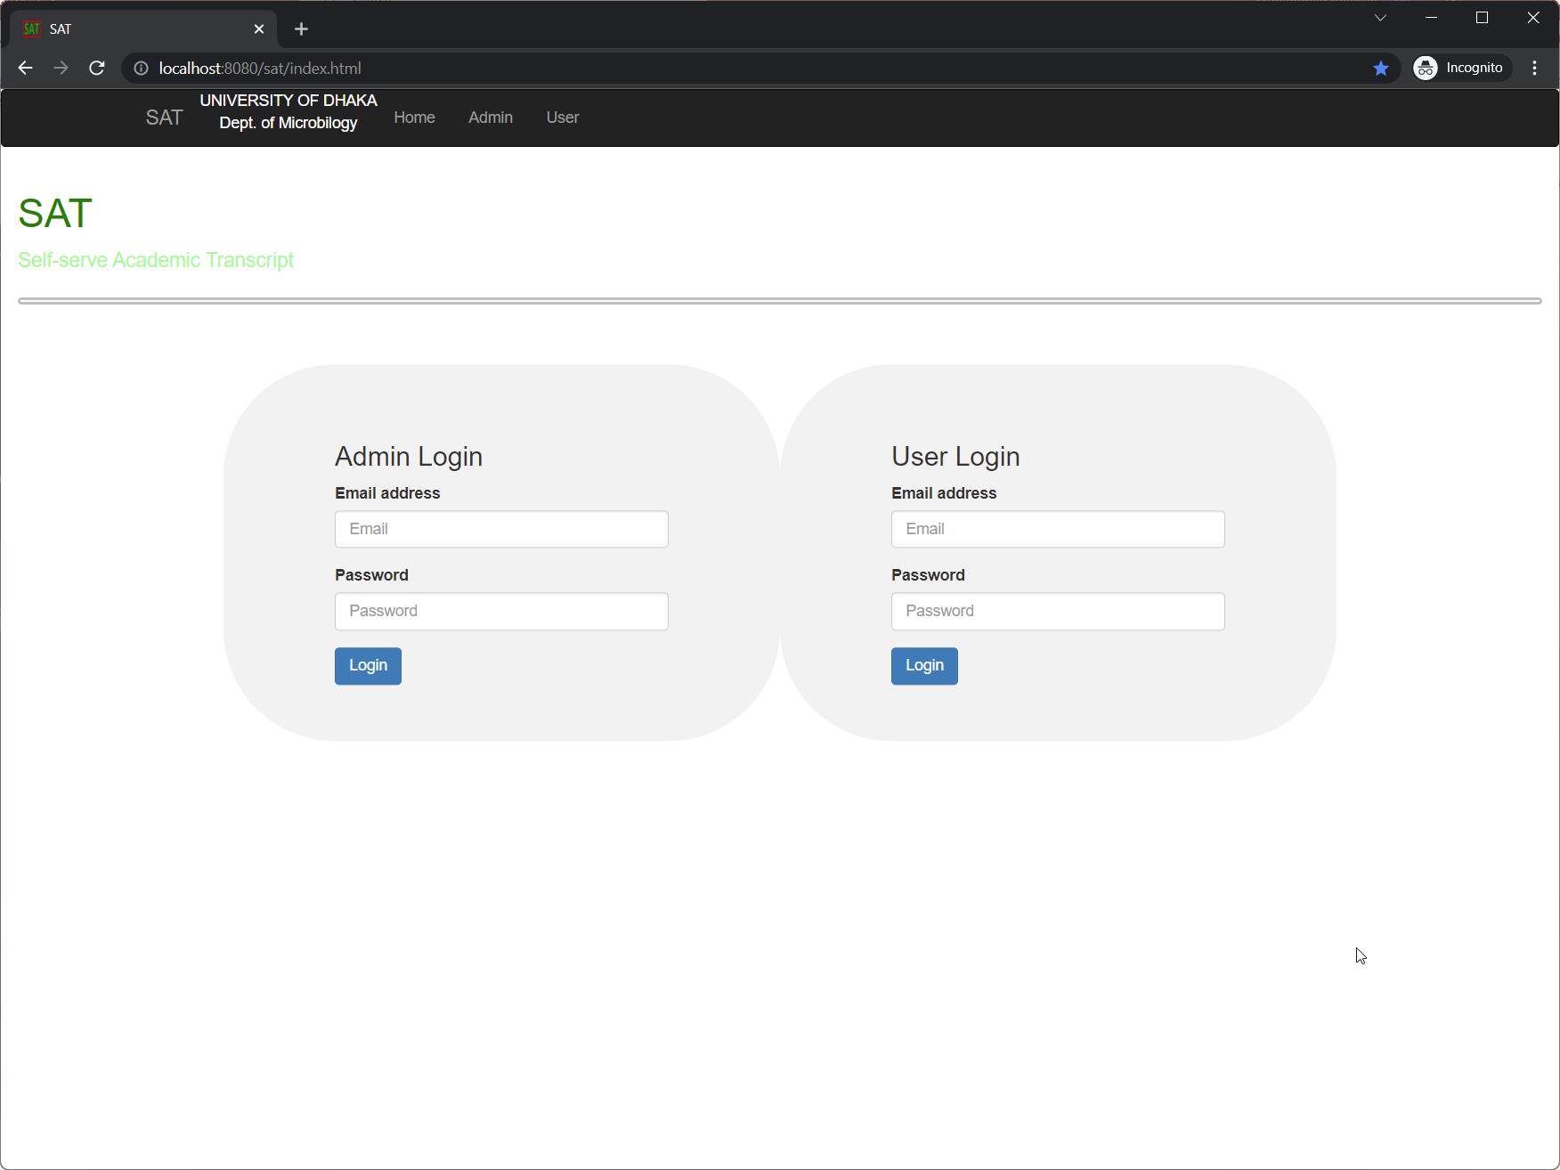
Login page
Student/ User Login
Admin Login

Slide 4
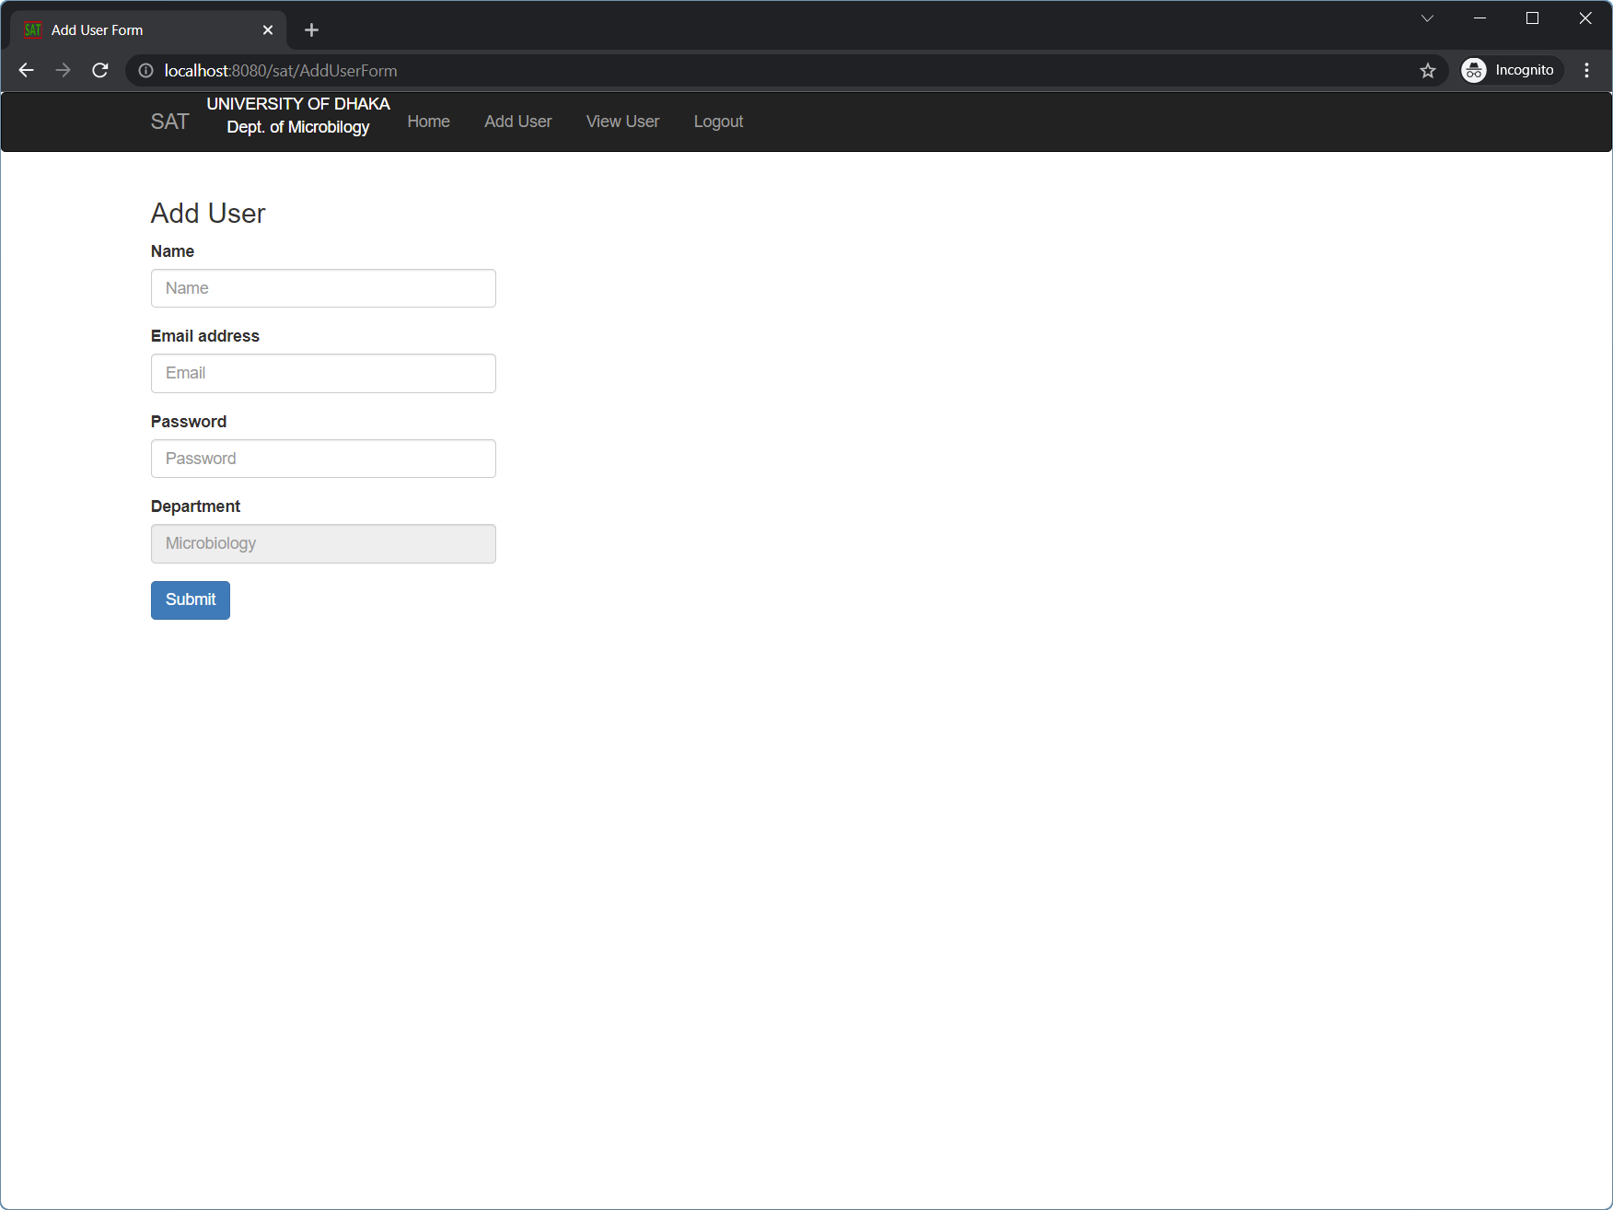
Admin page
New student can be added with auto generated student ID

Slide 5
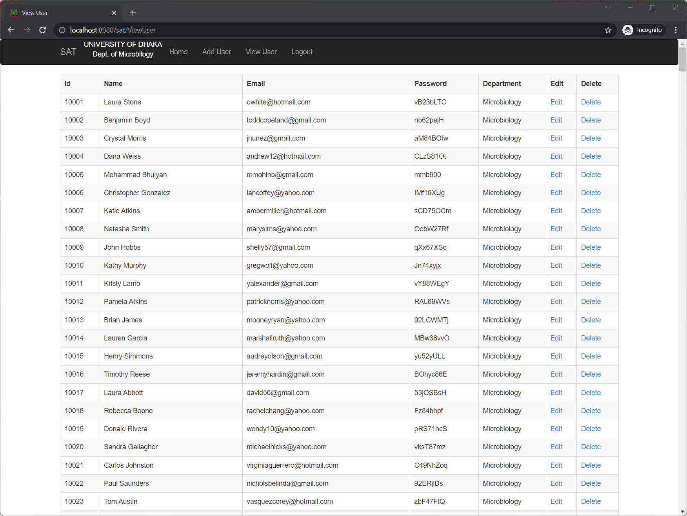
View user page
Student records can be Viewed, Edited and Deleted

Slide 6
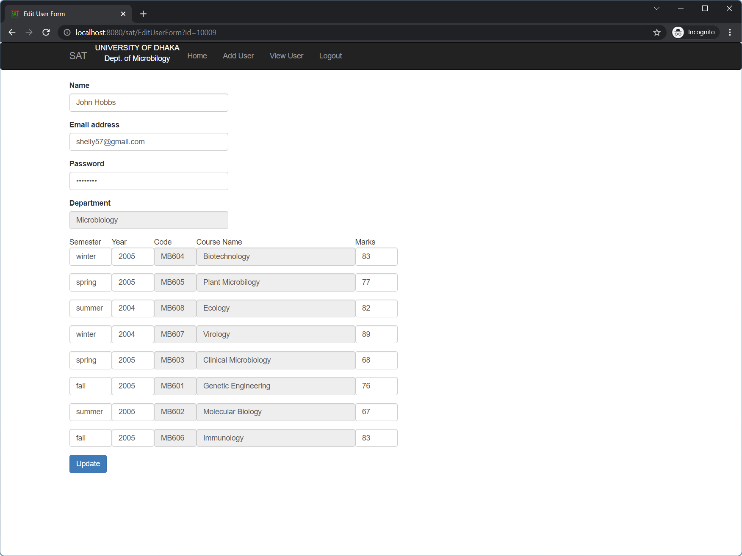
Admin edit page
Student records can be updated by administrator

Slide 7
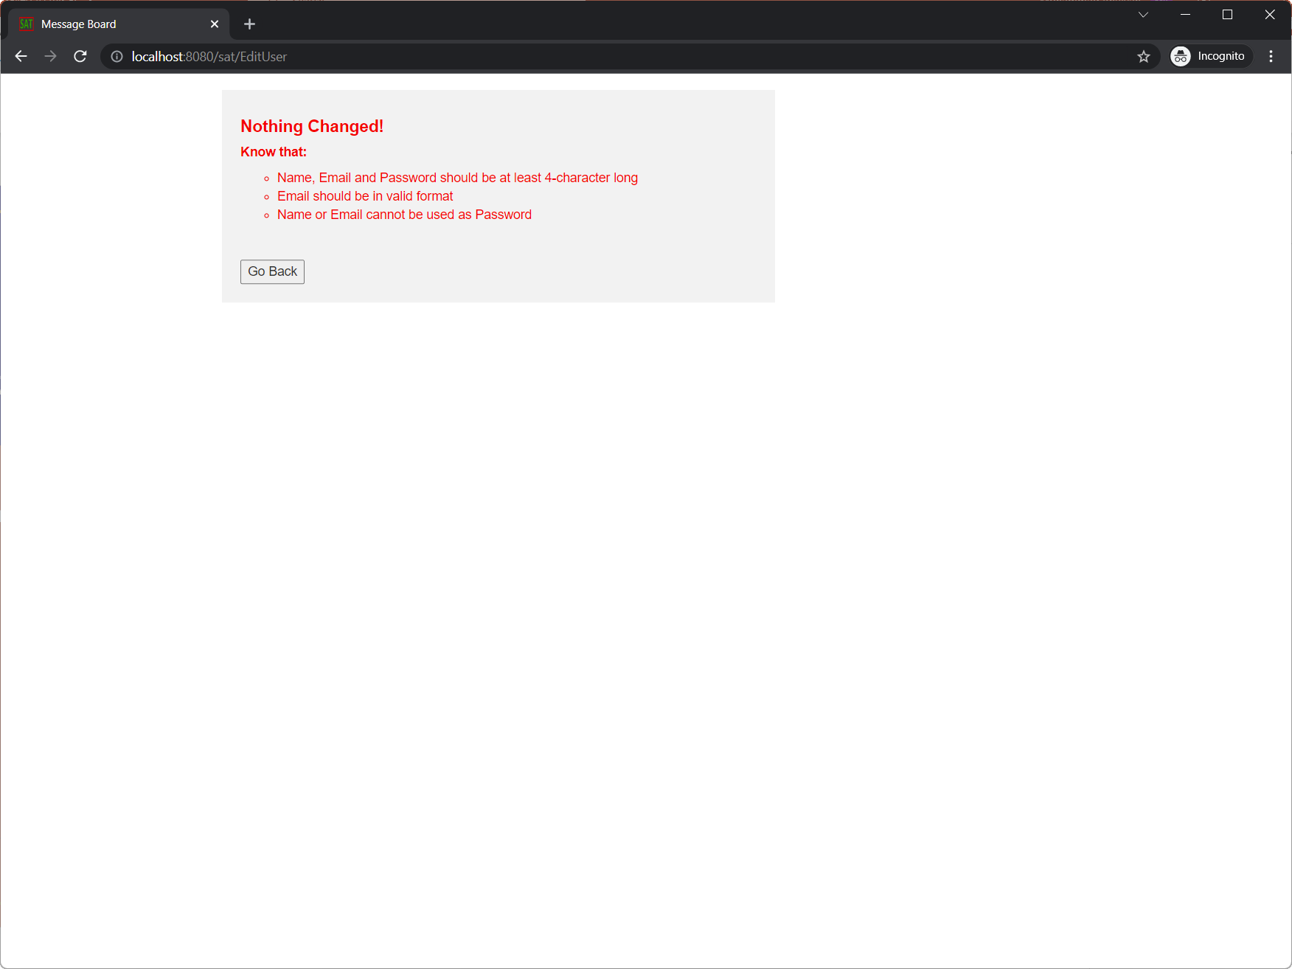
Validation page
Records are validated before addition and deletion that prevent invalid data entry

Slide 8
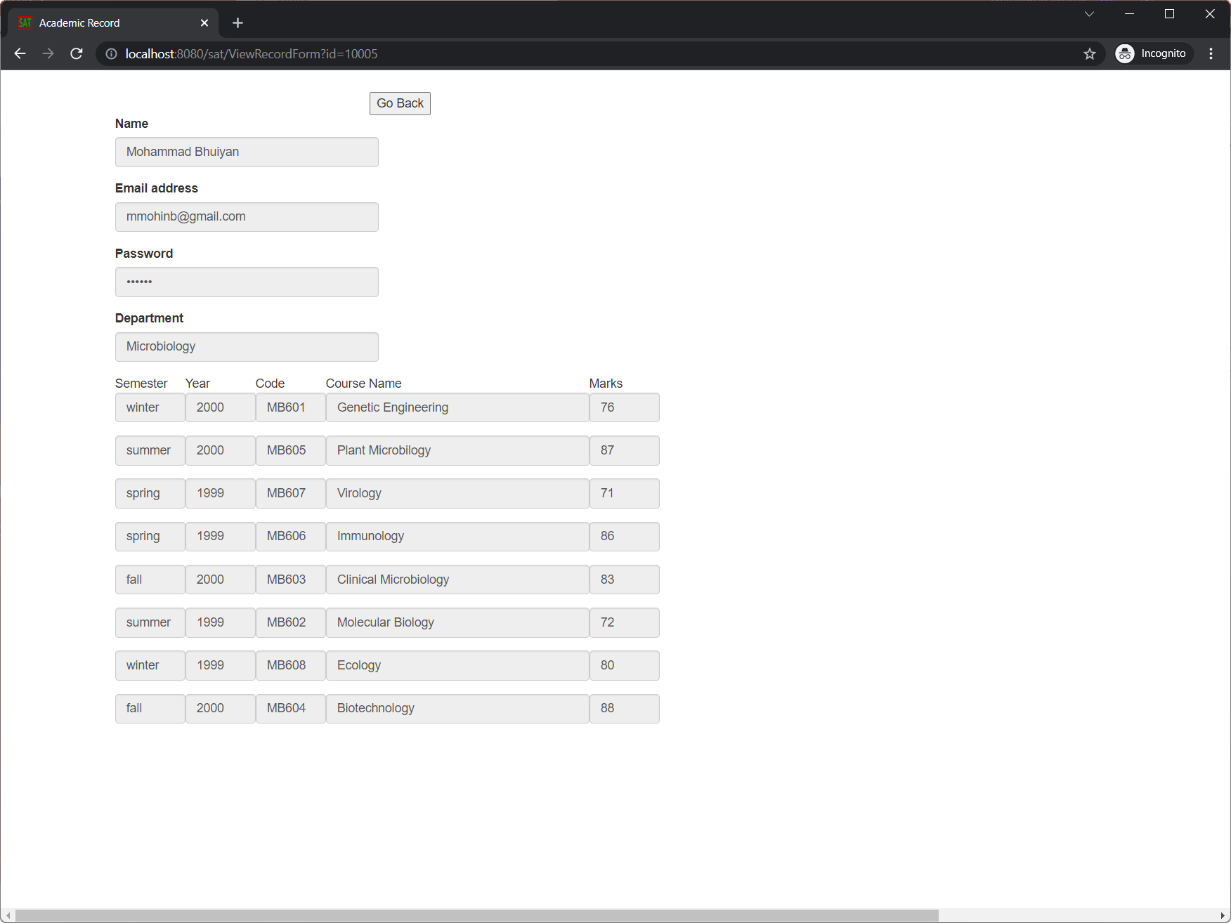
User record page
Student can view personal information and course-wise marks

Slide 9
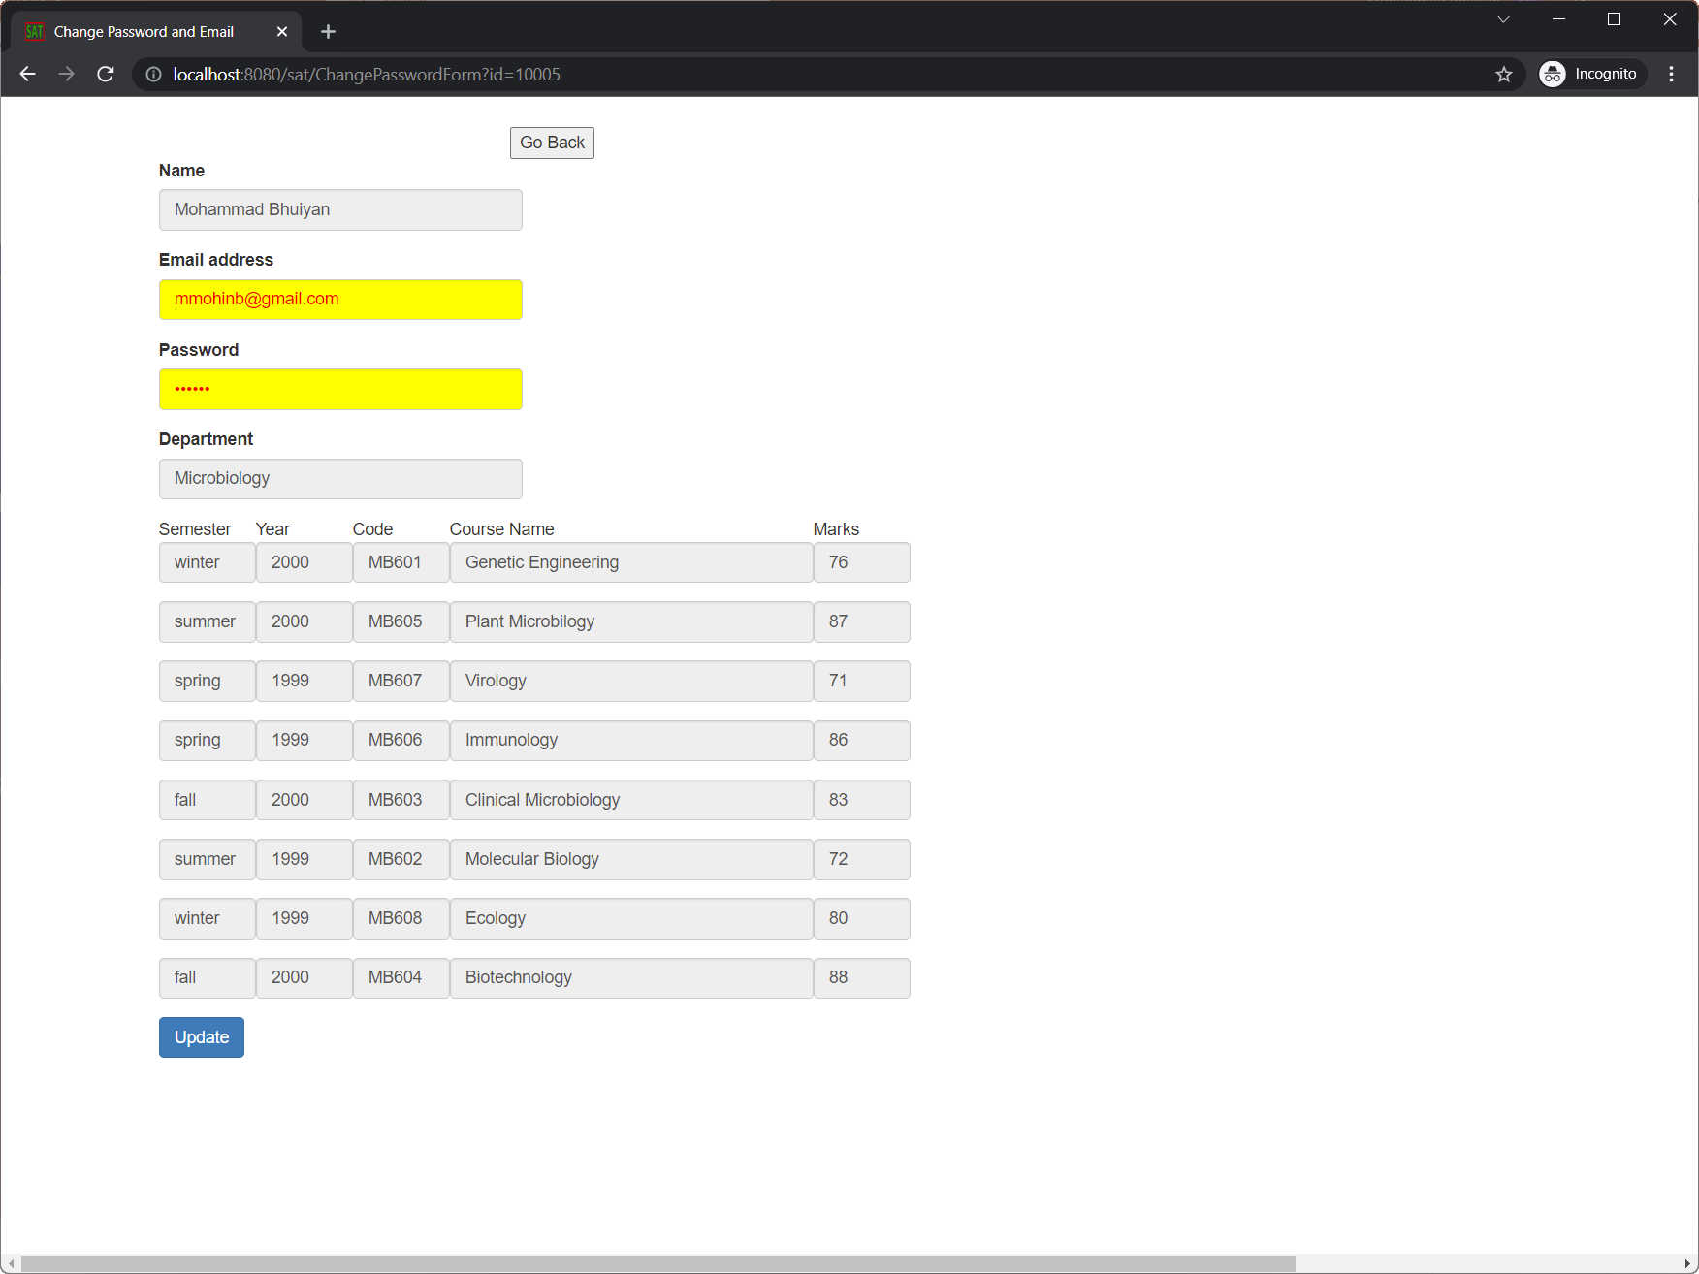
Password update page
Students can change email and password

Slide 10
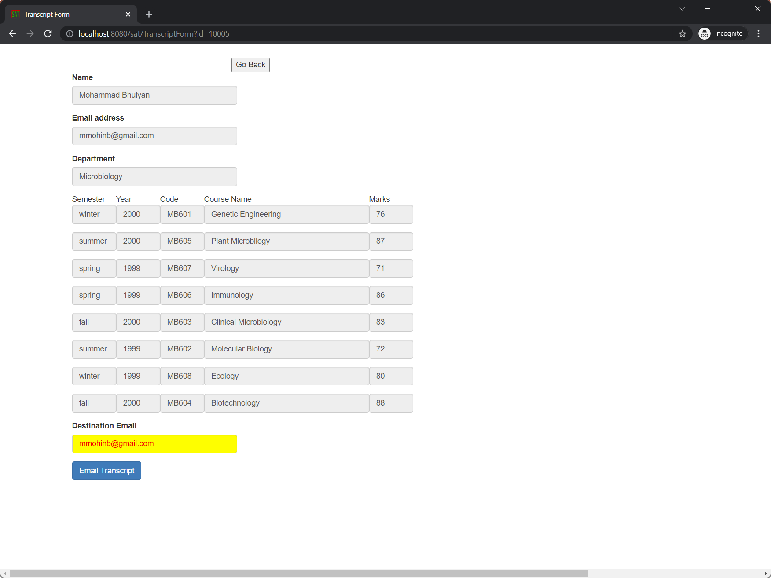
transcript
Student can send transcript to desired institution

Slide 11
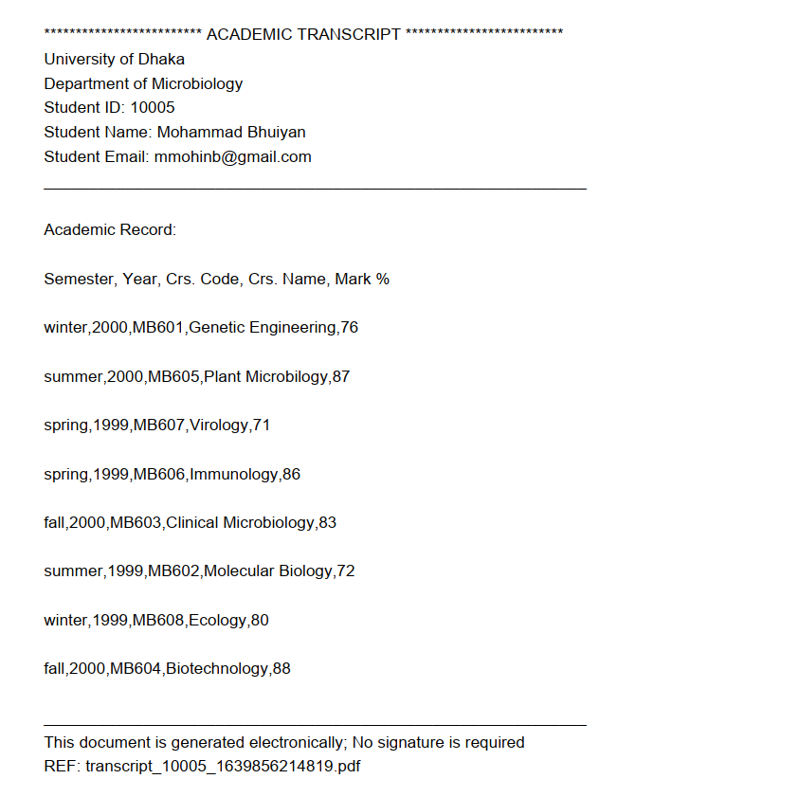
Sample transcript
Transcript has a unique reference number along with student’s mark and personal information

