Slide 1
DevOps

Slide 2
Agenda
1- why do we need DevOps ?
2- what is DevOps ?
3- DevOps Stages.
4- DevOps pipeline.
5- Jenkins.
6- Docker.
7- conclusion

Slide 3
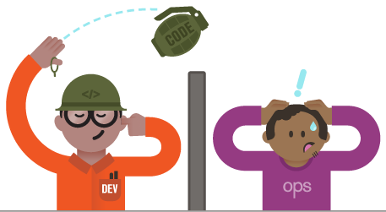
Why do we need DevOps ?
Developer : I fished some Features and I want to deploy it (Fire in the Hole)
Operation : I want stability and no Time Down
DevOps Fixed those issues

Slide 4
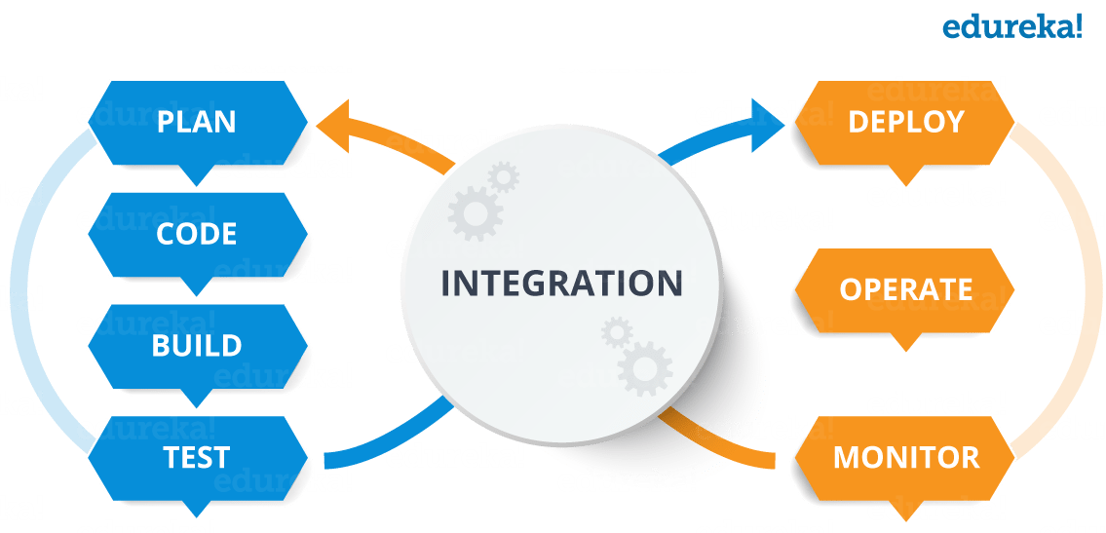
What is DevOps ?
DevOps is a Culture or mind set to:
1-share responsibilities

Slide 5
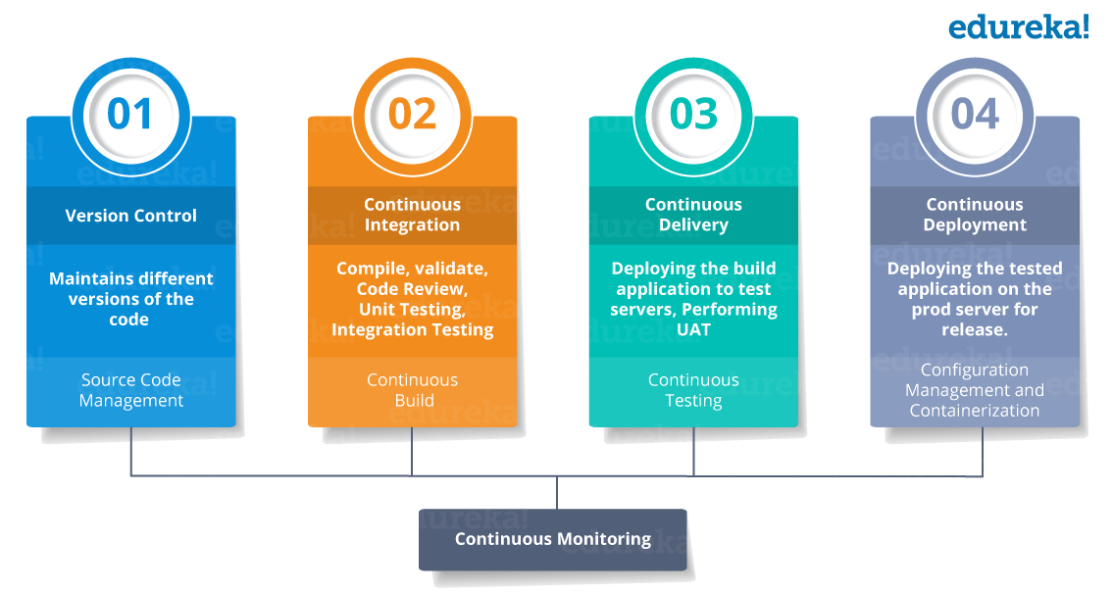
DevOps Stages .

Slide 6


Version Control .
Why we need Version Control ?
- to keep track of who did what .
- to roll back if any error happened

Slide 7
Continuous integration .
it means building the Application continuously
Which means validate the code,
perform (unit testing,integration testing)
And packing the Application

Slide 8
Continuous delivery .
for now the project ready and tested now we want
To deliver it .
example : Jenkins will deploy on the test server the code and run acceptance testing by selenium for example .
once it done will be deployed on production server for release.
(if done automatically will be called continuous deployment)
(if done manually called continuous delivery)
After delivery will be continuously monitored and send Feedback to related teams to solve the bugs and then go through the cycle again

Slide 9
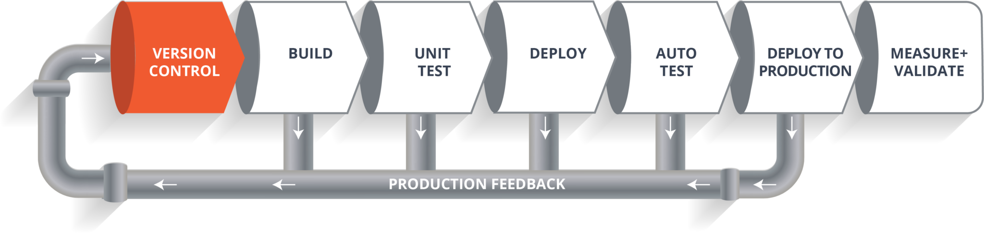

Slide 10
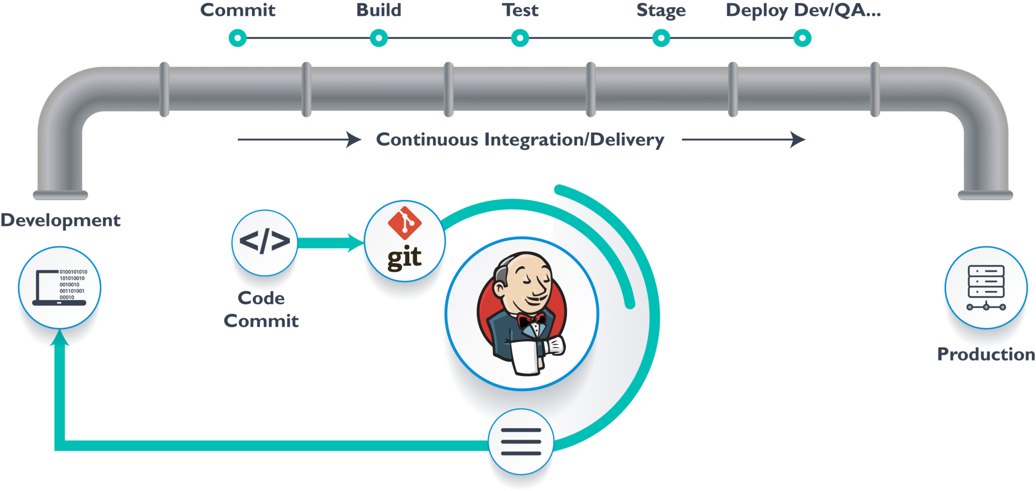
Jenkins (automate the Process)
Jenkins Receives the code From the Version Control And Commits all branches then
Move it to an automated Process .

Slide 11
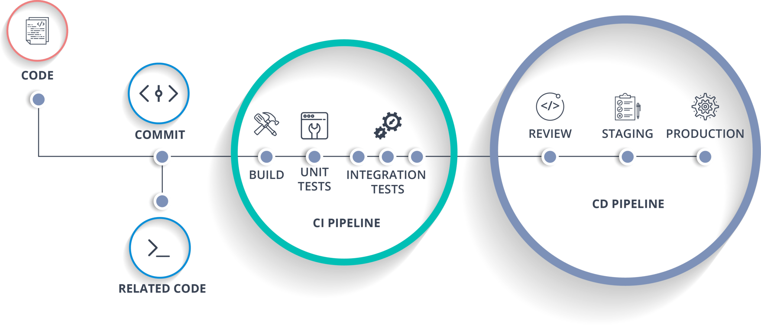
Docker
Allow me to create a Server
duplicate a platform or
Container in a few seconds
to deploy any files on it
To test those files
It’s not a exactly Virtual Machine but it can create Images
like Virtual Machines and run it as a Container on Docker

Slide 12
Conclusion
Why do we need DevOps

