Slide 1
California Housing
Price Prediction
Predicting Real Estate Values using Machine Learning
Comprehensive ML Regression Analysis | 20,640 Districts

Slide 2
Problem Statement
1
Multiple Influencing Factors
Property values affected by location, size, condition, time - factors vary substantially between properties
2
Market Volatility
Housing market depends on demand/supply fluctuations, interest rates, and inflation - challenging price prediction over time
3
Limited Data Features
Datasets contain limited features per property, making feature engineering critically important
4
Dataset Context
California housing dataset (1990 Census) with 20,640 districts and diverse house-related attributes

Slide 3
Study Aim & Dataset Overview
Study Objective
Dataset Statistics
Build and evaluate regression models to predict median house values in California districts
Key Focus Areas:
✓ Data preprocessing
✓ Feature engineering
✓ Model comparison
✓ Optimal performance
Using geographical, demographic, and housing-related features
Total Districts
Features
20,640
9 + Engineered
Target Variable
Missing Values
median_house_value
207 (0.1%)
Price Range
Median Price
$15k - $50k
$179,700

Slide 4
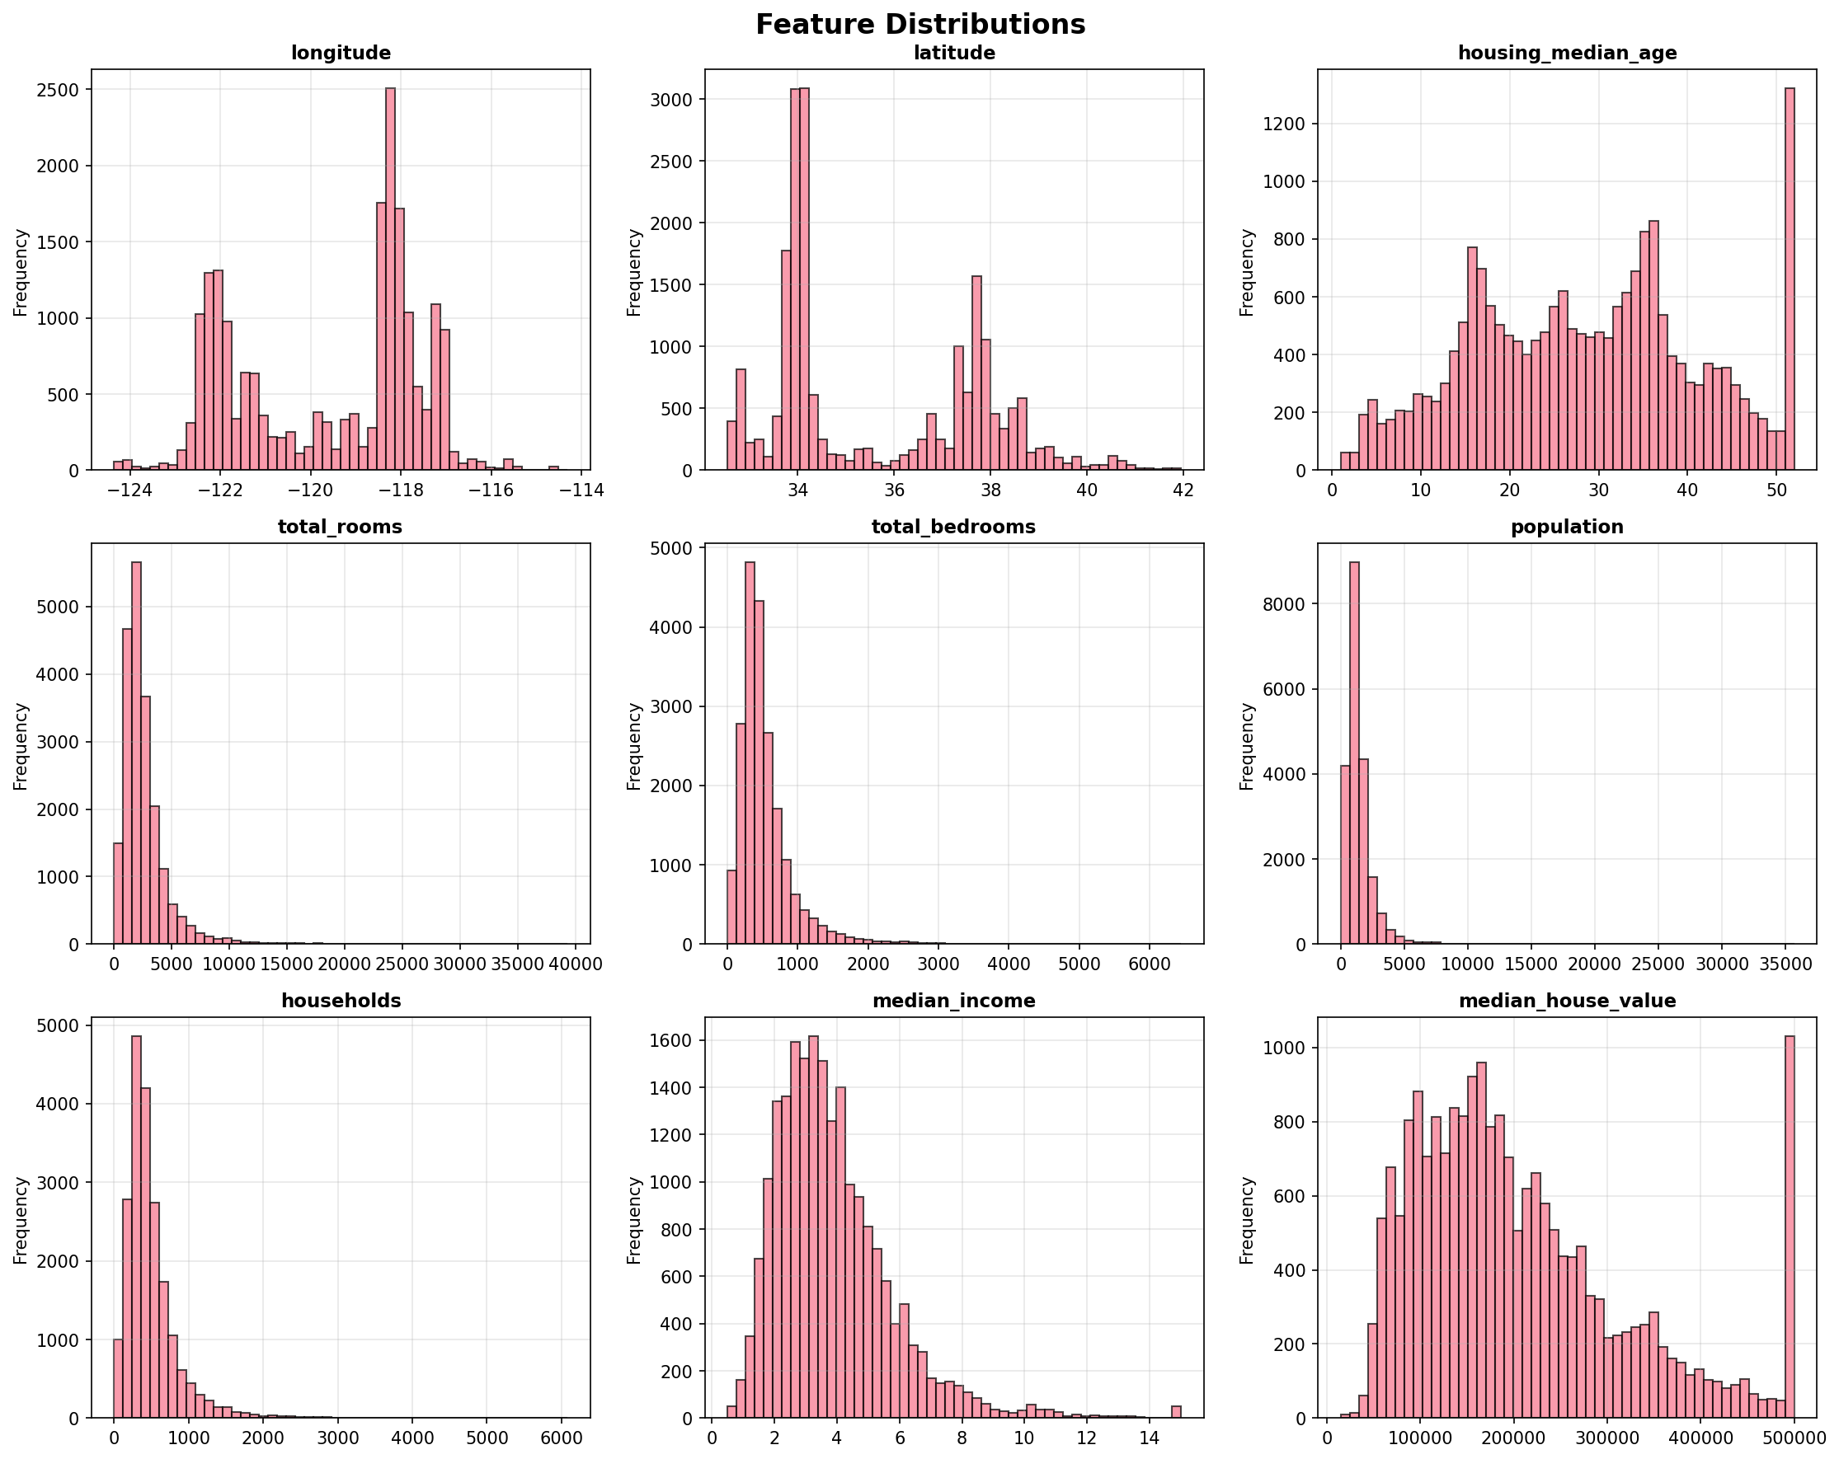
Data Distribution Analysis
⚠️ Critical Finding: Notice the spike at $500k in median_house_value - this data cap limits predictions for luxury homes (affects ~800 districts)

Slide 5
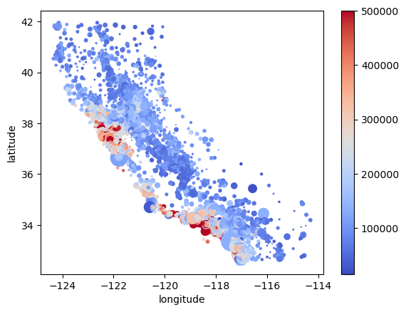
Geographic Price Distribution
Geographic Insights
Visualization:
• Circle size = Population
• Color = Price (Blue→Red)
Key Patterns:
✓ Coastal premium
(Bay Area, LA, San Diego)
✓ Inland affordability
(Central Valley regions)
💡 Geography is a major
price determinant - location
features critical for ML

Slide 6
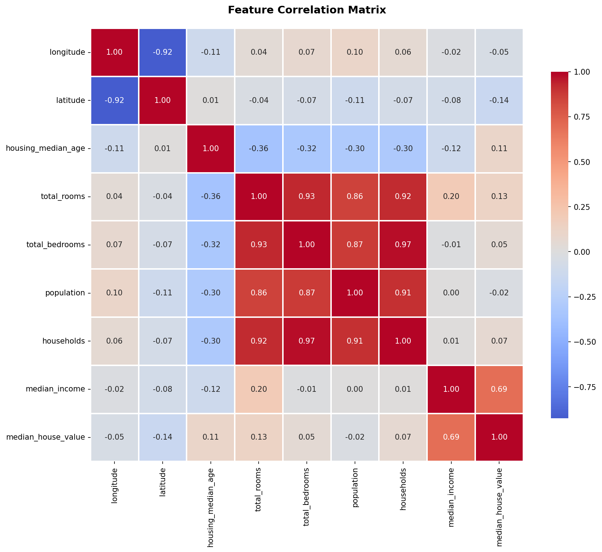
Feature Correlation Analysis
Top Correlations
With median_house_value:
#1 median_income
Correlation: +0.69
#2 Total rooms
Correlation: +0.13
#3 Latitude
Correlation: -0.14
(Prices ↓ going North)
💡 Income drives 48%
of price variance!

Slide 7
Feature Engineering & Preprocessing
Data Preprocessing ✓
Feature Engineering ⚙️
1. rooms_per_household
= total_rooms / households
Captures property size density
2. bedrooms_per_room
= total_bedrooms / total_rooms
Indicates room type distribution
3. population_per_household
= population / households
Measures household occupancy
✓ These ratios provide better
insights than raw counts!
• Dropped 207 missing bedrooms
2. Categorical Encoding
• One-Hot Encoding for
ocean_proximity (5 categories)
3. Feature Scaling
• StandardScaler applied
• Normalized all features
4. Train-Test Split
• 80% training (16,512)
• 20% testing (4,128)

Slide 8
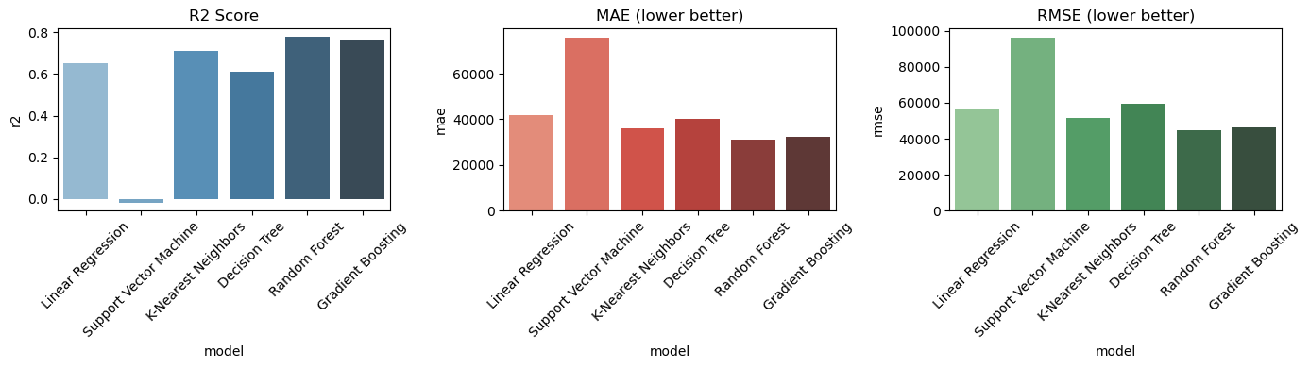
Model Performance Comparison
🏆 Winner: Random Forest Regressor | R² = 0.778371 | RMSE = 31002| MAE = 44984

Slide 9
Key Findings & Insights
📊
Strong Model Performance
💰
Income Dominance
Random Forest achieved R² = 0.77, explaining 77% of price variance with small average error
Median income is the strongest predictor (52% importance), with 0.69 correlation to house values
📍
Location Matters
🏠
Feature Engineering Impact
Geographic features (lat/long) contribute 37% combined - coastal properties command premium pricing
Engineered ratios (rooms per household, bedrooms per room) improved model interpretability
⚠️
Data Cap Limitation
🎯
Model Robustness
$500k price cap affects ~800 districts, limiting predictions for high-value properties
Ensemble methods (RF, GB) significantly outperform linear models by capturing non-linear relationships

Slide 10
Recommendations for
1
Remove Price Cap
Obtain or simulate data above $500k to improve luxury home predictions
HIGH
2
Hyperparameter Tuning
Use GridSearchCV or RandomizedSearchCV to optimize model parameters
HIGH
3
Cross-Validation
Implement k-fold CV (k=5 or 10) for more robust performance estimates
MEDIUM
4
Advanced Features
Add external data: school ratings, crime rates, proximity to amenities
MEDIUM
5
Ensemble Stacking
Stack multiple models (RF + GB + XGBoost) for improved accuracy
MEDIUM
6
Model Deployment
Deploy as REST API with Flask/FastAPI for real-time predictions
LOW

Slide 11
Conclusion
Project Summary
✓ Comprehensive data preprocessing with feature engineering
✓ Excellent model performance: R² = 0.77 (Random Forest)
✓ Strong insights: Income and location drive prices
✓ Professional implementation with multiple model comparison
✓ Clear visualizations and thorough documentation

