Slide 1
Normalization

Slide 2
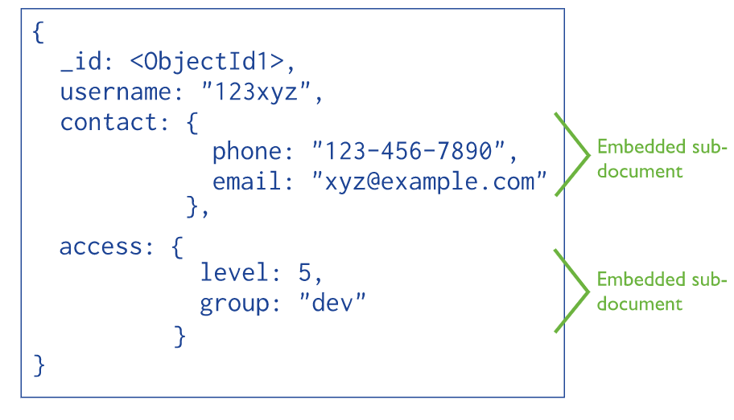
Normalizing in NoSQL
Denormalized data model

Slide 3
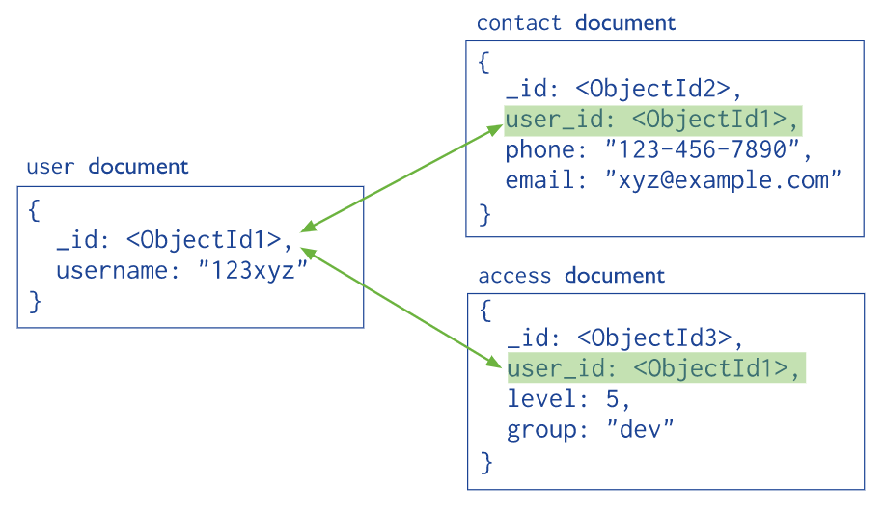
Normalizing in NoSQL
Normalized data model

Slide 4
SQLOS

Slide 5
Back up and restore

Slide 6
Attach and detach

Slide 7
File group

Slide 8
.mdf & .ldf

Slide 9
Collation

Slide 10
Schema

Slide 11
A user defined in a database can :
Add objects to database schemas
Own a schema
A user defined in a database cannot :
Define schemas

Slide 12
Example
Let’s create a login, user and schema from scratch …

Slide 13
SQL data types

Slide 14
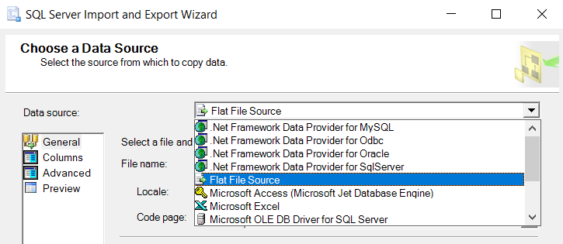
Importing data
Supporting data sources :

Slide 15
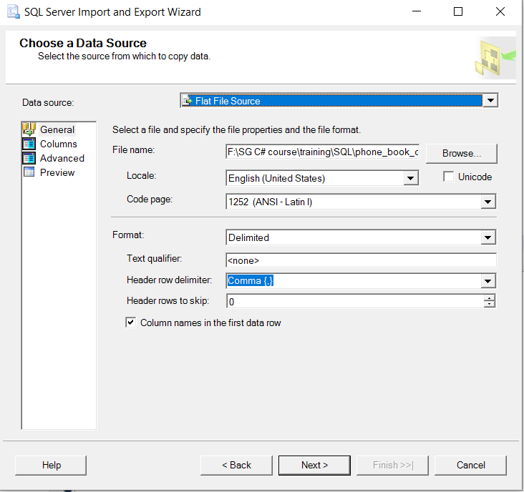
Importing data

Slide 16
T-SQL

Slide 17
Data type conversion (Database Engine)
When you convert between an application variable and a SQL Server result set column, return code, parameter, or parameter marker, the supported data type conversions are defined by the database API.
Implicit conversions are not visible to the user.
Explicit conversions use the CAST or CONVERT functions.
Ex.
SELECT CAST ( $157.27 AS VARCHAR(10))

Slide 18
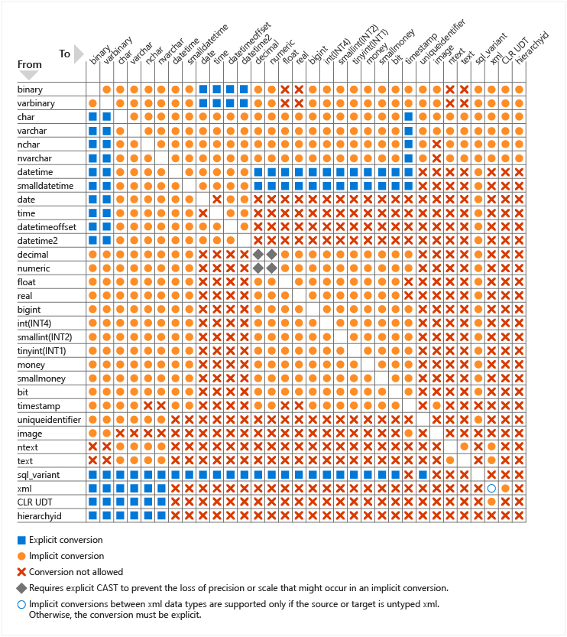

Slide 19
Explicit conversion
Implicit conversion
When SQL Server performs an explicit conversion, the statement itself determines the resulting data type
For implicit conversions, assignment statements such as setting the value of a variable or inserting a value into a column result in the data type that was defined by the variable declaration or column definition.
For comparison operators or other expressions, the resulting data type depends on the rules of data type precedence.

Slide 20

Implicit Conversion Example
Example : Implicit conversion in variable definition and expression evaluation
Code :
DECLARE @string VARCHAR(10);
SET @string = 1;
SELECT @string + ' is a string.' AS 'Concated'
result :

Slide 21
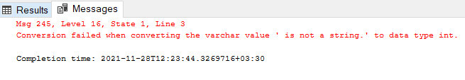
Implicit Conversion Example
Example : Implicit conversion in variable definition and expression evaluation
Code :
DECLARE @notastring INT;
SET @notastring = '1';
SELECT @notastring + ' is not a string.' AS 'Concated'
result :
Cause :
to evaluate the expression @notastring + ' is not a string.', SQL Server follows the rules of data type precedence to complete the implicit conversion before the result of the expression can be calculated. Because int has a higher precedence than varchar, SQL Server attempts to convert the string to an integer and fails.

Slide 22

Implicit Conversion Example
Previous example changed to operate successfully :
Code :
DECLARE @notastring INT;
SET @notastring = '1';
SELECT @notastring + '1'
result :
An addition occurred because string converted to int.

Slide 23
Join
INNER JOIN
LEFT [ OUTER ] JOIN
RIGHT [ OUTER ] JOIN
FULL [ OUTER ] JOIN
CROSS JOIN
Joins are treated logically.

Slide 24
Join
SQL Server employs four types of physical join operations to carry out the logical join operations :
Nested Loops joins
Merge joins
Hash joins
Adaptive joins (starting with SQL Server 2017 (14.x))

Slide 25
Join Syntax
Inner joins can be specified in either the FROM or WHERE clauses. Outer joins and cross joins can be specified in the FROM clause only. The join conditions combine with the WHERE and HAVING search conditions to control the rows that are selected from the base tables referenced in the FROM clause.

Slide 26
Join Syntax
Specifying the join conditions in the FROM clause helps separate them from any other search conditions that may be specified in a WHERE clause
FROM first_table < join_type > second_table [ ON ( join_condition ) ]
join_type specifies what kind of join is performed: an inner, outer, or cross join
Ex.
FROM Purchasing.ProductVendor INNER JOIN Purchasing.Vendor
ON ( ProductVendor.BusinessEntityID = Vendor.BusinessEntityID )

Slide 27
Join
In multi table join, one or few tables can bridge between other tables.

Slide 28
Join
Columns used in a join condition are not required to have the same name or be the same data type. However, if the data types are not identical, they must be compatible, or be types that SQL Server can implicitly convert. If the data types cannot be implicitly converted, the join condition must explicitly convert the data type using the CAST function.

Slide 29

Join
Programming Hints
Most queries using a join can be rewritten using a subquery (a query nested within another query), and most subqueries can be rewritten as joins.

Slide 30
Join
Programming Hints
Most queries using a join can be rewritten using a subquery (a query nested within another query), and most subqueries can be rewritten as joins.

Slide 31
Join
Note
Tables cannot be joined directly on ntext, text, or image columns. However, tables can be joined indirectly on ntext, text, or image columns by using SUBSTRING. For example, SELECT * FROM t1 JOIN t2 ON SUBSTRING(t1.textcolumn, 1, 20) = SUBSTRING(t2.textcolumn, 1, 20)
performs a two-table inner join on the first 20 characters of each text column in tables t1 and t2.

Slide 32
Nested Loops joins
If one join input is small (fewer than 10 rows) and the other join input is fairly large and indexed on its join columns, an index nested loops join is the fastest join operation because they require the least I/O and the fewest comparisons.

Slide 33
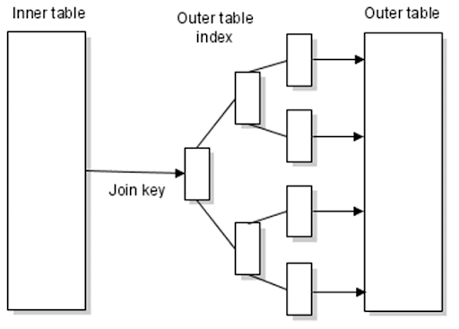
Nested Loops joins
The outer loop consumes the outer input table row by row.
The inner loop, executed for each outer row, searches for matching rows in the inner input table.
A nested loops join is particularly effective if the outer input is small and the inner input is preindexed and large???

Slide 34
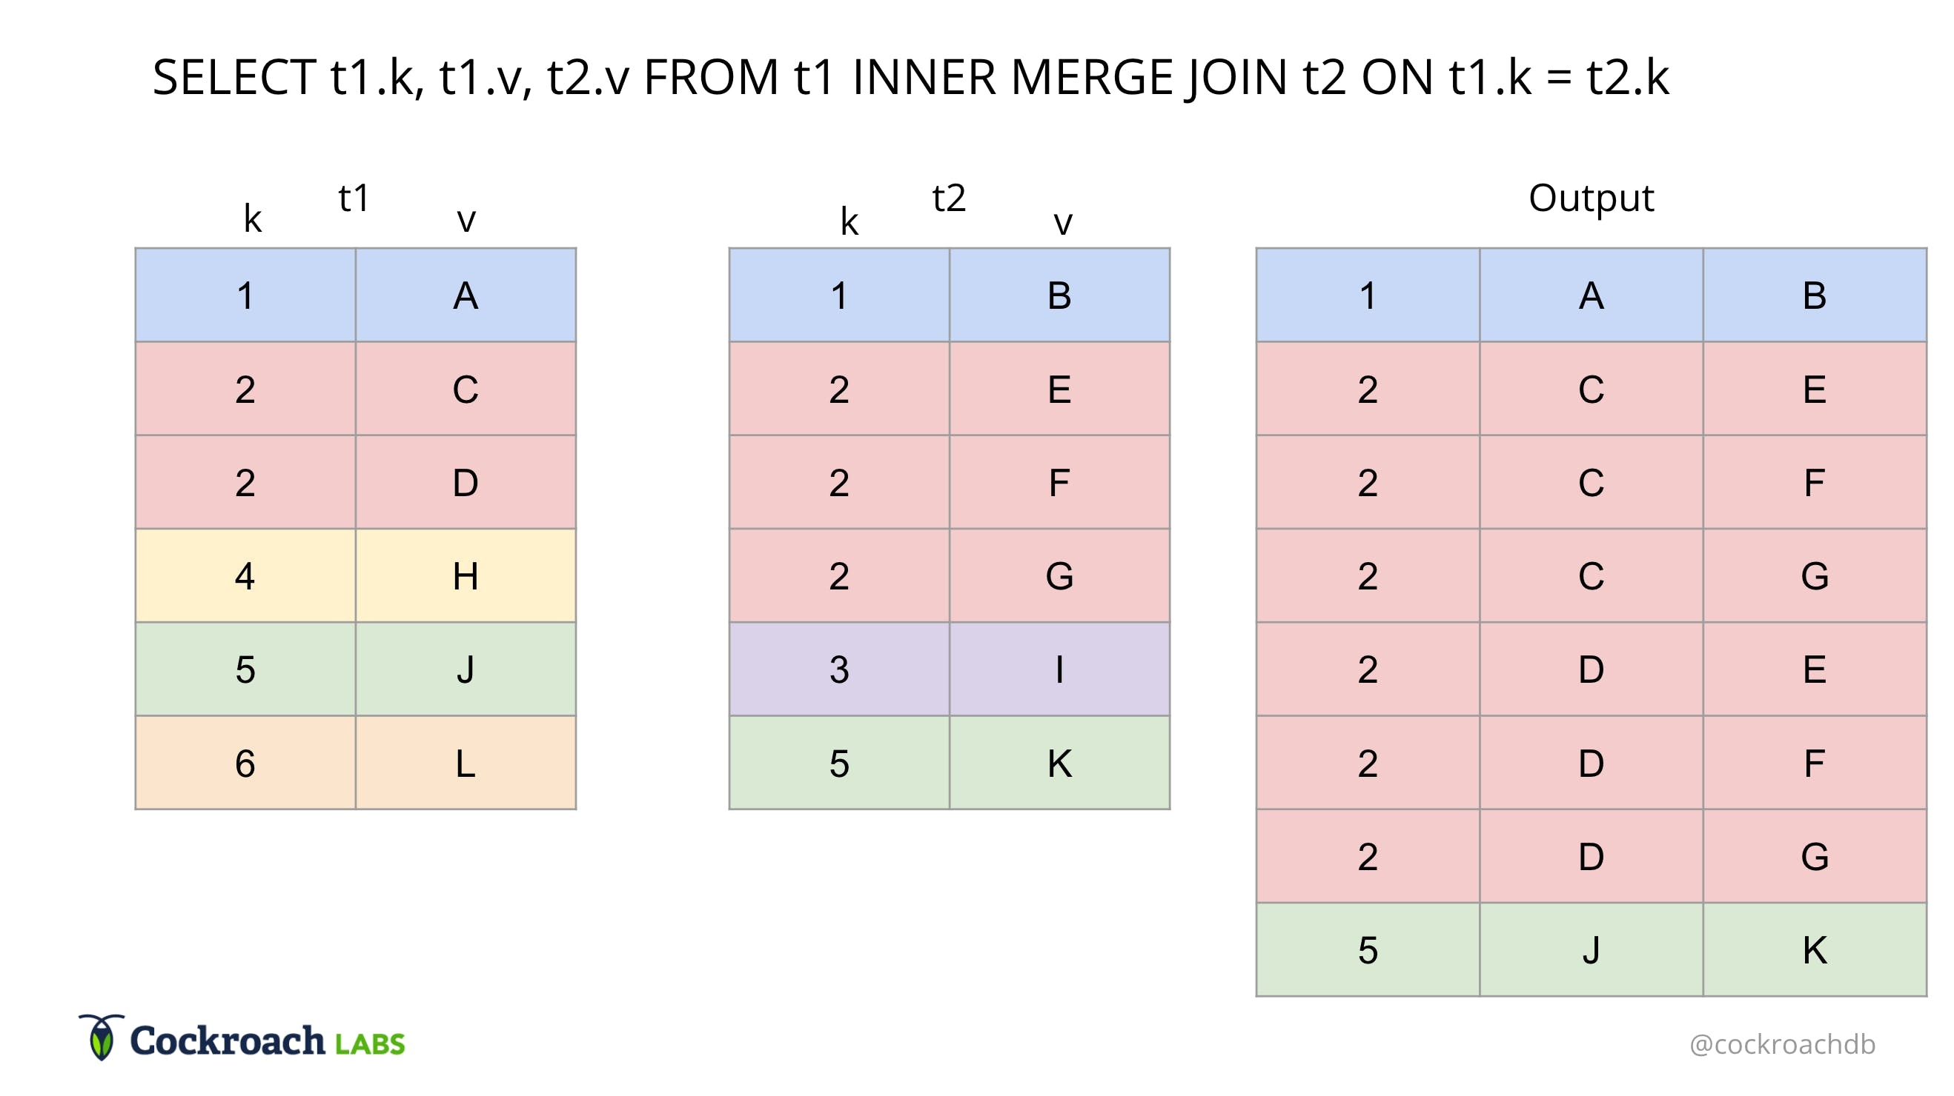
Merge joins
A many-to-many merge join uses a temporary table to store rows. If there are duplicate values from each input, one of the inputs will have to rewind to the start of the duplicates as each duplicate from the other input is processed.

Slide 35
Group by
--A "Single Item Order" is a customer order where only one item is ordered. Show the SalesOrderID and the UnitPrice for every Single Item Order.
SELECT distinct s1, up_avg as 'Average unit price' FROM
(SELECT SalesOrderID s1,AVG(UnitPrice) as up_avg,count(*) as item_count
FROM SalesLT.SalesOrderDetail
Group by SalesOrderID)as t
where item_count=1
In a group by selection, all columns except those which appear in group by columns, must be in aggregated format.

Slide 36
Cross Join
The CARTESIAN JOIN or CROSS JOIN returns the Cartesian product of the sets of records from two or more joined tables

