Slide 1
Normalization

Slide 2
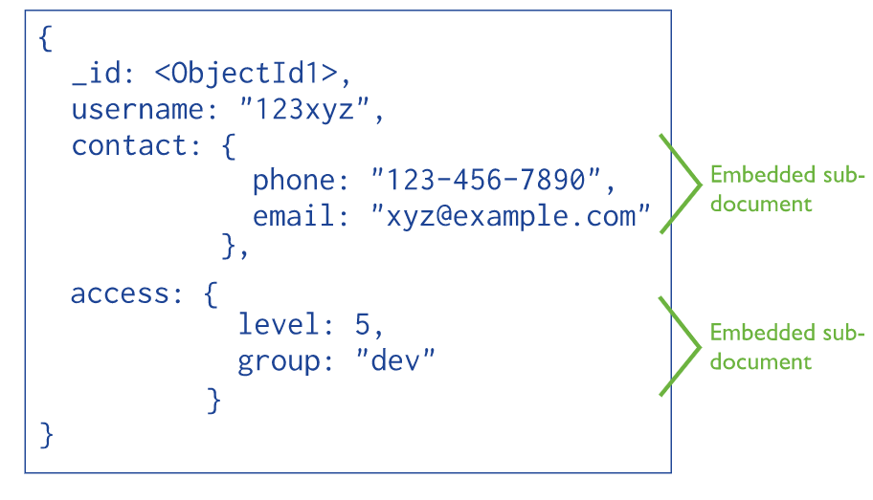
Normalizing in NoSQL
Denormalized data model

Slide 3
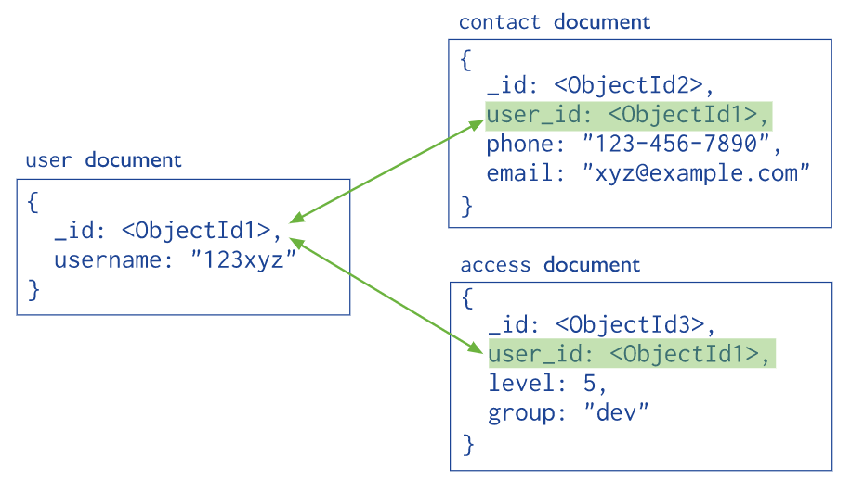
Normalizing in NoSQL
Normalized data model

Slide 4
SQLOS

Slide 5
Back up and restore

Slide 6
Attach and detach

Slide 7
File group

Slide 8
.mdf & .ldf

Slide 9
Collation

Slide 10
Schema

Slide 11
A user defined in a database can :
Add objects to database schemas
Own a schema
A user defined in a database cannot :
Define schemas

Slide 12
Example
Let’s create a login, user and schema from scratch …

Slide 13
SQL data types

Slide 14
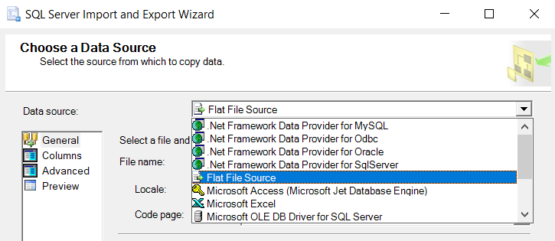
Importing data
Supporting data sources :

Slide 15
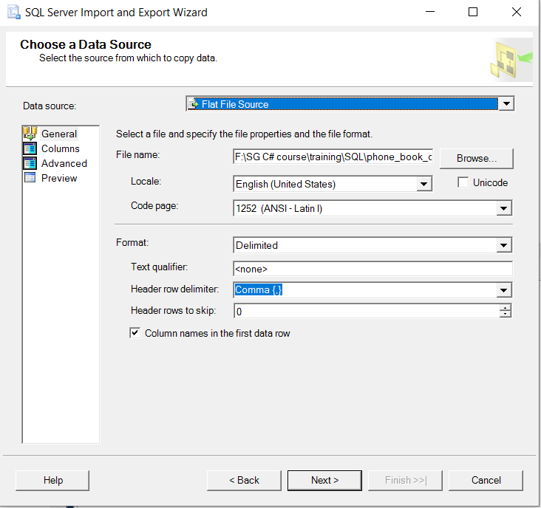
Importing data

