Slide 1
Predicting Diabetes Using a Data Science Workflow
Name: Mohamed Abdulrahman Younis
ID: 202211264
Name: Ali Al-Jayousi
ID: 202211264
Name: Mohammad Al-Dayem
ID: 202211264

Slide 2
Dataset Overview
The project uses the 'diabetes.csv’ dataset, which contains medical information used to predict diabetes.
The key features include:
Glucose levels
Blood Pressure
Skin Thickness
Insulin
BMI
Age, and the target variable 'Outcome' indicating diabetes status.

Slide 3
Operations Performed
Data Cleaning:
Handled missing and zero values in medical measurements.
Replaced physiologically impossible zero values with median values.
Normalized the numerical features to ensure consistent scales.
Removed any duplicate entries.

Slide 4
Operations Performed (Cont’d)
2. Data Visualization:
Created distribution plots showing the spread of each medical measurement.
Used boxplots to identify outliers in the data.
Generated a correlation heatmap to show relationships between features.
Visualized the balance between diabetic and non-diabetic cases.

Slide 5
Operations Performed (Cont’d)
3. Data Analysis:
Split data into training (80%) and testing (20%) sets.
Implemented two models: Random Forest and Logistic Regression.
Identified most important features for diabetes prediction.
Applied the models to make predictions on test data.

Slide 6
Operations Performed (Cont’d)
4. Data Evaluation:
Measured model performance using accuracy, precision, recall, and F1-score.
Created confusion matrices to understand prediction errors.
Generated ROC curves to assess model discrimination ability.
Compared performance between Random Forest and Logistic Regression models.

Slide 7
Crucial Results
Random Forest got 74%.
Logistic Regression got 74%.
Visualization shows Glucose and BMI are the most important features to predict diabetes.

Slide 8
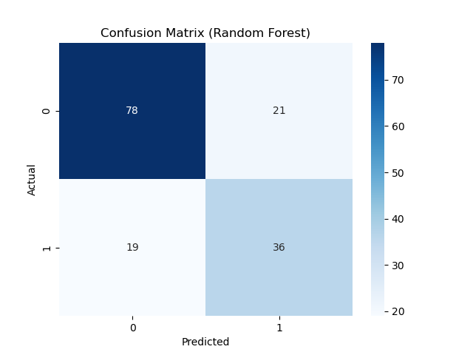
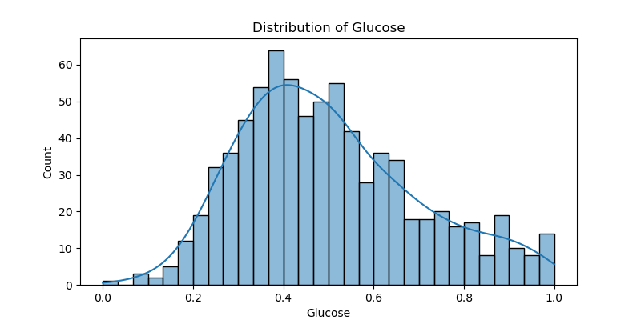
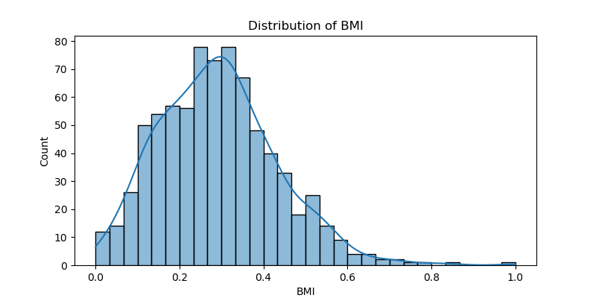
Crucial Graphics

