Slide 1
Expression evaluation using stack
Supervised by
Dr: Lamia Alrefaai
Eng: Shaimaa Yosry

Slide 2
Objectives
Project description
Introduction
Convert infix expressions to postfix
Evaluate postfix expressions using a stack
Explore corresponding MIPS assembly implementation
conclusion

Slide 3
Project description
This project demonstrates the conversion of postfix expressions to infix notation and evaluates the final result using MIPS assembly language. The program utilizes a stack-based approach to first accept a postfix expression from the user. It then converts this expression into its corresponding infix form using a stack for operand management. After the conversion, the infix expression is evaluated using another stack-based routine. Once the result is computed, it is displayed to the user. Finally, the program prompts the user to decide whether to perform another calculation or exit, enabling repeated use in a user-friendly loop.

Slide 4
Introduction
Expression evaluation is essential in computing and programming.
Expressions can be written in:
Infix (e.g., A + B)
Prefix (e.g., + A B)
Postfix (e.g., A B +)
Postfix notation is easier for machines to evaluate.
Stack data structure is ideal for evaluating postfix expressions

Slide 5
Postfix
What is postfix notation?
Also called Reverse Polish Notation (RPN).
Operators follow operands.
helps in easy evaluation using stacks.
Example:
Infix: 3 + 4
Postfix: 3 4 +

Slide 6
Stack
Why Use a Stack?
Stack = Last-In-First-Out (LIFO) structure.
Supports two main operations:
Push: Insert an element.
Pop: Remove the top element.
Useful for maintaining operand order during evaluation

Slide 7
Infix to Postfix – Algorithm
Algorithm Using Stack:
1. Initialize an empty stack and output string.
2. Read tokens from left to right:
Operand → Add to output.
( → Push to stack.
) → Pop to output until (.
Operator:
Pop from stack to output if top has higher or equal precedence.
Push current operator onto stack.

Slide 8
Continue
3. Pop all remaining operators to output.
Example:
Infix: ( A + B ) * ( C - D )
Postfix: A B + C D - *
Stack Trace:
Read ( → Stack: (
Read A → Output: A
Read + → Stack: (+
Read B → Output: A B
Read ) → Pop + → Output: A B +
(Repeat for second part)

Slide 9
Postfix Evaluation Algorithm
Step-by-step Process:
1. Create an empty stack.
2. Scan the expression left to right.
3. For each symbol:
If operand:
push to stack.
If operator:
Pop top two operands.
Apply the operator.
Push result back.
4. Final result = top of stack.

Slide 10
Example
Postfix: 5 6 2 + * 12 4 / -
Evaluation Steps:
Push: 5, 6, 2
+: 6+2=8 → Stack: 5, 8
*: 5*8=40 → Stack: 40
Push: 12, 4
/: 12/4=3 → Stack: 40, 3
-: 40-3=37 → Stack: 37
Result: 37

Slide 11
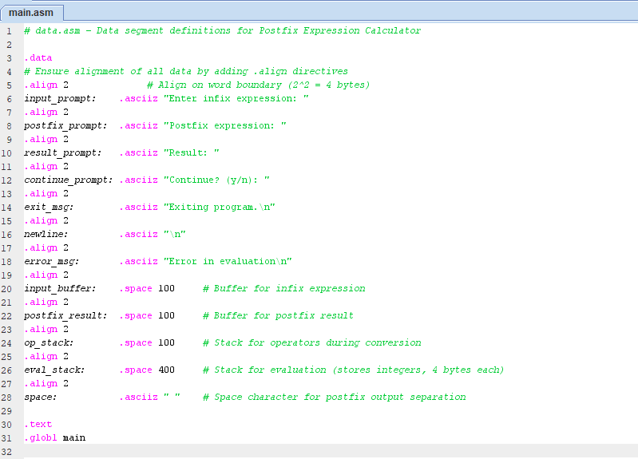
Explore corresponding MIPS assembly implementation
Code::https://www.mediafire.com/file/3x60x9s46jitd4z/project.rar/file

Slide 12
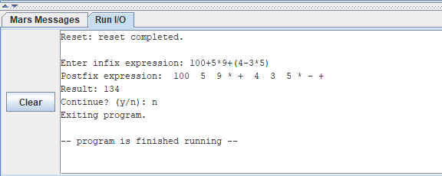
Output
Code :https://www.mediafire.com/file/3x60x9s46jitd4z/project.rar/file

Slide 13
INPUT LIMITATIONS
Buffer size
Maximum input expression length is limited to 100 characters
Maximum postfix result length is limited to 100 characters

Slide 14
NUMERICAL LIMITATIONS
Integer Only Operations Only Operations
Only handles integer arithmetic
No support for floating-point numbers
No Negative Number Input
Can only achieve negative results through subtraction
Division results are truncated to integers
Stack Size
Evaluation stack is limited to 100 integers (400 bytes)
Could overflow with very complex expressions

Slide 15
OPERATOR LIMITATIONS
Limited Operators
No modulo operator
No bitwise operators
No logical operators

Slide 16
Conclusion
Postfix notation simplifies expression evaluation.
Stacks manage operands and intermediate results.
Efficient and widely used in computing systems.
Knowing this technique helps in compiler design and algorithm development

Slide 17
Team
Name:
Achraf Mohamed Abobakr B.N.:12
Zyad Billal Gamal B.N.:25
Mohad Mohamed Hosni B.N.:50
Youssef Rashad Farouk B.N.:58
Youssef Mohamed Saeed B.N.:60

Slide 18
Thank you

