Slide 1

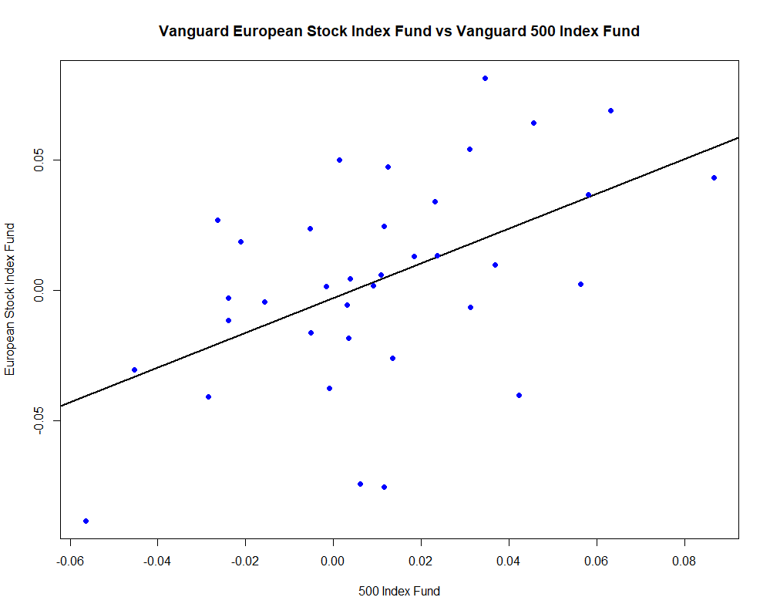
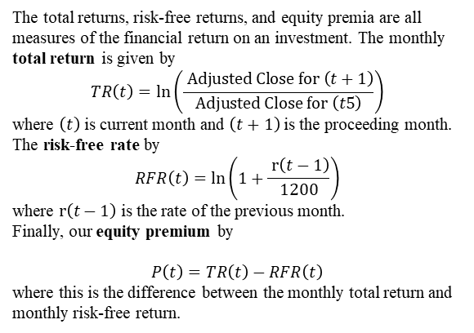
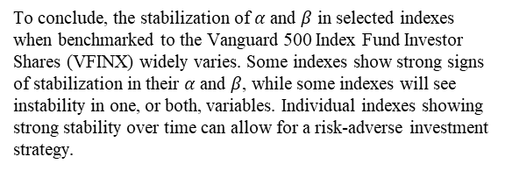
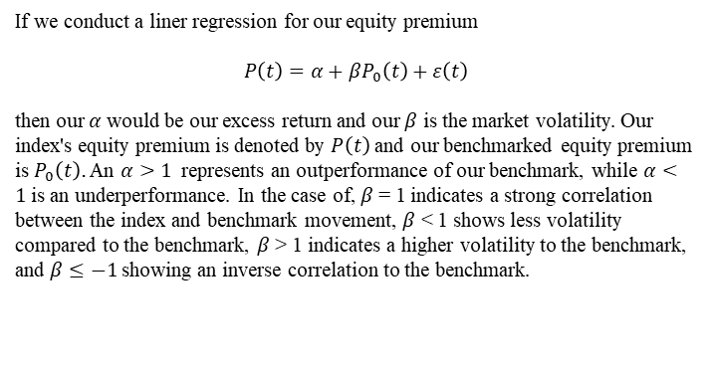
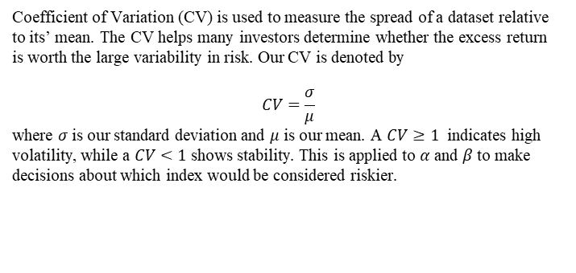
Stabilization of Alpha and Beta in Vanguard Index Funds
Mohagoney Moore
University of Nevada, Reno
Introduction
Alpha and Beta
*Results
The total returns, risk-free returns, and equity premia are all measures of the financial return on an investment. The monthly total return is given by
$$TR\left(t\right)=\ln\left(\frac{ \text{Adjusted} \text{Close} \text{for} \left(t+1\right)}{\text{Adjusted} \text{Close} \text{for} \left(t5\right)}\right)$$
where $\left(t\right)$ is current month and $\left(t+1\right)$is the proceeding month. The risk-free rate by
$$RFR\left(t\right)=\ln\left(1+\frac{ \text{r}\left(t−1\right)}{\text{1200}}\right)$$
where $\text{r}\left(t−1\right)$is the rate of the previous month.
Finally, our equity premium by
$$P\left(t\right)=TR\left(t\right)−RFR\left(t\right)$$
where this is the difference between the monthly total return and monthly risk-free return.
If we conduct a liner regression for our equity premium
$$P\left(t\right)=α+βP_{0}\left(t\right)+ε\left(t\right)$$
then our $α$ would be our excess return and our $β$ is the market volatility. Our
index's equity premium is denoted by $P\left(t\right)$and our benchmarked equity premium is $P_{0}\left(t\right).$ An $α>1$ represents an outperformance of our benchmark, while $α<1$is an underperformance. In the case of, $β$ = 1 indicates a strong correlation between the index and benchmark movement, $β$ < 1 shows less volatility compared to the benchmark, $β$ > 1 indicates a higher volatility to the benchmark, and $β≤−1$showing an inverse correlation to the benchmark.
(*Note: See if we need both the table and figure. Come back to)
Are Alpha and Beta Stable?
Conclusion
Coefficient of Variation (CV) is used to measure the spread of a dataset relative
to its’ mean. The CV helps many investors determine whether the excess return
is worth the large variability in risk. Our CV is denoted by
$$CV=\frac{σ}{μ}$$
where $σ$is our standard deviation and $μ$is our mean. A $CV≥1$ indicates high
volatility, while a $CV<1$ shows stability. This is applied to $α$ and $β$ to make decisions about which index would be considered riskier.
To conclude, the stabilization of $α$ and $β$ in selected indexes when benchmarked to the Vanguard 500 Index Fund Investor Shares (VFINX) widely varies. Some indexes show strong signs of stabilization in their $α$ and $β$, while some indexes will see instability in one, or both, variables. Individual indexes showing strong stability over time can allow for a risk-adverse investment strategy.
S&P 500
The Standard and Poor's 500 Index, better known as the S&P 500, is an index consisting of the 500 largest publicly traded companies in the United States. Since its' inception in 1957, the S&P 500 serves as one of the leading benchmarks in the U.S. stock market. We will look at a variety of Vanguard index funds and their performance against the Vanguard 500 Index Fund Investor Shares (VFINX) as our benchmark fund.
.
Acknowledgements
I would like to thank Dr. Andrey Sarantsev in mentoring me through the process of this research note and allowing me the possibility to engage in financial research.

