Slide 1
NAME: MOHAIMENUR RAHMAN
ID:19-40338-1
SECTION: N

Slide 2
OPERATION OF FULL WAVE CENTER TAPPED RECTIFIER

Slide 3
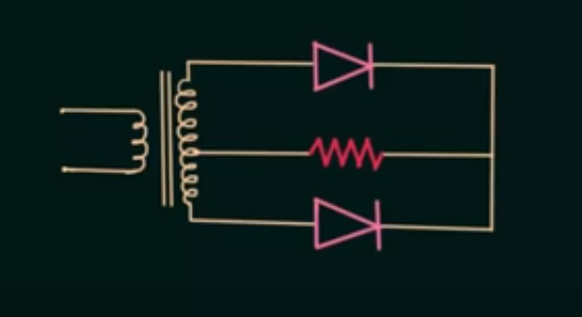
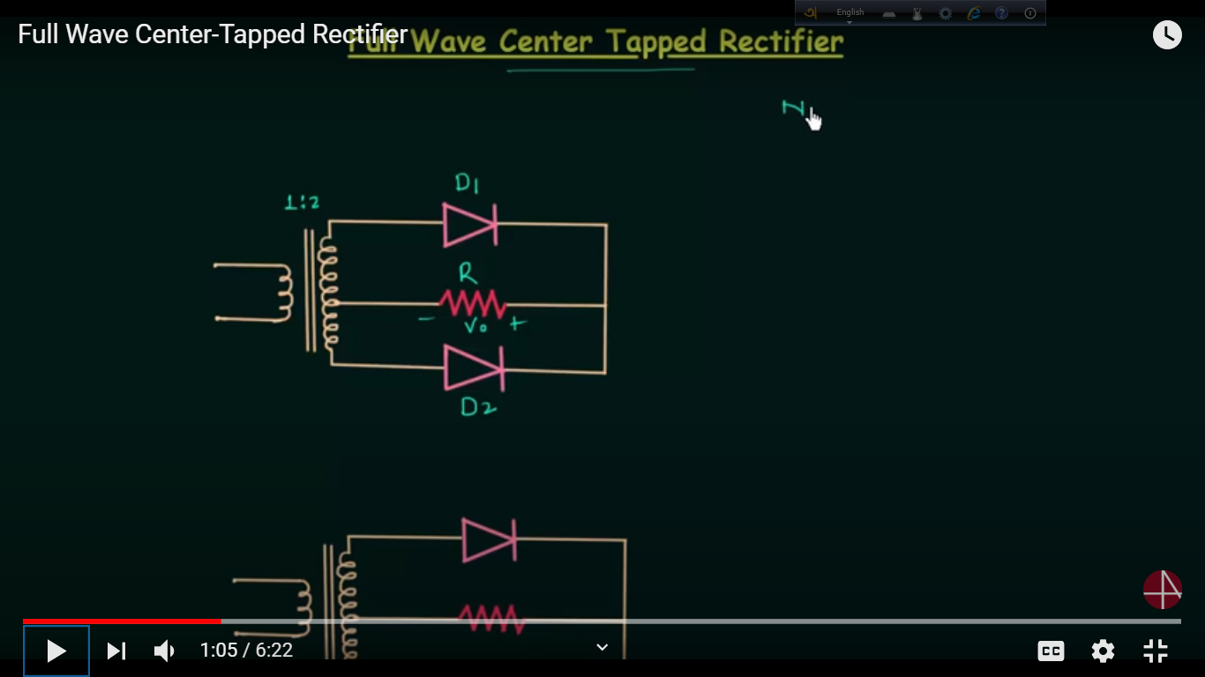

Slide 4
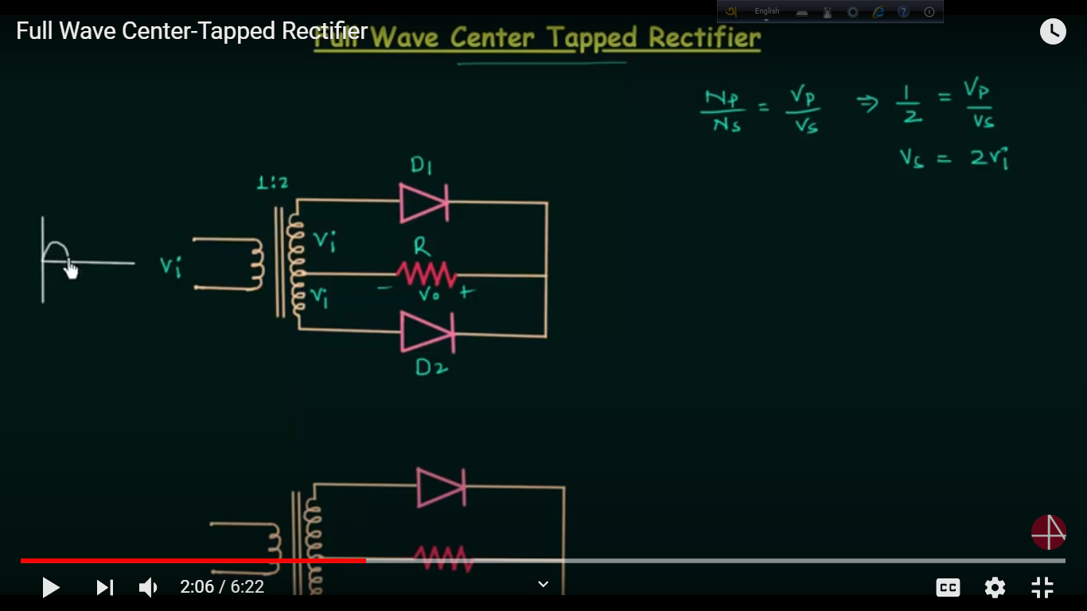

Slide 5
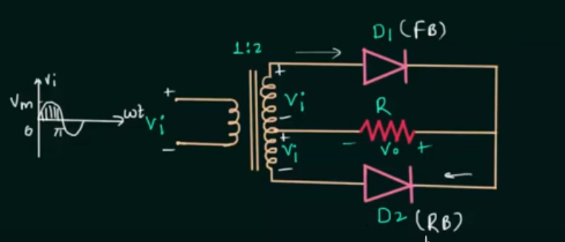
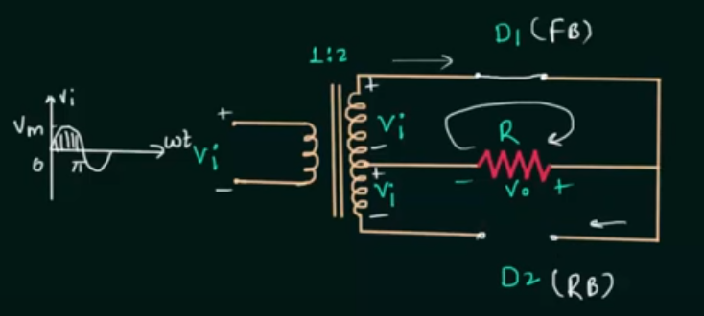
FOR POSITIVE HALF CYCLE

Slide 6
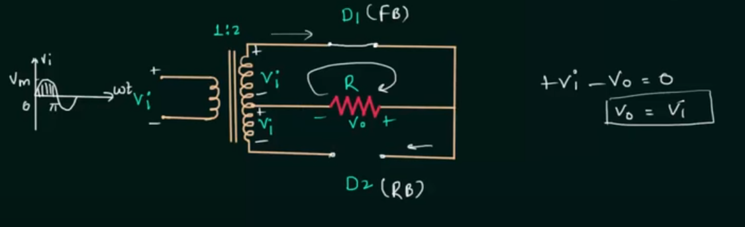

Slide 7
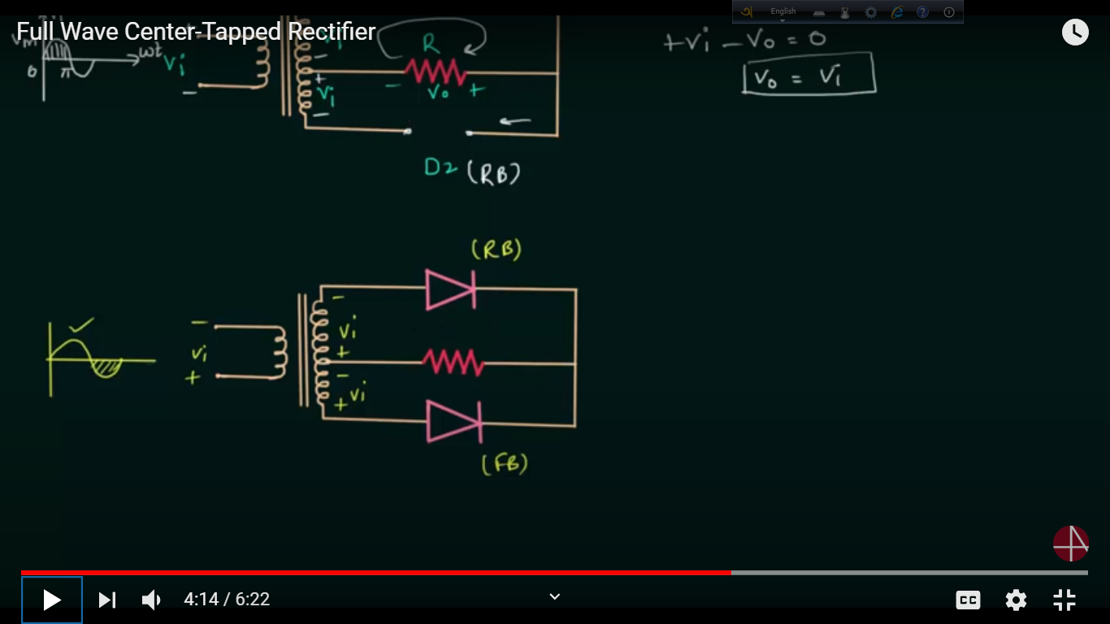
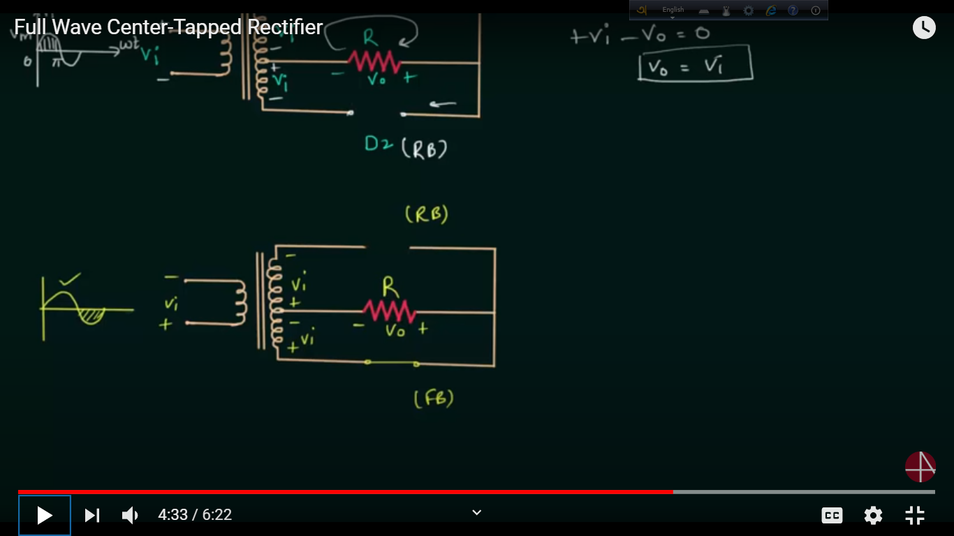
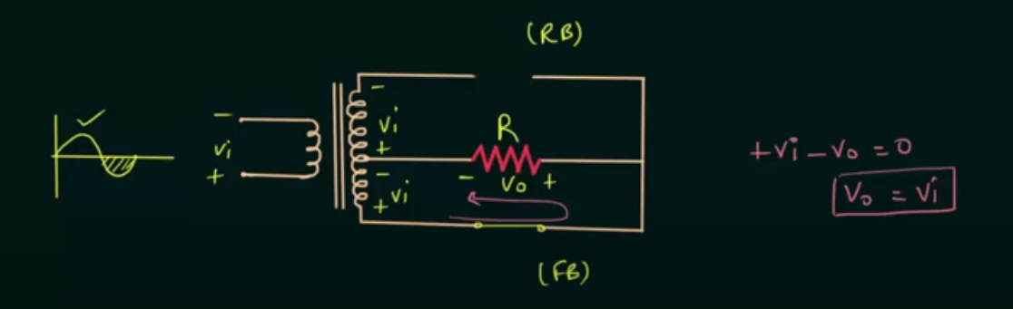
FOR NEGATIVE HALF CYCLE

Slide 8
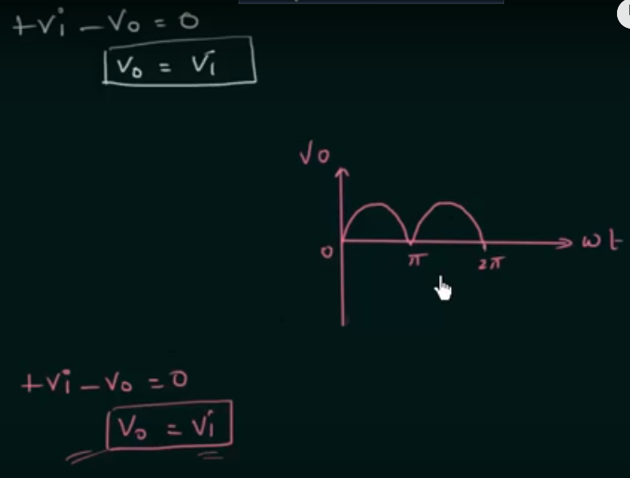
FINAL RESULT

