Slide 1
What the war of independence teaches us section: b17
Submitted by:
RIFAT FAHINUL AHMED (19-40364-1)
ZEBA SEHRISH (19-40342-1)
Fahmida khanam (19-40351-1)
Hasan MD. Mahin (19-40345-1)
Era israt yeasin (19-40331-1)
SAYMA ALAM (19-40376-1)

Slide 2
OUTLINE:
Importance of Independence
Sovereign Identity
About Patriotism
To accomplish Democracy
Responsible towards Country
Having Political Stability
Draw out the Conspirators
Women Power
Proper usage of intelligent & courage in Wars
Well Planning & Unity
Fight against Racism
Conclusion

Slide 3
Importance of Independence
Learning to support oneself is fundamental for any success one ever
hope to achieve.
Liberty works as a backbone for one to express strong opinion & to
live the life in his own way.

Slide 4
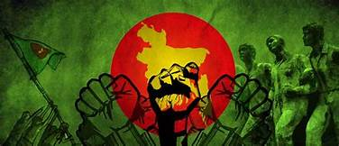
Sovereign identity
Independence war not only liberated our country, but also gave a sovereign identity to our country amongst the world.
Having sovereignty means living as with strong recognition, being individual by having a flag of our own and liberation war gave us that.
Sovereignty gave our country a protection to fight against unfavourable situations.

Slide 5
About Patriotism
Patriotism gives birth of loving our country more than any others and being proud of it.
Dedication & blood shedding in liberation war is a perfect symbol of patriotism
that is very important to have inside every people of our country.

Slide 6
To accomplish Democracy
In 1971, basically the war began to set democracy amongst the people of Bangladesh. So, it’s very important to have democracy in a country because it promotes equality among citizens.
As democracy is a system of rule by laws, it prominently strengthens the backbone of a country from every aspects to ensure equal rights.

Slide 7
Responsible towards Country
Our freedom fighters sacrificed their valuable lives to achieve
independence. So it is our responsibility to protect our independence.
Independence made us conscious about fulfilling mandatory duties &
helping our country to our utmost effort to bring more development for us.

Slide 8
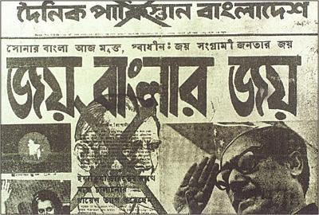

Having political stability
During war of our independence, political condition of our country was not stable, so we had to experience many military regimes. Thus, we know that political stability is very important to have powerful potential to defend opponents.
Balanced political conditions ensure democracy and anti corruption system in a society that results a stable and sovereign country.

Slide 9
Draw out the Conspirators
In 1971,there was a lot of conspirators inside & outside both in our
country. So, war taught us to be aware of conspirators against our country.
Insider enemies are more dangerous than outsider enemies. So, it’s very important to differentiate those viruses from us and give them proper punishment before they can do conspiracy against our nation.

Slide 10
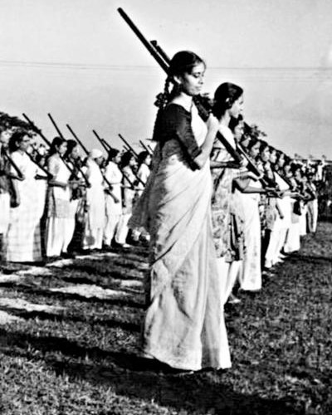
Women Power
During the liberation war, women also participated physically and in other ways. Their contribution undoubtedly makes us realize about woman power.
Women deserves equal respect like men in terms of liberating our country. That’s why, it’s our duty to ensure women power to give our mothers and sisters the platform so that they can serve our country proudly.

Slide 11
Proper usage of intelligence
& courage in wars
Intelligence during war works to execute plans properly and gather internal information to fight against enemies much effectively.
Without a lot amount of courage, maybe our fighters couldn’t make us independent and we could still need to live as slaves of Pakistani dictators. So, always we are to be courageous to fight for our rights.

Slide 12
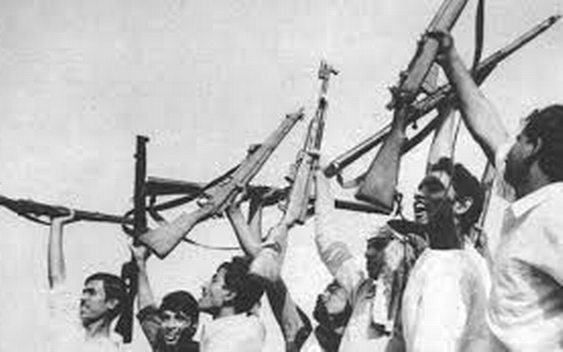
Well Planning & Unity
We can see some nice planning and strong unity among warriors of our liberation war. So, it is the best learning for us to be strong bond among our people to fight against adversities.
Independence war teaches us that unity formation works very importantly to defeat even people with stronger power than us.

Slide 13
Fight against Racism
To live a life without any immoral enforcement is the basic concept of fighting against racism.
Racism can never be the reason to have peace among people in any country. Independence war also teaches us to broaden our thoughts from stereotypic racism facts.

Slide 14
Conclusion
Achievement after the liberation war -
A new nation, A new flag, A new map, Most valuable freedom.
Steps to protect country and freedom
*Obey the rules of our country
* Practice the duties towards country whole heartedly.
*Forming several commission to ensure good governance
*Introducing local government system through election
*Development in education sector
*Minimizing dependency on foreign aids and emphasising on country products

Slide 15
Thank you everyone

