Slide 1
Operating system

Slide 2
Definition
An operating system is a program that controls the execution of application programs and acts as an interface between the user of a computer and the computer hardware.
A more common definition is that the operating system is the one program running at all times on the computer (usually called the kernel), with all else being application programs.
An operating system is concerned with the allocation of resources and services, such as memory, processors, devices and information. The operating system correspondingly includes programs to manage these resources, such as a traffic controller, a scheduler, memory management module, I/O programs, and a file system.

Slide 3
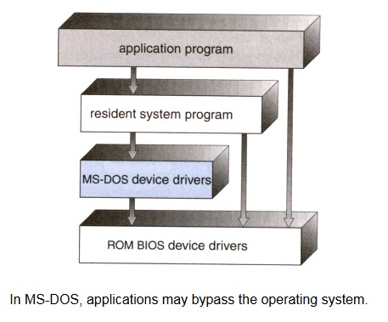
Structure of OS
Simple Structure
It is better that operating systems have a modular structure, unlike MS-DOS. That would lead to greater control over the computer system and its various applications. The modular structure would also allow the programmers to hide information as required and implement internal routines as they see fit without changing the outer specifications.

Slide 4
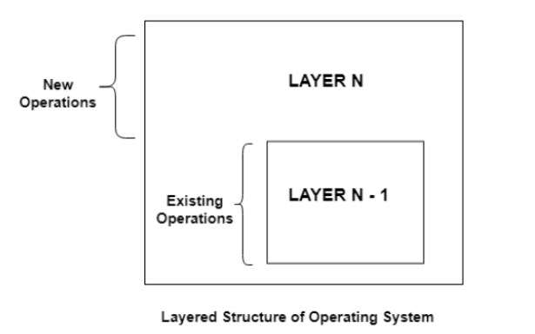
Layered Structure
One way to achieve modularity in the operating system is the layered approach. In this, the bottom layer is the hardware and the topmost layer is the user interface.
As seen from the image, each upper layer is built on the bottom layer. All the layers hide some structures, operations etc from their upper layers.
One problem with the layered structure is that each layer needs to be carefully defined. This is necessary because the upper layers can only use the functionalities of the layers below them.

Slide 5
Main function of Operating System
Operating system performs the following functions:
Booting: Booting is a process of starting the computer operating system starts the computer to work.
Memory Management.
Loading and Execution.
Data security.
Disk Management.
Process Management.
Device Controlling.
Printing controlling.

Slide 6
Services of Operating System
An Operating System provides services to both the users and to the programs.
It provides programs an environment to execute.
It provides users the services to execute the programs in a convenient manner.
Following are a few common services provided by an operating system −
Program execution
I/O operations
File System manipulation
Communication
Error Detection
Resource Allocation
Protection

Slide 7
Communication
Communication
In case of distributed systems which are a collection of processors that do not share memory, peripheral devices, or a clock, the operating system manages communications between all the processes. Multiple processes communicate with one another through communication lines in the network.
The OS handles routing and connection strategies, and the problems of contention and security. Following are the major activities of an operating system with respect to communication −
Two processes often require data to be transferred between them
Both the processes can be on one computer or on different computers, but are connected through a computer network.
Communication may be implemented by two methods, either by Shared Memory or by Message Passing.

Slide 8
Future Operating System
The next-generation operating system starts with the user. It ignores the underlying hardware -- and as a result, such systems are inherently less efficient than today's primitive, machine-centered ones. Instead, it reflects the shape of your life. Its role is to track your life event by event, moment by moment, thought by thought.
A life is a sequence of events in time. The future of information management is narrative information management, in which all of your stored documents are arranged as a "documentary history" of your life.

Slide 9
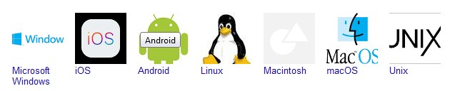
Some popular operating system
There are a few common operating systems available:
Mac OS X.
Linux.
Windows.
Android (based on Linux)
iOS.

Slide 10
Windows 7 is the most popular operating system for desktop and laptop computers. Android is the most popular smartphone operating system. iOS is the most popular tablet operating system. Variants of Linux are most widely used in the Internet of things and smart device

Slide 11
Conclusion
An operating system (OS) handles your computer needs by finding resources, applying hardware management and providing necessary services. Operating systems are essential for computers to be able to do everything they need to do. An operating system communicates with the various parts of your computer.

