Slide 1

Microprocessor Based Water Quality Monitoring System for Bangladesh
Submitted to
SUJAN HOWLADER

Slide 2
Group members
Serial Number | Name | ID
26 | SHAHRIAR, RUBAIYAD NOOR | 19-39541-1
33 | RAHMAN, FATIN ISTIAK | 19-39841-1
25 | HOSSAIN, MD. NAIMUL | 19-39513-1
41 | BARI, RABIA | 19-40573-1
38 | MRIDU, TAJNUBA NAHAR | 19-40012-1
37 | MUNA, UMME HABIBA | 19-39960-1
32 | ABID, SK. RAGIB ISHRAK | 19-39684-1
39 | RAHMAN, MOHAIMENUR | 19-40338-1
36 | BUSHRA, NAZIA AKHTER | 19-39943-1

Slide 3

WHAT IS WATER QUALITY TESTING?
A way to test USABILITY of water
A way to MAKE water usable
A way to ensure Human safety

Slide 4


OBJECTIVE
The main goal of this project is to monitor water quality and create an inexpensive water quality detector.
Required all the specifications related to the topic, and also requires a comparative discussion of the existing water quality monitoring system and its parameters.

Slide 5

IMPORTANCE OF PURE WATER
Pure water not only drinks thirsty, but keeps the body in good conditions.
Benefits of drinking purified water:
Essential to stay hydrated with a smooth function
Its supports kidney function
Improves digestion
Improves skin and hair health
Enables weight loss

Slide 6

Disadvantages of drinking polluted water
Polluted water and poor sanitary facilities are associated with the transmission of diseases.
The Disadvantages are shown below:
Cholera, diarrhea, dysentery, hepatitis A, typhoid and polio spread.
Globally, 15% of patients develop infection.
In 2017, more than 220 million people were infected with schistosomiasis, an acute and chronic disease caused by parasitic worms transmitted through contaminated water.
Insects live or breed in water carry and transmit dengue fever.

Slide 7
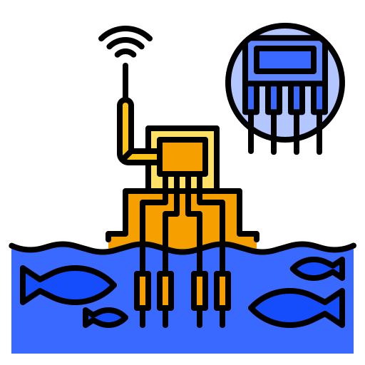
Water quality of Bangladesh
Today, 98 percent of Bangladesh's population has access to water technologically improved water resources. The water quality is poor. E. coli bacteria were present in 80 percent of private pipe water. taps sampled across the country, a similar rate to water retrieved from ponds
In addition, naturally occurring arsenic in groundwater also influences people: about 13% of the country's water sources include an arsenic level above the threshold of Bangladesh`s. The Chittagong and Sylhet divisions suffer most of arsenic contamination.

Slide 8

Water management system in Dhaka
Dhaka Water Supply and Sewerage Authority (WASA) is an independent, public sector service-oriented business organization responsible for providing water supply, wastewater and stormwater drainage services to residents. townspeople in the fast-growing metropolis of Dhaka. , the capital of Bangladesh. It covers more than 360 square kilometers of service area with 12.5 million people with an output of nearly 2.110 million liters per day (MLD). Dhaka WASA faces a number of challenges. These include unplanned urban development and informal settlements, the shift to using surface water instead of groundwater, and substantial investment financing. But Dhaka WASA has some notable achievements, including significant increase in water production and productivity, improvement in service quality, increase in income, reduction of uncollected water and provision water at low cost.

Slide 9
Properties of pure water
Chemical Properties
Biological Properties
Physical Properties Seawater
pH
Alkalinity
Total Hardness
Iron , Manganese
Metal-Zinc, Copper, Chromium, Lead
Nitrate / Nitrite
Arsenic, Fluoride
Chloride
Total and Chlorine
Dissolved Oxygen (DO)
Biochemical Oxygen Demand (BOD)
Chemical Oxygen Demand (COD)
Microorganisms-Bacterial counts
Temperature of seawater
Density structure of Seawater
Salinity of seawater
Optical(Light) Properties
Sound in seawater
Viscosity
Surface tension
Color of sea water

Slide 10

Thank You
Design requirements
Water filters are suitable for eliminating physical impurities, but is not effective in eliminating solid dissolved, heavy metals and other chemical contaminants.
. But water purification is very effective at removing excess TDS, heavy metals, pesticides, and harmful chemical pollutants.
A RO UV filter kills pathogens but dead bacteria remain suspended.
But a RO UV filter kills pathogens but also kills the dead body.

Slide 11

ANALYZED EQUIPMENT
The components required for the experiment:
Breadboard
Wires
LCD 16*2 Display
Power supply
Arduino Uno
Arduino IDE
pH sensor
Conductor
Inductor
These are some required components which we will need during our experiment.

Slide 12
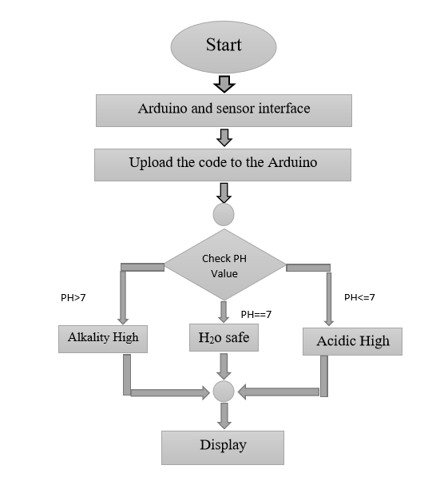
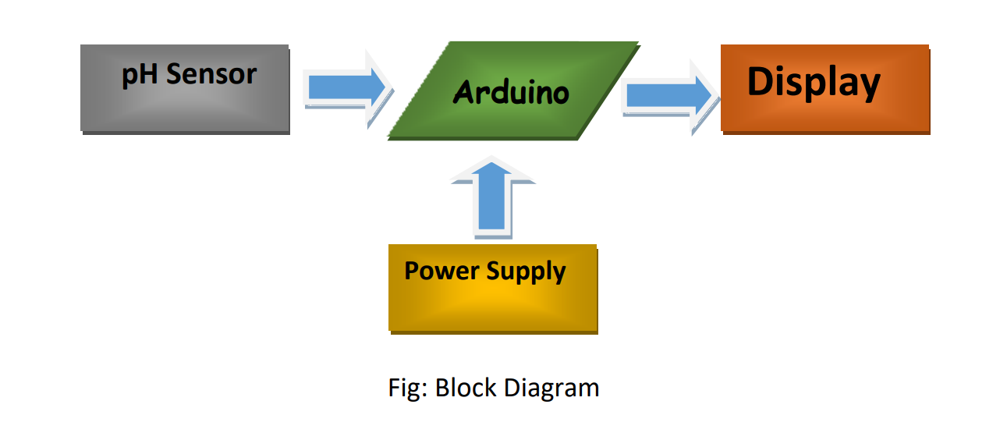
Block diagram & Data Flow diagram
Figure: Block diagram & Data Flow Diagram

Slide 13
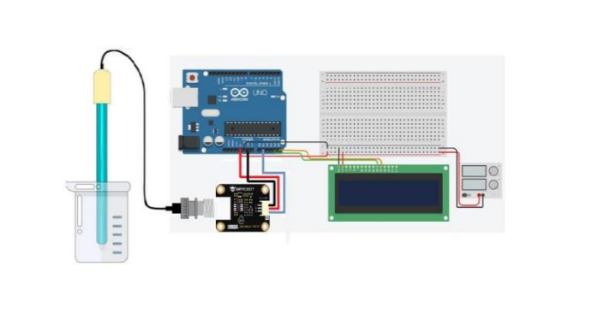
software implementation( Tinker CAD )
Figure: Tinker CAD implementation

Slide 14
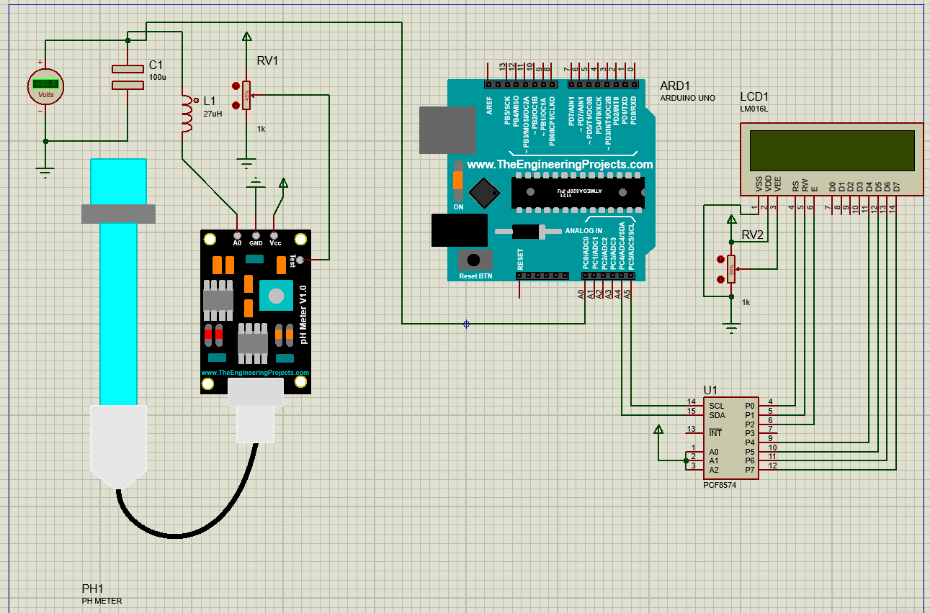
software implementation( Proteus )
Figure: Proteus 8 Professional implementation

Slide 15

TOTAL COST CALCULATION
Component | Price(Taka)
pH Sensor | 2650 taka
Wires | 10 taka
Arduino UNO | 645 taka
Breadboard | 95 taka
LCD Display | 160 taka
Total Amount | 3560 taka

Slide 16

LIMITATION OF THE PROJECT
The system we develop have some limitation. limitation of our system is given below
1. The system is not fully accurate
2. Not enough sensor is used
3. Not all the sensor are available in our country
4. Can not measure temperature

Slide 17

RECOMMENDATION
We should use more sensor for better accuracy keeping the cost low
Running the system in a simulator will increase the success rate
Developing the system physically is better for gaining practical knowledge

Slide 18

FUTURE SCOPE
We can add more sensor like
Temperature sensor
Turbidity sensor
Flow sensor

Slide 19

discussion
The optimum value for filtered water is always close to 7. Because it is the same as the pH in human eyes and mucous membranes. The low pH value in lemon water is harmful to human health because it can be as harmful to the skin as the higher value. On the other hand, a pH value greater than 7.5 is basic water.
Water containing calcium hydroxide is extremely dangerous to humans. We also get a value of the turbidity parameter which shows us that turbidity is also an important factor for humans and aquatic life. Values ​​below 20 are drinkable.
We observed that filtered water around 2050 was dangerous and adulterated with other ingredients.

Slide 20

references
Young-Jim Kim , Y.-C.L., Byung-Ki Sohn ,Chang-Soo Kim, Configuration for Micro pH Sensor Electrical & Computer Engineering Faculty research and Creative Works, 1 Oct 2003. 39: p. 2-3
C. Artero, M.N., A. Mànuel, Water Quality Automatic Monitoring System Based on GPRS 2012 International Conference on Modern Hydraulic Engineering, 2012: p. 1,3.
https://electronoobs.com/eng_arduino_liq_crystal.php
https://circuitdigest.com/microcontroller-projects/arduino-ph-meter
http://wiki.sunfounder.cc/index.php?title=How_to_Add_Libraries_to_Arduino/libraries

Slide 21

☢Thank You☣
If you have any questions feel free to contact us

