Slide 1
🌍 SafeEarth Intelligence
Exploratory Data Analysis — Deep Dive
What the data says, and how it shapes (and limits) the models
Mohamed Haitham · University Presentation
EM-DAT (1900–2021, 16,126 events) · XGBoost + CatBoost + RandomForest
Notes:
Open: I'll argue you can predict this model's per-class accuracy from two data properties alone (correlation 0.85), and that one headline metric is inflated by a data leak I'll show you. This is a data-science talk, not a product demo.

Slide 2
Roadmap
• The data — what one row is, and why that single fact governs everything
• Three data-quality stories — imbalance, skew, class-conditional missingness
• The thesis — data quality predicts per-class accuracy (r = 0.85)
• What we did — imbalance handling & the regressor fix (with the negative results)
• Two problems I found — train/test contamination, and a median-aggregation bug
• Prioritised gaps — what to fix next, highest-ceiling first
Notes:
Tell them the talk has a critical spine on purpose — negative results and self-found bugs are the evidence of real analysis. Every number is from this project's own data, extracted or computed by replaying the feature pipeline.

Slide 3
The Dataset & the Unit of Analysis
• Source: EM-DAT International Disaster Database — the standard global registry
• One row = one declared disaster event, curated AFTER the fact
• Impact columns (deaths, affected, damage) are POST-EVENT accounting totals —
– knowable only after the event we claim to predict (drives the leakage analysis)
• Scope: global — ~225 countries, 23 regions, 5 continents, 1900–2021
File | Raw | Modeled (8 types) | Dropped
Train (1900–2021) | 16,126 × 45 | 14,476 | 1,650 (10.2%)
Test (1970–2021) | 14,644 × 47 | 13,070 | —
Why it matters: post-event totals are the half of the data the model is NOT allowed to know at prediction time.

Slide 4
Where the EDA Actually Lives (provenance)
• notebooks/01_eda.ipynb is a one-cell stub — ZERO executed analysis
• The real EDA is distributed across four artifacts:
Artifact | What it actually contains
scripts/inspect_data.py | Inventory / missingness / cardinality (data-dictionary substitute)
streamlit_eda/ | Interactive EDA app — the quality→accuracy thesis
SafeEarth_ML_Report.ipynb | 62 cells; LOADS the production .pkl artifacts; reproduces every metric
streamlit_eda/experiments/ + metrics/ | Isolated experiments & the decision paper-trail
Note: figures tagged “computed” were produced fresh by replaying engineer_features on the raw CSV.
Notes:
Faculty respect provenance. Admitting the stub notebook up front buys credibility for everything after it.

Slide 5
From 45 Columns to 16 Features
• 45 raw columns → a 16-feature model input (27 object / 14 float / 4 int dtypes)
– Most “numeric” impact + coordinate fields arrive as text → need coercion
• Predictive: geography (lat/lon/encoded), time (decade, month sin/cos), magnitude + has_magnitude flag, regional frequency
• Deliberately EXCLUDED to avoid leakage:
– impact columns · Dis Mag Scale · Disaster Subtype · Associated Dis (all post-event or target-revealing)
• day_offset is constant 0 in training → a dead feature at fit time (revisited Slide 13)
Notes:
The 'I know which columns are features vs leaks vs metadata' slide. Keep brisk.

Slide 6
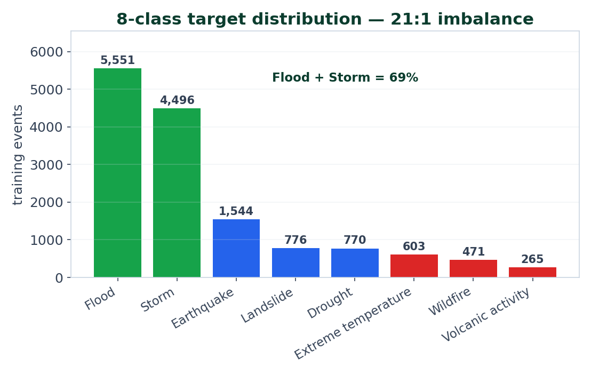
Class Imbalance — the 21:1 Problem
• Imbalance ≈ 21:1 (Flood : Volcanic)
• Flood + Storm = 69% of all rows
• Constant-“Flood” baseline ≈ 38% accuracy
– → accuracy / weighted-F1 are useless here; macro-F1 is the binding metric
• Subtlety: hardest ≠ smallest —
– Volcanic (265) BEATS Landslide (776) on F1 (0.67 vs 0.48). Size is the weaker driver.
Notes:
Set up the punchline: it's not row count, it's signal — next two slides prove it.

Slide 7
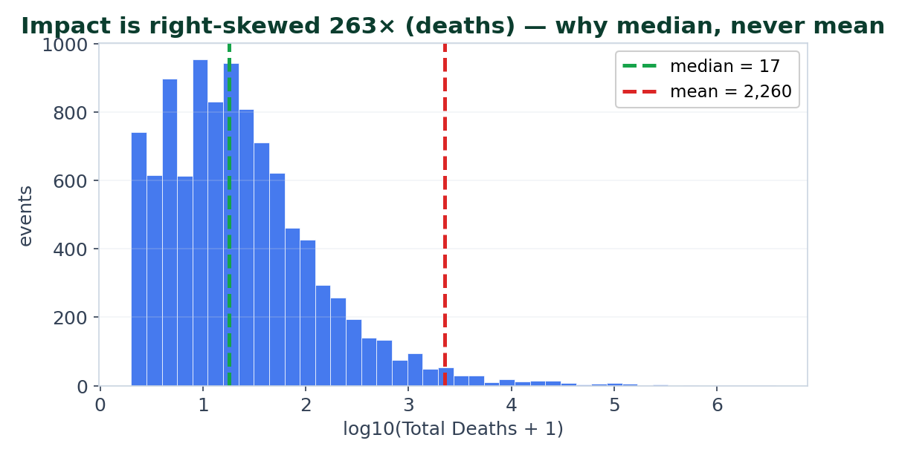
Impact Is Skewed 100×–1,400× → Median, Never Mean
Target | mean | median | ratio
Deaths | 1,576 | 6 | 263×
Affected | 558,521 | 400 | 1,396×
Injured | 531 | 0 | ∞
Damage ('000$) | 262,559 | 0 | ∞
Median 0 = missingness, not zeros: injuries/damage are 26%/36% present, coerced to 0 — the time-bomb the regressors step on (Slide 14).
Notes:
Two ideas: skew justifies median; and the zero-spike is masked missingness.

Slide 8
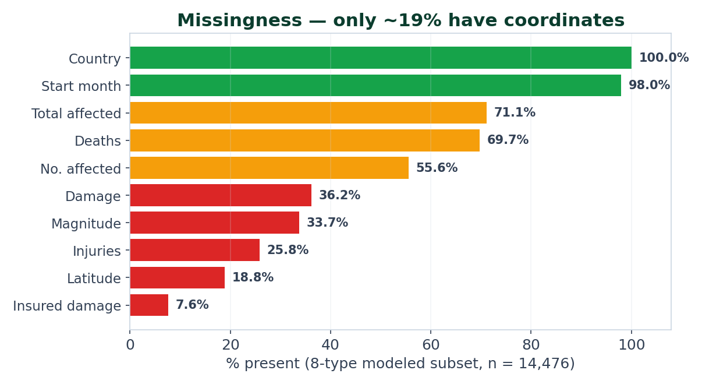
Missingness Is the Headline Data-Quality Story
• Reliable: Country 100%, Start Month 98%, Affected 71%, Deaths 70%
• Sparse: Damage 36%, Magnitude 34%, Injuries 26%, Coords ~19%, Insured 8%
• Most missingness is MNAR (recorded when severe), not MCAR
– → biases impact models low; imputation is not innocent
• Only ~19% have real coordinates — 81% imputed to centroids (Slide 12)

Slide 9
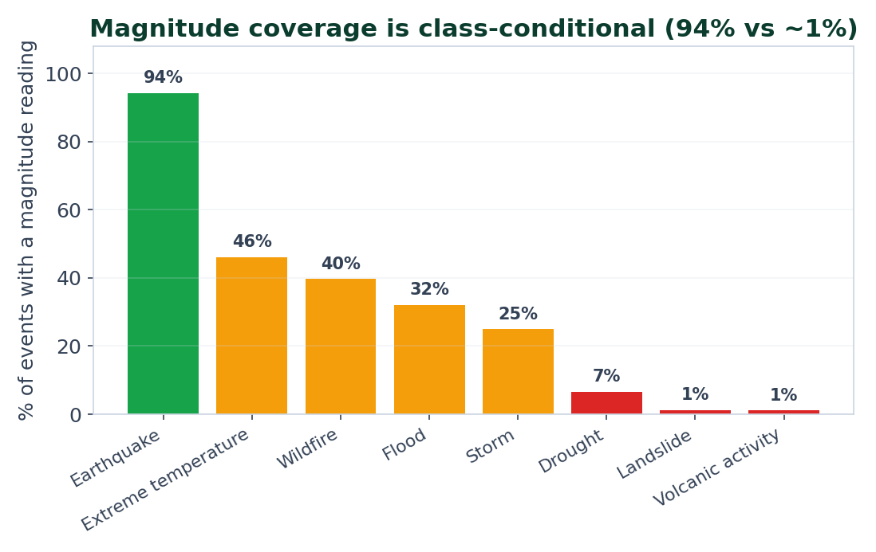
Magnitude Coverage Is Class-Conditional (key insight)
• Magnitude carries the MOST information about type (mutual information 0.503 — top of 16 features)
– …but recorded on different scales (Richter / Kph / Km² / °C) and present 94% for Earthquake, ~1% for Landslide/Volcanic
• The engineered has_magnitude flag turns MNAR-missingness into the strongest LINEAR separator (ANOVA F = 655)
Hold this chart — the next slide shows it predicts the model's per-class accuracy almost perfectly.

Slide 10
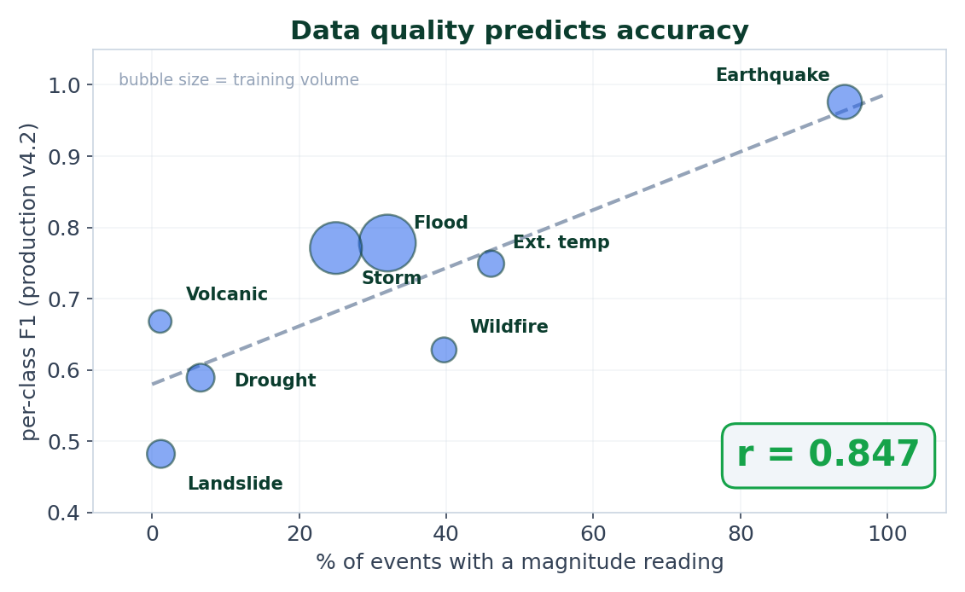
THE MONEY SLIDE The Thesis: Data Quality Predicts Accuracy
The takeaway: signal availability — not algorithm or row count (corr with size only 0.46) — sets the per-class ceiling. The model is only as strong as its rarest feature.
Notes:
The money slide. Earthquake wins on a near-complete distinct Richter signal; Landslide/Volcanic lose because their feature is absent and they overlap floods/storms spatially. This frames why resampling fails and what to fix.

Slide 11
Feature → Target Separability (bivariate evidence)
Rank by Mutual Information | MI | Rank by ANOVA F (linear) | F
dis_mag_value | 0.503 | has_magnitude | 655
latitude | 0.430 | abs_latitude | 182
abs_latitude | 0.420 | lon_cos | 176
longitude / lon_sin | ~0.42 | decade | 153
country_enc | 0.363 | continent_enc | 118
day_offset | 0.000 | day_offset | NaN
• Magnitude dominates non-linear information; its presence FLAG dominates linear separation
• Geography is a strong secondary; season is weak-but-real; day_offset is dead at training (MI 0 / F NaN)
Notes:
Pre-empts 'did you check relevance beyond importances?' — yes: MI and F-test.

Slide 12
Geography — 81% Imputed, and It Matters
• Only 18.8% of events have raw coordinates → 81% imputed country→continent→global median
• Coverage is class-conditional: Earthquake 97%, but Extreme-temp / Wildfire / Drought = 0% raw coords
– → pinned to one country centroid, collapsing within-country variance
• Imputation is OUTCOME-relevant, not cosmetic: centroid imputation moved holdout macro-F1
– 0.7285 → 0.7452 (+0.0167 > CV-std 0.008 → KEEP), filling 11,707 of 11,822 missing-coord rows
• Reporting drift: floods 524 (1980s) → 1,725 (2000s) = 3.3× — climate AND reporting, confounded; decade bakes the era-bias in

Slide 13
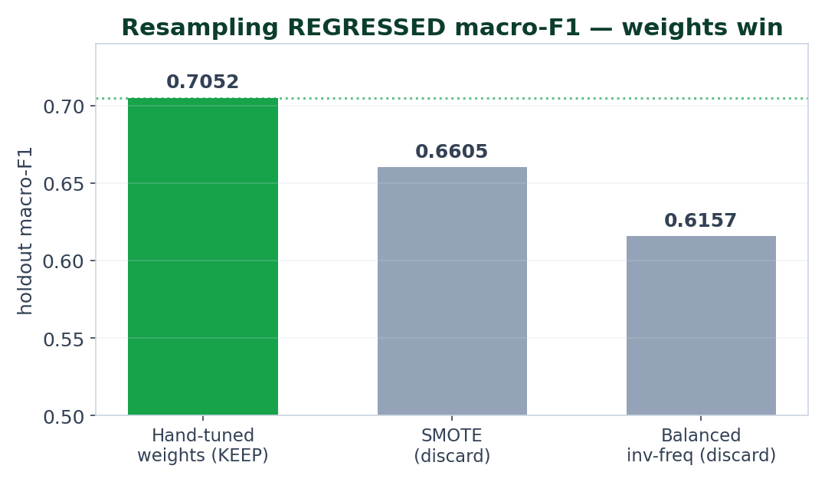
Imbalance Handling — Weights Beat Resampling
• Every resampling strategy REGRESSED holdout macro-F1 —
– the bottleneck is missing signal, not missing rows
• SMOTE is methodologically invalid here:
– 5 of 16 features are encoded categoricals — interpolating country_enc(Egypt)↔(Peru) invents a country that doesn't exist
• Chosen weights up-weight hard classes: Drought 4.0, Landslide/Volcanic 3.0, Wildfire 2.5
Notes:
Research-maturity slide: a tested-and-rejected result WITH the reason it fails.

Slide 14
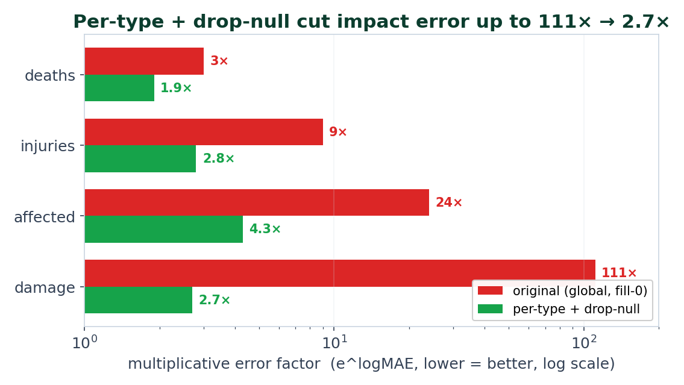
The Regressor Fix — Per-Type + Drop-Null
• Original regressors were type-blind AND trained on fake zeros (median injuries/damage = 0)
• Two independent wins: add the disaster-TYPE axis + DROP fake zeros
• Validated on an honest holdout (observed-target rows only)
• Exposed an evaluation trap: median-filling the HOLDOUT too makes a broken model look great (injuries 0.45 vs honest 1.28)
Notes:
Strongest single piece of analysis in the repo. The 'evaluation trap' is a great teaching moment — how you fill the test set can manufacture a false score.

Slide 15
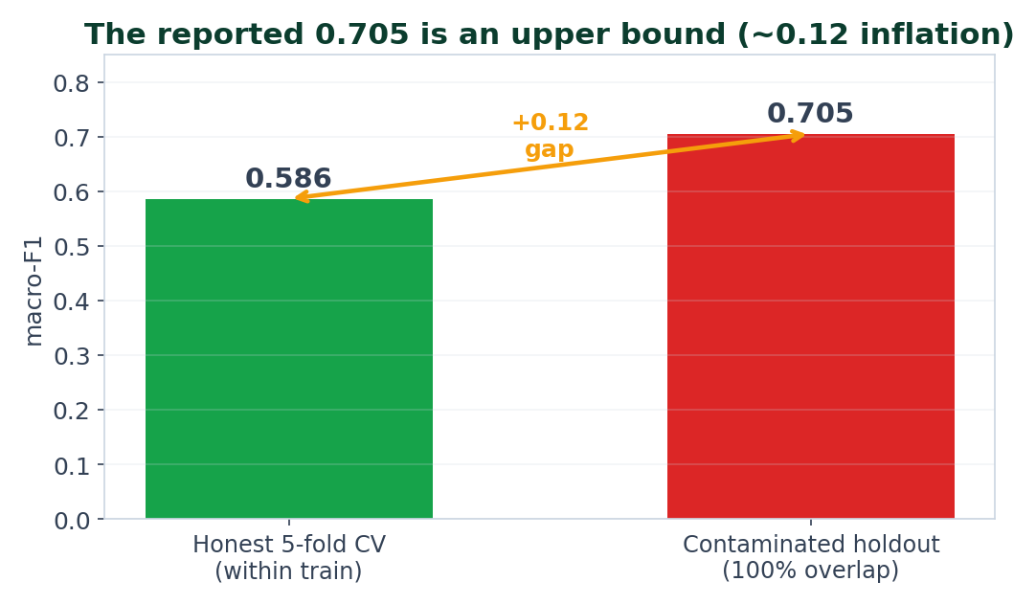
PROBLEM #1 Train/Test Contamination
• The “holdout” 1970–2021 file is a STRICT SUBSET of the 1900–2021 train file — same export, windowed twice
• Computed: 100.0% of the 14,644 test rows share an EM-DAT (Year, Seq) event id with a train row
– → the model sees every evaluation event during fit()
• So Macro-F1 0.7052 is IN-SAMPLE — an upper bound, not generalization
• It voids the absolute numbers, not the relative decisions (those used CV / honest holdout)
Fix (Slide 19 #1): re-split by (Year, Seq) or by time, then re-evaluate; expect macro-F1 to fall toward ~0.6.
Notes:
Deliver calmly and confidently — finding it is a strength, not a confession. This is the most likely probe; owning it is the win.

Slide 16
PROBLEM #2 Median Fails on Small Cells (a live analytics bug)
• The “median, never mean” rule protects GLOBAL aggregates — but it's applied per-cell with no minimum-support guard
• continent_stats.json reports Europe drought deaths = 600,001
– That “median” is over only ~2 observed European-drought death rows, dominated by the 1921 Soviet famine (1.2 M deaths)
• Median is robust to outliers — NOT to tiny samples
• Fix: apply the same n ≥ 5 guard the EM-DAT impact lookup already uses — but doesn't apply to continent analytics
Notes:
Short slide, big credibility: 'I audit my own outputs.'

Slide 17
EDA → Model Impact, in One Matrix
Insight | Effect | Mitigation
21:1 imbalance | majority bias → macro-F1 the honest read | class weights; report macro-F1
class-conditional magnitude (r=0.85) | sets the per-class ceiling | has_magnitude flag; BACKFILL magnitude
100×–1400× impact skew | breaks linear/distance models; trees survive | log1p targets; tree ensemble
fake-zero, type-blind regressors | error up to 111× | per-type + drop-null → 2.7×
VIF 12–21, r up to 0.94 | harmless for trees, fatal for LR/SVM | drop day_offset; prune if linear
outliers = genuine catastrophes | clipping destroys the key signal | log1p + per-type P99 display cap
train/test contamination | inflates every headline | re-split, re-evaluate
The recurring lesson: trees were the right call — collinear, mixed-unit, outlier-dominated, high-cardinality data breaks LR/SVM/SVR/KNN; trees absorb it.

Slide 18
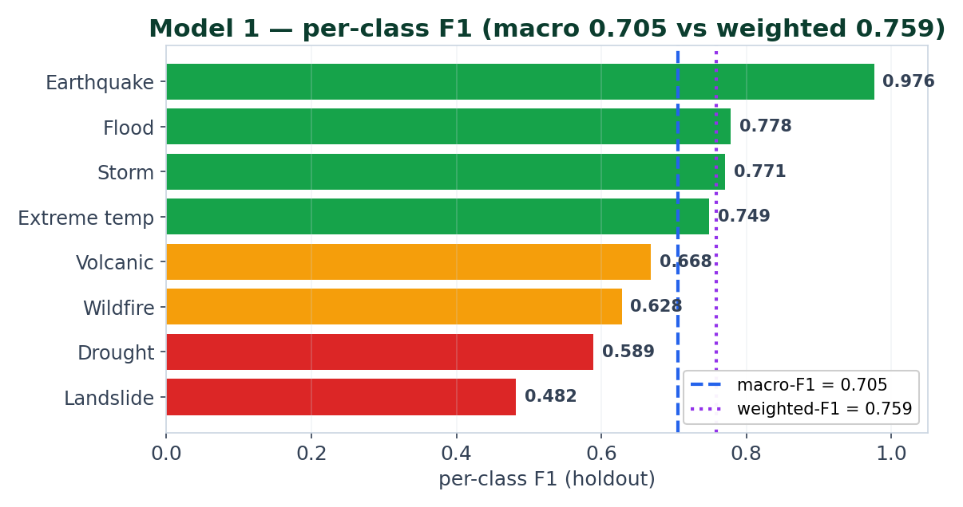
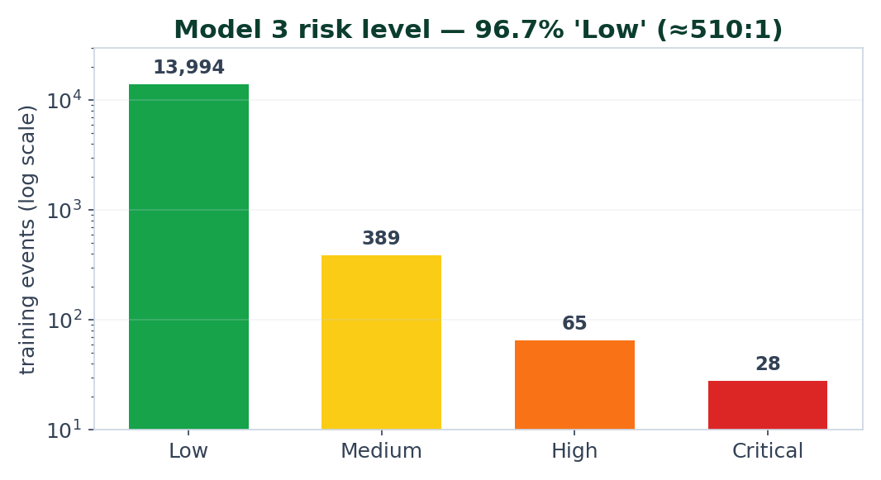
Model Scoreboard — What the Data Permits
Model | Task | Headline | Read
1 · Disaster Type | 8-class | Macro-F1 0.705 · Wtd 0.759 · AUC 0.962 | strong; EQ 0.98, Landslide 0.48
2 · Impact | 4 regressors | mean log-R² 0.377 · orig-R² ≈ 0 | location signal; type from EM-DAT medians
3 · Risk level | 4-class | Macro-F1 0.534 vs Wtd 0.946 | 97% Low; recall 0.92 / precision 0.24
Notes:
Left: Model 1 per-class F1 (macro vs weighted gap). Right: Model 3's 97%-Low imbalance — why risk level is COMPUTED, not classified. The data, not the algorithm, dictates each model's shape.

Slide 19
Recommendations — Highest Ceiling First
• 1. Fix the split — re-evaluate without contamination. Group by (Year, Seq) or split by time. The only number that matters first.
• 2. Backfill magnitude for Landslide / Volcanic / Drought (VEI, volume index, SPI) — directly attacks the macro-F1 floor (r=0.85)
• 3. Significance & power: bootstrap CIs on per-class F1; flag underpowered classes (test Critical n=27)
• 4. Distribution-match / drift audit (PSI/KS) after re-splitting; quantify the decade era-bias
• 5. Multicollinearity hygiene: compute VIF (done); drop the dead day_offset
• 6. Real skew/kurtosis + dip-test for bimodality (median can hide bimodal impact)
• 7. Calibration: the class-weighted ensemble is likely miscalibrated, yet thresholds drive alerts → reliability diagrams + isotonic
• 8. Grouped / temporal CV for spatial-overfitting; fix the small-cell median bug
Notes:
Ordered by expected impact. #1 and #2 are the only two that move the real ceiling; the rest are rigor.

Slide 20
Key Takeaways
• The data explains the model. Per-class accuracy is predicted by magnitude coverage at r = 0.85 — signal availability is the ceiling, not the algorithm.
• Median, never mean — impact is skewed 100×–1,400× — but median needs a minimum-support guard.
• Negative results are results: resampling/SMOTE tested and rejected with reasons; the regressor fix came from a controlled experiment.
• I audited my own pipeline and found a contaminated evaluation and a live aggregation bug — with concrete, prioritised fixes.
Notes:
End on rigor and honesty — the differentiator for an academic audience.

Slide 21
Thank You 🌍
Questions?
Anticipated questions:
• Is 0.705 real? → No — upper bound; contaminated holdout. Honest CV ≈ 0.59.
• Why not oversample? → Tested; SMOTE −0.04 macro & invalid on encoded categoricals.
• Why trees over a linear model? → VIF 21, mixed-unit magnitude, 100× outliers, 225-level categoricals all break LR/SVM/KNN.
• Biggest single improvement? → Backfill magnitude for the 3 signal-poor classes (r = 0.85).
• Median vs mean concretely? → Flood deaths mean 1,735 vs median 16; affected mean/median = 1,396×.
Full write-up: docs/EDA_DEEP_DIVE.md · Data: EM-DAT (1900–2021) · safeearth.tech
Notes:
Keep the contamination answer ready — most likely probe; owning it is the win.

