Slide 1
🌍 SafeEarth Intelligence
Machine-Learning Deep Dive
Every model, every metric — and a rigorous floor/ceiling analysis
Mohamed Haitham · University Presentation
EM-DAT (1900–2021) · XGBoost + CatBoost ensemble · per-type impact regressors
Notes:
Thesis of this talk: I'll give the real per-model numbers, then argue precisely WHY they sit where they do — and show that the headline macro-F1 is inflated by a train/test leak I found and quantified. Every number is from this project's own runs.

Slide 2
Roadmap
• Two ML problems — 8-class disaster type, and 4 impact regressors
• Every model trained, with baselines that anchor the floor
• Per-model metrics — classification (macro-F1, per-class) and regression (log-MAE, R²)
• What actually moved the numbers (and what didn't)
• The contamination I found: the headline 0.705 is in-sample; honest ≈ 0.586
• Floor & ceiling — the bias/variance verdict per problem
• Recommendations — highest-ceiling-first
Notes:
Tell them the spine is honesty: real numbers, negative results, a self-found leak, and a concrete bias-vs-variance diagnosis.

Slide 3
Two ML Problems, One Feature Pipeline
 | Classification | Regression
Target | Disaster type (8 classes) | Deaths · Injuries · Affected · Damage
Model | XGBoost + CatBoost soft-vote | Per-type XGB / RandomForest
Loss | softmax / multiclass logloss | squared error on log1p(target)
Metric that counts | macro-F1 (21:1 imbalance) | log1p-MAE on observed rows
Why that metric | rare-disaster miss = costly | raw R² ≈ 0 — tail is unpredictable
Design rule: impact is right-skewed 100×–1,400× → median / log1p everywhere, never mean (CLAUDE.md).
8 classes: Drought · Earthquake · Extreme temperature · Flood · Landslide · Storm · Volcanic activity · Wildfire.

Slide 4
Data, Splits & the 21:1 Imbalance
Class | Train n | Train % | Holdout n
Flood | 5,551 | 38.3% | 5,272
Storm | 4,496 | 31.1% | 4,005
Earthquake | 1,544 | 10.7% | 1,137
Landslide | 776 | 5.4% | 713
Drought | 770 | 5.3% | 685
Extreme temperature | 603 | 4.2% | 584
Wildfire | 471 | 3.3% | 452
Volcanic activity | 265 | 1.8% | 222
• Train 14,476 · holdout 13,070 (8 modelled types)
• Imbalance ≈ 21:1 (Flood : Volcanic)
• CV = 5-fold StratifiedKFold, random_state=42
• Encoders + freq-maps fit on the train fold only
• Target coverage: deaths 70%, injuries 26%,
– affected 56%, damage 36% — nulls ≠ zeros
Foreshadow: the test file is a 100% subset of train — quantified on Slide 14.

Slide 5
Models Inventory
Classification
Regression (per-type + drop-null)
Model | Role | Outcome
Logistic Regression | candidate | rejected — macro-F1 0.137 (≈ dummy)
Random Forest | candidate | competitive 0.700, no edge
XGBoost | final (primary) | best single learner — 0.60 weight
CatBoost | final (member) | diversity — 0.40 weight
LightGBM | dropped | optimal weight tuned to 0.00
Soft-vote ensemble (v4.2) | deployed | 0.60·XGB + 0.40·CAT
Target | Model
deaths, damage | XGBRegressor
injuries, affected | RandomForest
(light variant) | XGB for all 4 (23 MB)
Ridge | rejected (worst / exploded)
SVR / KNN | never built → §recs
Why LightGBM went: weakest member (0.654) AND the macro-F1-optimal ensemble weight for it was exactly 0.00 → v4.2 dropped it (bundle 26 MB → 10 MB).
Notes:
SVM/SVR/KNN were named in the brief but never built — given LogReg's collapse, a kernel SVM is unlikely to beat trees and scales badly at n≈14k. Moved to recommendations.

Slide 6
Baselines — the Floor Reference
Classification dummies (holdout)
Strategy | Accuracy | Macro-F1
most_frequent (Flood) | 0.403 | 0.072
stratified | 0.271 | 0.129
• Macro-F1 floor ≈ 0.07–0.13
• Honest [CV] macro-F1 0.586 sits +0.46 above
– the stratified dummy — 4.5× its value.
• Every deployed regressor beats its
– median baseline (e.g. damage 2.66× vs 8.3×).
• Judge regression lift vs THIS, not raw R².
Regression — train-median predictor (log-MAE)
Target | median | log-MAE | factor
deaths | 17 | 1.22 | 3.4×
injuries | 50 | 1.54 | 4.7×
affected | 15,000 | 2.36 | 10.6×
damage ('000$) | 60,000 | 2.12 | 8.3×

Slide 7
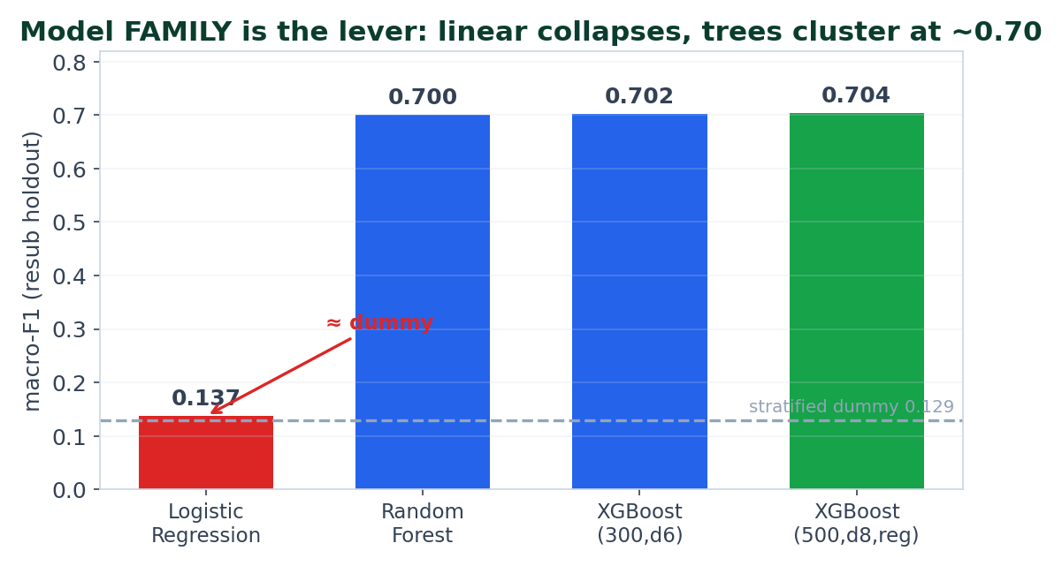
CLASSIFICATION Model Family Is the Lever
The point: swapping linear → trees buys ~+0.57 macro-F1. All three tree models cluster at 0.700–0.704; the choice among them is noise (≈ CV std).
Notes:
Logistic Regression collapses to ~the stratified dummy — the type boundaries are massively non-linear (collinear, mixed-unit magnitude, 225-level categoricals). This single decision is essentially the entire score.

Slide 8
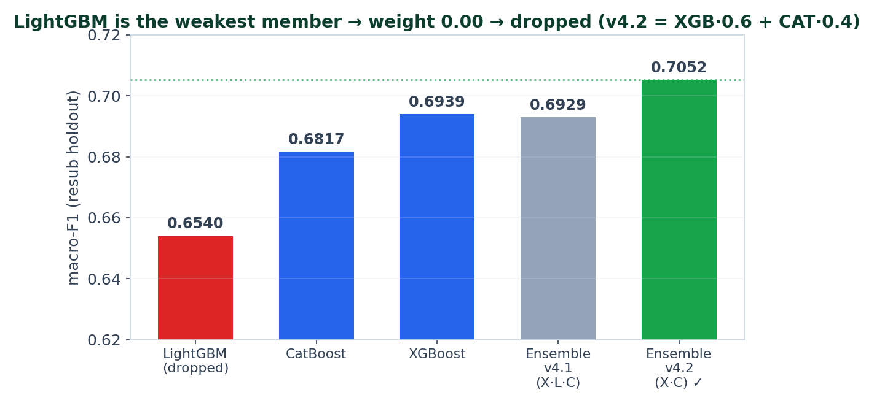
CLASSIFICATION The Ensemble — and Why LightGBM Was Dropped
Honest read: v4.2 (XGB+CAT) beats its best single member by +0.0113 — real, but ~2× the CV std. The ensemble is a modest lever, not a transformation.
Notes:
A step-0.05 simplex grid over (XGB,LGB,CAT) put LightGBM's optimal weight at 0.00. The v4.1 3-way ensemble actually scored BELOW its own best member; removing LGB and reweighting to 0.6/0.4 is what made the ensemble net-positive.

Slide 9
Hyperparameter Tuning — and an Honest Caveat
• Optuna TPE (seed 42), maximizing 3-fold CV macro-F1: XGB 40 trials · LGB 30 · CAT 20
– Search space e.g. XGB: depth 4–10, lr 0.01–0.2 (log), reg_alpha 0–2, reg_lambda 0.5–5, subsample/colsample
• Selected XGB: n=481, depth=8, lr=0.052, reg_alpha=1.85, reg_lambda=2.40, gamma=0.50
• Selected CatBoost: 426 iters, depth 6, lr 0.169, l2_leaf_reg 9.71
• Measured gain from tuning over a sensible default: +0.0018 macro-F1 (0.7020 → 0.7038)
– → within fold noise (CV std ≈ 0.006–0.008). Tuning is NOT where the points came from.
Takeaway: model family bought ~0.57; Optuna bought ~0.002. Spend effort on features & evaluation, not the 40th trial.

Slide 10
Per-Model Scoreboard — Classification
Model / config | Macro-F1 [resub] | Wtd-F1 | Accuracy | Macro-F1 [CV]
XGBoost only (v4.1) | 0.6939 | — | — | —
LightGBM only (v4.1) | 0.6540 | — | — | —
CatBoost only (v4.1) | 0.6817 | — | — | —
Ensemble v4.1 (X·L·C) | 0.6929 | 0.7519 | 0.7467 | —
Ensemble v4.2 (X·C) — deployed | 0.7052 | 0.7587 | 0.7467 | 0.5857 ±0.006
• [resub] = full test set, which is a 100% subset of train → a training-set fit.
• [CV] = 5-fold StratifiedKFold on train → the honest generalization estimate.
• The deployed model is 0.7052 in-sample but ~0.586 out-of-fold — a 0.12 gap (Slides 14–15).
• ROC-AUC / PR-AUC / log-loss were never computed — flagged in recommendations.

Slide 11
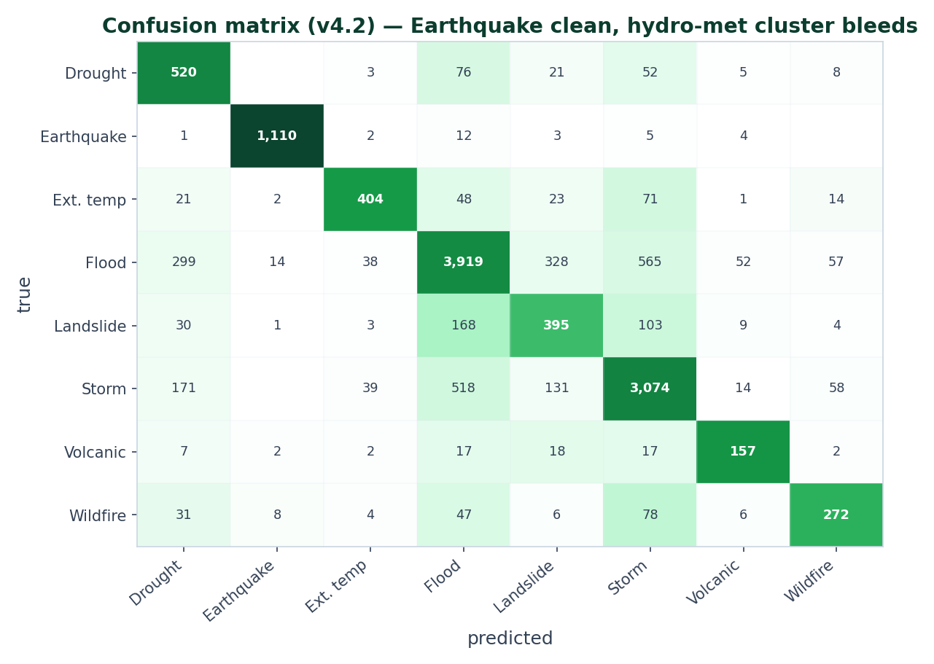
ERROR ANALYSIS Where the Classifier Fails
• Earthquake near-perfect:
– 1,110 / 1,137 — the magnitude signal.
• Hydro-met cluster bleeds:
– 565 Flood→Storm, 518 Storm→Flood,
– 168 Landslide→Flood, 103 Landslide→Storm.
• Minority precision collapses:
– Landslide P=0.43, Drought P=0.48 —
– class weights trade precision for recall.
Notes:
The four hydro-meteorological classes overlap in (continent, region, season, coordinate) space — ~1,800 mutual misclassifications. The features have no hydrology/meteorology to separate them. Earthquake is the one class with a clean feature.

Slide 12
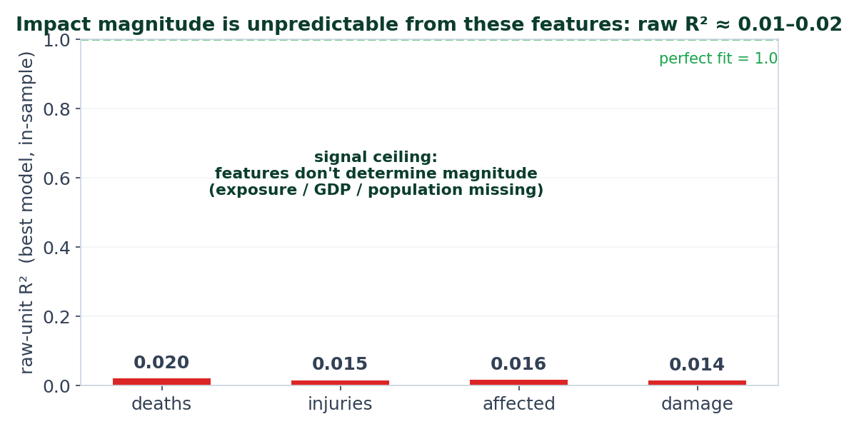
REGRESSION Per-Model Metrics — Regression
Target | best model | MAE (non-zero) | raw R² | log-MAE (factor)
deaths | XGB (300,d6) | 368 | 0.0202 | 0.63 (1.9×)
injuries | XGB (300,d6) | 1,830 | 0.0151 | 1.02 (2.8×)
affected | XGB (300,d6) | 990,998 | 0.0158 | 1.46 (4.3×)
damage ('000$) | XGB (300,d6) | 747,942 | 0.0142 | 0.98 (2.7×)
The honest read: raw R² ≈ 0.01–0.02 even IN-SAMPLE → the features cannot fit the heavy tail. log-MAE captures type-conditioned central tendency; magnitude itself is unpredictable here.

Slide 13
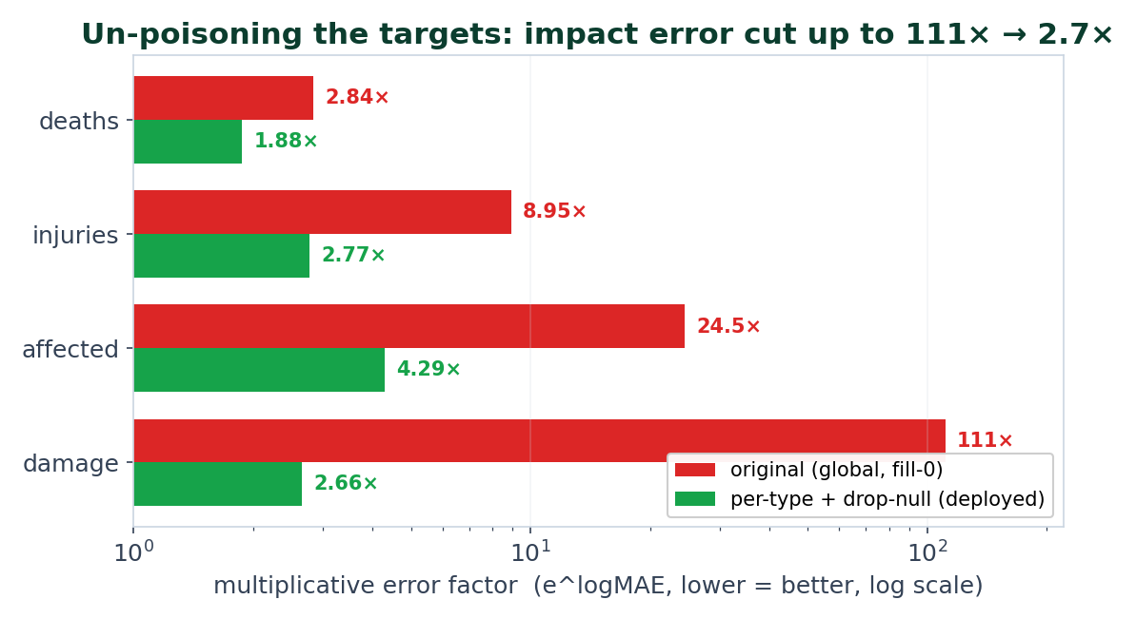
REGRESSION The Regressor Fix — Per-Type + Drop-Null
• Old regressors were type-blind AND
– trained on fake zeros (64% of damage
– rows are NULL → filled 0 → model
– learns ≈0).
• Two independent wins:
– add the disaster-TYPE axis +
– DROP the fake zeros.
• Caveat: this un-poisons the target;
– it does NOT crack magnitude (R²≈0).
Notes:
Validated on an honest holdout (observed-target rows only). The headline 111×→2.7× for damage is mostly about not poisoning the model with fake zeros, plus conditioning on type — not about new feature signal.

Slide 14
What Actually Moved the Numbers
Lever | Δ | Evidence
Model family: linear → trees | +0.565 macro-F1 | benchmark sweep
Hand weights vs balanced inv-freq | +0.090 | minority strategies
Centroid imputation (validated, NOT shipped) | +0.017 | preprocessing exp.
Drop LightGBM + reweight (v4.2) | +0.011 | weight tuning
Ensemble weight tuning (LGB→0) | +0.0014 | weight tuning
Optuna over a sensible default | +0.0018 | candidate sweep
Per-class threshold tuning | −0.0027 → DISCARDED | overfit val
Regression: per-type + drop-null | 111× → 2.7× (damage) | combined exp.
The verdict: one lever (trees) bought ~0.57; everything after lives in the ±0.01–0.09 band, and several 'improvements' were noise or negative. Hand weights mostly rebalance precision/recall.

Slide 15
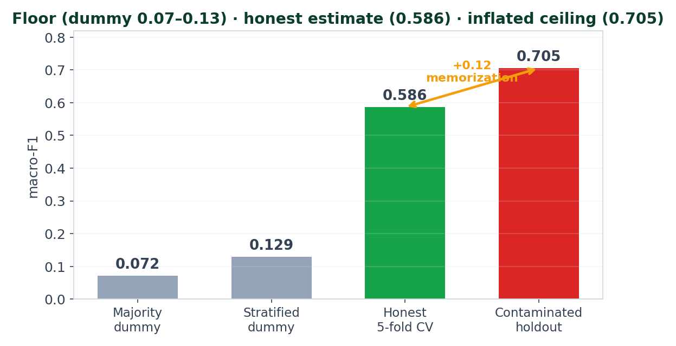
PROBLEM I FOUND The Headline Metric Is Inflated
• The 'holdout' 1970–2021 file is a
– STRICT SUBSET of the 1900–2021 train file.
• Verified: 100.0% of the 13,070 test
– rows share an EM-DAT Year-Seq-Country
– key with a train row.
• → macro-F1 0.7052 is IN-SAMPLE.
• Honest 5-fold CV ≈ 0.586.
• It voids absolute numbers, not the
– relative decisions (those used CV).
Notes:
Deliver this calmly and confidently — finding and quantifying it is the strength. Most likely faculty probe. The relative experiment decisions used CV / honest holdout, so the engineering choices still stand; only the headline number is inflated.

Slide 16
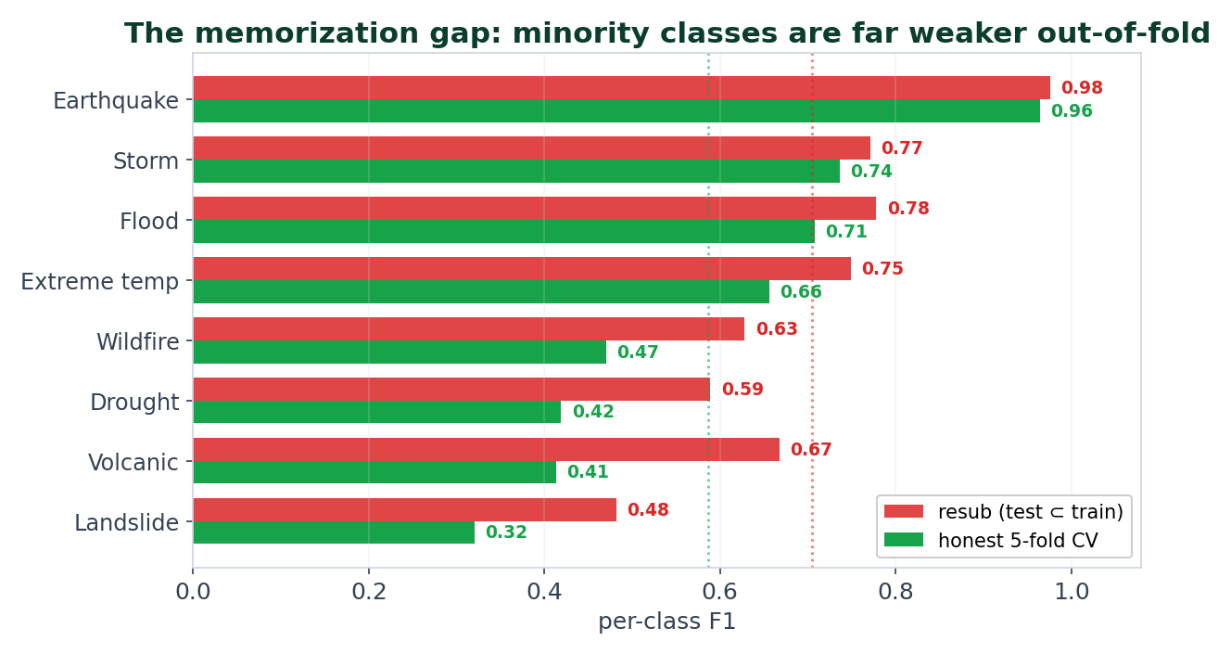
Floor & Ceiling — the Bias/Variance Verdict
• Earthquake gap +0.012 → bias-limited,
– already at its signal ceiling (0.96).
• Minorities gap +0.16–0.26 → variance-
– limited: tiny support (Volcanic n=265),
– F1 variance-dominated, memorized.
• Regression: raw R²≈0 in-sample →
– bias/signal-limited (features don't
– determine magnitude).
Notes:
This slide IS the answer to 'why not better.' Majority classes: bias-limited → need better features, not more data. Minorities: variance-limited → more data / merging / two-stage. Regression: signal-limited → exogenous features (exposure, GDP, population).

Slide 17
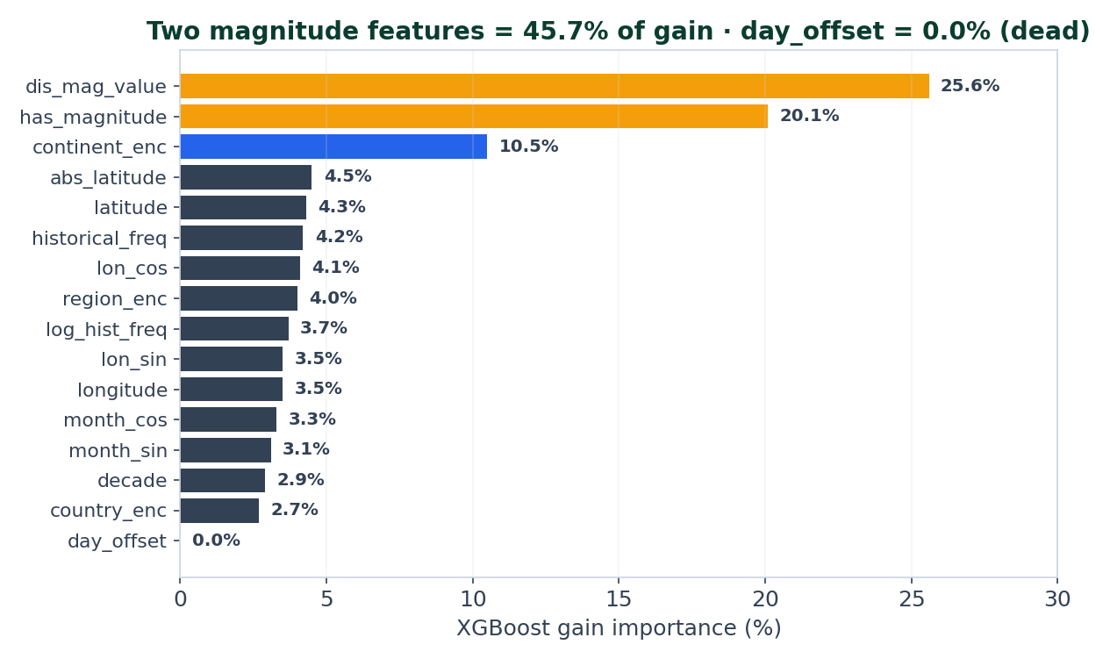
Explainability — Feature Importance & a Red Flag
• Two magnitude features = 45.7% of gain.
• Red flag: has_magnitude is essentially
– 'is this an Earthquake/Storm' — one
– binary carries 20% of decisions and
– is why Earthquake hits F1 0.98.
– (Not leakage — magnitude is known
– pre-event.)
• day_offset = 0.0%: constant in training,
– so the 30-day forecast varies only by season.
Notes:
SHAP is computed per-prediction (top-3) at inference; a formal per-class SHAP table isn't persisted. The gain importances shown are from the deployed v4.2 XGBoost.

Slide 18
Recommendations — Highest Ceiling First
• P0 · Fix the evaluation: de-duplicate by Year-Seq-Country, adopt a TEMPORAL split, re-measure. The prerequisite for trusting any gain.
• P0 · Report ROC-AUC / PR-AUC / log-loss + learning curves to confirm the bias/variance verdicts empirically.
• P1 · Variance-limited minorities: ship centroid imputation (+0.017, already validated, unshipped); two-stage common-vs-rare classifier; consider class merging.
• P2 · Bias-limited hydro-met cluster: add external features (ERA5/CHIRPS precip, elevation, Köppen) — the only real lever (exp. +0.03–0.06).
• P3 · Probability calibration (isotonic/temperature) — severity thresholds drive alerts but run on uncalibrated probabilities.
• P4 · Regression: add exposure features (population, GDP, building codes) or reframe to ordinal risk bands; rebalance the EM-DAT blend now that regressors are stronger.
• Skip SVM/SVR/KNN — given LogReg's collapse, they won't beat trees and scale badly.
Notes:
Ordered by expected impact. P0 (fix the split) and P2/P1 (features for the signal-poor classes) are the only levers that move the real ceiling; the rest is rigor.

Slide 19
Key Takeaways
• Model family is the lever: linear → trees bought ~0.57 macro-F1; tuning/ensembling bought ~0.01.
• The honest number is 0.586, not 0.705 — I found and quantified a 100% train/test overlap.
• Classification: majority classes bias-limited, minorities variance-limited. Regression: signal-limited (raw R²≈0).
• The biggest regressor win was un-poisoning the target (drop fake zeros + per-type), not a better algorithm.
• Negative results are results: SMOTE, balanced weights, threshold tuning, extra geo features — all tested and rejected with reasons.
Notes:
End on rigor and honesty — the differentiator for an academic audience.

Slide 20
Thank You 🌍
Questions?
Anticipated questions:
• Is 0.705 real? → No — in-sample upper bound; test ⊂ train. Honest CV ≈ 0.586.
• Why not oversample? → Tested; SMOTE −0.04 macro & invalid on encoded categoricals.
• Why trees over linear? → LogReg collapsed to 0.137; mixed-unit magnitude + 225-level categoricals + outliers break LR/SVM.
• Biggest single win available? → Fix the split, then add magnitude/exposure features for the signal-poor classes.
• Why is regression R² ≈ 0? → Impact needs exposure/GDP/population — absent from the feature set.
Full write-up: docs/ML_DEEP_DIVE.md · Data: EM-DAT (1900–2021) · safeearth.tech
Notes:
Keep the contamination answer ready — most likely probe; owning it is the win.

