Slide 1
🌍 SafeEarth Intelligence
Preprocessing Deep Dive
Every transform, and how it moved classification F1 and regression error
Mohamed Haitham · University Presentation
EM-DAT (1900–2021) · XGBoost + CatBoost classifier · per-type XGB/RF regressors
Notes:
Thesis of the talk: preprocessing — not the algorithm — drove the wins here. The single biggest improvement in the whole project (impact error 111x -> 2.7x) is a missing-value decision, not a model change. Every number is from our own metrics/ and streamlit_eda/experiments/ JSON, evaluated on a held-out test set.

Slide 2
Roadmap
• The split & the pipeline order — where every fitted transform sits vs the split
• Missing values — 81.7% of rows have no coordinates (the governing fact)
• CLASSIFICATION lever — class weights beat SMOTE & inverse-frequency (+0.0123 macro-F1)
• REGRESSION lever — drop-null + per-type cut impact error up to 111× → 2.7×
• Decision discipline — every choice ablated against a noise floor; leaks caught & rejected
• Two honest gaps + prioritised fixes (one validated win not yet shipped)
Notes:
Set expectations: I separate CLASSIFICATION effects (macro/weighted F1) from REGRESSION effects (log-MAE / error factor) the whole way through, because different steps help different models. I'll also show negative results and a validated-but-unshipped win — evidence of real ablation, not cherry-picking.

Slide 3
The Split — Pre-Materialised, Not Programmatic
• Two CSV files ARE the split — no train_test_split for the main model
• Train 1900–2021 (14,476 rows, 8 types) · Holdout 1970–2021 (13,070 rows)
• random_state=42 on every downstream CV / sub-split / Optuna sampler / SMOTENC
• Neither temporal nor geographic structure is respected:
– test window (1970–2021) ⊂ train window (1900–2021); same regions in both (by design — encoders must see them)
Sub-split | Used by | Scheme
Optuna HP search | run_training.py | StratifiedKFold(3) on TRAIN, macro-F1 objective
Minority-strategy CV | train_minority_strategies.py | StratifiedKFold(5) on TRAIN
Weight / threshold tuning | tune_*.py | stratified 50/50 of TEST → val 6,535 / holdout 6,535
Validity: this tests generalization across event records, not forecasting the future — read macro-F1 as in-distribution (see Problem on Slide 14).

Slide 4
Order of Operations (where leakage would hide)
latin-1 load + type filter
parse_coord + range mask
lat/lon median impute
16-feature engineering
LabelEncoders · region_freq_map · month-mode · class weights — ALL fit on TRAIN only (test → unseen-category 0)
CLASSIFIER PATH
REGRESSOR PATH
class sample weights
Optuna 3-fold (macro-F1)
targets: NaN PRESERVED
per-type drop-null fit
fit XGB / CAT + weights
grid-search ensemble wts
log1p target
expm1 + EM-DAT blend + p99
No feature scaling anywhere: every model is a tree (XGB / CatBoost / RandomForest) → scale-invariant. Inference rebuilds the identical 16-feature vector; coord imputation never runs at serve time (lat/lon is supplied).
Notes:
Walk the flow left-to-right. The green banner is the leakage guarantee — every fitted transform is fit on train only. The amber 'lat/lon median impute' chip is the one I flag (it's fit per-split offline, but never runs at serve time since the caller supplies coords).

Slide 5
Data Cleaning — the Correctness Preconditions
Step | What | Why
Encoding | read_csv(encoding='latin-1') | raw export has °C, mojibake Â°C, accented names
Type normalize | Disaster Type .str.strip(); keep 8 types | CSV stores 'Extreme temperature ' (trailing space)
Coordinate parse | regex '34.01 N' / '78.46 W' → signed float | 274 rows store directional strings, not floats
Impossible values | lat∉[−90,90] / lon∉[−180,180] → NaN | DMS artefacts stored as 36100.0 etc.
Magnitude → numeric | to_numeric(coerce).fillna(0) + has_magnitude | present in only ~38% of rows; absence is signal
Target sign | targets .clip(lower=0) | no negative deaths / damage
Deduplication | NONE | not performed — flagged on Slide 14
Not an ablation arm: cleaning is a correctness precondition, not a measured delta — but the coord parse + range mask feed directly into the imputation quality measured next.

Slide 6
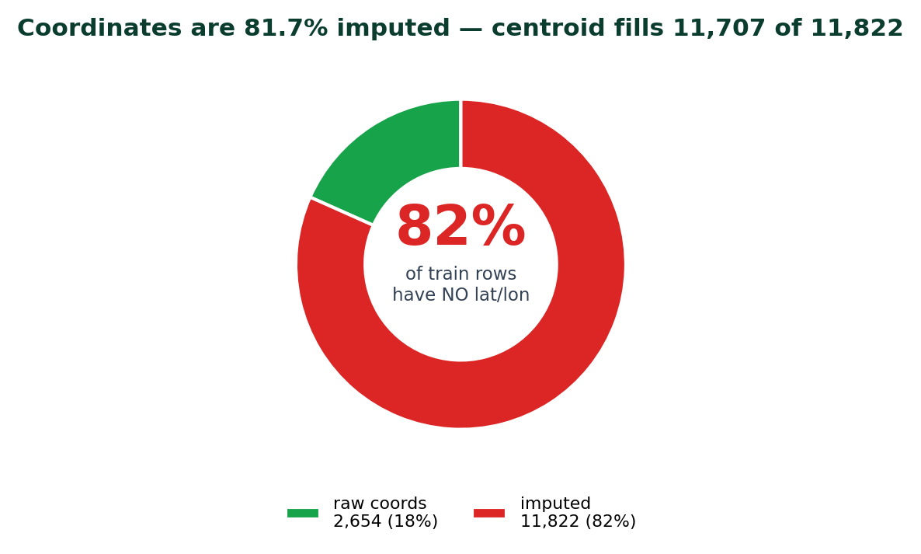
Missing Values — the Governing Fact
• 81.7% of TRAIN rows have no usable lat/lon
– filled by country → continent → global median chain
• So raw latitude/longitude are mostly imputed constants per country
– → a BETTER coordinate fill moves the needle (next slide);
– → lat/lon-derived geo features add little (Slide 13)
• has_magnitude missingness indicator preserves the 'value absent' bit
– → top-2 SHAP feature; drives Earthquake F1 = 0.976
Notes:
This one fact governs the rest of the imputation story. When 4 in 5 rows have no real coordinates, how you fill them is an outcome-relevant modelling decision, not cosmetic.

Slide 7
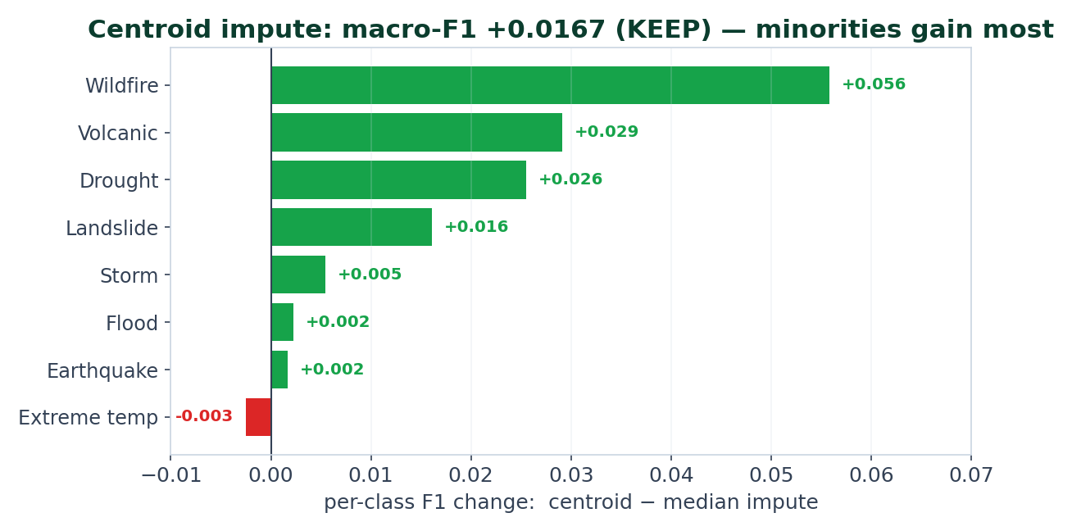
MEASURED · CLASSIFICATION + REGRESSION Coordinate Imputation — a Validated, Unshipped Win
• Clean A/B: median chain vs curated ISO3 centroids (fills 11,707 / 11,822)
• CLASSIFICATION: macro-F1 0.7285 → 0.7452
– +0.0167 > CV-std 0.008 → KEEP
• REGRESSION: mean log-MAE 2.3526 → 2.3215
– (all four impact targets improved)
• Minorities gain most: Wildfire +0.056, Volcanic +0.029
Status: validated but NOT in run_training.py yet — the highest-confidence un-deployed preprocessing win in the repo (Recommendation P0).
Notes:
This is a strength to show, not hide: an experiment with a clean KEEP verdict that hasn't shipped. Risk-free to deploy because lat/lon is caller-supplied at inference — only the training fill changes.

Slide 8
Outliers & Skew — Cap Statistics, Not the Rows
• Impact is right-skewed ~100×+ (Flood mean deaths 1,735 vs median 16)
• Genuine extreme events carry the signal — they must NOT be clipped away
• Three mechanisms, none touching the rows fed to the trees:
– log1p target transform — the primary regression skew fix (expm1 at predict)
– per-type p99 cap on EM-DAT MEDIANS — one tsunami can't inflate a small country's median
– per-type p99 ceilings on impact OUTPUTS — guards against absurd over-prediction
• No input-feature winsorizing — trees are split-invariant, so none is needed
Classification vs regression: skew handling is a REGRESSION concern (log1p targets). The classifier is unaffected — trees split on thresholds regardless of input skew.

Slide 9
Categorical Encoding & the Scaling No-Op
• Label-encode continent(5) / region(23) / country(225); unseen → 0 at test
• historical_freq = FREQUENCY encoding (train event count per region) + log1p
• No target/mean encoding → no per-fold target-encoding leakage surface
• Ordinal country codes are safe ONLY because every consumer is a tree
• CatBoost gets the same float matrix — native cat_features raises on float arrays
Model | Needs scaling? | In project?
XGBoost (clf + reg) | No | ✓ used
CatBoost (clf) | No | ✓ used
RandomForest (reg) | No | ✓ used
Logistic / SVM / SVR / KNN | YES | ✗ not used
Scaling delta = 0: no StandardScaler/RobustScaler anywhere — a no-op for the all-tree stack. It becomes mandatory the day a linear/distance model is added (Recommendation P7).

Slide 10
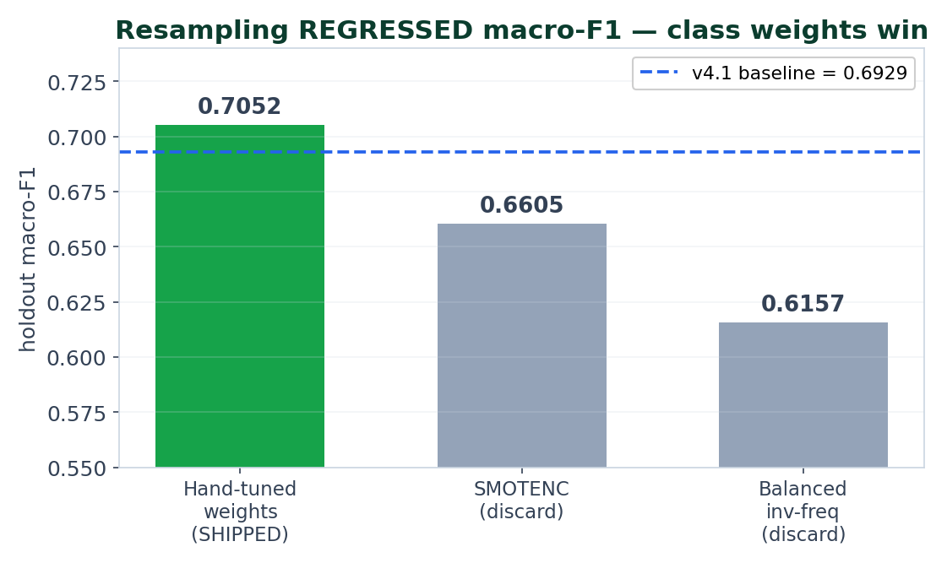
CLASSIFICATION LEVER Class Imbalance — Weights Beat Resampling
• Macro-F1 is PRIMARY so minorities (Volcanic 222, Landslide 713) count equally
• Hand-tuned sample weights SHIPPED: +0.0123 macro-F1 (the only v4.1→v4.2 change)
– Drought +0.056, Landslide +0.013, Wildfire +0.010; no majority regression >0.02
• SMOTE was done RIGHT — SMOTENC, cat-idx [5,6,7,11,14], in-fold only…
– …and still HURT (−0.0324; Landslide −0.12): scattered minorities → implausible synthetics
Why minorities are hard: it's a feature-separability problem (Landslide overlaps Flood/Storm in lat/lon/season), not a row-count problem — synthetic interpolation makes it worse.
Notes:
Research-maturity slide: a tested-and-rejected method WITH the reason it fails. Stress that SMOTE was implemented correctly (SMOTENC, in-fold) — it still lost, so the conclusion is about the data, not a bug.

Slide 11
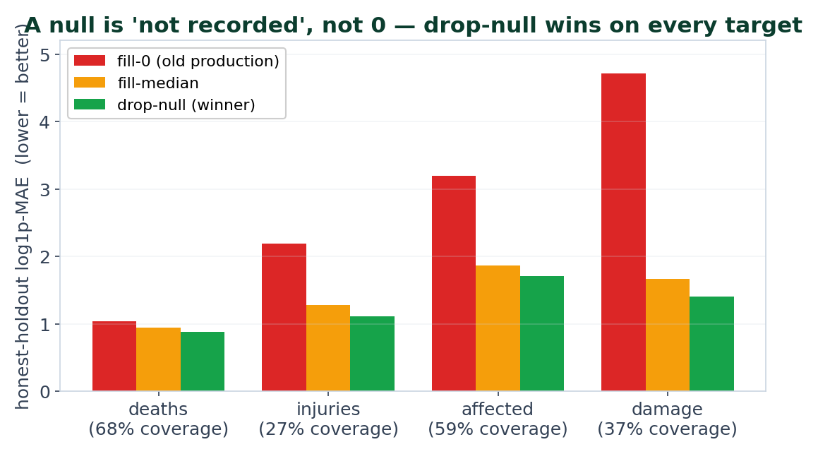
REGRESSION LEVER Target Handling — 'Null' Is Not 'Zero'
• Old regressors filled null targets with 0 — but 73% of injuries/damage are nulls
• Model learns ≈0, then mispredicts real events (injuries=1 next to $1B damage)
• Drop-null (train only on observed rows) wins on EVERY target
• The trap: scoring on a median-FILLED holdout makes a broken model look great
– (damage MAE 0.83 'illusion' vs 1.66 honest)
Notes:
Evaluation-integrity teaching moment: the only HONEST way to score is on observed-target rows. Filling the test set the same way you filled training manufactures a fake score.

Slide 12
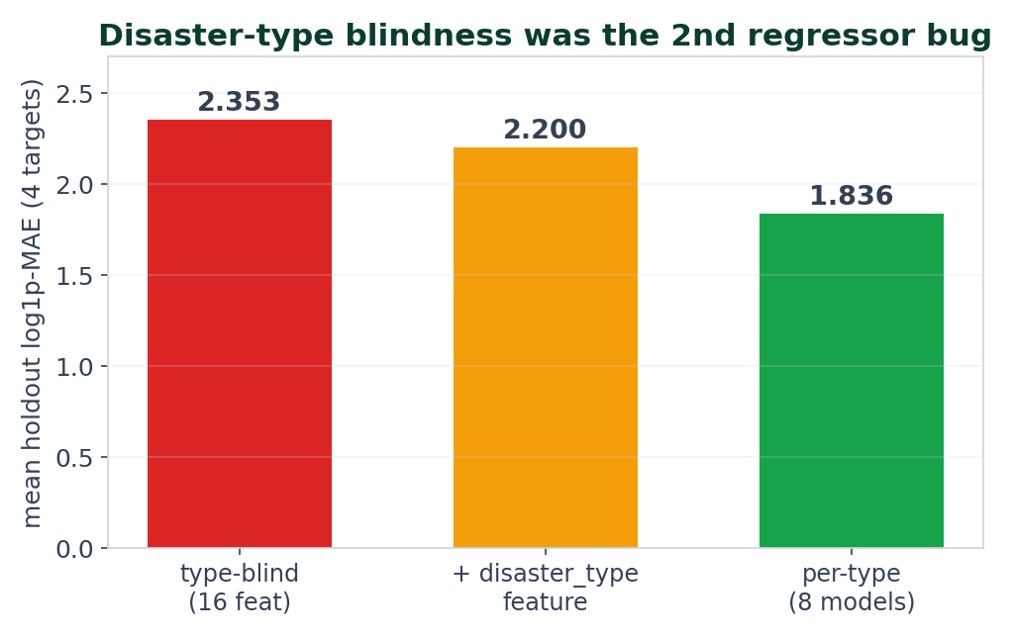
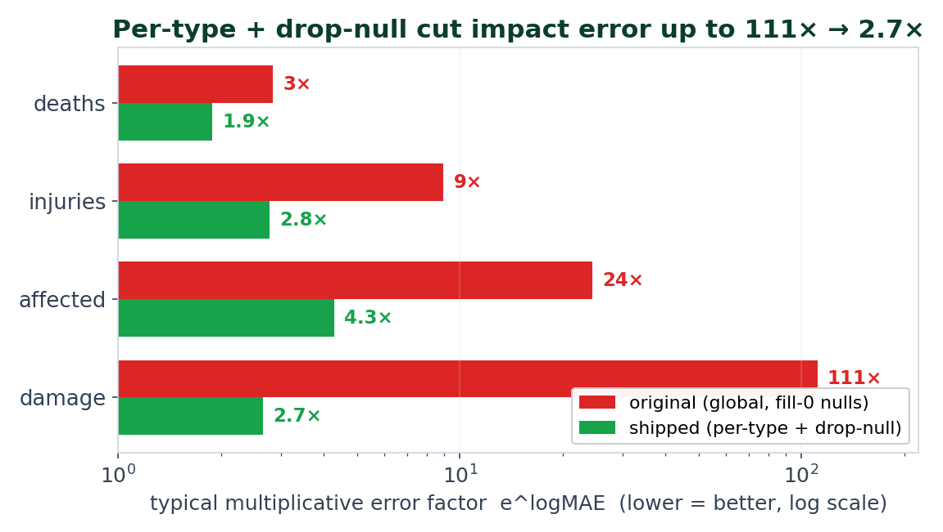
THE BIGGEST IMPROVEMENT IN THE PROJECT Two Independent Regression Wins, Combined
Combined (per-type + drop-null), shipped: damage error 111× → 2.7×, affected 24.5× → 4.3×, injuries 9× → 2.8×, deaths 2.8× → 1.9× — entirely a preprocessing/structure change, classifier untouched.
Notes:
Left: adding the disaster-TYPE axis (type-blind regressors gave Flood and Earthquake the same impact at the same coords). Right: dropping fake zeros. Independent axes that compound. This is the single strongest result in the repo and it is 100% preprocessing.

Slide 13
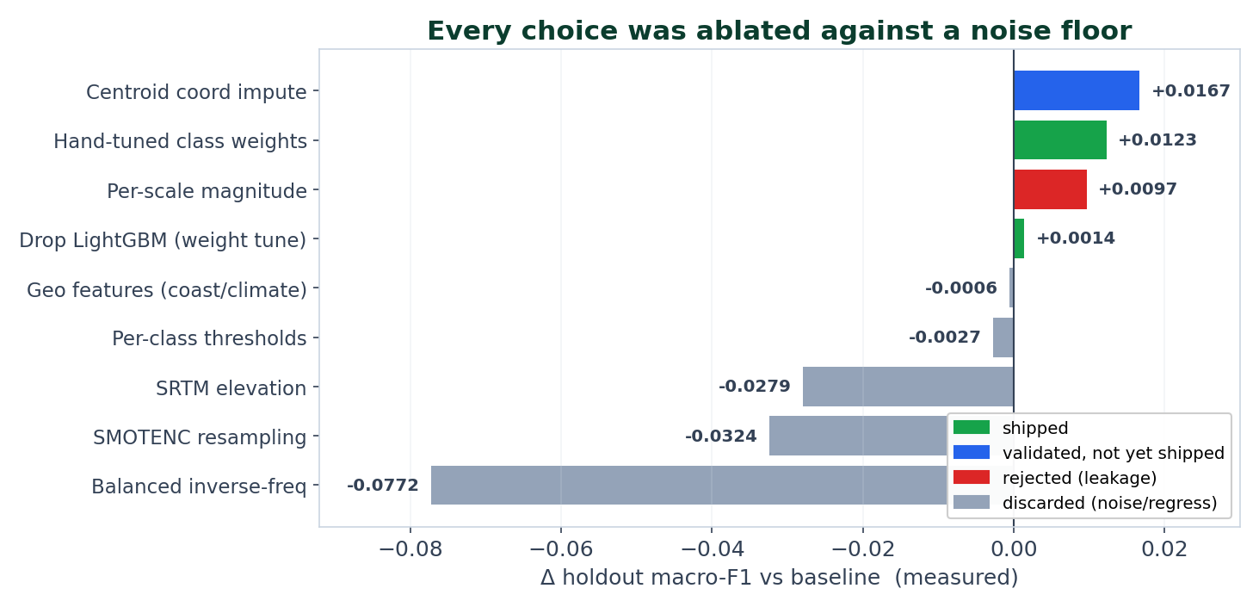
Decision Discipline — Ablate Against a Noise Floor
Rule: keep a step iff holdout_gain > baseline CV-std. Tempting gains were rejected when they were leaks (per-scale magnitude +0.0097 — Dis Mag Scale ≈ the label for 93% of rows) or within noise (geo −0.0006).
Notes:
This single chart is the 'I do controlled experiments' slide. Blue = validated-not-shipped (centroid). Green = shipped. Red = a measured +0.0097 we REJECTED because it's leakage. Grey = discarded within noise or because it regressed. Discipline over chasing deltas.

Slide 14
CROSS-CUTTING Leakage Audit — Two Honest Open Items
Surface | Status
Encoders / freq-map / weights fit on TRAIN only | ✓ clean
SMOTENC in training fold only; val & holdout never resampled | ✓ clean
Target drop-null / log1p (targets only) | ✓ clean
Per-scale magnitude leak (Dis Mag Scale ≈ label) | ✓ caught & rejected
frac_* label-distribution features | ✓ caught & dropped
lat/lon median impute fit PER-SPLIT (not train-only) | ⚠ minor — never runs at serve time
Cross-file train↔test row deduplication | ✗ NOT done — unquantified
Earthquake F1 = 0.976 is NOT a leak: it's the dense Richter magnitude channel (has_magnitude / dis_mag_value). The genuinely leaky signal (Dis Mag Scale) was identified and kept out of production.
Notes:
Own the two open items confidently. The dedup gap is the biggest threat to the absolute numbers (train 1900-2021 and test 1970-2021 overlap in time). It threatens absolute macro-F1, not the RELATIVE decisions, which all used CV or the honest observed-row holdout.

Slide 15
Preprocessing → Performance, in One Matrix
Step | CLASSIFICATION (Δ macro-F1) | REGRESSION (Δ log-MAE / factor) | Measured?
Centroid coord impute | +0.0167 (KEEP, unshipped) | −0.0311 mean (all 4 down) | ✓
Hand-tuned class weights | +0.0123 (SHIPPED) | — | ✓
Drop-null targets (vs fill-0) | — | damage 111× → 4.1× (global) | ✓
Per-type regressors | — | mean 2.353 → 1.836 | ✓
Per-type + drop-null (shipped) | — | damage 111× → 2.7× | ✓
Feature scaling | 0 (no-op) | 0 (no-op) | n/a
SMOTENC / balanced-inv-freq | −0.032 / −0.077 (discard) | — | ✓
Per-scale magnitude (leak) | +0.0097 — REJECTED | — | ✓
No RMSE/R² stored: regression is reported as log1p-MAE on observed rows (↔ multiplicative error factor) — RMSE would be swamped by mega-events; R² is uninformative under 27–68% coverage. Adding back-transformed RMSE/R² is Recommendation P3.

Slide 16
Recommendations — Highest Ceiling First
• P0 · Ship centroid coordinate imputation — already validated (+0.0167 macro, −0.0311 log-MAE); risk-free at inference
• P1 · Deduplicate train vs test before trusting the holdout — biggest threat to every absolute number
• P2 · Re-tune the inference blend (still 70% EM-DAT) now that per-type regressors are strong; reconcile coverage constants
• P3 · Add back-transformed RMSE/R² per type to the regressor validation
• P4 · Keep class_weight; do NOT revisit SMOTE — data already answered this; next minority lever is better features / focal loss
• P5 · Fix two train/serve skews (month-mode at serve; heavy-vs-light regressor bundle)
• P6 · Encapsulate build_features in ONE transformer (it's hand-duplicated across ≥6 files)
• P7 · Only if a linear/distance model is added: RobustScaler + target/hashing encoders, in-CV
Notes:
Ordered by expected impact × confidence. P0 and P1 are the two that change the real picture: P0 ships a known win; P1 tells us how much of 0.7052 is real. The rest is rigor and hygiene.

Slide 17
Key Takeaways
• Preprocessing, not the algorithm, drove the wins. The biggest single improvement (impact error 111× → 2.7×) is a missing-value + structure decision.
• Classification and regression need different levers: class weights lifted macro-F1; drop-null + per-type + log1p cut regression error. Scaling helped neither (all trees).
• Negative results are results: SMOTE, inverse-frequency, geo features, per-class thresholds — all tested, measured, and rejected against a noise floor.
• Honesty: a validated win not yet shipped (centroid), a leak caught (Dis Mag Scale), and a dedup gap I won't hide — each with a concrete fix.
Notes:
Land the separation of classification vs regression effects, and the discipline narrative. For an academic audience the honesty (negative results + self-found gaps) is the differentiator.

Slide 18
Thank You 🌍
Questions?
Anticipated questions:
• Is 0.7052 macro-F1 real? → In-distribution upper bound; train/test windows overlap and aren't deduped (P1).
• Why not oversample? → Tested SMOTENC (done right, in-fold): −0.0324 macro; Landslide −0.12. Weights won.
• Biggest single win? → Per-type + drop-null regressors: impact error 111× → 2.7×. Pure preprocessing.
• Why no scaling? → Every model is a tree (XGB/CatBoost/RF) — scale-invariant; scaling is a measured no-op.
• One thing to ship tomorrow? → Centroid coordinate imputation — already validated +0.0167 macro-F1.
Full write-up: docs/PREPROCESSING_DEEP_DIVE.md · Data: EM-DAT (1900–2021) · safeearth.tech
Notes:
Keep the contamination/dedup answer ready — most likely probe. Owning it (with the fix) is the win, same as the centroid 'validated but unshipped' answer.

