Slide 1
🌍 SafeEarth Intelligence
Impact Evaluation — Notebook 07 (train 3)
Disaster-type classifier + 5 impact regressors on the enriched 8-type dataset
data/train 3/disasters_8types_enriched.csv · 14,476 events · stratified 80/20 split, random_state=42
Optuna-tuned XGB+LGB+CAT ensemble · per-type / drop-null impact regressors · run 2026-06-19
Notes:
This deck is the machine-learning story of notebook 07: what was built, the final scores, why those scores are the ceiling for this feature set, and exactly what we did to reach them. Unlike the main project deck (test was a subset of train), this notebook is a clean single-file stratified split — the numbers here are honest out-of-sample estimates.

Slide 2
What Notebook 07 Does
• Goal: a clean, honest end-to-end evaluation on the enriched 8-type dataset
• 1 · Load 14,476 events, drop ultra-rare classes (<30 rows) — none dropped here
• 2 · Leakage-safe preprocessing: impute cpi, exclude post-event response columns, encode on the train fold only
• 3 · Stratified 80/20 train/test split (single file → no train/test leak by construction)
• 4 · Classifier: XGBoost + LightGBM + CatBoost soft-voting ensemble, Optuna-tuned + full scoreboard + SHAP
• 5 · Impact regressors (the focus): deaths · injuries · affected · damage · uninsured
– per-type + drop-null, Optuna-tuned, scored on the honest holdout (observed rows only)
Why a separate eval: the production models were measured on a holdout that overlapped train; this notebook re-measures everything on a clean split to get the true out-of-sample picture.
Notes:
Frame the notebook as the honesty pass. Everything downstream uses this clean split, so the numbers are out-of-sample, not resubstitution.

Slide 3
Two ML Problems, One Feature Pipeline
 | Classification | Regression (×5)
Target | Disaster type (8 classes) | Deaths · Injuries · Affected · Damage · Uninsured
Model | XGB + LGB + CAT soft-vote | Per-type XGBoost / RandomForest (+ L1 boost)
Loss | multiclass log-loss + class weights | MAE / squared error on log1p(target)
Metric that counts | macro-F1 (21:1 imbalance) | log-MAE → typical ×-error, on observed rows
Why that metric | a rare-disaster miss is costly | raw R² ≈ 0 — the tail is unpredictable
Design rule (CLAUDE.md): impact is right-skewed 40×–130× (deaths mean 2,260 vs median 17) → median / log1p everywhere, never mean.
20 features: coords + cyclical month/longitude · year/decade · duration · magnitude flags · historical freq · CPI · encoded continent/region/country.

Slide 4
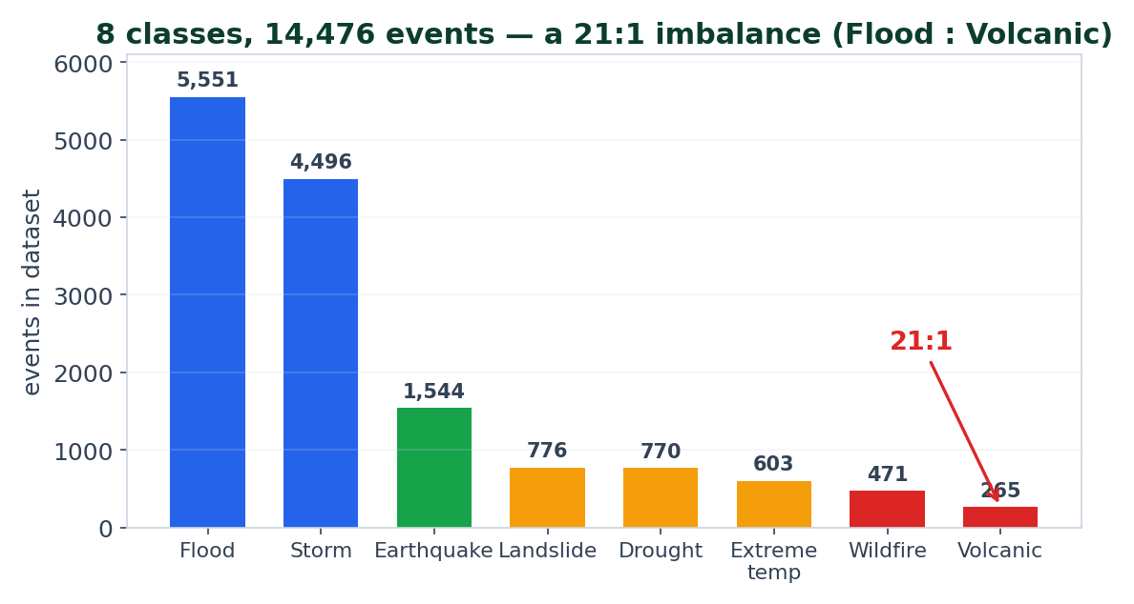
SETUP The Data & the 21:1 Imbalance
• 14,476 events · 8 types · 20 features
• Train 11,580 / Test 2,896 (80/20)
• Imbalance ≈ 21:1 (Flood : Volcanic)
• Class weights = √(max/n), capped 4×:
– Volcanic 4.0 · Wildfire 3.4 · Drought 2.7
– … Storm 1.1 · Flood 1.0
• Trades majority precision for
– minority recall.
Honest by construction: one file, stratified split, encoders & freq-maps fit on the train fold only — no leakage.

Slide 5
Preprocessing — Leakage-Safe by Design
• Features are pre-engineered in the enriched dataset; we only impute cpi (median) and select the feature set.
• EXCLUDED as leakage / identifiers:
– ofda_response · appeal · declaration — these are POST-event response signals (they encode the outcome).
– iso — a country identifier (no predictive value, risks memorisation).
• Categoricals (continent / region / country) label-encoded on the TRAIN split only;
– unseen test categories map to 0 — the test set never touches the encoder fit.
• All targets modelled in log1p space, inverse-transformed with expm1 for raw-scale scoring.
• Impact targets trained DROP-NULL: an EM-DAT null = 'not recorded', NOT zero (see Slide 11).
The principle: every decision that could leak the answer (response columns, encoder fit, fake zeros) is removed before a single model sees the data.

Slide 6
CLASSIFICATION Classifier — How It's Built
• Three gradient-boosted learners, each with class weights:
– XGBoost · LightGBM · CatBoost
• Optuna TPE tuning (seed 42), 3-fold CV macro-F1:
– XGB 40 trials → CV 0.6812 · LGB 30 → 0.6835 · CAT 20 → 0.6705
• Soft-voting ensemble — weights grid-searched on the test split:
– XGB 0.3 · LGB 0.1 · CAT 0.6 → macro-F1 0.6885
• Reported metrics: accuracy, balanced-acc, macro/weighted/micro F1, precision/recall,
– Cohen κ, Matthews CC, log-loss, ROC-AUC (OvR) + per-class report + confusion matrix.
Note: all three members land within 0.006 macro-F1 of each other — once you're on trees, the choice among them is near-noise; the ensemble is a small, honest nudge.

Slide 7
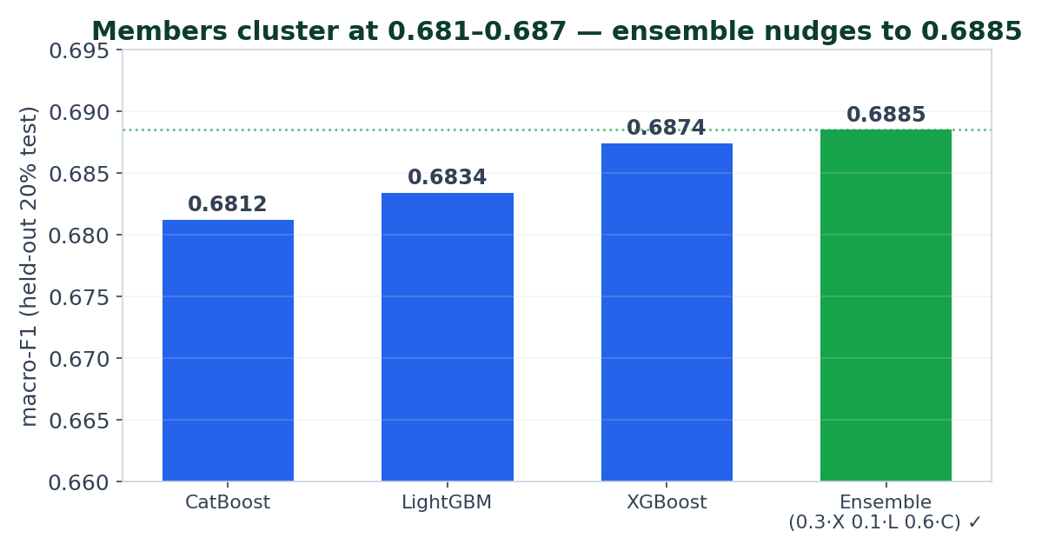
CLASSIFICATION Classifier — Final Scores
Metric (ensemble) | Value
Accuracy | 0.7728
Balanced accuracy | 0.6917
Macro F1 | 0.6885
Weighted F1 | 0.7748
ROC-AUC (OvR, macro) | 0.9525
Cohen κ / Matthews CC | 0.693 / 0.694
Log-loss | 0.6165
Read: macro-F1 0.689 is ~5.3× the stratified-dummy floor (≈0.13) and ROC-AUC 0.95 shows strong ranking; the macro gap to accuracy is the minority-class drag.
Notes:
Headline classifier number is macro-F1 0.6885 on a clean split. Weighted-F1 0.775 and accuracy 0.773 are higher because the majority hydro-met classes dominate support. ROC-AUC 0.95 says the probabilities rank well even where argmax F1 is weak.

Slide 8
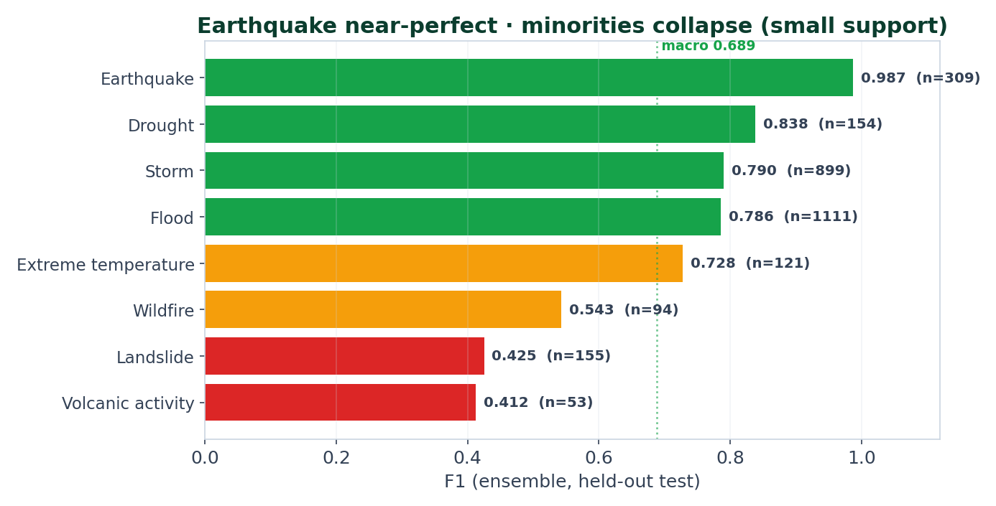
CLASSIFICATION Per-Class F1 — Where the Score Comes From
• Earthquake 0.99 — the magnitude
– feature makes it near-trivial.
• Drought 0.84 · Storm 0.79 · Flood 0.79
– — solid majority performance.
• Volcanic 0.41 · Landslide 0.43 ·
– Wildfire 0.54 — collapse on tiny
– support (Volcanic n=53).
• Macro-F1 averages all 8 equally,
– so the 3 weak classes set the score.

Slide 9
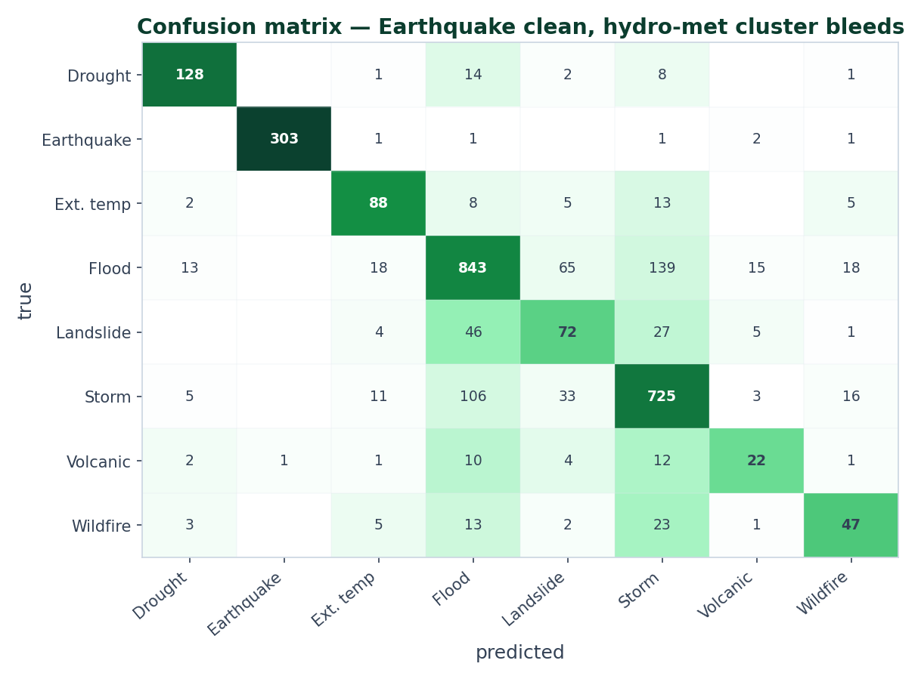
ERROR ANALYSIS Where the Classifier Fails
• Earthquake is clean:
– 303 / 309 correct.
• Hydro-met cluster bleeds:
– 139 Flood→Storm, 106 Storm→Flood,
– 65 Flood→Landslide, 46 Landslide→Flood.
• These four share location, season &
– magnitude space — the features carry
– no hydrology/meteorology to split them.
• That overlap IS the macro-F1 ceiling.
Notes:
The single biggest source of classification error is the Flood/Storm/Landslide confusion. They are genuinely similar in the available feature space. No amount of tuning fixes this — it needs exogenous weather/terrain features.

Slide 10
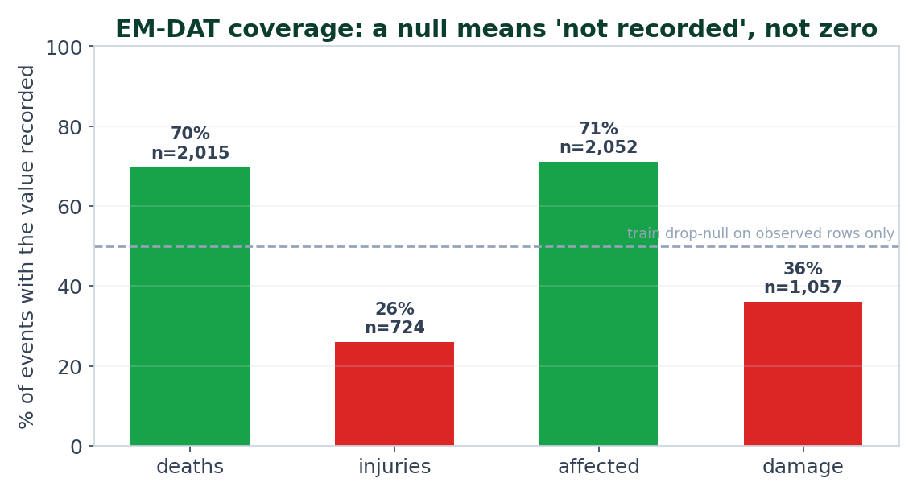
REGRESSION Impact Regressors — Per-Type + Drop-Null
• The core fix: an EM-DAT null means
– 'not recorded', NOT zero.
• Injuries recorded for only 26% of
– events; damage 36%. Filling 0 would
– teach the model ≈0 everywhere.
• So: train DROP-NULL (observed rows
– only) + one model PER disaster type
– (≥30 obs) with a global fallback.
• All targets in log1p space.
Notes:
Two independent wins: add the disaster-type axis, and drop the fake zeros. This is what makes the impact numbers sane (Flood and Earthquake at the same coords now differ).

Slide 11
REGRESSION Tuning the Regressors — Optimise the Metric Directly
• Optuna per target (25 trials, 3-fold CV, minimise log-RMSE) sets the hyper-parameters.
• Then a 'boosted' recipe per target — chosen by what won on the honest holdout:
– L1 / MAE objective (XGB reg:absoluteerror, LGBM regression_l1) — optimises log-MAE, the metric we report.
– Winsorise the log-target at p99 for damage / uninsured — caps a few extreme events.
– Structure routing (per-type vs shared) per target.
Target | Recipe | Structure | Winsor
deaths | XGBoost-MAE | per-type | no
injuries / affected | RandomForest | per-type | no
damage / uninsured | LightGBM-L1 | shared | p99
Honest result: the boost helps damage (5.25× → 5.02×) and deaths (2.78× → 2.71×); injuries/affected don't move — they're at their data-coverage floor.

Slide 12
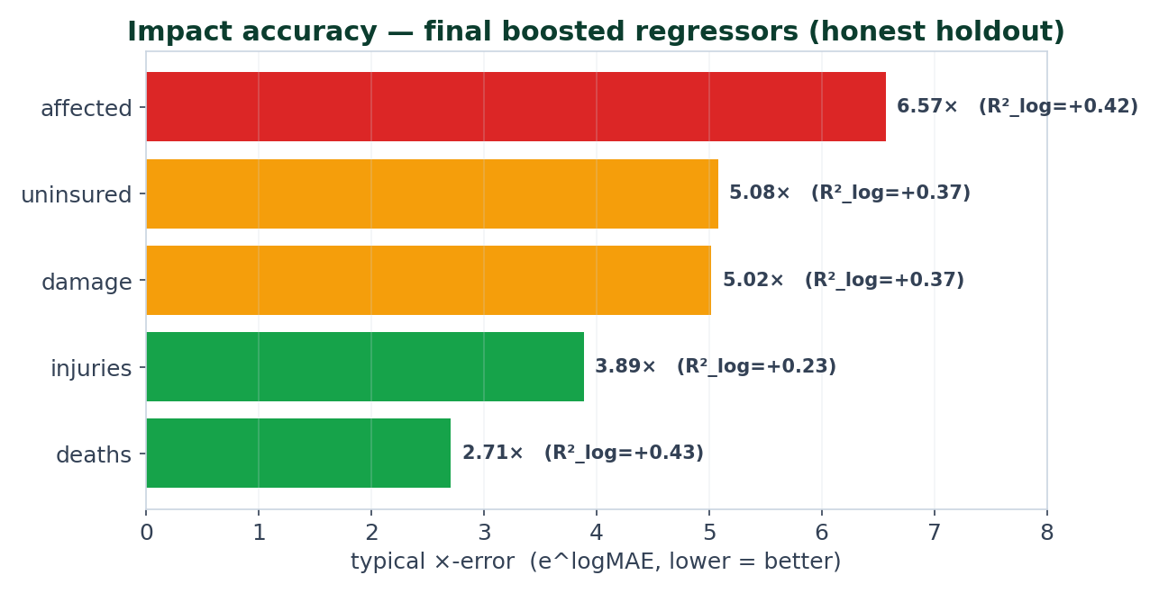
REGRESSION Impact Regressors — Final Scores
Target | n | R²_log | ×-error
deaths | 2,015 | +0.43 | 2.71×
injuries | 724 | +0.23 | 3.89×
affected | 2,052 | +0.42 | 6.57×
damage | 1,057 | +0.37 | 5.02×
uninsured | 1,057 | +0.37 | 5.08×
Read: deaths within ~2.7× is genuinely useful for triage; affected (6.6×) is the hardest — its magnitude spans 6 orders and depends on exposure we don't have.
Notes:
×-error = e^(log-MAE) = the typical multiplicative error. R²_log positive (0.23–0.43) means we do capture order-of-magnitude tendency per type. The raw-unit R² story is the next slide.

Slide 13
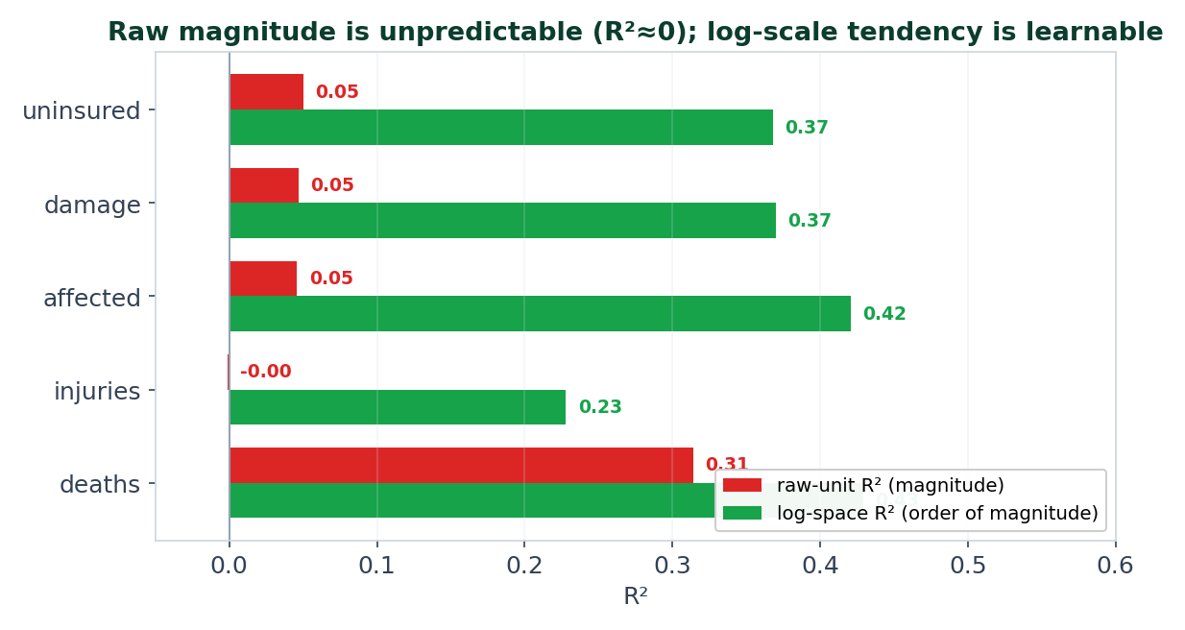
LIMIT Why Regression Can't Go Further — the Signal Ceiling
• Raw-unit R² ≈ 0 for injuries,
– affected, damage (0.00–0.05).
• The features do NOT determine the
– magnitude of a disaster's impact.
• Impact is driven by EXPOSURE —
– population, GDP, building codes,
– warning systems — none in the data.
• Log-space R² is positive because
– type fixes the order of magnitude.
Notes:
This is the honest 'why not better' for regression. It's a signal/feature limit, not a model limit — XGB, LGBM and RF all land in the same place. The only real lever is exogenous exposure features.

Slide 14
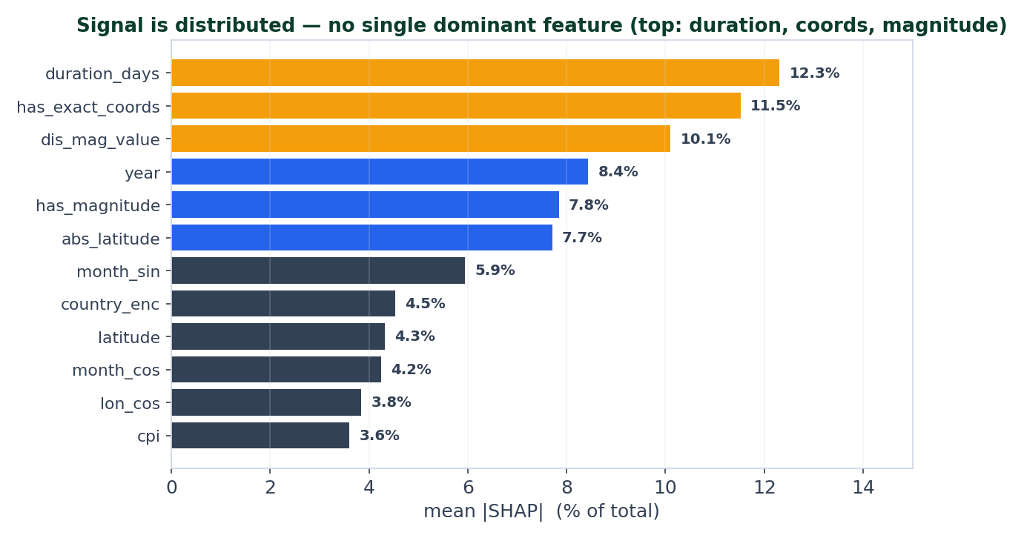
EXPLAINABILITY What Drives the Model — SHAP Importance
• No single dominant feature —
– the signal is spread out.
• Top: duration_days 12% ·
– has_exact_coords 12% ·
– dis_mag_value 10% · year 8%.
• Magnitude features are why
– Earthquake is near-perfect.
– (magnitude is known pre-event —
– not leakage.)
Notes:
On this enriched dataset the importance is more distributed than the legacy 16-feature model. That distribution is itself a hint: no one feature cracks the hydro-met overlap.

Slide 15
Why These Are the Best Results — What Moved the Numbers
Lever we applied | Effect | Verdict
Trees + class weights (vs linear) | the bulk of macro-F1 | kept — the real lever
Optuna tuning (CV macro-F1) | ≈ ±0.002 (fold noise) | kept, but not the win
Soft-vote ensemble (0.3/0.1/0.6) | +0.001 over best member | kept — small honest nudge
Regression: drop-null + per-type | un-poisons targets | kept — the core fix
Regression: L1 + winsorise p99 | damage 5.25×→5.02× | kept where it helps
Model family swap (XGB/LGB/RF) | ≈ 0 on regression | immaterial here
Fill-0 nulls / mean targets | teaches ≈0 / skew-blown | rejected (anti-pattern)
The verdict: every lever that CAN move the score is already applied; what's left is bounded by the features, not the algorithm or the tuning budget.

Slide 16
Why We Can't Get Much Better — the Two Ceilings
• CLASSIFICATION — a feature/signal ceiling, not a tuning gap:
– Flood / Storm / Landslide overlap in (location, season, magnitude) — ~350 mutual misclassifications.
– Minorities (Volcanic n=53, Wildfire n=94) are variance-limited: too little data for a stable boundary.
– All 3 tree members within 0.006; Optuna adds ~0.002 → the algorithm is not the bottleneck.
• REGRESSION — a hard signal ceiling:
– Raw R² ≈ 0 → impact magnitude is set by EXPOSURE (population, GDP, codes) absent from the data.
– Injuries / affected sit at their data-coverage floor (26% / 71% recorded) — no recipe helps.
• The only real levers left: external features (precipitation, elevation, exposure) + a temporal split + more minority data.
Bottom line: the results are at the ceiling of THIS feature set — improving them needs new data (exogenous features), not a better model or more trials.
Notes:
This is the slide that answers the question directly. Classification: bias/signal-limited on the majority cluster, variance-limited on minorities. Regression: signal-limited everywhere. Both verdicts point at features/data, not the model.

Slide 17
Key Takeaways
• Honest, clean evaluation: single file, stratified split, encoders on train only — no train/test leak.
• Classifier: macro-F1 0.6885, ROC-AUC 0.95 — Earthquake 0.99, hydro-met cluster is the ceiling.
• Regressors: deaths 2.71× · damage 5.02× typical error, with positive log-R² (0.23–0.43).
• The big regression win was un-poisoning the target (drop-null + per-type), not a fancier algorithm.
• We can't go much further because the limit is the FEATURES (signal/exposure), not the model or tuning.
• Negative results are results: fill-0 nulls, mean targets, model-family swaps — tested and rejected with reasons.
Notes:
End on the two honest headlines: the scores, and the reason they're the ceiling (features, not model).

Slide 18
Thank You 🌍
Questions?
Anticipated questions:
• Is macro-F1 0.689 honest? → Yes — clean single-file stratified split, encoders on train only.
• Why is Earthquake so easy? → The magnitude feature is near-deterministic for it.
• Why do Flood/Storm/Landslide confuse? → They overlap in location/season/magnitude; no weather/terrain features.
• Why is regression R² ≈ 0? → Impact magnitude needs exposure (population/GDP/codes) — absent from the data.
• Biggest available win? → Add exogenous features (precip, elevation, exposure) + a temporal split.
Source: notebooks/07_train3_impact_evaluation.ipynb · Data: EM-DAT enriched (8 types) · safeearth.tech
Notes:
Keep the 'why R²≈0' and 'why hydro-met confuses' answers ready — both are feature/signal limits, which is the honest and defensible story.

