Slide 1
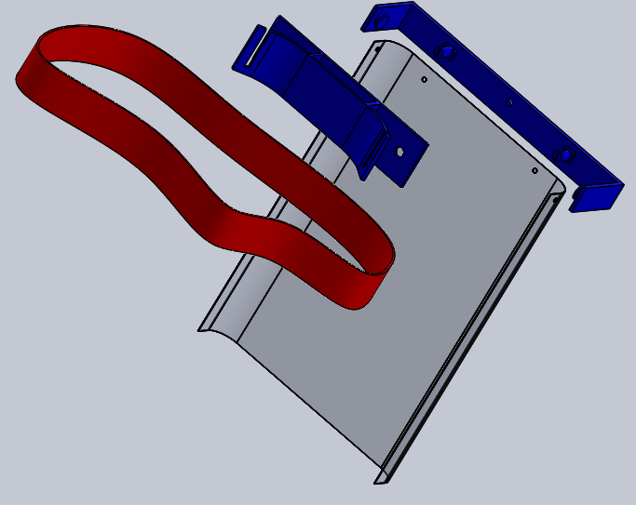
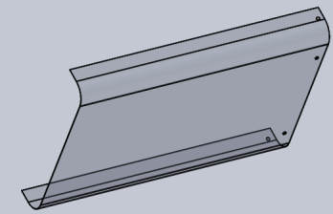
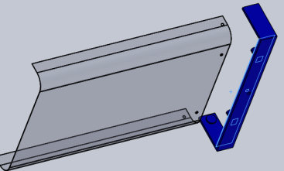
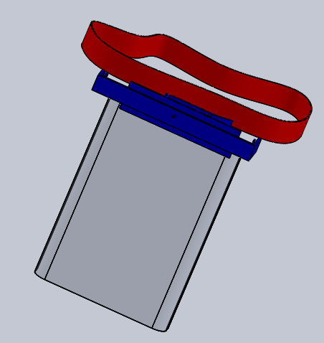
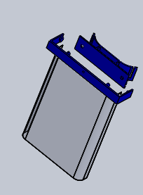
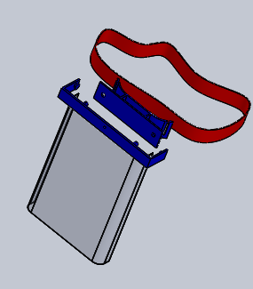

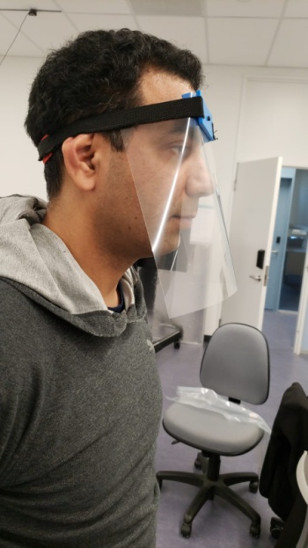
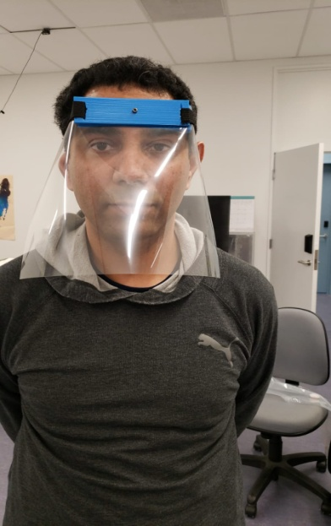
Assembly Instructions
Wear hand gloves to do the following assembly:-
1. Make holes on sheet at proper place
with respect to sheet holder
2. Place sheet in sheet holder
3. Place both on head rest
4. Fix elastic head band
Material information:.
Head band is readily available at Dollar stores, Walmart, etc.
Transparent sheets are available at Staples or Amazon

