Slide 1
May 21st Demo
Scope, Structure & Known Points

Slide 2
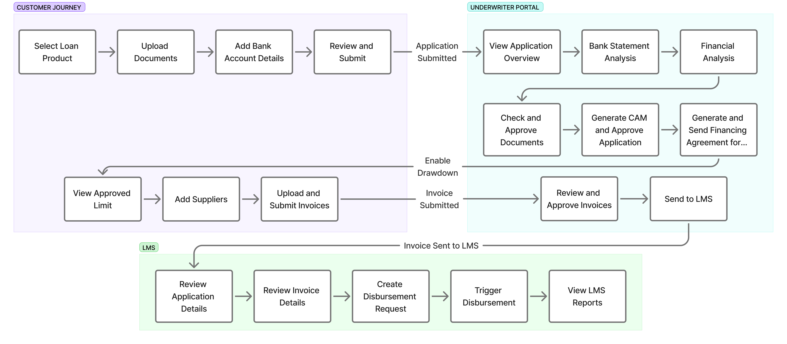
Demo Structure

Slide 3
Scope of May 21st Demo
Customer Journey
• Customer submits the application
Underwriter Portal
The application moves to Underwriter, where underwriter would be able to see:
• Loan Application Details
• Bureau Analysis (Static Data as actual Bureau data won’t be pulled)
• Bank Statement (Actual statement analysis)
• Financial Analysis (Actual statement analysis)
• Application Overview
• Business Details
• Owner / Guarantor Details
• Credit Bureau Section
• Compliance Screening
• Documents
• Approval
• Rule Output
• Limit Setting
Post Approval – Customer Dashboard
• Customer navigates to dashboard to see limits, add suppliers and respective invoices
• Invoices visible to Underwriter who can approve/reject
• Once approved, case sent to LMS for disbursement to the respective account

Slide 4
Known Points
1. The agreement formats shared by MAL are out of scope of this demo. Default templates are being used currently.
2. Embedded e-signing is not part of this demo. Biz2X is working on the same.
3. DBR and DSCR will be covered in the subsequent release.
4. Direct Debit Agreement is not getting sent for e-sign.
5. Murabaha Agreement content is of the default offer letter, and the execution is not working.
6. Some parameters like TL Issue Date, Expiry Date, Economic Zone, Industry, Sub-Industry etc. which need to flow from the KYB is not getting punched in currently on application submission. Default data for the same has been setup from backend.
7. Supplier and Invoice metrics on the dashboard have not been integrated yet.

Slide 5
Thank You

