Slide 1
June 10th Demo
Scope, Structure & Known Points

Slide 2
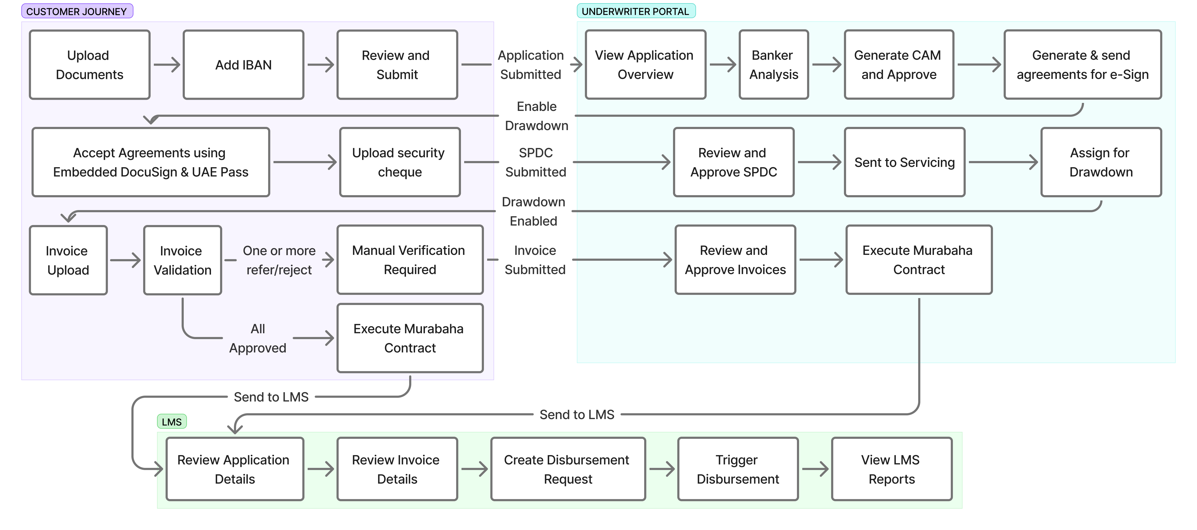
Demo Structure – Non-STP

Slide 3
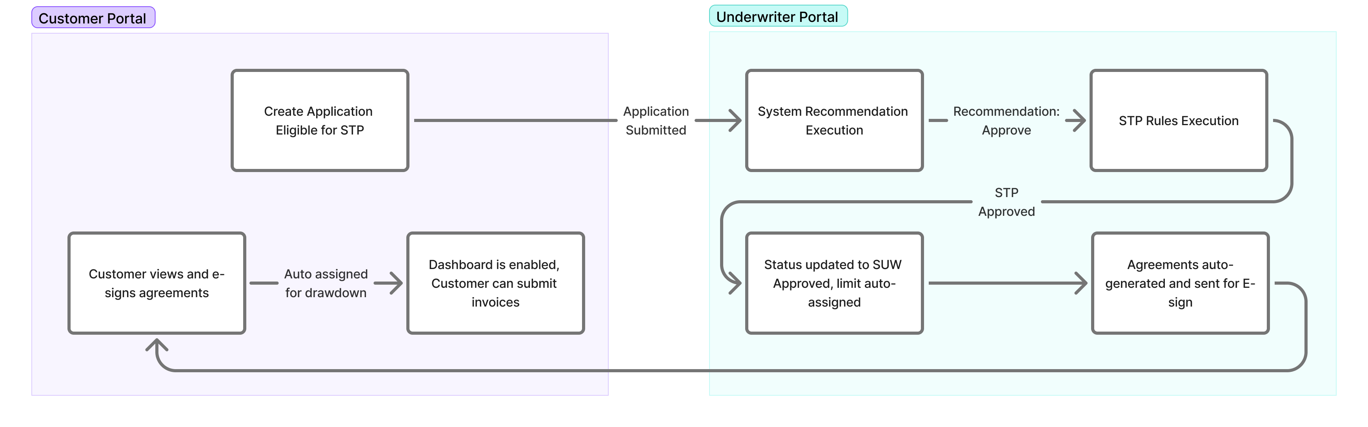
Demo Structure – STP

Slide 4
Scope of May 21st Demo
Non-STP Flow
Application Submission — Customer Journey-->Bank Statements-->Financial Statement Upload-->IBAN Verification--Review and Submit.
Banker Portal Processing — Move the application through all stages in the banker portal; review analysis.
CAM & Agreements — Generate the CAM to record the banker's decision, then generate and send agreements for e-sign.
Customer Agreements & E-Sign — Walk through the agreements flow on the customer portal, including embedded e-sign and DDS.SPDC Flow — Customer uploads a cheque; banker reviews and approves the SPDC.
Servicing & Drawdown — Banker sends the case to servicing and enables drawdown.
Invoice Upload & Validation — Customer uploads invoices. Observe invoice validation rules and pricing.
All-Approved Group — Observe a case where all invoices in a group are approved and the group is sent directly for Murabaha contract execution and to LMS for disbursement.
LMS Disbursement — Maker creates a disbursement request; checker initiates disbursement from LMS.LMS will disburse the entire group of invoices, and each invoice will become due on the 30th day along with the principal amount and processing fee. Payments collected will be used to monitor and adjust the limit accordingly, increasing or decreasing it as applicable.
Mixed-Decision Group — Observe a case where some invoices in a group are referred or rejected. The group is sent first for banker review, then for Murabaha contract execution and to LMS for disbursement.
Disbursed Status Update — Observe the status update sent from LMS to MOS confirming disbursement.

Slide 5
Scope of May 21st Demo
STP Flow
STP Application — Submit an application that qualifies for STP.
Rule Engine — Observe STP rules executed in the rule engine.
Auto-Approval & Agreements — Application is auto-approved; agreements are auto-generated and sent to the customer.
E-Sign & Dashboard — Customer e-signs agreements. Dashboard is enabled once signing is complete.

Slide 6
Known Points

Slide 7
Thank You

