Slide 1

STOCK PRICE PREDICTION MODEL USING RNN
MOHAK MAHAJAN
SAMARTH JOSHI
SANKALP CHATURVEDI

Slide 2
PROBLEM STATEMENT
In order to predict stock prices correctly, a stock buyer has to reasonably decide when to buy or sell stocks.
We thus need good machine learning models that can look at the history of a sequence of data and accurately predict its movement in the near future.

Slide 3

TECHNOLOGY USED :
Python, its core ML libraries and keras.
Recurrent Neural Networks (RNN)
LSTM architecture

Slide 4
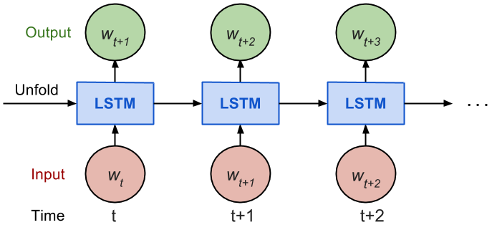
What is RNN?
A recurrent neural network looks quite similar to a traditional neural network except that a memory-state is added to the neurons.

Slide 5
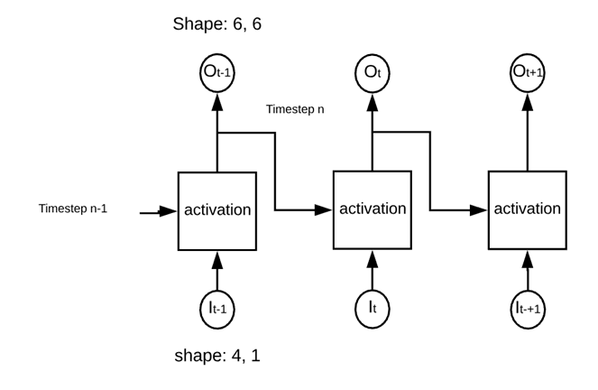
In a traditional neural network, the model produces the output by multiplying the input with the weight and the activation function. With an RNN, this output is sent back to itself number of time. This is especially useful for the time series data we are using in our project.

Slide 6
DATASET USED:
S&P 500 DATA : The S&P 500, or just the S&P, is an American stock market index based on the market capitalizations of 500 large companies having common stock listed on the NYSE, NASDAQ, or the Cboe BZX Exchange. We used the TATA Global company stock data for our initial project.

Slide 7
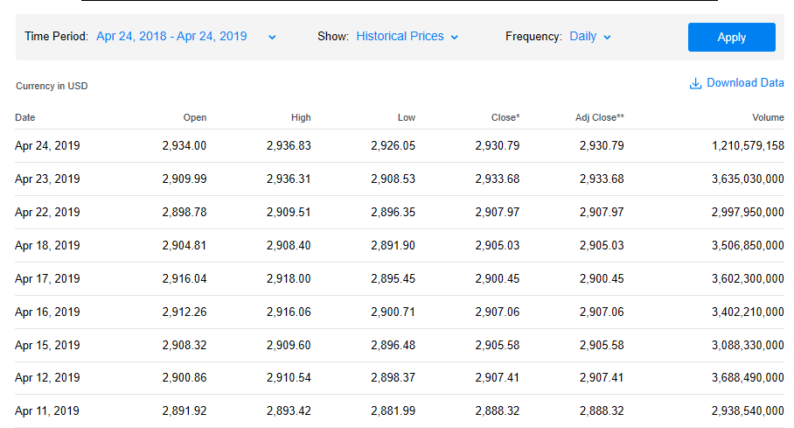

Slide 8
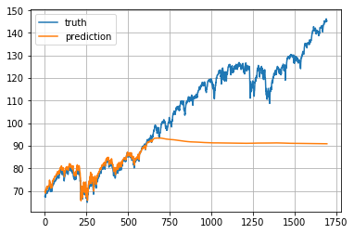
DATA PREPARATION :
NORMALIZATION :

Slide 9
DATA USED :
We used the closing points of each company's stock at the end of each day. We then used it as a time series data of the closing values of stock vs date.
TRAIN / TEST SPLIT :
80% of the data was used for training the model while predictions were made on the latest 20% of the data.

Slide 10
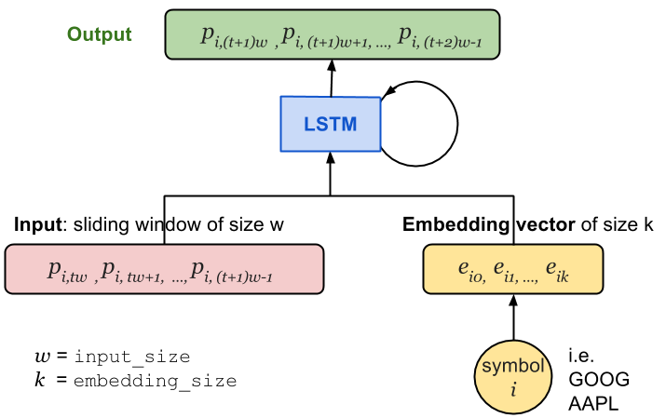
MODEL CONSTRUCTION :

Slide 11
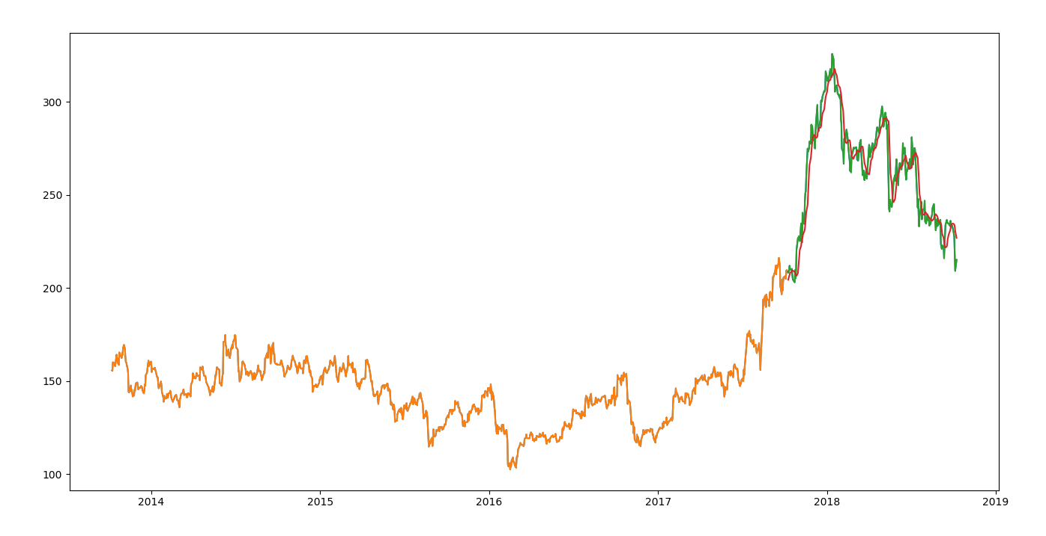
RESULTS:

Slide 12
CHALLENGES FACED :
A lot of time was spent on choosing the input size and LSTM size variables.
Lack of proper tutorials for LSTM RNN models.

Slide 13
SOME DRAWBACKS :
The prediction values get diminished and flatten quite a lot as the training goes.
We use mean square error as the loss metric and the AdamOptimizer algorithm for gradient descent optimization.
The loss function decreases fast at the beginning, but it suffers from occasional value explosion (a sudden peak happens and then goes back immediately).

Slide 14
CONCLUSION :
We were able to build a sufficiently accurate model that can analyze common stock trends and make predictions.
Although not very feasible in the real market, this project is a start for us into finance analytics.

Slide 15


