Slide 1
Machine learning for football commentary
Pranali Majmundar 5170114428
Krish Lalwani 6298930470
Mohak Wagh 3430937395

Slide 2
PLAN
Choose an environment: Google Research Football is a Reinforcement Learning environment where there are modules to take control of various aspects of the game. Open-source code available on https://github.com/google-research/football
Although originally made for reinforcement learning, it can be used for our project as it provides play-by-play information about the current state of the game such as ball position, ball direction, team with possession, player with possession, agent and opposition team information and much more.

Slide 3
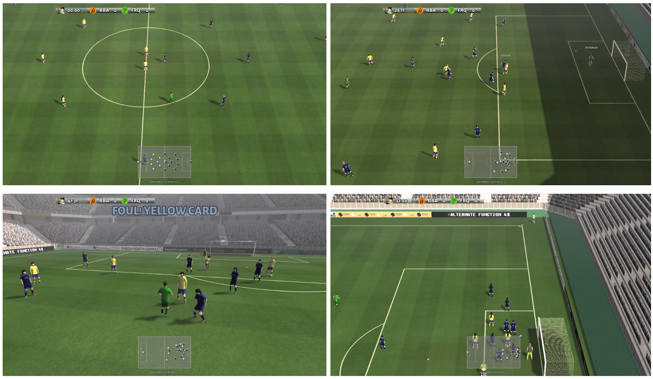

Slide 4
Learn about RNNs and LSTMs in Keras/TensorFlow or PyTorch. If creating our own language model is tricky we can use transfer learning using some existing solutions.
Existing language models: OpenAI’s GPT-2, Google’s BERT, Google’s Transformer-XL.
Train the language model on football commentary from a real game and FIFA/PES. Additional idea was to make it ‘parody’ commentary where the training data would have to be augmented by excerpts from comedians or sitcoms but the there is the possibility of the commentary being completely off topic and nothing related to football.
Extract information from the Football Research environment during a game and create a prompt or seed for the language model. For e.g. if a goal is scored, the prompt will be ”That’s a goal”.

Slide 5
THANK YOU

