Slide 1
OOPs

Slide 2
Basic concept of oops
Inheritance
Encapsulation
Polymorphism
Abstraction

Slide 3
Inheritance
Inheritance allows a child class to use the properties and methods of parent class.
The derived class inherits the states and behaviours from the base class. The derived class is also called subclass and the base class is also known as super-class. The derived class can add its own additional variables and methods. These additional variable and methods differentiates the derived class from the base class.
Inheritance is a compile-time mechanism. A super-class can have any number of subclasses. But a subclass can have only one super class. This is because Java does not support multiple inheritance.
The superclass and subclass have “is-a” relationship between them.
Restriction
The derived class inherits all the members and methods that are declared as public or protected. If declared as private it cannot be inherited by the derived classes. The private members can be accessed only in its own class.

Slide 4
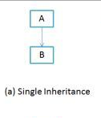
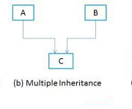
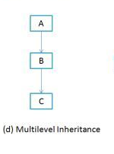
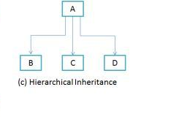
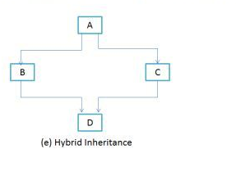
Types of Inheritance
Single Inheritance
Multiple Inheritances
Multilevel Inheritance
Hierarchical Inheritance
Hybrid Inheritance

Slide 5
Encapsulation
The whole idea behind encapsulation is to hide the implementation details from users.
If a data member is private it means it can only be accessed within the same class. No outside class can access private data member (variable) of other class.
However if we setup public getter and setter methods to update fields then the outside class can access those private data fields via public methods. This way data can only be accessed by public methods thus making the private fields and their implementation hidden for outside classes. That’s why encapsulation is known as data hiding

Slide 6
Polymorphism
Polymorphism is the capability of a method to do different things based on the object that it is acting upon.
We can achieve Polymorphism by two ways.
Method Overloading
Method Overriding

Slide 7
Method Overloading
Method Overloading is a feature that allows a class to have two or more methods having same name, if their argument lists are different.
Rules for Method Overloading
Must have different argument lists
May have different return types, if argument lists are also different
May have different access modifiers
May throw different exceptions

Slide 8
Method Overriding
Declaring a method in subclass which is already present in parent class is known as method overriding.
Rules of method overriding
Must have the same argument list.
Must have the same return type,.
Must not have a more restrictive access modifier.
May have a less restrictive access modifier.
An overriding method (the method of child class) can throw any unchecked exceptions, whether the overridden method (method of base class) throws exceptions or not.
The overriding method can throw those checked exceptions, which have less scope than the exception declared in the overridden method

Slide 9
Overloading vs. Overriding
First and most important difference between method overloading and overriding is that, In case of method overloading in Java, signature of method changes while in case of method overriding it remain same
Second major difference between method overloading vs overriding in Java is that you can overload method in one class but overriding can only be done on subclass
You cannot override static, final and private method in Java but you can overload static, final or private method in Java.
Overloaded method in Java is bonded by static binding and overridden methods are subject to dynamic binding

Slide 10
Abstraction
The purpose of abstraction is to hide information that is not relevant and show only the relevant information
We can achieve Abstraction by:-
Abstract Class
Interface

Slide 11
Abstract Classes
A class that is declared using “abstract” keyword is known as abstract class. It may or may not include abstract methods which means in abstract class you can have concrete methods as well along with abstract methods .An abstract class cannot be instantiated.
Points to remember about abstract class:
An abstract class has no use until unless it is extended by some other class.
Abstract class can have non-abstract method (concrete) as well.
If you declare an abstract method in a class then you must declare the class abstract as well.
public abstract class AbstractClassDemo{}

Slide 12
Why we need an abstract class
If you want to provide common, implemented functionality among with all implementations of your component, use an abstract class. Abstract classes allow you to partially implement your class.
Abstract class has concrete method which is commonly shared by all the inherited class, if we updating the base class, all inheriting classes are automatically updated with the change.

Slide 13
Interface
Interface is a contract or an interface in java is a blueprint of a class. It has static constants and abstract methods only.
Key points
We can’t instantiate an interface in java.
Interface provides complete abstraction.
Interface cannot be declared as private, protected.
All the interface methods are by default abstract and public.
Variables declared in interface are public, static and final by default.
Interface variables must be initialized at the time of declaration otherwise compiler will through compile time exception.

Slide 14
Why we use Interface in java
A particular advantage of using interface in Java is that it allows multiple inheritance.
Java programming language does not support multiple inheritance, using interfaces we can achieve this as a class can implement more than one interfaces, however it cannot extend more than one classes.

Slide 15
Abstract Class v/s Interface
Abstract Class | Interface
abstract class can have both abstract and concrete methods | interface can have only abstract methods
A class can extend only one abstract class | A class can implement any number of interfaces
In abstract class keyword ‘abstract’ is mandatory to declare a method as an abstract | In an interface keyword ‘abstract’ is optional to declare a method as an abstract
abstract class can have protected , public and public abstract methods | Interface can have only public abstract methods i.e. by default
abstract class can have static, final or static final variable with any access specifier | interface can have only static final (constant) variable i.e. by default

Slide 16
Constructor
Constructor in Java is block of code which is executed at the time of Object creation
Things to remember about constructor
constructor name and class name must be exactly same.
constructor doesn't have return type
You can use any access modifier with Java constructor. they can be public, protected or private.
Constructor in Java cannot be abstract, static, final or synchronized.
parent class is initialized before child class in Java, Constructor of parent class is executed before constructor of child class, that explains why super() is first statement in default no argument constructor.

Slide 17
Access Modifiers
Access Modifier | within class | within package | outside package by subclass only | outside package
Private | Y | N | N | N
Default | Y | Y | N | N
Protected | Y | Y | Y | N
Public | Y | Y | Y | Y

